Slide 1

SMART INDIA HACKATHON 2026
Problem Statement ID – 26208
Problem Statement Title- Develop unique toys and games based on our civilization, history, and culture .
Theme - History Reimagined in XR
PS Category- Software
Team ID - SIH26-A0H-T504
Team Name - SthapatyaX

Slide 2





LEGO of Indian heritage in XR
STHAPATYAX
PROPOSED IDEA
Creating an immersive XR experience that allows users to step into historic civilizations, explore their culture, recreate lost spaces, and relive India’s architectural heritage through interactive gaming .
DETAILED SOLUTION
DISCOVER
CREATE
Exploring routes and traces of the history as clues of the game
Rebuilding historical monuments and cultural knowledge
EXPLORE
COLLECT
EXPERIENCE
Navigating civilizations and historical timeline
Collecting digital library and construction methodology of the civilization
Unlocking the experience of re- living ancient civilization
ADRESSING THE PROBLEM
Navigating civilizations , Exploring routes and traces , Digital library , Rebuilding historical monuments, experience of re- living

Slide 3


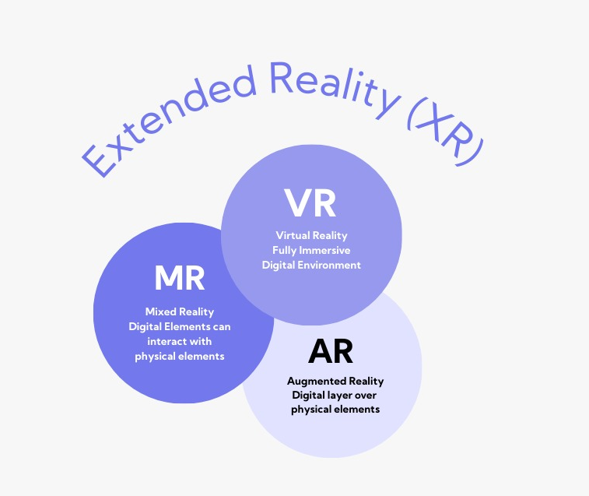

TECHNICAL APPROACH
STHAPATYAX
STAGE 2 : 3D digital prototyping of Indian civilization using SketchUp, developing monuments, ruins, artifacts, spatial clues, cultural elements and material representation.
STAGE 4 : IMMERSIVE EXPERIENCE
Prototype testing in an immersive environment for
Users experience using
Oculus meta quest 3
STAGE 1 : HISTORICAL DATA MAPPING: Research and documentation of Indian civilizations through historical records, cultural narratives, monuments, ruins, and historical clues
through an AI enhanced
workflow.
STAGE 3 : UNITY 3D
Digital prototyping of civilization in Unity 3D with optimized graphics, realistic lighting, high-quality visuals, and interactive elements for an immersive experience.

Slide 4
FEASIBILITY AND VIABILITY
STHAPATYAX
FEASIBILITY:
CHALLENGES
• COST AND ECONOMY :
Hardware , software , and training
Expenses can be significant.
• HARDWARE CONSTRAINTS:
VR and AR headsets can have resolution , battery , and latency
Constraints.
• HISTORY ACCURACY AND SOURCE REALIABILITY:
Historical information may vary across from sources , having an accurate information is
challenging
SOLUTIONS
• PC – based VR deployment with a centralized experiential centre for cost – efficient scalability.
• ARCHITECTURAL:
The prototype can be initially
Designed with limited data set and can be progressively scaled to include more civilizations.
• Multiple configuration can be
provided stand alone PC
version, PC- based VR version and
stand alone on VR
• Historical data will be validated
through authoritative records
and scholarly research.
• Technically and Operationally feasible because of the use of existing VR game development technology

Slide 5




IMPACT AND BENEFITS
STHAPATYAX
Education:
Spatial and analytical thinking:
Engagement through user experience:
Digital preservation:
Connects the past and present through an immersive heritage experience, where players explore, discover and reconstruct lost structures—transforming learning from passive “read → memorize → forget” into active “explore → discover → understand.”
Players explore their surroundings, uncover hidden artifacts, and follow clues that spark curiosity about the past. Through discovery and decision-making, they become active explorers and develop a deeper connection with heritage.
Players explore structures, connect clues, and understand how climate, materials, culture, and lifestyle shaped architecture while reconstructing the past.
The game digitally documents and reconstructs lost or damaged heritage, creating an immersive way to preserve architectural and cultural knowledge for future generations.
TARGET AUDIENCE:
Students & young learners:
Builds historical knowledge, curiosity, problem-solving, and active learning.
Architecture Students:
Develops spatial understanding, architectural analysis, and knowledge of traditional building practices.
Travellers & Tourists:
Helps users learn about heritage sites before or during visits, making travel more meaningful and informative.
General public:
Makes history and heritage more accessible through immersive exploration, discovery, and storytelling.

Slide 6
RESEARCH AND REFERENCES
STHAPATYAX
HISTORY & CULTURAL RESEARCH
Agkathidis, A., Varinlioglu, G. and Sopher, H., 2026. Archival Fragments to Immersive Worlds: An AI Workflow for the Digital Reconstruction of Lost
Architectural Heritage. Informed creativity and fabrication in architecture and engineering
https://whc.unesco.org/en/statesparties/in/
https://historicvr.com/
https://asi.nic.in/
ARCHITECTURE & XR
https://www.arkitera.com/haber/anadolu-selcuklu-kervansaraylari-steamde-silk-2-0-dijital-mirasi-oyun-dunyasina-tasiyor/
Agnello, F., Avella, F. and Agnello, S., 2019. Virtual reality for historical architecture. The International Archives of the Photogrammetry, Remote Sensing and Spatial Information Sciences, 42, pp.9-16.

