Slide 1



Credit Card Weekly Status Dashboard
An end-to-end Power BI solution for tracking credit card customer behavior, transaction performance, and weekly revenue trends — designed to empower data-driven decision-making.
AUTHOR: SHIVANI BHATT
Notes:
1

Slide 2

Project Objective & Data Sources
What We Set Out to Build
Data Sources
Design and develop interactive Power BI dashboards to analyze credit card customer behavior and transaction performance — delivering weekly insights, customer segmentation, and revenue analysis to support business decision-making.
CreditCard.csv
Customer.csv
Transaction amounts, revenue, interest earned, annual fees, card category, and weekly dates
Customer demographics including age, income, job, education, marital status, and state
Both datasets are linked via Client_Num in a one-to-many relationship.
Customer Analysis
Transaction Analysis
Extra Insights
Behavioral segmentation & demographics
Revenue trends & card performance
WoW tracking & risk analysis
Notes:
2

Slide 3

Implementation: Data Setup & Modeling
Model Relationships
Clean & Validate
Link Customer to CreditCard via Client_Num key.
Fix nulls, correct types, and normalize dates.
Import CSVs
Calculated Fields
Load Customer and CreditCard files into Power BI.
Create columns and DAX measures for analysis.
Data preparation ensured null-free, correctly typed columns before modeling. A one-to-many relationship was established between Customer[Client_Num] and CreditCard[Client_Num], forming the foundation for all DAX calculations.
Notes:
3

Slide 4

DAX FORMULAS — CREDIT CARD TABLE
Calculated Columns & Revenue Measures
Calculated Columns
Calculated Measures
Total_Revenue aggregates all revenue streams per transaction:
Current & Previous Week Revenue using CALCULATE + FILTER:
Total_Revenue =
CreditCard[Annual_Fees]
+ CreditCard[Total_Trans_Amt]
+ CreditCard[Interest_Earned]
Current_Week_Revenue =
CALCULATE(SUM(CreditCard[Total_Revenue]),
FILTER(ALL(CreditCard),
CreditCard[Week_Num_2] =
MAX(CreditCard[Week_Num_2])))
Previous_Week_Revenue =
CALCULATE(SUM(CreditCard[Total_Revenue]),
FILTER(ALL(CreditCard),
CreditCard[Week_Num_2] =
MAX(CreditCard[Week_Num_2])-1))
Week_Num_2 extracts the ISO week number for time intelligence:
Week_Num_2 =
WEEKNUM(CreditCard[Week_Start_Date])
WOW_Revenue computes week-over-week growth rate:
WOW_Revenue =
DIVIDE(
([Current_Week_Revenue]
- [Previous_Week_Revenue]),
[Previous_Week_Revenue])
Notes:
4

Slide 5

DAX FORMULAS — CUSTOMER TABLE
Customer Segmentation Columns
Age_Group — Demographic Segmentation
Income_Group — Revenue Strategy
Groups customers into 5-year age bands using SWITCH for efficient bucketing:
Classifies customers into Low, Medium, and High income tiers to support targeted revenue strategy:
Age_Group = SWITCH(TRUE(),
customer[Customer_Age] >= 20
&& customer[Customer_Age] <= 30, "20-30",
customer[Customer_Age] >= 30
&& customer[Customer_Age] <= 40, "30-40",
customer[Customer_Age] >= 40
&& customer[Customer_Age] <= 50, "40-50",
customer[Customer_Age] >= 50
&& customer[Customer_Age] <= 60, "50-60",
customer[Customer_Age] >= 60, "60+"
)
Income_Group = SWITCH(TRUE(),
customer[Income] < 30000,
"Low",
customer[Income] >= 30000
&& customer[Income] < 70000,
"Medium",
"High"
)
These two segmentation columns power the age and income slicers across all three dashboards, enabling dynamic customer analysis.
Notes:
5

Slide 6
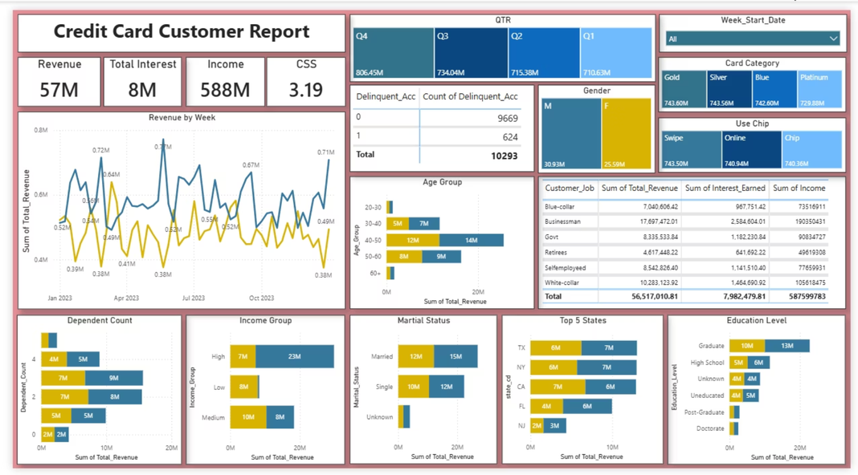
DASHBOARD 1
Credit Card Customer Report
$57M
$8M
Total Revenue
Total Interest
$588M
3.19
Total Income
CSS Score
Key visualizations include: Weekly Revenue Line Chart, Delinquent Account Table, Gender Treemap, Age Group & Income Group breakdowns, Customer Job Table, Marital Status Chart, Top 5 States, and Education Level analysis. Slicers: Quarter, Week Start Date, Card Category.
Notes:
6

Slide 7
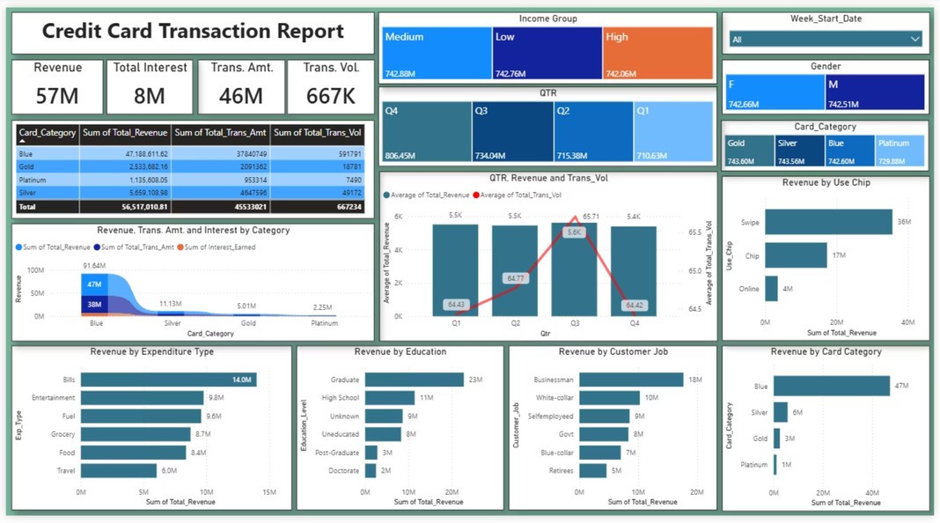
DASHBOARD 2
Credit Card Transaction Report
$57M
$8M
Revenue
Interest Earned
$46M
667K
Transaction Amount
Transaction Volume
Visualizations include: Card Category Table (revenue, amount, volume), Revenue by Category Area Chart, Quarterly Revenue & Volume combo bar+line chart, Revenue by Expenditure Type (Fuel, Bills, Grocery), Revenue by Education, and Revenue by Customer Job. Slicers: Income Group, Quarter.
Notes:
7

Slide 8
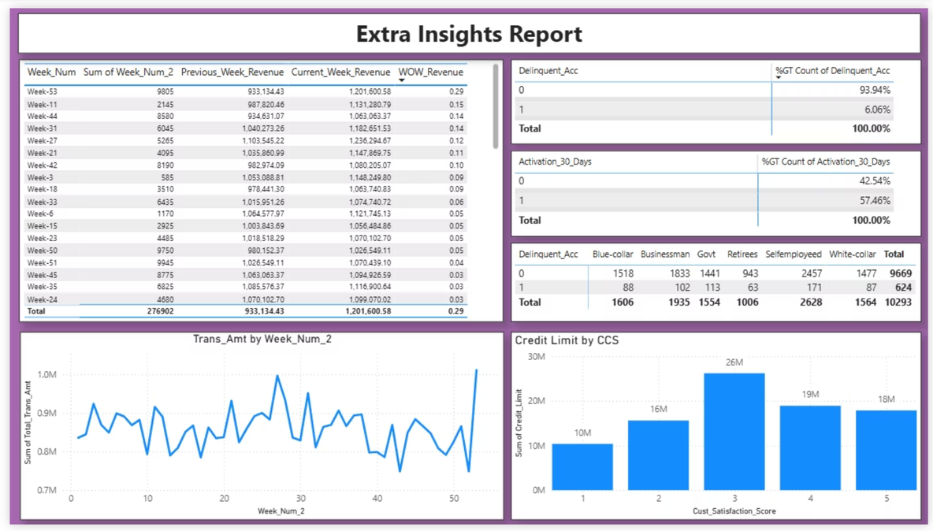
DASHBOARD 3
Extra Insights Report
Purpose
Key Elements
Advanced weekly performance tracking to support forward-looking business decisions and risk management at a granular level.
Weekly Revenue Table — Current Week, Previous Week & WoW Growth
Delinquency Analysis — Tracks risk patterns over time
Activation Analysis — Active vs. inactive customers
Transaction Trend — Line chart for transaction amount
Credit Limit Analysis — Distribution of credit usage
Notes:
8

Slide 9

Key Insights & Conclusion
Key Business Insights
Project Conclusion
Revenue Growing Weekly
This project successfully demonstrates end-to-end Power BI development — from raw CSV ingestion to polished interactive dashboards with advanced DAX measures.
Consistent upward trend observed across all quarters
Low Delinquency Rate
The solution is fully interactive, filterable by quarter, week, card category, and income group — ready for live stakeholder review.
Only ~6% of accounts are delinquent — a healthy portfolio
High Activation Rate
~57% of customers are actively using their cards
Blue & Silver Cards Dominate
These two categories lead in both volume and revenue
Advanced DAX
BI Reporting
Decision Support
WoW, segmentation & time intelligence
Clear, actionable visual storytelling
Weekly insights for stakeholders
Notes:
9

Slide 10

Thank You
Credit Card Weekly Status Dashboard — Power BI
Designed & developed by Shivani Bhatt · Powered by Power BI · Built with advanced DAX · Three interactive dashboards delivered
QUESTIONS & FEEDBACK WELCOME
Notes:
10

