Slide 1
🛒
Ecommerce Data Analysis Project
Target Dataset Exploration:
An SQL and Python Approach
Navigating the Future of Online Shopping
Prepared by: Shivani Bhatt
Tools: MySQL Workbench • Python • Pandas • Matplotlib • Google Colab

Slide 2
PROJECT OVERVIEW
Project Summary
Project Objectives
This project analyzes a comprehensive ecommerce dataset using a dual-tool approach — MySQL Workbench for relational queries and Python (Pandas + Matplotlib) for scripted analysis and visualization.
1
Perform SQL-based data analysis on ecommerce data
The dataset includes 7 CSV files covering customers, orders, order items, payments, products, sellers, and geolocation data.
2
Connect MySQL database with Python using mysql.connector
3
Execute identical SQL queries in Python for comparison
15 SQL/Python questions are solved across three difficulty levels: Basic, Intermediate, and Advanced.
4
Generate visual insights using Matplotlib graphs
Business insights are derived from customer behavior, sales trends, seller performance, and retention metrics.
5
Analyze customer retention and revenue growth patterns
6
Understand and measure ecommerce business performance

Slide 3
TOOLS & DATASET
🗄️
🐍
📊
📈
☁️
MySQL
Workbench
Python
Pandas
Matplotlib
Google
Colab
Relational DB queries and schema management
Scripting, data processing & automation
Data manipulation and analysis library
Data visualization and charting library
Cloud-based Python notebook environment
Database Setup
Dataset Files (7 CSVs)
CREATE DATABASE ecommerce;
USE ecommerce;
customers.csv
orders.csv
order_items.csv
payments.csv
Customer IDs and locations
Order timestamps and status
Products per order
Payment type and amount
products.csv
sellers.csv
geolocation.csv
Product categories & pricing
Seller ID and location
ZIP codes and coordinates

Slide 4
PYTHON & MYSQL CONNECTION
Setting up the database connection is the foundation of this project. The Python mysql.connector library bridges MySQL Workbench and Python, allowing seamless execution of SQL queries through Python scripts.
Python Connection Code
Connection Steps
import pandas as pd
import matplotlib.pyplot as plt
import mysql.connector
db = mysql.connector.connect(
host='localhost',
user='root',
password='shivani@13',
database='ecommerce'
)
cursor = db.cursor()
print('Connection successful!')
01
Import Libraries
pandas, matplotlib.pyplot, and mysql.connector are essential imports for the project
02
Configure Connection
Provide host, user, password, and database name as connection parameters
03
Create Cursor
A cursor object executes SQL queries and fetches results from MySQL
04
Execute Queries
Run SQL queries via Python and load results into Pandas DataFrames for analysis
05
Visualize Results
Use Matplotlib to generate plots and charts from the query results

Slide 5
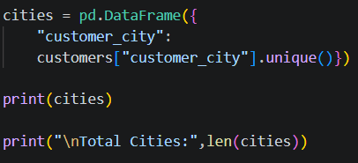

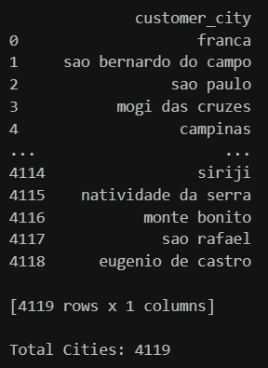
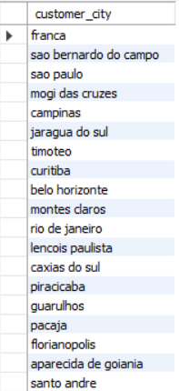
Q1: List all unique cities where customers are located
BASIC
🐍 Python Code
🗄️ MySQL Query
📤 Python Output
📤 MySQL Output
💡 Insight: Reveals geographic distribution of customers — SP and RJ cities dominate the customer base | 📊 Visualization: Count Plot

Slide 6
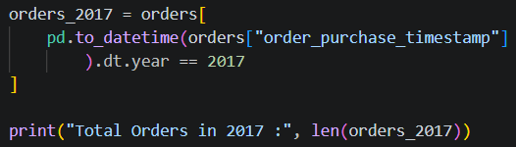
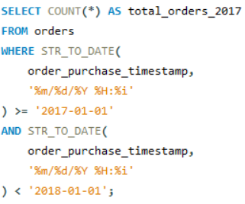


Q2: Count the number of orders placed in 2017
BASIC
🐍 Python Code
🗄️ MySQL Query
📤 Python Output
📤 MySQL Output
💡 Insight: 2017 saw significant order volume, with peak months indicating seasonal shopping trends | 📊 Visualization: Bar Chart

Slide 7
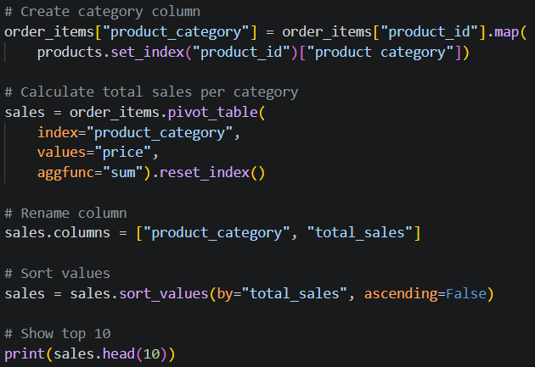
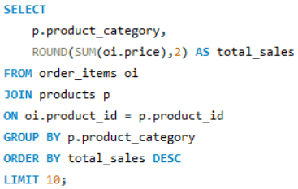
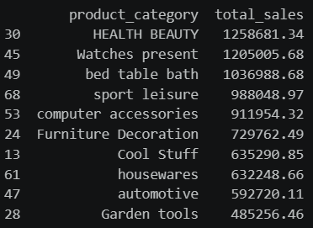
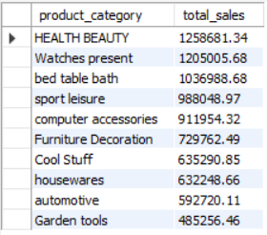
Q3: Find the total sales per category
BASIC
🐍 Python Code
🗄️ MySQL Query
📤 Python Output
📤 MySQL Output
💡 Insight: Health & beauty, watches, and bed/bath/table are the top revenue-generating categories | 📊 Visualization: Horizontal Bar Chart

Slide 8
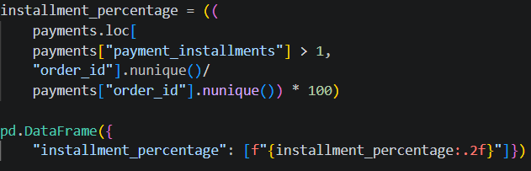
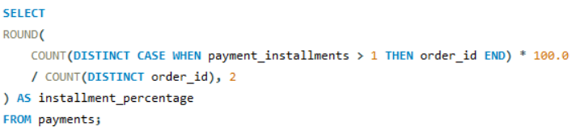


Q4: Calculate the percentage of orders paid in installments
BASIC
🐍 Python Code
🗄️ MySQL Query
📤 Python Output
📤 MySQL Output
💡 Insight: A large share of orders use installment payments, indicating customer preference for flexible payment | 📊 Visualization: Pie Chart

Slide 9
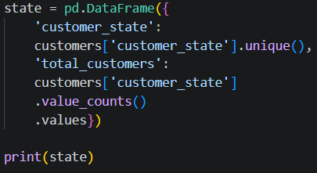
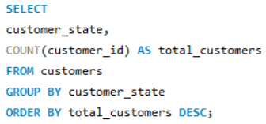
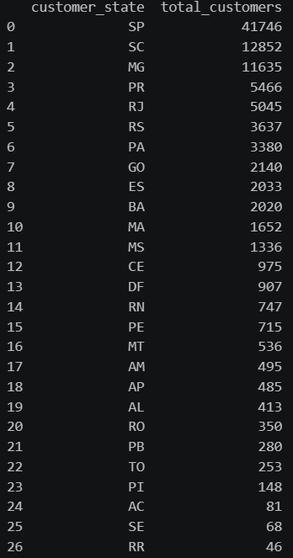
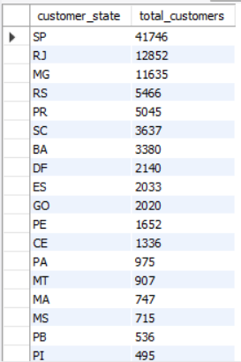
Q5: Count the number of customers from each state
BASIC
🐍 Python Code
🗄️ MySQL Query
📤 Python Output
📤 MySQL Output
💡 Insight: São Paulo (SP) has the highest customer density, followed by Rio de Janeiro (RJ) and Minas Gerais (MG) | 📊 Visualization: Bar Chart

Slide 10
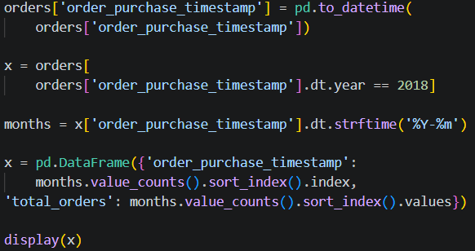
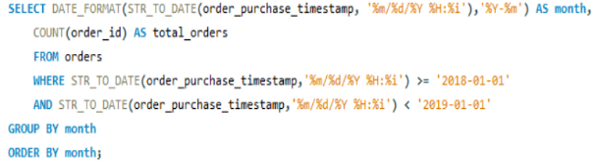
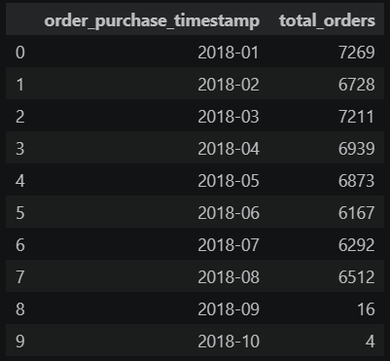
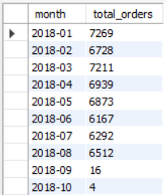
Q6: Calculate the number of orders per month in 2018
INTERMEDIATE
🐍 Python Code
🗄️ MySQL Query
📤 Python Output
📤 MySQL Output
💡 Insight: Monthly trend shows high activity in early 2018 with gradual variation — useful for demand planning | 📊 Visualization: Line Chart

Slide 11
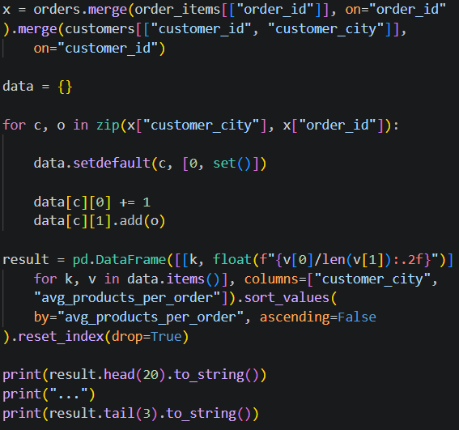
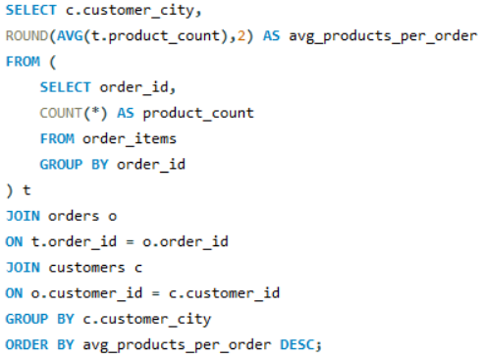
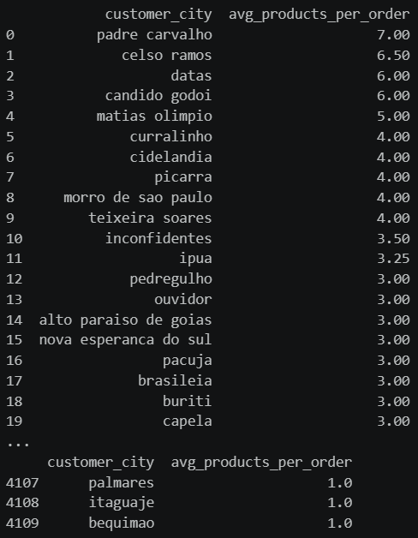
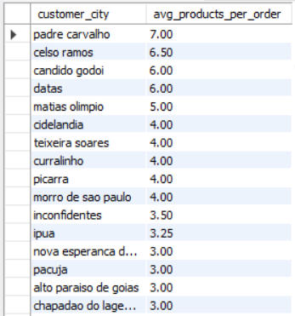
Q7: Find the average number of products per order, grouped by customer city
INTERMEDIATE
🐍 Python Code
🗄️ MySQL Query
📤 Python Output
📤 MySQL Output
💡 Insight: Customers from certain cities tend to buy more products per order, indicating bulk purchasing behavior | 📊 Visualization: Bar Chart

Slide 12
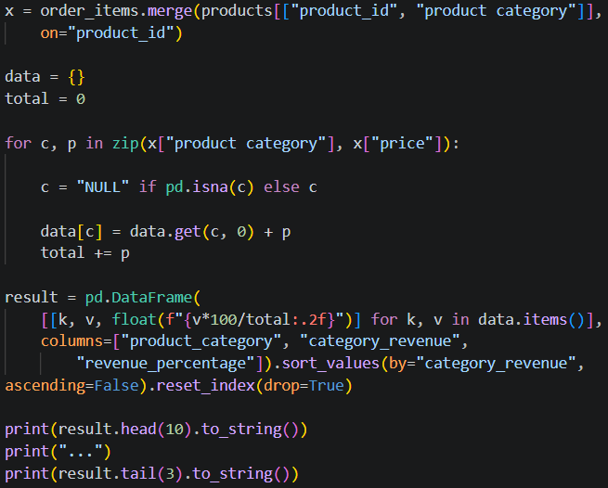
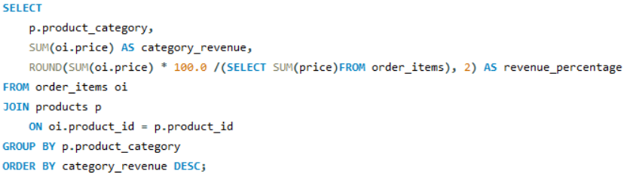
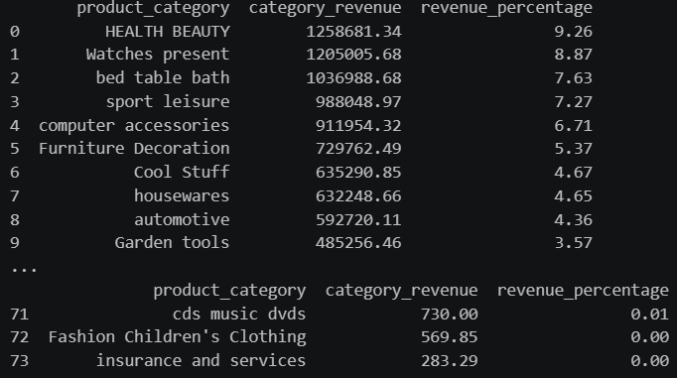
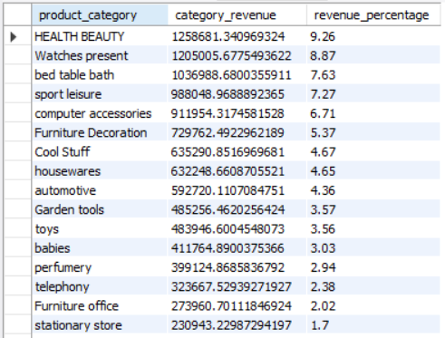
Q8: Calculate the percentage of total revenue contributed by each product category
INTERMEDIATE
🐍 Python Code
🗄️ MySQL Query
📤 Python Output
📤 MySQL Output
💡 Insight: A few categories dominate total revenue — Pareto principle applies with top categories driving majority of sales | 📊 Visualization: Pie Chart

Slide 13
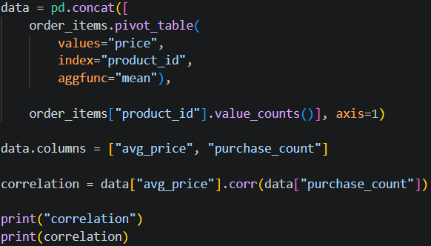
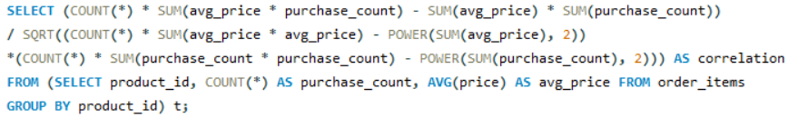


Q9: Identify the correlation between product price and the number of times a product has been purchased
INTERMEDIATE
🐍 Python Code
🗄️ MySQL Query
📤 Python Output
📤 MySQL Output
💡 Insight: Lower-priced products tend to be purchased more often — negative correlation between price and purchase frequency | 📊 Visualization: Scatter Plot

Slide 14
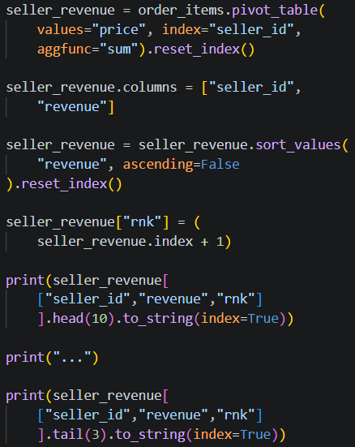
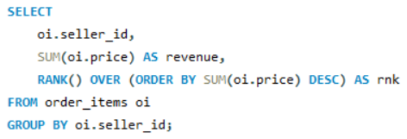
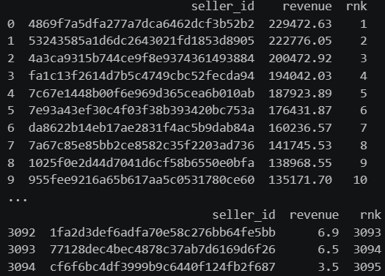
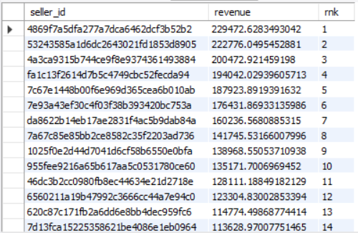
Q10: Calculate the total revenue generated by each seller, and rank them by revenue
INTERMEDIATE
🐍 Python Code
🗄️ MySQL Query
📤 Python Output
📤 MySQL Output
💡 Insight: Top sellers generate disproportionately high revenue — focusing on retaining top sellers is critical | 📊 Visualization: Horizontal Bar Chart

Slide 15
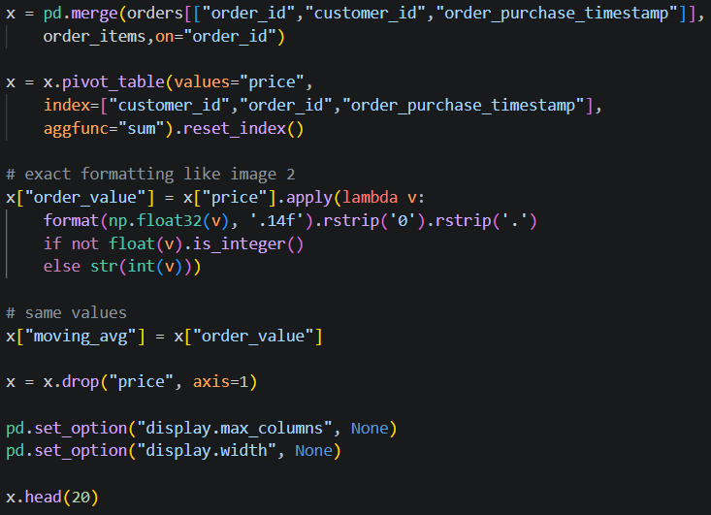
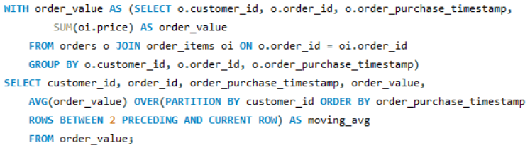
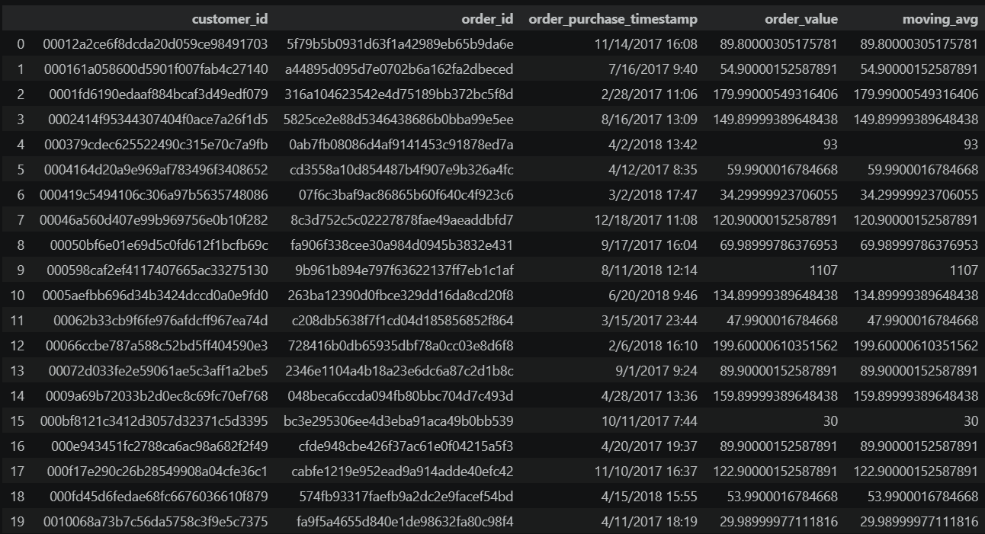
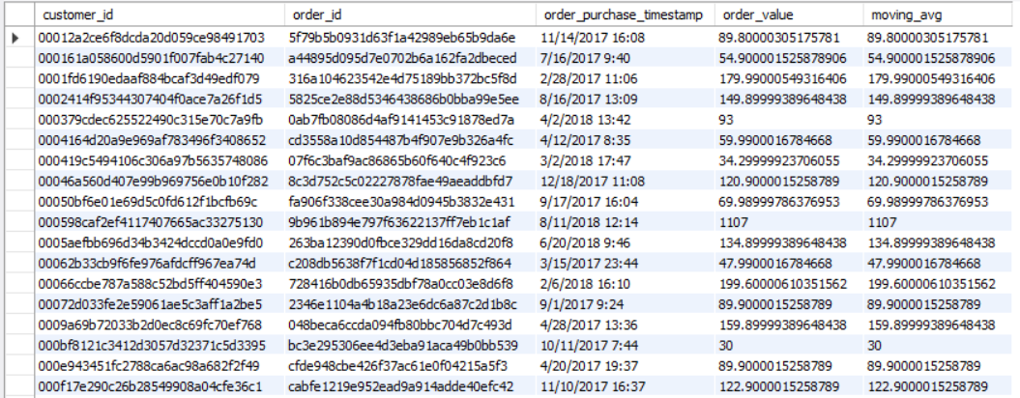
Q11: Calculate the moving average of order values for each customer over their order history
ADVANCED
🐍 Python Code
🗄️ MySQL Query
📤 Python Output
📤 MySQL Output
💡 Insight: Moving averages smooth out fluctuations and reveal whether customers are increasing their spend over time | 📊 Visualization: Line Chart

Slide 16
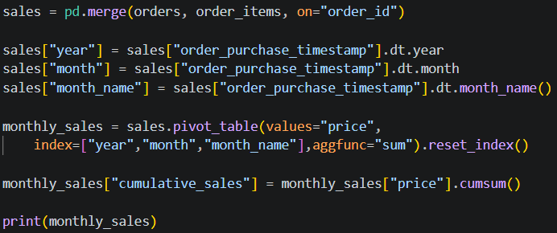
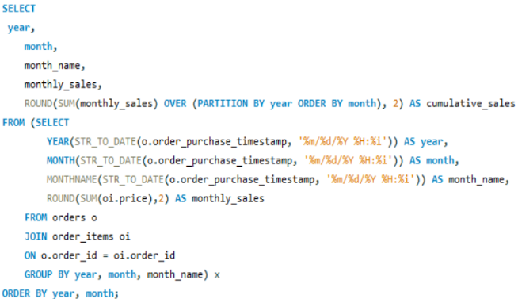
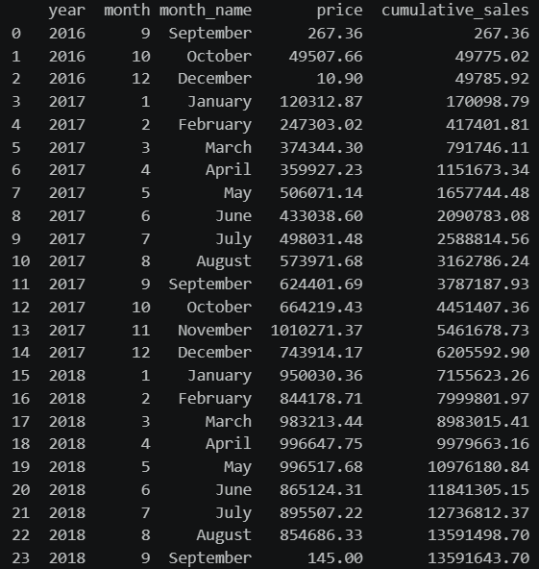
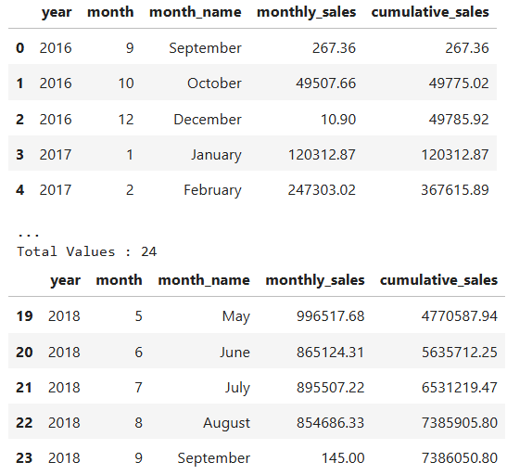
Q12: Calculate the cumulative sales per month for each year
ADVANCED
🐍 Python Code
🗄️ MySQL Query
📤 Python Output
📤 MySQL Output
💡 Insight: Cumulative view shows steady growth trajectory — 2018 significantly outpaces 2017 in total revenue | 📊 Visualization: Area Chart

Slide 17
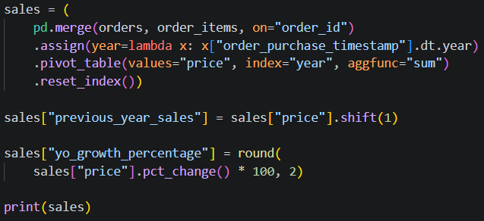
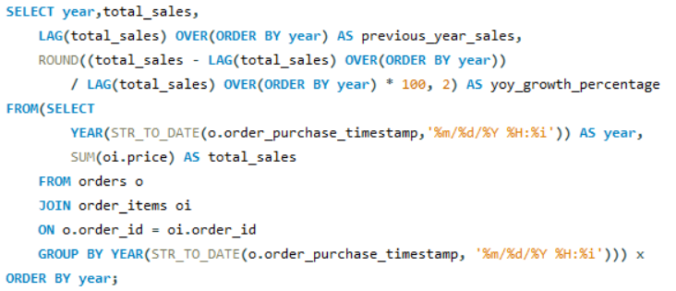
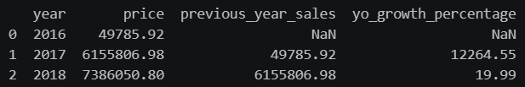
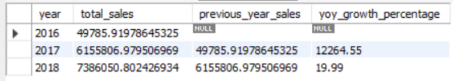
Q13: Calculate the year-over-year growth rate of total sales
ADVANCED
🐍 Python Code
🗄️ MySQL Query
📤 Python Output
📤 MySQL Output
💡 Insight: Strong YoY growth confirms the ecommerce platform is expanding its market reach and customer spend | 📊 Visualization: Line Chart

Slide 18
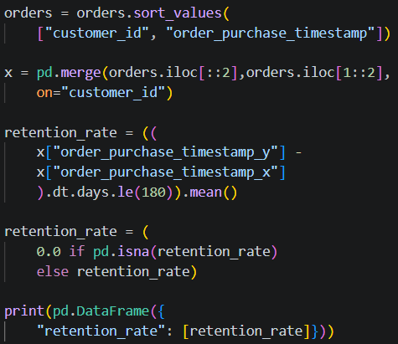
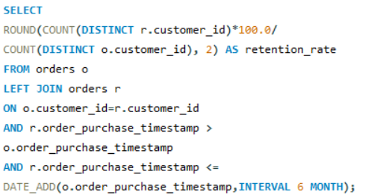


Q14: Calculate the retention rate — customers making another purchase within 6 months
ADVANCED
🐍 Python Code
🗄️ MySQL Query
📤 Python Output
📤 MySQL Output
💡 Insight: Customer retention rate provides direct insight into loyalty — improving retention is more cost-effective than acquisition | 📊 Visualization: Doughnut Chart

Slide 19
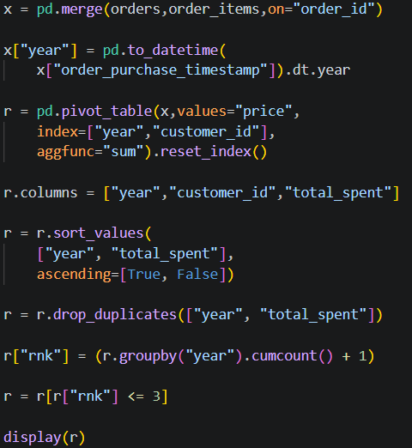
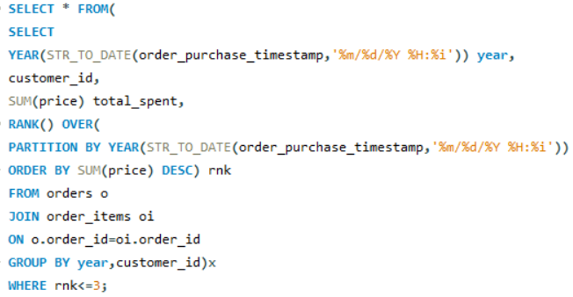
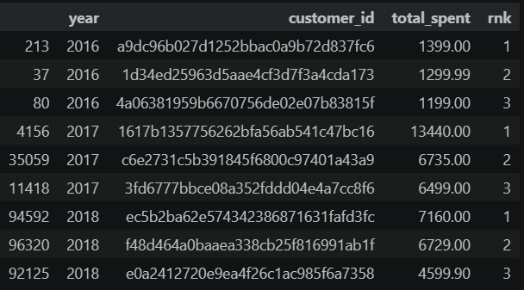

Q15: Identify the top 3 customers who spent the most money in each year
ADVANCED
🐍 Python Code
🗄️ MySQL Query
📤 Python Output
📤 MySQL Output
See Python output above
See MySQL output above
💡 Insight: High-value customers should be targeted with VIP loyalty programs to maximize lifetime customer value | 📊 Visualization: Bar Chart

Slide 20
VISUALIZATIONS USED
# | Query | Visualization | Purpose
1 | Unique Customer Cities | Count Plot | Location comparison
2 | Orders in 2017 | Bar Chart | Order count trend
3 | Sales per Category | Horizontal Bar Chart | Revenue analysis
4 | Installment Orders % | Pie Chart | Payment distribution
5 | Customers by State | Bar Chart | Customer distribution
6 | Orders per Month 2018 | Line Chart | Monthly trend analysis
7 | Avg Products per Order | Bar Chart | Purchase analysis by city
8 | Revenue Contribution | Pie Chart | Category revenue share
9 | Price vs Purchase Count | Scatter Plot | Correlation detection
10 | Seller Revenue Ranking | Horizontal Bar Chart | Seller performance
11 | Moving Average Orders | Line Chart | Trend smoothing
12 | Cumulative Sales | Area Chart | Growth tracking
13 | YoY Growth Rate | Line Chart | Year-over-year analysis
14 | Customer Retention Rate | Doughnut Chart | Loyalty tracking
15 | Top Spending Customers | Bar Chart | Customer spending analysis

Slide 21
KEY BUSINESS INSIGHTS
🏆
📍
📅
Revenue Concentration
Geographic Concentration
Seasonal Demand Patterns
A small number of product categories contribute the majority of total revenue — aligning with the Pareto principle (80/20 rule)
São Paulo and Rio de Janeiro account for the largest customer bases, suggesting targeted marketing campaigns for these regions
Monthly sales fluctuations indicate seasonal demand cycles — valuable for inventory planning and promotional campaigns
💳
🔄
📈
Installment Payment Preference
Customer Retention
Seller Performance Gap
A significant percentage of customers prefer installment payments, highlighting the importance of flexible payment options
Retention rate analysis shows that improving repeat purchase behavior within 6 months can significantly boost long-term revenue
Top sellers generate disproportionately high revenue — identifying and nurturing high-performing sellers is key to platform growth

Slide 22
CHALLENGES FACED
🔌
MySQL–Python Integration
Configuring the mysql.connector library and handling authentication parameters was tricky initially, particularly for password encoding and host settings.
⚖️
Matching SQL & Python Outputs
Ensuring that Python Pandas queries produced identical results to MySQL queries required careful alignment of JOIN logic and GROUP BY clauses.
🪟
Understanding Window Functions
Advanced SQL concepts like ROW_NUMBER(), RANK(), and OVER() partitions required extra study and testing to implement correctly.
📦
Managing Large Datasets
Loading all 7 CSV files simultaneously and running complex multi-table JOINs was memory-intensive, requiring optimization of queries and DataFrame operations.
📊
Creating Meaningful Visualizations
Choosing the right chart type for each query result and styling plots for clarity and business readability required iterative refinement.

Slide 23
CONCLUSION
This project successfully demonstrated end-to-end ecommerce data analysis using SQL and Python, bridging the gap between database management and data science workflows.
SQL Analysis
Python Integration
Successfully implemented 15 SQL queries across three difficulty levels — Basic, Intermediate, and Advanced — covering aggregation, window functions, and subqueries.
Seamlessly connected MySQL with Python using mysql.connector and replicated all SQL queries as Pandas DataFrames, confirming result consistency.
Data Visualization
Business Intelligence
Created 15 meaningful charts using Matplotlib — including bar charts, pie charts, scatter plots, line charts, and area charts — to communicate business insights visually.
Derived actionable insights on customer geography, payment behavior, product revenue, seller performance, and customer retention rates.
🏆 PROJECT COMPLETED SUCCESSFULLY 🏆

Slide 24
🙏
THANK YOU
for your time and attention
Target Dataset Exploration: An SQL and Python Approach
Navigating the Future of Online Shopping
Author
Tools
Queries
Shivani Bhatt
MySQL • Python • Pandas • Matplotlib
15 SQL + Python Questions

