Slide 1



BUS ROUTE COST OPTIMIZER

Slide 2
PROBLEM STATEMENT
In cities, daily travelers often choose between regular and express bus routes, each with different costs.
The goal is to calculate the minimum cost to reach each station, considering :
Cost per stop for regular and express routes.
Additional transfer cost when switching from regular to express
02

Slide 3
REFINED APPROACH
We use Dynamic Programming to store and update the minimum cost to reach each station.
Two cost-tracking arrays :
dpRegular[i]: Min cost to reach station i via regular route.
dpExpress[i]: Min cost to reach station i via express route.
At each station :
We check if continuing on the same route or switching is cheaper.
Consider the extra cost when switching from regular to express.

Slide 4
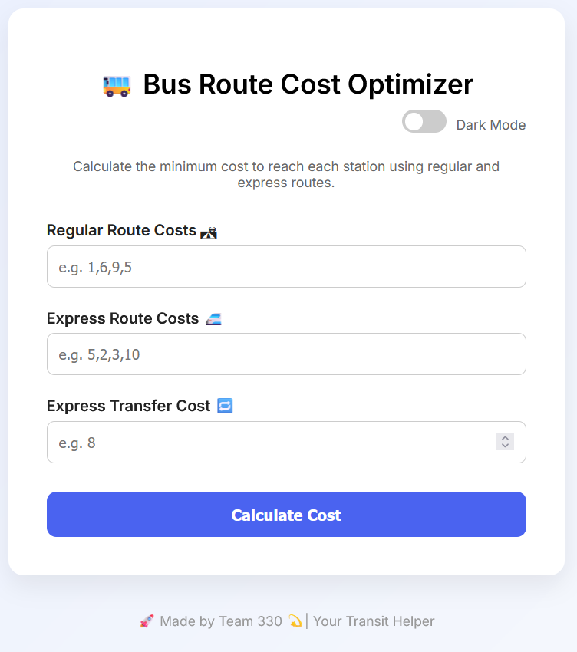
TECH STACK
FRONTEND :
HTML, CSS (with dark mode), JavaScript
Responsive UI with subtle glowing effects
CORE LOGIC :
JS function to calculate minimum costs using dynamic programming
Efficient parsing and handling of input data (cost arrays)
USER INTERACTION :
Simple inputs for route costs
Dark mode toggle for better UX
Instant display of results with clear formatting
01
01
02
02

Slide 5
WORKING DEMO OVERVIEW
INPUT :
Regular route cost (comma-separated values)
Express route cost (comma-separated values)
Transfer cost between routes
OUTPUT :
Minimum cost to reach each station is calculated and shown
Automatically hides the result box if output is empty
EXTRAS :
Interactive UI
Visual feedback (glowing button, clean result display)
Fully functional in both light and dark mode
01
01
02
02

Slide 6
KEY TAKEAWAYS
Helps commuters plan cheapest routes easily
Can be adapted for real-world data from transport systems
Scalability possible for larger networks (bus, train, etc.)
Encourages cost-aware commuting and better city planning
01
01
02
02

Slide 7
Studio Shodwe
THANK YOU

