Slide 1
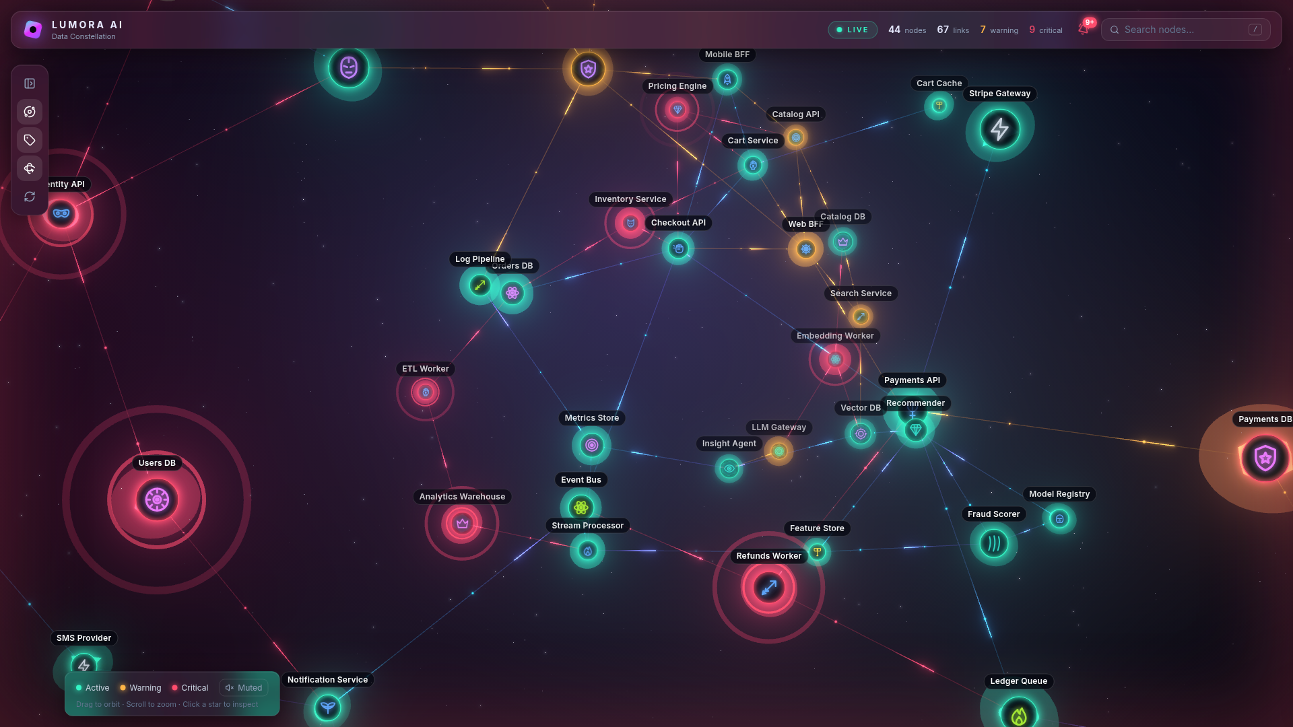
HACKATHON DEMO
LUMORA AI
Your system, as a living constellation.
44 services · live
1-click AI diagnosis
Hero mode
Notes:
Lumora turns a microservice platform into a glowing 3D constellation. Every star is a service, coloured by health, streaming live telemetry.

Slide 2
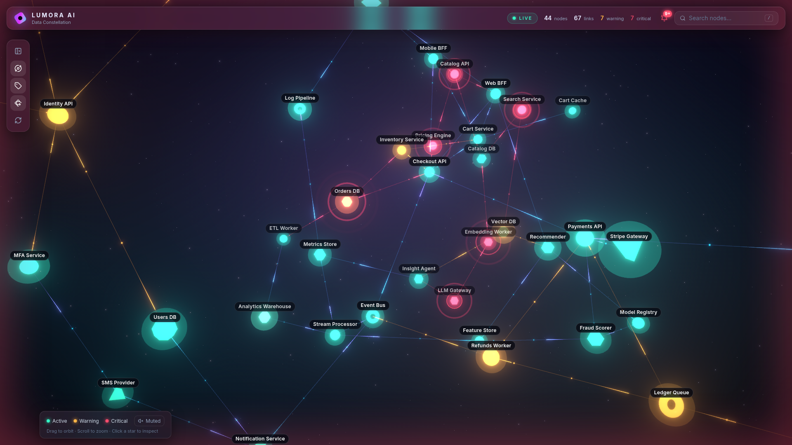
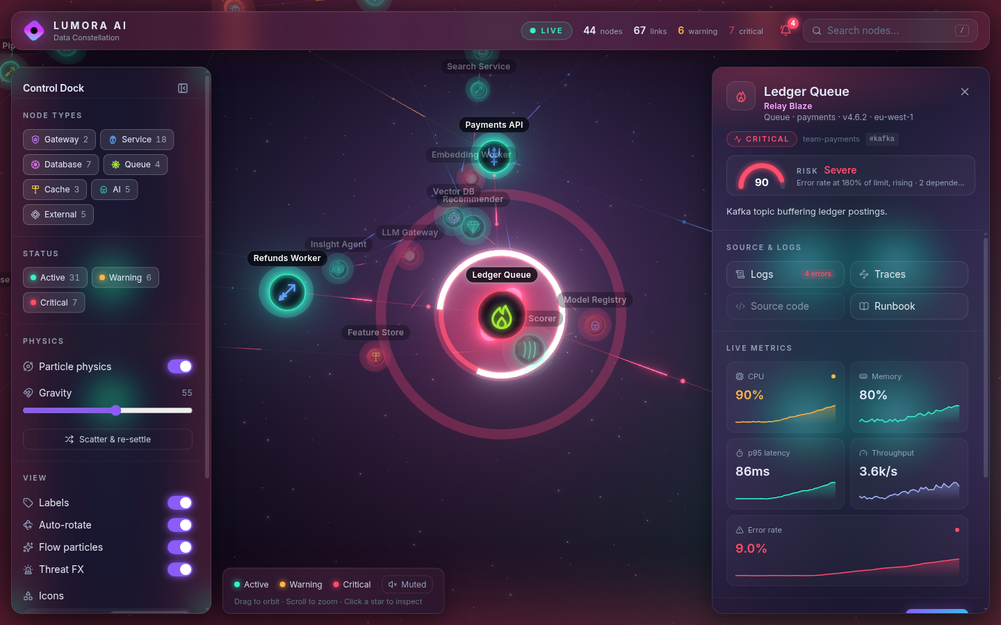
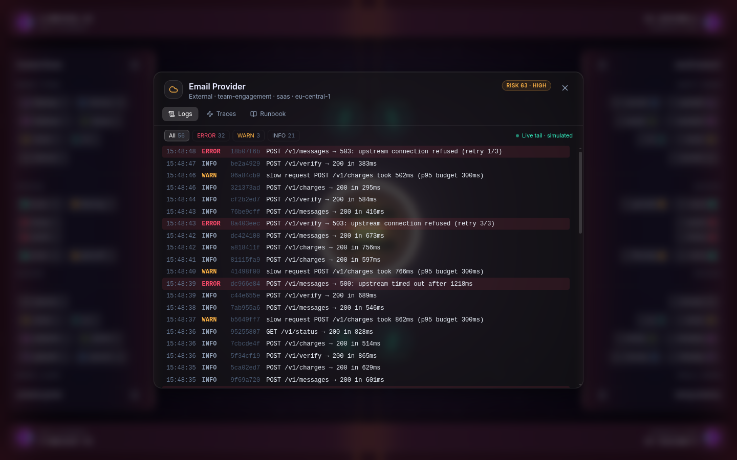
See it. Feel it. Fix it.
SEE
FEEL
FIX
Live 3D constellation
Threat mode + risk meter
Logs · traces · runbook
Notes:
SEE: orbit the live topology. FEEL: critical nodes pulse with shockwaves, the screen edge glows red, every node gets a 0-100 risk score. FIX: one click opens logs, traces and a generated runbook; AI diagnostics explain the root cause.

Slide 3
Break it.
Watch it heal.
1
2
3
4
5
Spike
Alert
Fly-in
Diagnose
Recover
Hero mode: every service gets a hero.
LIVE DEMO →
Notes:
Demo: wait for a node to spike (or pick a critical one). The bell rings, click the alert, the camera flies in and highlights the metric. Hit Analyse for the AI diagnosis, open Logs/Runbook, then watch it recover. Finish by toggling Hero mode.

