Slide 1
⚡
ReconEdge
Detect. Quantify. Investigate. Resolve.
Intelligent financial reconciliation powered by Daytona sandboxes + AI reasoning
Problem
Solution
Demo
Reconciliation systems detect breaks — but analysts still investigate why.
Compute the facts in Daytona. Let AI reason over the evidence.
6 sample transactions → 4 exceptions → risk + root-cause path.
Daytona determines the facts. AI interprets the facts. ReconEdge turns both into an operational investigation.
ReconEdge | Daytona HackSprint
01

Slide 2
The real problem: breaks are easy to detect, hard to investigate
ReconEdge focuses on the gap between mismatch detection and human resolution
Traditional reconciliation often stops here:
But analysts still answer these questions manually:
Why?
fee, amendment, timing, interface?
BREAK DETECTED
TX002
Bank: €8,500
Internal: €8,000
How material?
€ amount + percentage variance
What evidence?
source records and status signals
What next?
recommended checks + escalation
ReconEdge is an investigation layer: it quantifies the break, builds evidence, scores risk, and gives an action path.
ReconEdge | Daytona HackSprint
02

Slide 3
Product thesis: separate facts from interpretation
Financial arithmetic should be deterministic; root-cause reasoning can be AI-assisted
1
Raw financial data
2
Daytona sandbox
3
Calculation engine
4
AI reasoner
bank / custodian + internal ledger
isolated execution boundary
presence, amount, variance, status
hypotheses + next checks
Daytona / code determines:
AI determines:
• signed difference • exposure
• variance % • exception type
• match rate • net discrepancy
• likely causes • confidence rank
• recommended checks • escalation guidance
• human-readable report
“The LLM never decides if €8,500 equals €8,000 — it reasons over the evidence generated in the sandbox.”
ReconEdge | Daytona HackSprint
03

Slide 4
Workflow architecture: controlled financial investigation
A stateful pipeline with explicit execution, evidence, reasoning, verification and decision gates
1
Intake
2
Validate
3
Plan
4
Daytona
5
Evidence
business date + files
schema + quality
checks to run
execute safely
facts package
6
Risk
7
AI Reason
8
Verifier
9
Report
materiality score
root causes
no hallucinated facts
next action
MVP slice: Validator → Fixed planner → ONE Daytona sandbox → Evidence → Risk → ONE AI request → Report
ReconEdge | Daytona HackSprint
04

Slide 5
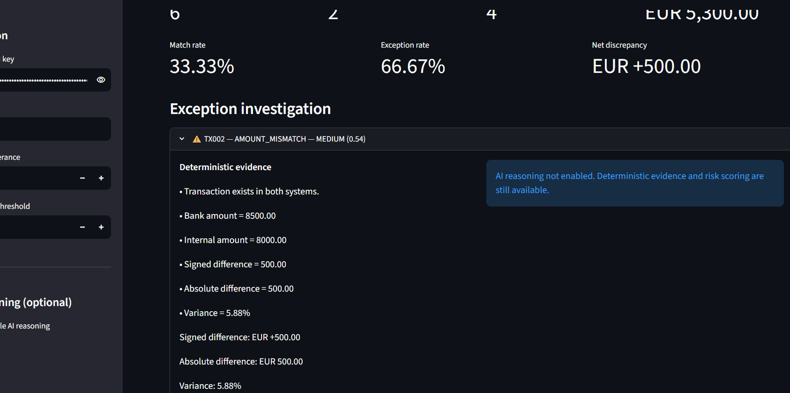
Demo result: deterministic evidence + risk scoring
A synthetic six-transaction dataset exposes multiple break types in one run
6
2
4
€5,300
+€500
Transactions reviewed
Matches
Exceptions
Gross exposure
Net discrepancy
Calculation examples
TX002 Amount mismatch
Bank €8,500 vs internal €8,000
Signed difference: +€500 | variance: 5.88%
TX003 Missing internally
Bank €2,400 absent from internal ledger
Risk: HIGH due to 100% variance + materiality
TX006 Status mismatch
Amount matches; settled vs pending
Live UI proof: Daytona execution → evidence → risk
ReconEdge | Daytona HackSprint
05

Slide 6
Why Daytona matters
ReconEdge is designed for AI-driven financial investigations that need a safe execution boundary
Without sandboxing
With Daytona
Future scale
AI-generated or user-driven analysis risks running inside the app/server environment.
Shared environments can contaminate results.
Cleanup and isolation are harder to guarantee.
Each investigation gets isolated disposable compute.
Code executes away from the UI process.
Structured evidence returns; sandbox is deleted.
1 account
→ 1 sandbox
100 accounts
→ parallel sandboxes
AI planner
→ generated checks safely executed
Demo message: one sandbox per investigation today; one sandbox per account/break tomorrow.
ReconEdge | Daytona HackSprint
06

Slide 7
AI reasoning: bounded interpretation, not hallucinated arithmetic
The AI receives structured evidence produced by Daytona and returns root-cause hypotheses
Evidence package from Daytona
AI investigation output
TX002
classification: AMOUNT_MISMATCH
bank: 8500
internal: 8000
signed_difference: +500
absolute_difference: 500
variance_pct: 5.88
risk_score: 0.54
Ranked hypotheses
1. Fee / adjustment missing internally
2. Incorrect internal booking
3. Partial settlement or amendment
Recommended checks
→ source confirmation
→ fee / adjustment fields
→ amendment history
→ ledger posting
Escalation guidance
Guardrail: AI never edits or recalculates supplied financial facts — it explains what those facts may mean.
ReconEdge | Daytona HackSprint
07

Slide 8
What is demo-ready now — and what comes next
A focused MVP with a credible path to enterprise-grade financial operations intelligence
Live MVP
Next build
✓ Daytona sandbox execution
→ AI JSON verifier loop
✓ deterministic reconciliation
→ confidence gate
✓ evidence package
→ audit trail
✓ risk score
→ ageing and materiality thresholds
✓ CSV upload flow
→ parallel sandboxes per account
✓ Streamlit demo UI
→ generated investigation code
Closing line
“Daytona determines the facts. AI interprets the facts. ReconEdge turns both into an actionable financial investigation.”
ReconEdge | Daytona HackSprint
08

