Slide 1

PROJECT ON
EXPLORATORY DATA ANALYSIS ON THE AMCAT
NAME :VURUKONDA SHIVA SAI CHAKRADHAR
EDUCATION :BACHELOR OF COMPUTER APPLICATION
INTERN ID : IN9240844
LINKED URL : ( Shiva Sai Chakradhar | LinkedIn

Slide 2

AGENDA:
1. INTRODUCTION
2. DESCRIPTION OF DATA
3. UNIVARIATE ANALYSIS
4. BIVARIATE ANALYSIS
5. CONCLUSION

Slide 3



1. INTRODUCTION
OBJECTIVE:
The goal of this Exploratory Data Analysis (EDA) is to extensively investigate the provided dataset, with a particular emphasis on understanding the link between various variables and the target variable, Salary.
The key aims of this analysis include:
- Providing a detailed explanation of the dataset's features.
- Find any observable patterns or trends in the data.
- Investigating the relationships between the independent factors and the target variable (salary).
- Identify any outliers or abnormalities in the dataset.
- Offering practical insights and recommendations based on the analysis.

Slide 4

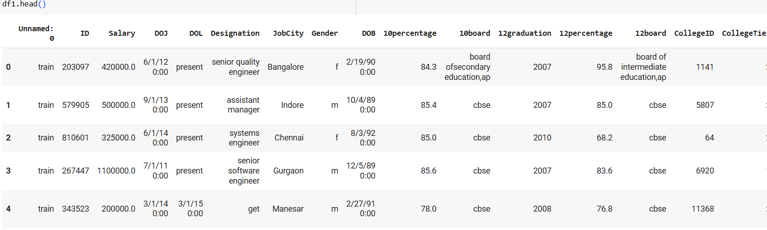
2. DESCRIPTION OF DATA
Description:
The Aspiring Mind Employment Outcome 2015 (AMEO) dataset, provided by Aspiring Minds, is designed to examine the employment outcomes of engineering graduates. It comprises essential variables like Salary, Job Titles, and Job Locations, as well as standardized scores reflecting cognitive skills, technical skills, and personality traits. Featuring approximately 40 independent variables and a dataset size of 4000 entries, this dataset encompasses a mix of continuous and categorical data. Additionally, it incorporates demographic characteristics and unique identifiers for individual candidates.

Slide 5

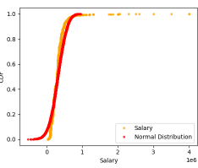
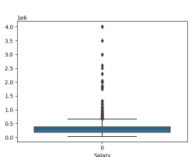
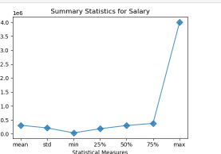
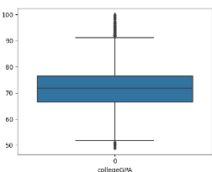
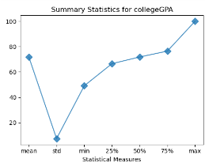
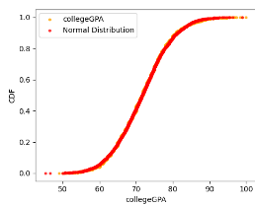
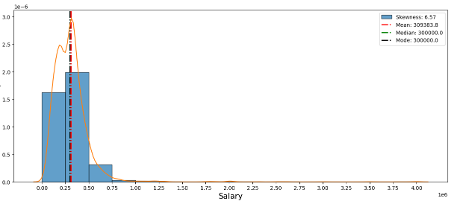
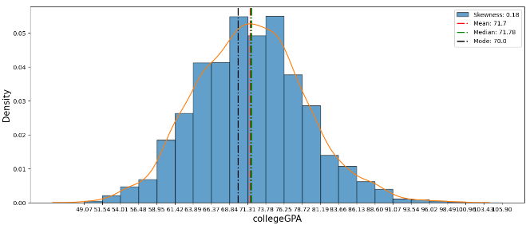
3 . UNIVARIATE ANALYSIS
UNIVARIATE ANALYSIS:
Univariate analysis involves the examination of a single variable, providing insights into its distribution, central tendency, and dispersion. In this analysis, we focus on individual variables without considering their relationships with other variables.
Salary:
Summary Plot: The summary plot for salary provides a quick overview of its statistical measures, such as mean, median, and quartiles.
Histogram: A histogram visualizes the distribution of salary values, revealing skewness and central tendencies.
Box Plot: The box plot helps identify outliers and displays the overall distribution of salary.
Cumulative Distribution Function (CDF): CDF illustrates the cumulative probability distribution of salary values.
COLLEGE GPA:
Summary Plot: Similar to salary, a summary plot presents statistical measures for COLLEGE percentage.
Histogram: Visualizes the distribution of COLLEGE percentage values and highlights measures like mean and median.
Box Plot: Displays the spread and central tendency of COLLEGE percentage.
CDF: Cumulative Distribution Function for COLLEGE percentage provides insights into the data's cumulative distribution.

Slide 6

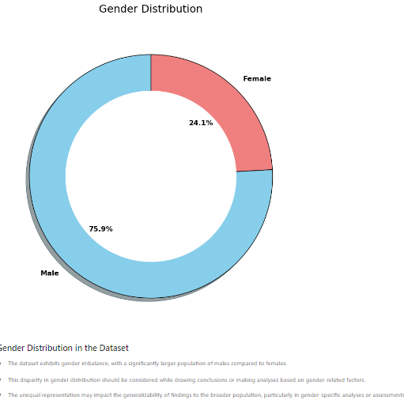
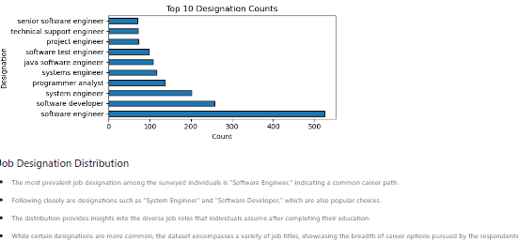
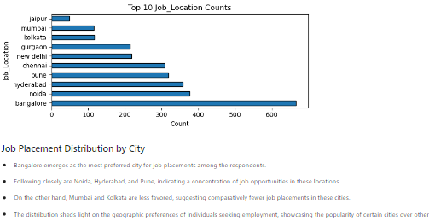
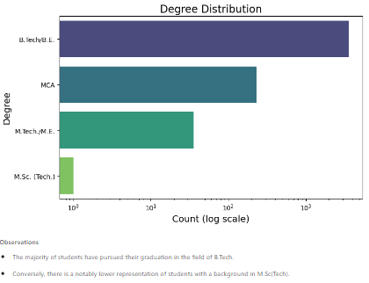
CATEGORICAL FEATURES ANALYSIS: UNIVARIATE
Gender Distribution:
The gender distribution reveals that the dataset comprises both male and female students.
Job Designation:
The job designation distribution showcases the variety of roles students take on after graduation.
Degree Distribution:
There is a mix of different degrees among the students, including both engineering and non-engineering disciplines.
Job Location Distribution:
The distribution of job locations indicates that students secured employment in various cities.

Slide 7

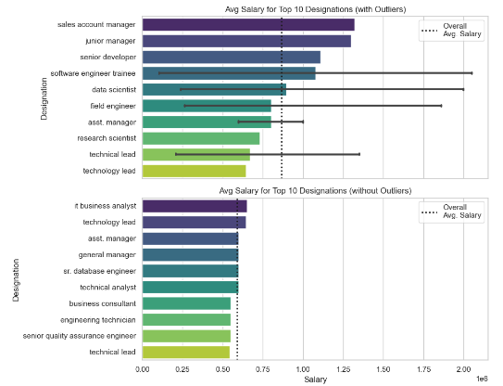
4. BIVARIATE ANALYSIS
Bivariate analysis involves exploring the relationships and patterns between two variables. By examining the interactions between pairs of features, we gain insights into how they influence each other and contribute to the overall dataset. In this analysis, we focus on specific pairs of features and evaluate their joint behavior.
1. Continuous vs. Continuous Features
Correlation Analysis: Investigating the correlation between pairs of continuous features to understand how changes in one variable correspond to changes in another.
Scatter Plots: Visualizing the distribution of data points in a scatter plot to identify trends, patterns, and potential outliers.
2. Categorical vs. Continuous Features
Box Plots: Utilizing box plots to compare the distribution of continuous variables across different categories.
Bar Plots: Visualizing the average or aggregated values of continuous features for each category.
3. Categorical vs. Categorical Features
Stacked Bar Plots: Creating stacked bar plots to display the distribution of one categorical variable within each category of another.
Chi-Square Test: Applying statistical tests to assess the independence or association between two categorical variables.
4. Time-Series Analysis
Line Plots: Analyzing the trends and patterns in time-series data to identify seasonality or other temporal patterns.
Correlation Over Time: Examining how the correlation between two variables evolves over different time intervals.
Average Salary for each Designation
Observations:
The bar plot illustrates the maximum salary for each designation. Notably, the Senior Software Engineer position commands the highest salary, but it also exhibits the maximum standard deviation, indicating a wider range of salaries within this role. Additionally, only two designations, namely Software Developer and Technical Support Engineer, have salaries below the average salary

Slide 8

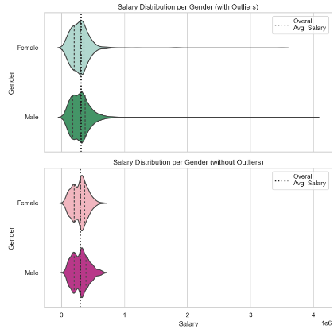
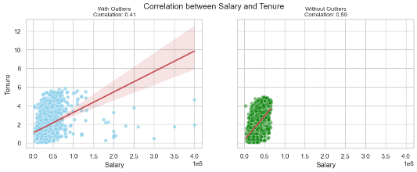
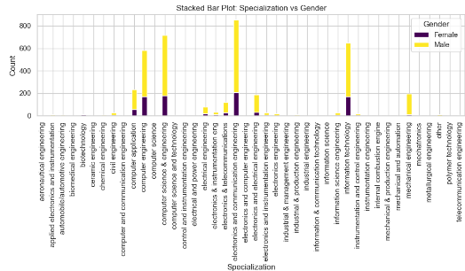
Average Salary for each Gender:
Observations:
The violin plot reveals that the average salary for both male and female employees is approximately equal, suggesting no significant gender bias in terms of salary. However, it is noteworthy that the distribution for female salaries tends to have a slightly wider range, with some salaries falling below the overall average salary.
Salary & Tenure:
Observations:
After removing outliers, a clear positive correlation between Salary and Tenure emerges, with a correlation coefficient of 0.59. This indicates that, on average, salary tends to increase with tenure, and the relationship is stronger without the influence of outliers compared to the correlation of 0.41 with outliers.
Gender and Specialization:
Observations:
The bar plot displays the distribution of specializations within the domain of Engineering. Electronic and Communication Engineering is the most prevalent specialization, followed by Computer Engineering. The plot further breaks down the distribution by gender, highlighting the proportions of both male and female students in each specialization.

Slide 9

5. CONCLUSION:
This project aimed to analyze a detailed dataset on the employment outcomes of engineering graduates, with a special focus on the "Salary" variable. The analysis was carried out in several steps, including understanding the data, cleaning and preparing it, and using visualizations to derive useful insigths.
Data Understanding: The dataset provided a wealth of information, including scores on cognitive, technical, and personality skills. Our main goal was to explore how these factors affect salary diferences among graduates.
Data Manipulation: We started by cleaning the data, removing duplicates and filling missing values. This helped us get a strong and reliable dataset for the analysis. The dataset contained 4000 rows and 40 colums, which needed careful preprocessing to uncover meaningful patterns.
Data Visualization: We used a variety of visual techniques to understand the data. Univariate analysis (like histograms and box plots) helped us see the distribution of individual factors, while bivariate analysis (like scatter plots, bar charts, and pivot tables) allowed us to compare different variables and spot trends.
Key Observations:
There was a balanced gender distribution among the graduates.
Significant salary differences were observed based on job location and designation.
In some job roles, a noticeable gender-based pay gap was present.
Educational performance (such as academic scores) had a strong impact on salary ranges.
Region-Specific Insights:
Salary trends were explored in key cities like Bangalore, Chennai, Mumbai, and Hyderabad.
Certain job roles showed competitive salaries for both men and women in these regions.
Overall Insights and Recommendations:
The analysis pointed out potential gender pay gaps and salary differences based on location, which are areas that organizations should pay attention to.
It also highlighted the importance of educational performance in determining salary, suggesting that employers could focus more on academic acheivements during recruitment.
For a deeper understanding, further analysis could be done, possibly using machine learning techniques, to identify more specific factors influencing salary.
In conclusion, this project provided important insights into the employment outcomes of engineering graduates. It highlighted key issues like gender pay gaps and regional salary differences, offering valuable information for companies and policymakers. These insights can help create more equitable and fair employment practises in the future. This study also sets the foundation for more advanced research into the factors that determine salaries in the engineering field.

Slide 10

Thank You

