Slide 1
Transformer-Based Semantic Segmentation for Autonomous Driving in Adverse Weather Conditions Using Weather and Time Aware Supervision
Presenter: Shiv Chaudhary
First Examiner : Prof. Dr. Gordon Elger
Second Examiner :Prof. Dr. rer. nat. Armin Arnold
Supervisor : Zhiran Yan, M.Sc
Presentation Date: 10.10.2025

Slide 2




Presentation Structure
Organized into Four Key Sections
Section 1: The Problem & Motivation
Section 2 : Our Proposed Method
Section 3 : Results & Evaluation
Section 4 : Ablation & Conclusion

Slide 3

Slide 1 : Problem Statement
Section 1
Problem & Motivation
Slide 2 : Key Challenges
Slide 3 : Thesis Goals

Slide 4
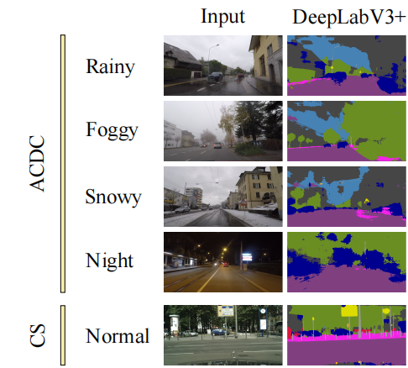
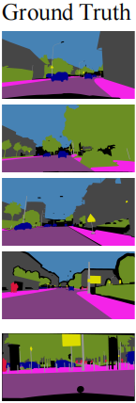
Problem Statement
What's Broken: Why Today's Models Fail
What is Semantic Segmentation?
Pixel-wise classification of an image into meaningful classes (road, car, pedestrian, tree, building, …).
Each class is shown in a different color in the generated segmentation mask
Key Reference: arxiv.org/abs/2210.05626
Semantic Segmentation under Adverse Conditions
What’s the problem?
Existing semantic segmentation models like DeepLabV3+ work well in clear, daytime conditions.
But their performance significantly drops in adverse conditions like:
Rain
Fog
Snow
Night
Visual Comparison Between Ground Truth and Generated Segmentation Mask
Shown on ACDC and CITYSCAPE Dataset.

Slide 10
Visual Comparison Between Ground Truth and Generated Segmentation Result.

Slide 11
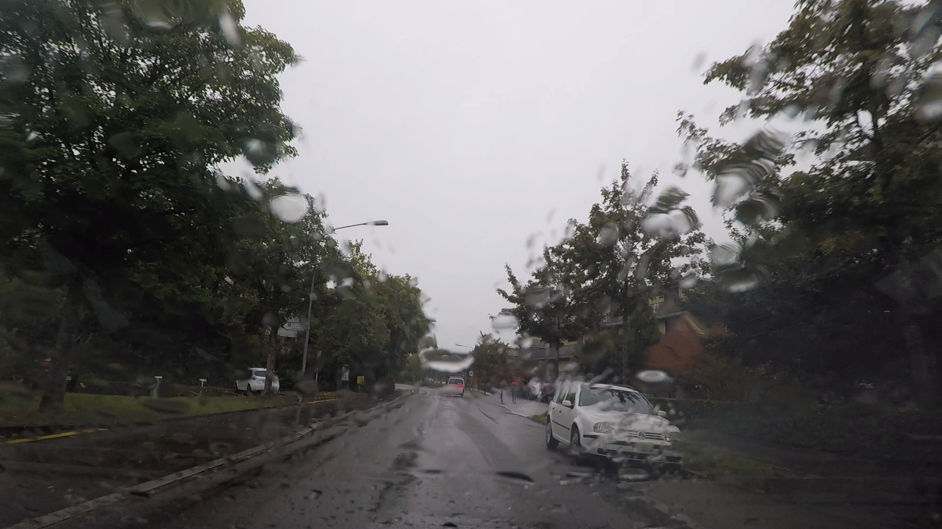
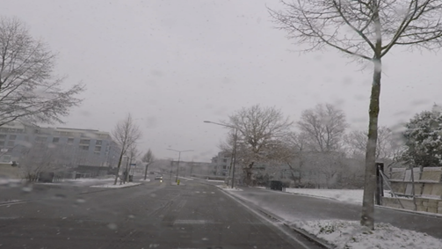


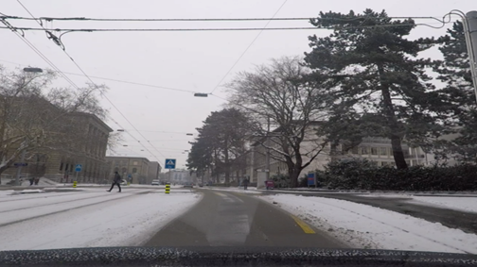
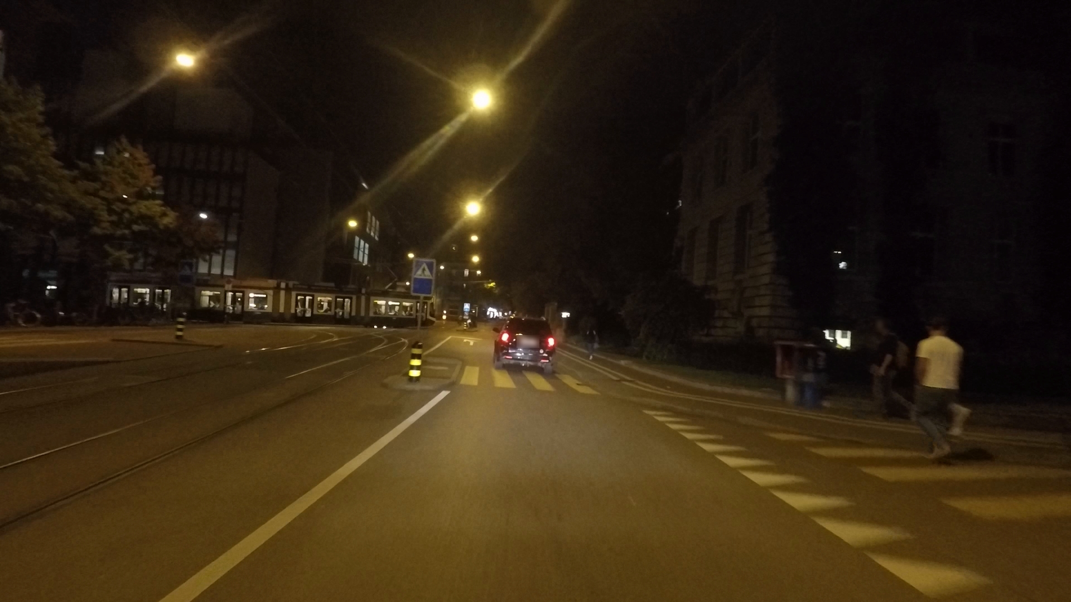


Key Challenges in Adverse Segmentation and Motivation
Why training on normal data isn’t enough
Domain Gap
A model trained on clear-day datasets performs poorly on adverse datasets because of domain gap
Rain
Fog
Manual annotation effort
~90 min per Cityscapes image ( Normal Weather)
>3 hours per ACDC image (Adverse Weather )
Adverse Data Complexity
Snow
Night
Extreme conditions (rain, fog, snow, night) distort features and make segmentation harder.
Motivation:
Safety: Autonomous driving needs reliable segmentation in all conditions to increase trust and safety.
Improve performance on Target Domain will make semantic segmentation more reliable for Autonomous Driving
Visual Images from ACDC dataset showing Adverse Weather Conditions
Rain – Fog – Snow -- Night

Slide 12
Prime Goals
Planned Steps to Achieve our prime goal
Prime Goal : A Single Semantic Segmentation model that performs well on both Weather Conditions
NORMAL WEATHER and ADVERSE WEATHER Condition like RAIN, FOG ,SNOW ,NIGHT and CLEAR WEATHER
1
Mask2Former Architecture
Use SOTA Model for Semantic Segmentation
2
Alternate-batch training using 2 Datasets
Implement Alternate training (ACDC – CS)
4 IMPLEMENTATIONS TO ACHIVE GOAL
3
Targeted encoder freezing (CS only)
Preserves clear-weather features
4
Auxiliary supervision (WAS/TAS)
Weather & Time-aware heads guide the encoder (training only)

Slide 13
Presentation Structure
Proposed Method
Slide 4 : Proposed Architecture
Slide 5 : Dataset Used
Section 2
Proposed Method
Slide 6 : Training Strategy
Slide 7 : Loss Calculation

Slide 14

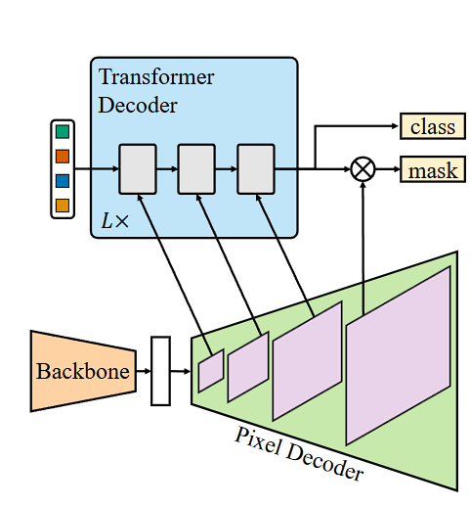
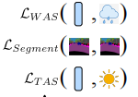
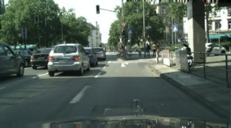

Proposed Architecture – Weather & Time Aware Mask2former
Alternate training with Mask2Former, WAS/TAS & real datasets
Mask2Former Architecture
A state-of-the-art architecture that achieving top performance on the Cityscapes dataset for semantic segmentation
Backbone chosen from Hugging Face Platform:
facebook/mask2former-swin-large-cityscapes-semantic
Multi-task Learning
Two auxiliary branches added to the encoder output:
WAS – Weather-Aware Supervisor (Rain / Fog / Snow / Clear)
TAS – Time-Aware Supervisor (Day / Night)
Input Image
Proposed Transformer-based Mask2Former Architecture
with Weather- and Time-Aware Supervision

Slide 15
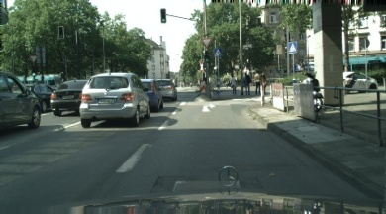
Original Mask2fomer Architecture
Input Image
Proposed Transformer-based Mask2Former Architecture
with Weather- and Time-Aware Supervision

Slide 16
During Training Phase
Backbone working
BACKBONE USED
FUNCTION
Transformer based backbone for Mask2former-swin-large- pretrained on cityscapes for semantic Segmentation task.
Avaliable on Hugging Face interface
Acts as feature Extractor for the model
Extracts low-level (edges, textures) and high-level (objects, regions) features.
Multi-scale feature maps
To the Pixel decoder. (low Resolution)
Output
Input RGB Image from
cityscapes or acdc dataset

Slide 17
During Training Phase
Pixel Decoder working
FUNCTION
The pixel decoder takes compressed features and rebuilds them into detailed pixel-level maps
A dense per-pixel feature map
sharper boundaries and finer object details
Which to the Transformer decoder
Output
Multi-scale feature maps from Backbone
Input

Slide 18
During Training Phase
Transformer Decoder working
FUNCTION
Breaks the image into regions.
Each region is handled by a separate “helper” (query).
Each helper focuses only on its own region and refine it. To produce final segmentation map
The detailed map from the pixel decoder
Input
Final Segmentation Mask with clean object masks with labels
(roads, cars, people, etc.)
Output

Slide 19
Original Mask2former Architecture
what object it found (class) Example: car, road, person, etc
Exactly where the object is in the image (mask) Located at pixel level
Output
Input Image
Complete Original Mask2fomer Architecture

Slide 20
During Training Phase
Extra WAS, TAS Outputs for Proposed Architecture
1. WAS Output
Weather-Aware Supervisor (WAS)
Input: Features from backbone.
Function: Forces encoder to learn weather-specific robust features.
Output: Predicts is it clear, rain, fog or snow weather.
2. TAS Output
Time-Aware Supervisor (TAS)
Input: Features from backbone.
Function: Forces encoder to learn illumination-aware features.
Output: Predicts is it day or night
Updated Mask2fomer Architecture with WAS+TAS

Slide 21
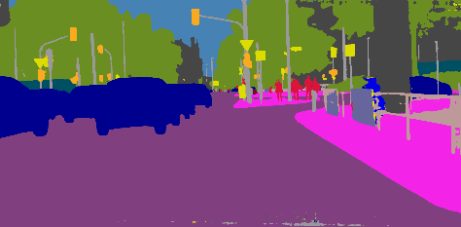
During Training Phase
What we provide and what we get
Input Image
Predicted Segmentation Map
Predicted Segmentation Map
Predicted Weather (Rain/Fog/Snow/Night)
Predicted Time (Day/Night)
We Get
Input Image
Segmentation Map (Ground Truth)
Weather Label (Ground Truth)
Time label (Ground Truth)
We provide

Slide 22
During Inference phase
What we provide and what we get
Input Image
Segmentation Map Generated by Model
Predicted Segmentation Map
We get
Input Image
We provide

Slide 23
Datasets used and Data Splits
Real-world 19-class datasets used for training, Validation and evaluation (Cityscapes + ACDC)
Cityscapes (Real, Urban, Clear Weather)
ACDC (Real, Adverse Weather)
Cityscapes official train set = 2975 images
Split into (85/15)→ For Training (85%) = 2529 images
→ For validation (15%) = 446 images
For during Evaluation only :
Cityscapes official Validation set used as Test set = 500 images
ACDC Official train set = 1600 images
Split into (85/15) → For Training (85%) = 1360
→ For Validation (15%) = 240
For during Evaluation only :
ACDC official Validation set used as Test set = 406
406 images Split like : Rain = 100 | Fog = 100 | Snow = 100 | Night = 106 )
Dataset | Weather Conditions | Classes | Train Split (85%) | Validation Split (15%) | Test split
CITYSCAPES | CLEAR, DAY TIME | 19 | 2529 | 446 | 500
ACDC | FOG, RAIN, SNOW, NIGHT | 19 | 1360 | 240 | 406

Slide 24
Proposed Method – Training Strategy
How We Teach Mask2Former : Alternate-Batch Training with Encoder Freezing
Alternate-Batch Training Strategy
Two datasets trained batch-wise in alternation: Cityscapes (clear) and ACDC (adverse)
based on batch size = 1 → Cityscapes image → ACDC image→ Cityscapes image → ACDC image→ …
Cityscapes batches
ACDC batches
Backbone Freezing but rest of model trains
Prevents overfitting to clear-weather dataset
Preserves pretrained backbone performance
Full Model Trains
Enables adaptation to adverse conditions
Encourages feature extraction on ACDC
Outcome
Maintains Cityscapes performance
Significantly Improves on ACDC Performance

Slide 25
Proposed Method – Training Strategy
During CS
Except Backbone Whole Model Train
Encoder Freezing
Alternate-Batch Training Strategy
Two datasets trained batch-wise in alternation: Cityscapes (clear) and ACDC (adverse)
based on batch size = 1 → Cityscapes image → ACDC image→ Cityscapes image → ACDC image→ …
During CS
Frozen
Not involve in Training
Cityscapes batches
ACDC batches
Backbone Freezing but rest of model trains
Prevents overfitting to clear-weather dataset
Preserves pretrained backbone performance
Full Model Trains
Enables adaptation to adverse conditions
Encourages feature extraction on ACDC
Outcome
Maintains Cityscapes performance
Significantly Improves on ACDC Performance

Slide 26
Proposed Method – Training Strategy
Encoder Freezing
Alternate-Batch Training Strategy
Two datasets trained batch-wise in alternation: Cityscapes (clear) and ACDC (adverse)
based on batch size = 1 → Cityscapes image → ACDC image→ Cityscapes image → ACDC image→ …
Cityscapes batches
ACDC batches
Backbone Freezing but rest of model trains
Prevents overfitting to clear-weather dataset
Preserves pretrained backbone performance
Full Model Trains
Enables adaptation to adverse conditions
Encourages feature extraction on ACDC
During ACDC
Whole Model Train
Outcome
During ACDC
Maintains Cityscapes performance
Significantly Improves on ACDC Performance
Not Frozen
Involve in Training

Slide 27
Proposed Method – Training Strategy
During CS
Except Backbone Whole Model Train
How We Teach Mask2Former : Alternate-Batch Training with Encoder Freezing
Alternate-Batch Training Strategy
Two datasets trained batch-wise in alternation: Cityscapes (clear) and ACDC (adverse)
based on batch size = 1 → Cityscapes image → ACDC image→ Cityscapes image → ACDC image→ …
During CS
Frozen
Not involve in Training
Cityscapes batches
ACDC batches
Backbone Freezing but rest of model trains
Prevents overfitting to clear-weather dataset
Preserves pretrained backbone performance
Full Model Trains
Enables adaptation to adverse conditions
Encourages feature extraction on ACDC
During ACDC
Whole Model Train
Outcome
During ACDC
Maintains Cityscapes performance
Significantly Improves on ACDC Performance
Not Frozen
Involve in Training

Slide 28
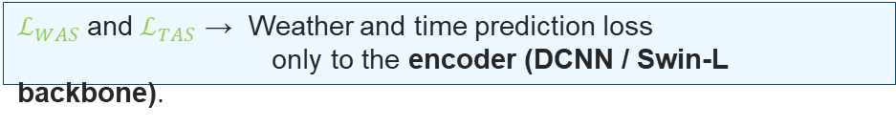
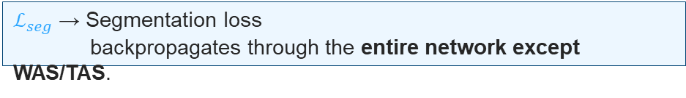
Multi-Task Learning: Weather- and Time-Aware Supervision (WAS / TAS)
How WAS and TAS functions during training
Functioning of WAS, TAS during Training:
WAS – Weather-Aware Supervisor predicts weather condition like :
-- Output → (Rain / Fog / Snow / Clear)
TAS – Time-Aware Supervisor predicts is it -- Output → (Day / Night)
Active only during training; removed during Evaluation.
Equation : $ℒ_{total}=ℒ_{seg}+αℒ_{WAS}+βℒ_{TAS}$
$ℒ_{seg}$→ Segmentation loss
backpropagates through the entire network except WAS/TAS.
During Training (Forward + Loss Computation)
Encoder outputs feature maps → passed to:
Decoder (for segmentation)
WAS and TAS (for auxiliary classification)
$ℒ_{WAS}$and${ ℒ}_{TAS}$ → Weather and time prediction loss
only to the encoder (DCNN / Swin-L backbone).
$α=β\text{→}$Loss weighting factors (1e-5)
$\text{To} \text{C}\text{ontrol} \text{the} \text{relative} \text{contribution} \text{of} \text{the} \text{auxiliary} \text{losses}$
Backpropagation & Learning Dynamic
Type: Cross-Entropy Loss (CE Loss)
3 Losses are back propagated separately
Encourage encoder to learn weather/time-sensitive robust features.

Slide 29
Slide 8 : Evaluation Metrics
Slide 9 : Baselines used
Section 3
Evaluation and Results
Slide 10 : Quantitative Results
Slide 11 : Qualitative Results

Slide 30
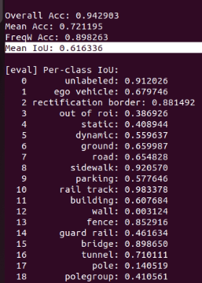
Evaluation Setup
Datasets, Metrics, and Baselines used for Performance Assessment
Evaluation
Conducted on Best Checkpoint generated during Training
Normal Weather
Cityscapes
Adverse Weather
ACDC
500 Images
406 Images
Rain =100 | Fog =100 | Snow = 100 | Night = 106
Evaluation Metric
Mean Intersection over Union (mIoU)
Standard metric for semantic segmentation (average overlap of prediction vs. ground truth).
Computed per-class (19 classes) and overall.
Reported for both datasets (Cityscapes & ACDC) using,
Mode = 11 ( for CS ) | Mode = 21 ( for ACDC )
ACDC additionally reported per weather condition (rain, fog, snow, night).
Evaluation results we get on terminal for 19 Classes

Slide 31
Quantitative Results — Evaluation Result
DeeplabV3+ vs Mask2Former Result Comparison

Slide 32
Baseline Used for Comparison
Our proposed method implemented on baseline – Deeplabv3+
Model | Backbone | Training Data | Description
Baseline DeepLabV3+ | Mobile Net V2 | Cityscapes | Reference model from the 2022 paper, trained only on Cityscapes as the standard baseline for semantic segmentation.
Baseline DeepLabV3+ | Mobile Net V2 | Cityscapes + ACDC (alternate-batch training) | DeeplabV3+ model Trained on Alternately Trained (Cityscapes ↔ ACDC)
Baseline (Proposed Method) DeeplabV3+ | Mobile Net V2 | Cityscapes + ACDC (alternate-batch training) WAS+TAS | Batch-wise alternate training (Cityscapes ↔ ACDC) Auxiliary WAS/TAS supervision for multi-task learning Encoder freezing on Cityscapes batches
Key Points
Our implementation extends the Cityscapes-trained DeeplabV3+ by adding,
alternate-batch training
encoder freezing
WAS/TAS-based multi-task learning to enhance robustness in adverse conditions

Slide 33
Baselines Used for Comparison
Comparison between baseline models and our proposed implementation for evaluation
Model | Backbone | Training Data | Description
Baseline DeepLabV3+ | Mobile Net V2 | Cityscapes | Reference model from the 2022 paper, trained only on Cityscapes as the standard baseline for semantic segmentation.
Baseline DeepLabV3+ | Mobile Net V2 | Cityscapes + ACDC (alternate-batch training) | DeeplabV3+ model Trained on Alternately Trained (Cityscapes ↔ ACDC)
Baseline (Proposed Method) DeeplabV3+ | Mobile Net V2 | Cityscapes + ACDC (alternate-batch training) WAS+TAS | Batch-wise alternate training (Cityscapes ↔ ACDC) Auxiliary WAS/TAS supervision for multi-task learning Encoder freezing on Cityscapes batches
Key Points
Our implementation extends the Cityscapes-trained DeeplabV3+ by adding,
alternate-batch training
encoder freezing
WAS/TAS-based multi-task learning to enhance robustness in adverse conditions

Slide 34
Baselines Used for Comparison
Comparison between baseline models and our proposed implementation for evaluation
Model | Backbone | Training Data | Description
Baseline DeepLabV3+ | Mobile Net V2 | Cityscapes | Reference model from the 2022 paper, trained only on Cityscapes as the standard baseline for semantic segmentation.
Baseline DeepLabV3+ | Mobile Net V2 | Cityscapes + ACDC (alternate-batch training) | DeeplabV3+ model Trained on Alternately Trained (Cityscapes ↔ ACDC)
Baseline (Proposed Method) DeeplabV3+ | Mobile Net V2 | Cityscapes + ACDC (alternate-batch training) WAS+TAS | Batch-wise alternate training (Cityscapes ↔ ACDC) Auxiliary WAS/TAS supervision for multi-task learning Encoder freezing on Cityscapes batches
Key Points
Our implementation extends the Cityscapes-trained DeeplabV3+ by adding,
alternate-batch training
encoder freezing
WAS/TAS-based multi-task learning to enhance robustness in adverse conditions

Slide 35
Quantitative Results — Evaluation Result
Results which Deeplabv3+ Baseline Achieves
Training Style
Trained on Normal Weather data
(CS only)
Training Style
Trained on Normal + Adverse weather
(CS + ACDC)
Proposed Training Style
Trained on Normal + Adverse weather
(CS + ACDC) + (WAS+TAS)

Slide 36
Baselines Used for Comparison
Comparison between baseline models and our proposed implementation for evaluation
Model | Backbone | Training Data | Description
Mask2Former | Swin-L | Cityscapes | Mask2Former SOTA model benchmarked on Cityscapes — represents the raw transformer model
Mask2Former | Swin-L | Cityscapes + ACDC (alternate-batch training) | Mask2Former model Trained on Alternately Trained (Cityscapes ↔ ACDC)
(Proposed Method) Mask2Former | Swin-L | Cityscapes + ACDC (alternate-batch training) WAS+TAS | Batch-wise alternate training (Cityscapes ↔ ACDC) Auxiliary WAS/TAS supervision for multi-task learning Encoder freezing on Cityscapes batches
Key Points
Our implementation extends the Cityscapes-trained Mask2Former by adding,
alternate-batch training
encoder freezing
WAS/TAS-based multi-task learning to enhance robustness in adverse conditions

Slide 37
Baselines Used for Comparison
Comparison between baseline models and our proposed implementation for evaluation
Model | Backbone | Training Data | Description
Mask2Former | Swin-L | Cityscapes | Mask2Former SOTA model benchmarked on Cityscapes — represents the raw transformer model
Mask2Former | Swin-L | Cityscapes + ACDC (alternate-batch training) | Mask2Former model Trained on Alternately Trained (Cityscapes ↔ ACDC)
(Proposed Method) Mask2Former | Swin-L | Cityscapes + ACDC (alternate-batch training) WAS+TAS | Batch-wise alternate training (Cityscapes ↔ ACDC) Auxiliary WAS/TAS supervision for multi-task learning Encoder freezing on Cityscapes batches
Key Points
Our implementation extends the Cityscapes-trained Mask2Former by adding,
alternate-batch training
encoder freezing
WAS/TAS-based multi-task learning to enhance robustness in adverse conditions

Slide 38
Baselines Used for Comparison
Comparison between baseline models and our proposed implementation for evaluation
Model | Backbone | Training Data | Description
Mask2Former | Swin-L | Cityscapes | Mask2Former SOTA model benchmarked on Cityscapes — represents the raw transformer model
Mask2Former | Swin-L | Cityscapes + ACDC (alternate-batch training) | Mask2Former model Trained on Alternately Trained (Cityscapes ↔ ACDC)
(Proposed Method) Mask2Former | Swin-L | Cityscapes + ACDC (alternate-batch training) WAS+TAS | Batch-wise alternate training (Cityscapes ↔ ACDC) Auxiliary WAS/TAS supervision for multi-task learning Encoder freezing on Cityscapes batches
Key Points
Our implementation extends the Cityscapes-trained Mask2Former by adding,
alternate-batch training
encoder freezing
WAS/TAS-based multi-task learning to enhance robustness in adverse conditions

Slide 39
Quantitative Results — Evaluation Result
Results which Mask2Former Achieves
Training Style
Trained on Normal Weather data
(CS only)
Training Style
Trained on Normal + Adverse weather
(CS + ACDC)
Proposed Training Style
Trained on Normal + Adverse weather
(CS + ACDC) + (WAS+TAS)

Slide 40
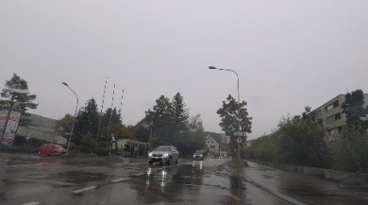
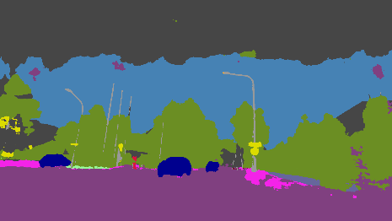
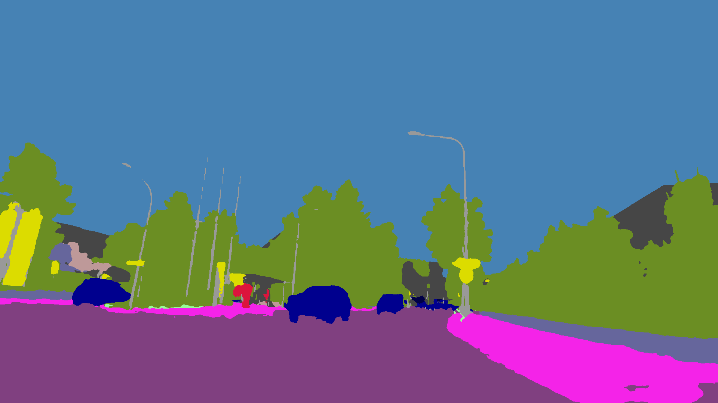
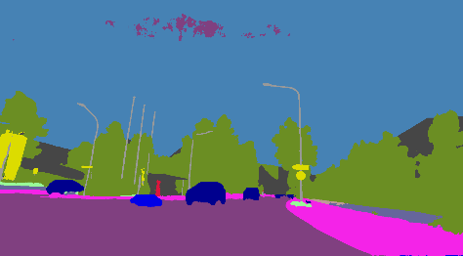
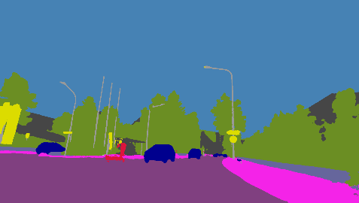
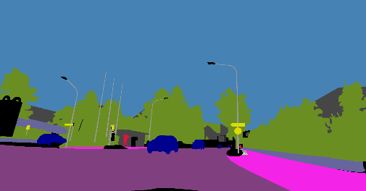
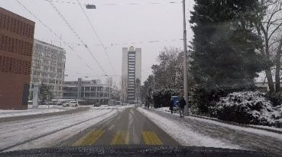
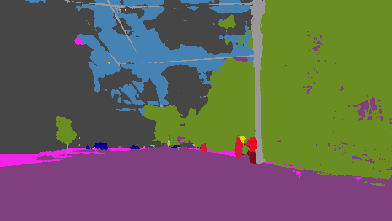
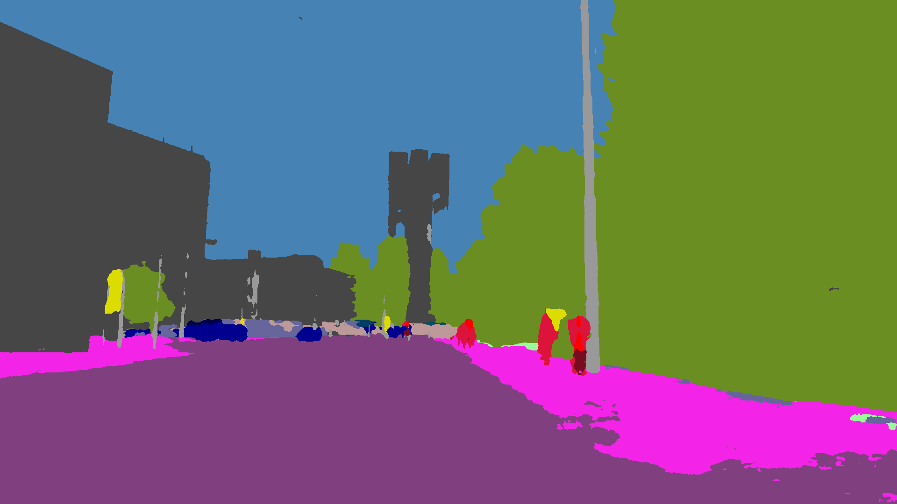
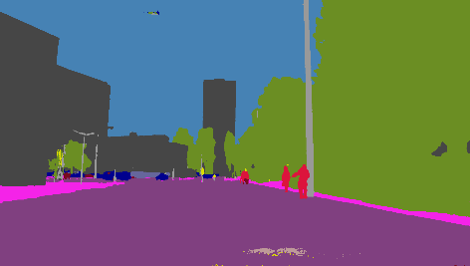
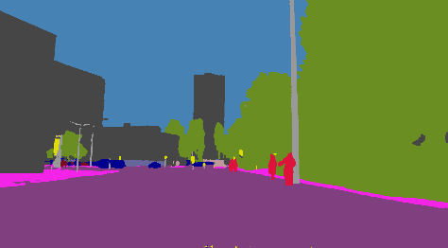
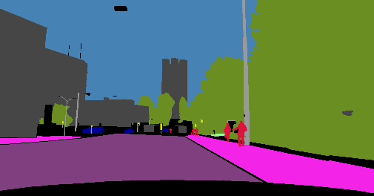
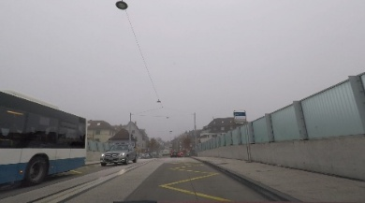
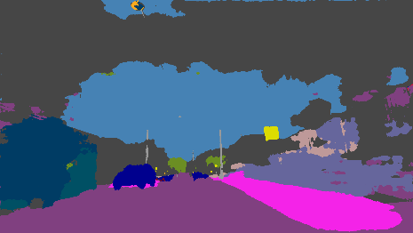
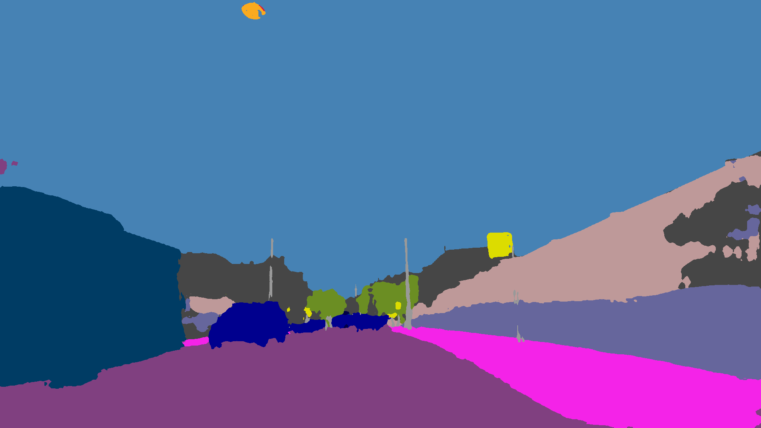
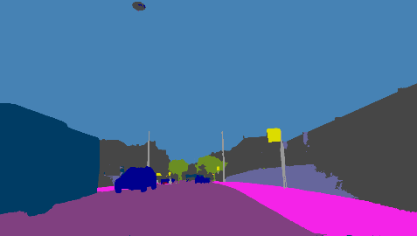
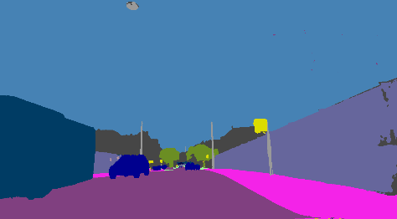
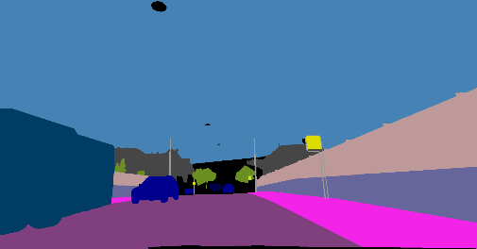
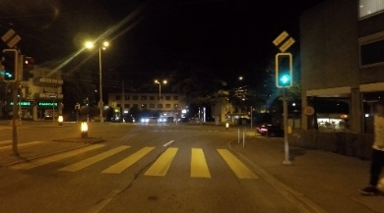
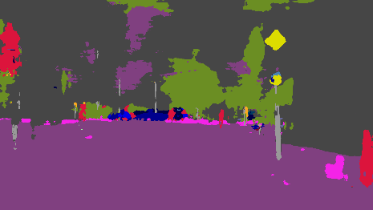
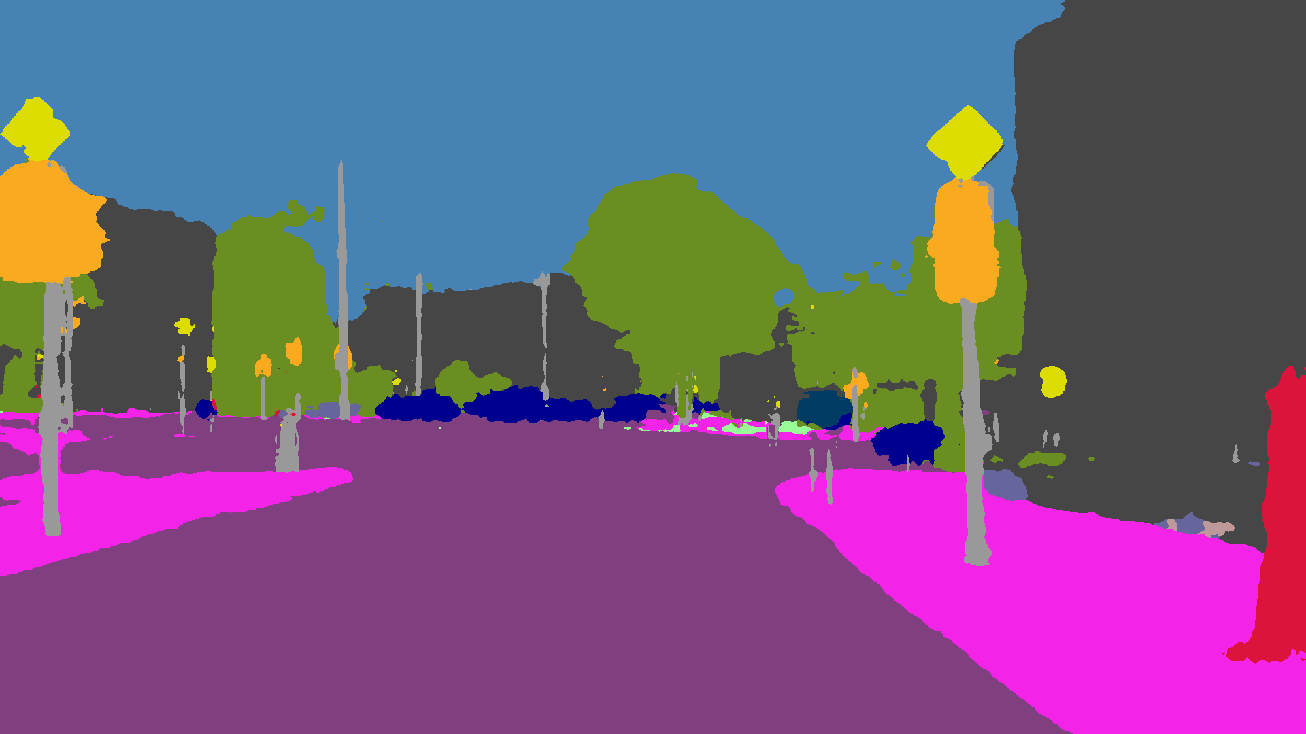
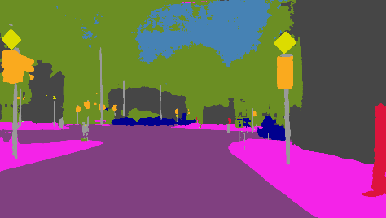
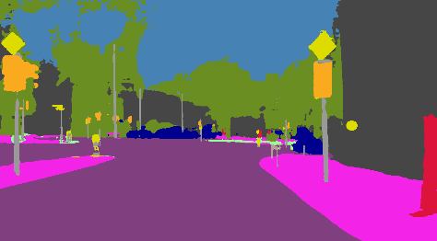
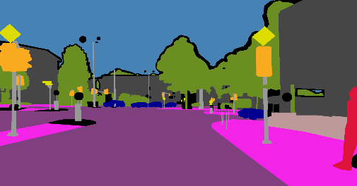
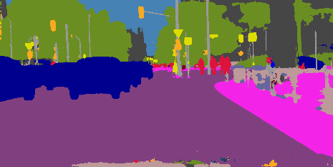

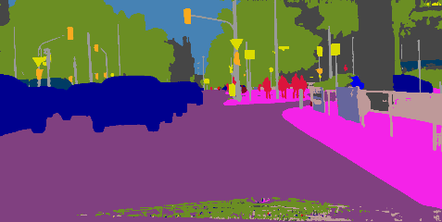
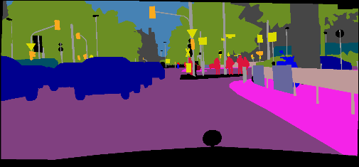
Qualitative Analysis
DeeplabV3+
CS + ACDC
(WAS + TAS)
Mask2Former
CS+ACDC (WAS+TAS)
Input Image
DeeplabV3+
CS
Mask2Former
CS
Ground Truth
RAINY
FOGGY
SNOWY
NIGHT
NORMAL

Slide 41
DeeplabV3+
CS + ACDC
(WAS + TAS)
Mask2Former
CS+ACDC (WAS+TAS)
Input Image
DeeplabV3+
CS
Mask2Former
CS
Ground Truth
RAINY
FOGGY
SNOWY
NIGHT
NORMAL

Slide 42
DeeplabV3+
CS + ACDC
(WAS + TAS)
Mask2Former
CS+ACDC (WAS+TAS)
Input Image
DeeplabV3+
CS
Mask2Former
CS
Ground Truth
RAINY
FOGGY
SNOWY
NIGHT
NORMAL

Slide 43
DeeplabV3+
CS + ACDC
(WAS + TAS)
Mask2Former
CS+ACDC (WAS+TAS)
Input Image
DeeplabV3+
CS
Mask2Former
CS
Ground Truth
RAINY
FOGGY
SNOWY
NIGHT
NORMAL

Slide 44
DeeplabV3+
CS + ACDC
(WAS + TAS)
Mask2Former
CS+ACDC (WAS+TAS)
Input Image
DeeplabV3+
CS
Mask2Former
CS
Ground Truth
RAINY
FOGGY
SNOWY
NIGHT
NORMAL

Slide 45
DeeplabV3+
CS + ACDC
(WAS + TAS)
Mask2Former
CS+ACDC (WAS+TAS)
Input Image
DeeplabV3+
CS
Mask2Former
CS
Ground Truth
RAINY
FOGGY
SNOWY
NIGHT
NORMAL

Slide 46
DeeplabV3+
CS + ACDC
(WAS + TAS)
Mask2Former
CS+ACDC (WAS+TAS)
Input Image
DeeplabV3+
CS
Mask2Former
CS
Ground Truth
RAINY
FOGGY
SNOWY
NIGHT
NORMAL

Slide 47
DeeplabV3+
CS + ACDC
(WAS + TAS)
Mask2Former
CS+ACDC (WAS+TAS)
Input Image
DeeplabV3+
CS
Mask2Former
CS
Ground Truth
RAINY
FOGGY
SNOWY
NIGHT
NORMAL

Slide 48
DeeplabV3+
CS + ACDC
(WAS + TAS)
Mask2Former
CS+ACDC (WAS+TAS)
Input Image
DeeplabV3+
CS
Mask2Former
CS
Ground Truth
RAINY
FOGGY
SNOWY
NIGHT
NORMAL

Slide 49
DeeplabV3+
CS + ACDC
(WAS + TAS)
Mask2Former
CS+ACDC (WAS+TAS)
Input Image
DeeplabV3+
CS
Mask2Former
CS
Ground Truth
RAINY
FOGGY
SNOWY
NIGHT
NORMAL

Slide 50
DeeplabV3+
CS + ACDC
(WAS + TAS)
Mask2Former
CS+ACDC (WAS+TAS)
Input Image
DeeplabV3+
CS
Mask2Former
CS
Ground Truth
RAINY
FOGGY
SNOWY
NIGHT
NORMAL

Slide 51
Slide 12 : Five Steps of Ablations
Section 4
Ablations & Conclusion
Slide 13 : Conclusion and Future work

Slide 52
Ablation Study
5 stages of ablation study and Incremental Improvements
Stages | Training Mode | Rain | Fog | Snow | Night | ACDC Overall | Cityscapes Overall
Baseline | DeepLabV3+ on CS | 0.35 | 0.47 | 0.30 | 0.11 | 0.30 | 0.71
Baseline Extension | DeeplabV3+ on (CS+ACDC) | 0.62 | 0.73 | 0.62 | 0.47 | 0.62 | 0.68
Baseline Final | DeeplabV3+ on (CS+ACDC) +WAS/TAS | 0.62 | 0.73 | 0.625 | 0.48 | 0.62 | 0.68
Original Model | Mask2Former on CS | 0.69 | 0.80 | 0.63 | 0.37 | 0.63 | 0.819
Our model Extension | Mask2Former on (CS+ACDC) | 0.803 | 0.816 | 0.798 | 0.554 | 0.762 | 0.820
Our Final model | Mask2Former on (CS+ACDC) + WAS/TAS | 0.812 | 0.825 | 0.804 | 0.578 | 0.772 | 0.829
Key Points
During Ablation all other parameters were kept same for all runs on Mask2former :
Like batch size =3 , total Iterations =90k , learning rate = 1e-5

Slide 53
Ablation Study
5 stages of ablation study and Incremental Improvements
Stages | Training Mode | Rain | Fog | Snow | Night | ACDC Overall | Cityscapes Overall
Baseline | DeepLabV3+ on CS | 0.35 | 0.47 | 0.30 | 0.11 | 0.30 | 0.71
Baseline Extension | DeeplabV3+ on (CS+ACDC) | 0.62 | 0.73 | 0.62 | 0.47 | 0.62 | 0.68
Baseline Final | DeeplabV3+ on (CS+ACDC) +WAS/TAS | 0.62 | 0.73 | 0.625 | 0.48 | 0.62 | 0.68
Original Model | Mask2Former on CS | 0.69 | 0.80 | 0.63 | 0.37 | 0.63 | 0.819
Our model Extension | Mask2Former on (CS+ACDC) | 0.803 | 0.816 | 0.798 | 0.554 | 0.762 | 0.820
Our Final model | Mask2Former on (CS+ACDC) + WAS/TAS | 0.812 | 0.825 | 0.804 | 0.578 | 0.772 | 0.829
Key Points
During Ablation all other parameters were kept same for all runs on Mask2former :
Like batch size =3 , total Iterations =90k , learning rate = 1e-5

Slide 54
Ablation Study
5 stages of ablation study and Incremental Improvements
Stages | Training Mode | Rain | Fog | Snow | Night | ACDC Overall | Cityscapes Overall
Baseline | DeepLabV3+ on CS | 0.35 | 0.47 | 0.30 | 0.11 | 0.30 | 0.71
Baseline Extension | DeeplabV3+ on (CS+ACDC) | 0.62 | 0.73 | 0.62 | 0.47 | 0.62 | 0.68
Baseline Final | DeeplabV3+ on (CS+ACDC) +WAS/TAS | 0.62 | 0.73 | 0.625 | 0.48 | 0.62 | 0.68
Original Model | Mask2Former on CS | 0.69 | 0.80 | 0.63 | 0.37 | 0.63 | 0.819
Our model Extension | Mask2Former on (CS+ACDC) | 0.803 | 0.816 | 0.798 | 0.554 | 0.762 | 0.820
Our Final model | Mask2Former on (CS+ACDC) + WAS/TAS | 0.812 | 0.825 | 0.804 | 0.578 | 0.772 | 0.829
Key Points
During Ablation all other parameters were kept same for all runs on Mask2former :
Like batch size =3 , total Iterations =90k , learning rate = 1e-5

Slide 55


Ablation Study
5 stages of ablation study and Incremental Improvements
Stages | Training Mode | Rain | Fog | Snow | Night | ACDC Overall | Cityscapes Overall
Baseline | DeepLabV3+ on CS | 0.35 | 0.47 | 0.30 | 0.11 | 0.30 | 0.71
Baseline Extension | DeeplabV3+ on (CS+ACDC) | 0.62 | 0.73 | 0.62 | 0.47 | 0.62 | 0.685
Baseline Final | DeeplabV3+ on (CS+ACDC) +WAS/TAS | 0.62 | 0.73 | 0.625 | 0.48 | 0.62 | 0.68
Original Model | Mask2Former on CS | 0.69 | 0.80 | 0.63 | 0.37 | 0.63 | 0.819
Our model Extension | Mask2Former on (CS+ACDC) | 0.803 | 0.816 | 0.798 | 0.554 | 0.762 | 0.820
Our Final model | Mask2Former on (CS+ACDC) + WAS/TAS | 0.812 | 0.825 | 0.804 | 0.578 | 0.772 | 0.829
0.30 → 0.62
0.71 → 0.68
Key Points
During Ablation all other parameters were kept same for all runs on Mask2former :
Like batch size =3 , total Iterations =90k , learning rate = 1e-5

Slide 56
Ablation Study
5 stages of ablation study and Incremental Improvements
Stages | Training Mode | Rain | Fog | Snow | Night | ACDC Overall | Cityscapes Overall
Baseline | DeepLabV3+ on CS | 0.35 | 0.47 | 0.30 | 0.11 | 0.30 | 0.71
Baseline Extension | DeeplabV3+ on (CS+ACDC) | 0.62 | 0.73 | 0.62 | 0.47 | 0.62 | 0.68
Baseline Final | DeeplabV3+ on (CS+ACDC) +WAS/TAS | 0.62 | 0.73 | 0.625 | 0.48 | 0.62 | 0.68
Original Model | Mask2Former on CS | 0.69 | 0.80 | 0.63 | 0.37 | 0.63 | 0.819
Our model Extension | Mask2Former on (CS+ACDC) | 0.803 | 0.816 | 0.798 | 0.554 | 0.762 | 0.820
Our Final model | Mask2Former on (CS+ACDC) + WAS/TAS | 0.812 | 0.825 | 0.804 | 0.578 | 0.772 | 0.829
0.30 → 0.63
0.71 → 0.82
Key Points
During Ablation all other parameters were kept same for all runs on Mask2former :
Like batch size =3 , total Iterations =90k , learning rate = 1e-5

Slide 57

Ablation Study
5 stages of ablation study and Incremental Improvements
Stages | Training Mode | Rain | Fog | Snow | Night | ACDC Overall | Cityscapes Overall
Baseline | DeepLabV3+ on CS | 0.35 | 0.47 | 0.30 | 0.11 | 0.30 | 0.71
Baseline Extension | DeeplabV3+ on (CS+ACDC) | 0.62 | 0.73 | 0.62 | 0.47 | 0.62 | 0.68
Baseline Final | DeeplabV3+ on (CS+ACDC) +WAS/TAS | 0.62 | 0.73 | 0.625 | 0.48 | 0.62 | 0.68
Original Model | Mask2Former on CS | 0.69 | 0.80 | 0.63 | 0.37 | 0.63 | 0.819
Our model Extension | Mask2Former on (CS+ACDC) | 0.803 | 0.816 | 0.798 | 0.554 | 0.762 | 0.820
Our Final model | Mask2Former on (CS+ACDC) + WAS/TAS | 0.812 | 0.825 | 0.804 | 0.578 | 0.772 | 0.829
0.63 → 0.76
0.82 → 0.82
Key Points
During Ablation all other parameters were kept same for all runs on Mask2former :
Like batch size =3 , total Iterations =90k , learning rate = 1e-5

Slide 58
Ablation Study
5 stages of ablation study and Incremental Improvements
Stages | Training Mode | Rain | Fog | Snow | Night | ACDC Overall | Cityscapes Overall
Baseline | DeepLabV3+ on CS | 0.35 | 0.47 | 0.30 | 0.11 | 0.30 | 0.71
Baseline Extension | DeeplabV3+ on (CS+ACDC) | 0.62 | 0.73 | 0.62 | 0.47 | 0.62 | 0.68
Baseline Final | DeeplabV3+ on (CS+ACDC) +WAS/TAS | 0.62 | 0.73 | 0.625 | 0.48 | 0.62 | 0.68
Original Model | Mask2Former on CS | 0.69 | 0.80 | 0.63 | 0.37 | 0.63 | 0.819
Our model Extension | Mask2Former on (CS+ACDC) | 0.803 | 0.816 | 0.798 | 0.554 | 0.762 | 0.820
Our Final model | Mask2Former on (CS+ACDC) + WAS/TAS | 0.812 | 0.825 | 0.804 | 0.578 | 0.772 | 0.829
0.63 → 0.77
14%
0.82 → 0.83
1%
Key Points
During Ablation all other parameters were kept same for all runs on Mask2former :
Like batch size =3 , total Iterations =90k , learning rate = 1e-5

Slide 59
Ablation Study
5 stages of ablation study and Incremental Improvements
Stages | Training Mode | Rain | Fog | Snow | Night | ACDC Overall | Cityscapes Overall
Baseline | DeepLabV3+ on CS | 0.35 | 0.47 | 0.30 | 0.11 | 0.30 | 0.71
Baseline Extension | DeeplabV3+ on (CS+ACDC) | 0.62 | 0.73 | 0.62 | 0.47 | 0.62 | 0.68
Baseline Final | DeeplabV3+ on (CS+ACDC) +WAS/TAS | 0.62 | 0.73 | 0.625 | 0.48 | 0.62 | 0.68
Original Model | Mask2Former on CS | 0.69 | 0.80 | 0.63 | 0.37 | 0.63 | 0.819
Our model Extension | Mask2Former on (CS+ACDC) | 0.803 | 0.816 | 0.798 | 0.554 | 0.762 | 0.820
Our Final model | Mask2Former on (CS+ACDC) + WAS/TAS | 0.812 | 0.825 | 0.804 | 0.578 | 0.772 | 0.829
0.76 → 0.77
0.82 → 0.83
Key Points
During Ablation all other parameters were kept same for all runs on Mask2former :
Like batch size =3 , total Iterations =90k , learning rate = 1e-5

Slide 60
Ablation Study
5 stages of ablation study and Incremental Improvements
Stages | Training Mode | Rain | Fog | Snow | Night | ACDC Overall | Cityscapes Overall
Baseline | DeepLabV3+ on CS | 0.35 | 0.47 | 0.30 | 0.11 | 0.30 | 0.71
Baseline Extension | DeeplabV3+ on (CS+ACDC) | 0.62 | 0.73 | 0.62 | 0.47 | 0.62 | 0.68
Baseline Final | DeeplabV3+ on (CS+ACDC) +WAS/TAS | 0.62 | 0.73 | 0.625 | 0.48 | 0.62 | 0.68
Original Model | Mask2Former on CS | 0.69 | 0.80 | 0.63 | 0.37 | 0.63 | 0.819
Our model Extension | Mask2Former on (CS+ACDC) | 0.803 | 0.816 | 0.798 | 0.554 | 0.762 | 0.820
Our Final model | Mask2Former on (CS+ACDC) + WAS/TAS | 0.812 | 0.825 | 0.804 | 0.578 | 0.772 | 0.829
0.55 → 0.58
Key Points
During Ablation all other parameters were kept same for all runs on Mask2former :
Like batch size =3 , total Iterations =90k , learning rate = 1e-5

Slide 61
Conclusion & Future Work
Research Achievements and Future Directions
A ) Research Achievement
B ) Final Results
Achieved Initial Objectives:
Successfully use Mask2Former with transformer backbone → ✔️ Achieved
Successfully alternate batch-wise training (Cityscapes ↔ ACDC) → ✔️ Achieved
Successfully Implemented selective Encoder Freezing → ✔️ Achieved
Successfully Integrate WAS/TAS auxiliary supervision → ✔️ Achieved
Main Goal:
Build a Single Model that performs well on both weather conditions Final result mIoU: 0.83 (Cityscapes), 0.77 (ACDC) → ✔️ Achieved
Summary
Improved ACDC overall mIoU by +14% vs. Mask2former baseline
Strong per-condition gains, especially in Night
Alternate training , Dataset choices and Encoder Freezing works out seamlessly and is quite promising for semantic segmentation.
Was, Tas – worked fine giving a little boost to result, further optimizing it
Achieved robustness without sacrificing clear-weather accuracy
Future Work 🔭
Extend this work on synthetic simulation datasets (e.g., CARLA, AWSS)
Extend to 2D anomaly detection under adverse weather

Slide 62
THANK YOU!

