Slide 1
DASHBOARD
File created on: 10/31/2023 9:12:30 AM

Slide 2
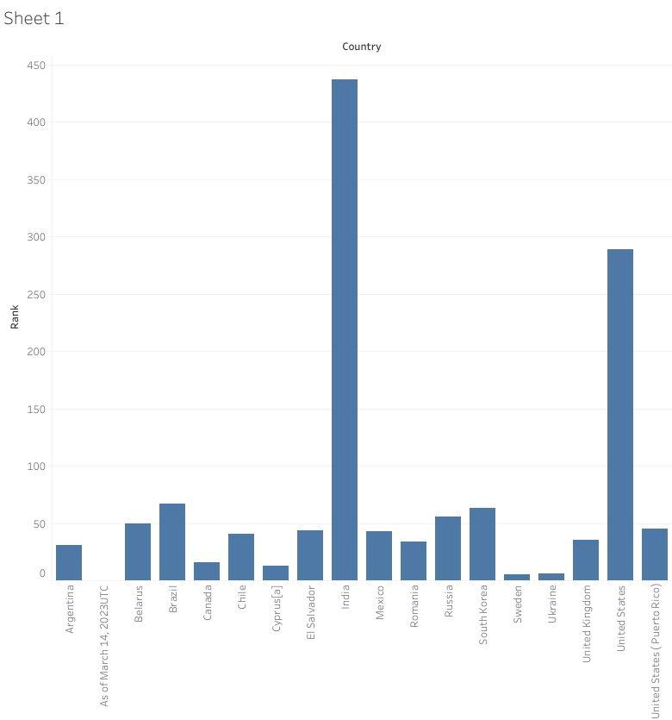

Slide 3
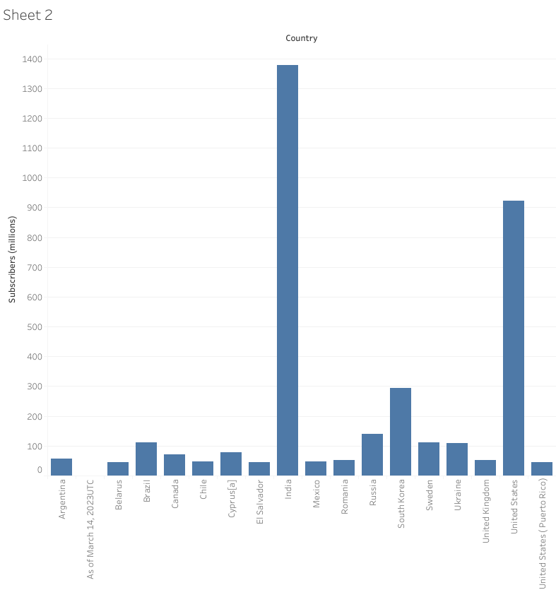

Slide 4
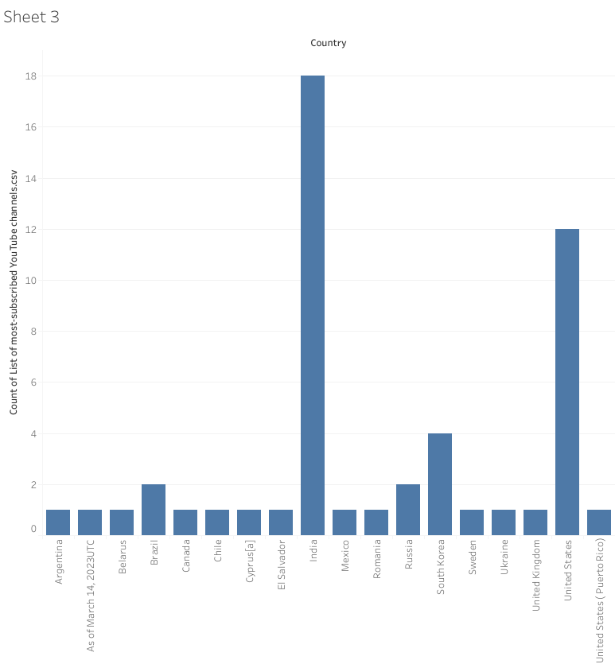

Slide 5
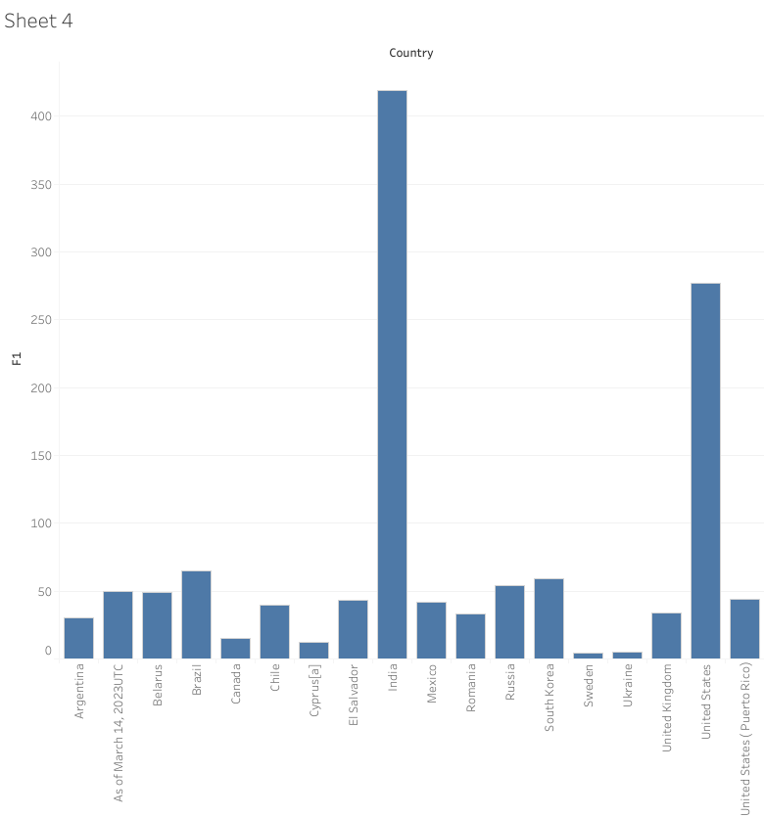

Slide 6
