Slide 1
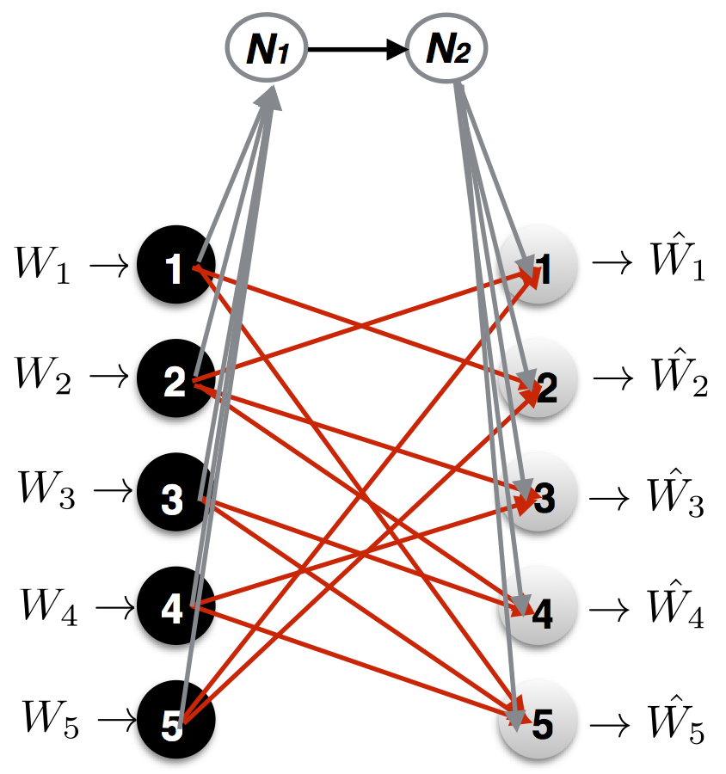
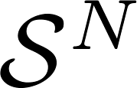


Bottleneck: the only finite-capacity link
source
1 |  | 0 | 0
 | 1 | 0 | 0
0 |  | 1 |  | 0
0 |  |  | 1 | 0
 | 0 |  |  | 1
destinations
^{Antidotes}

