Slide 1

Modelling Human Visual Attention in Dynamic Scenes
Shokoofeh Hosseini
M.sc of Computational Neuroscience at BCCN
Supervisor: Prof.Obermayer
Women’s Retreat
Winter 2025

Slide 2

Visual Scene
Notes:
Motivation (≈ 45 seconds)
Understanding visual scenes requires more than recognizing isolated objects. Humans naturally organize visual input into objects, relations, and events, and this organization strongly shapes where and how we look.

Slide 3
Visual Scene
Cat
Sofa
Table
Lamp
Objects
Notes:
Motivation (≈ 45 seconds)
Understanding visual scenes requires more than recognizing isolated objects. Humans naturally organize visual input into objects, relations, and events, and this organization strongly shapes where and how we look.

Slide 4
Visual Scene
On
Above
Under
Beside
Cat
Sofa
Table
Lamp
Objects Relations
Notes:
Motivation (≈ 45 seconds)
Understanding visual scenes requires more than recognizing isolated objects. Humans naturally organize visual input into objects, relations, and events, and this organization strongly shapes where and how we look.

Slide 5
Visual Scene
Cat
Sofa
Table
Lamp
On
Above
Under
Beside
Sitting
Seeing
Lightening
Objects Relations events
Notes:
Motivation (≈ 45 seconds)
Understanding visual scenes requires more than recognizing isolated objects. Humans naturally organize visual input into objects, relations, and events, and this organization strongly shapes where and how we look.

Slide 6
Scene Graph
Cat
Cat
Lamp
Cat
Lamp
Cat
Lamp
Cat
Lamp
Cat
Lamp
Cat
Lamp
Lamp
In front
In front
In front
In front
In front
In front
In front
on
on
on
on
on
on
on
on
on
on
on
on
on
rear
rear
behind
rear
behind
behind
behind
behind
Table
Sofa
Table
Table
Sofa
Table
Sofa
Sofa
near
near
near
near
Objects Relations events
Notes:
In parallel, modern computer vision models aim to represent scenes using scene graphs, where objects are nodes and relations are edges.

Slide 7
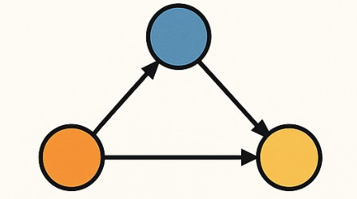
Motivation
To what extent do scene graph representations generated by computer vision models align with human visual attention patterns
Notes:
However, it remains largely unclear:
To what extent do scene graph representations generated by computer vision models align with human visual attention patterns
This lab rotation investigates whether predicted scene relations reflect the way humans perceptually organize dynamic scenes—and whether this alignment can improve both scene graph generation and human scanpath prediction.

Slide 8
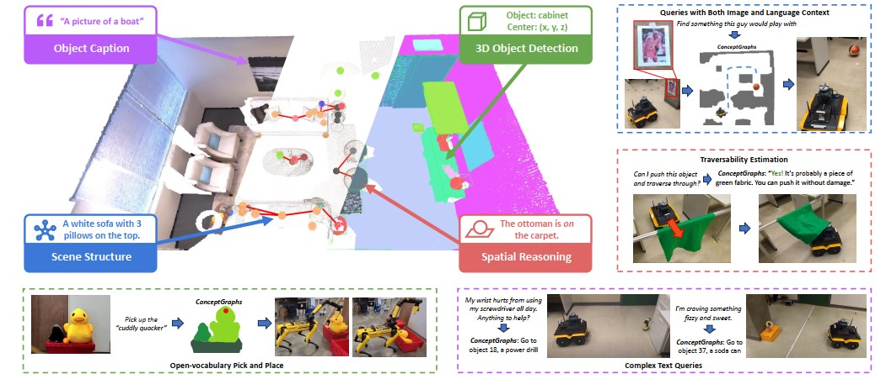
Concept Graph
Gu, Qiao, et al.
Notes:
Background I: Scene Graphs as Structured Scene Representations
Scene graph generation models aim to move beyond pixel-level representations by explicitly encoding:
objects
their attributes
and relations between them
Recent work such as ConceptGraphs demonstrates that graph-based representations provide a compact, semantically rich abstraction of visual scenes, enabling spatial reasoning, language queries, and planning.
ConceptGraphs show that scene understanding can be formulated as:
nodes: objects
edges: relations inferred from spatial and semantic cues
This provides a natural computational counterpart to human perceptual organization, which is also relational and object-centered.
However, these models are typically evaluated using vision benchmarks, not against human attentional behavior

Slide 9
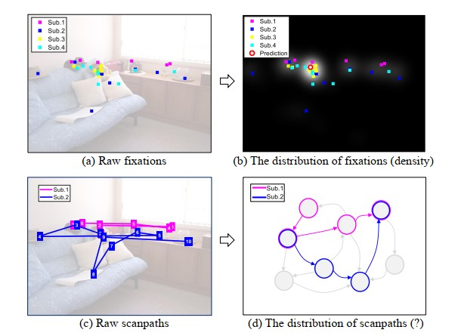
Graph-based Attention
Kai-Fu Yang et al
Notes:
Background II: Object-Based and Graph-Based Attention
From the cognitive side, eye-tracking research suggests that gaze is not random nor purely stimulus-driven.
The Attention Graph framework proposes that:
gaze behavior can be represented as transitions between:
semantic objects
fixations cluster on objects
scanpaths reflect structured movement on an object graph
By constructing graph-based representations of eye movements, Attention Graphs capture common attentional structure across observers, reducing noise inherent in raw gaze data
this suggests a natural bridge:
If humans attend to scenes via object graphs, then scene graph models may reflect attentional structure

Slide 10
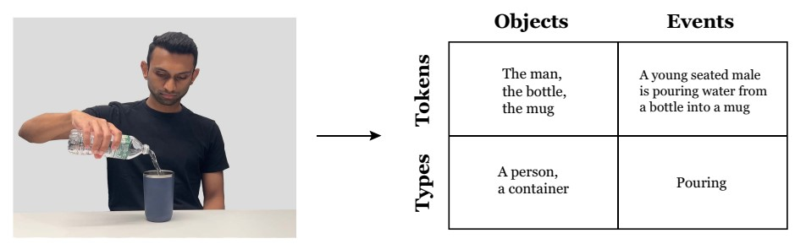
Dynamic Scenes, Event-Type (Visual Verbs)
Huichao Ji et al
Notes:
4. Background III: Event Structure and Dynamic Scene Understanding (≈ 1 min)
Dynamic scenes introduce an additional layer of complexity: time.
The Visual Verbs framework demonstrates that humans spontaneously segment continuous motion into discrete event types, such as pouring, rolling, or bouncing—even when events are task-irrelevant.
These event categories:
influence visual working memory
shape perceptual sensitivity
and likely modulate gaze behavior over time
This implies that attention is guided not only by objects and relations, but also by the type of event unfolding in the scene.
Yet, event structure is largely absent from both scene graph evaluation and gaze prediction models

Slide 11
Research Gap:
Scene graph models are rarely evaluated against human attentional organization
Gaze prediction models often ignore explicit object relations
Event-level structure is largely missing from both domains
Notes:
despite advances in both computer vision and cognitive science, three gaps remain:
Scene graph models are rarely evaluated against human attentional organization
Gaze prediction models often ignore explicit object relations
Event-level structure is largely missing from both domains
This project directly addresses these gaps by asking:
How closely do predicted scene graph relations align with graph-based representations of human eye movements in dynamic scenes?

Slide 12
Research Gap:
Scene graph models are rarely evaluated against human attentional organization
Gaze prediction models often ignore explicit object relations
Event-level structure is largely missing from both domains
This project directly addresses these gaps by asking:
How closely do predicted scene graph relations align with graph-based representations of human eye movements in dynamic scenes?
Notes:
despite advances in both computer vision and cognitive science, three gaps remain:
Scene graph models are rarely evaluated against human attentional organization
Gaze prediction models often ignore explicit object relations
Event-level structure is largely missing from both domains
This project directly addresses these gaps by asking:
How closely do predicted scene graph relations align with graph-based representations of human eye movements in dynamic scenes?

Slide 13
Proposed Method
Graph-Based Representation of Human Gaze
Create attentional graph based on eye movement data
Notes:
. Graph-Based Representation of Human Gaze
Eye-tracking data is projected onto scene objects
Human scanpaths are represented as attention graphs
nodes: objects
edges: gaze transitions
2. Scene Graph Generation
For the same visual scenes, scene graphs are generated using computer vision models
These graphs encode predicted object relations
3. Graph Alignment and Analysis
Structural and semantic correspondences between:
human attention graphs
predicted scene graphs
are quantitatively compared
This allows us to assess:
whether relations predicted by models reflect human perceptual organization
and whether these relations can improve human scanpath prediction

Slide 14
Proposed Method
Graph-Based Representation of Human Gaze
Create attentional graph based on eye movement data
Scene Graph Generation
Using computer vision models which encode predicted object relations
Notes:
. Graph-Based Representation of Human Gaze
Eye-tracking data is projected onto scene objects
Human scanpaths are represented as attention graphs
nodes: objects
edges: gaze transitions
2. Scene Graph Generation
For the same visual scenes, scene graphs are generated using computer vision models
These graphs encode predicted object relations
3. Graph Alignment and Analysis
Structural and semantic correspondences between:
human attention graphs
predicted scene graphs
are quantitatively compared
This allows us to assess:
whether relations predicted by models reflect human perceptual organization
and whether these relations can improve human scanpath prediction

Slide 15
Proposed Method
Graph-Based Representation of Human Gaze
Create attentional graph based on eye movement data
Scene Graph Generation
Using computer vision models which encode predicted object relations
Graph Alignment and Analysis
Human attention graphs
Predicted scene graphs
Notes:
. Graph-Based Representation of Human Gaze
Eye-tracking data is projected onto scene objects
Human scanpaths are represented as attention graphs
nodes: objects
edges: gaze transitions
2. Scene Graph Generation
For the same visual scenes, scene graphs are generated using computer vision models
These graphs encode predicted object relations
3. Graph Alignment and Analysis
Structural and semantic correspondences between:
human attention graphs
predicted scene graphs
are quantitatively compared
This allows us to assess:
whether relations predicted by models reflect human perceptual organization
and whether these relations can improve human scanpath prediction

Slide 16
Expected Contribution
Human gaze in dynamic scenes is guided by object relations and event structure
Scene graph representations can be evaluated through alignment with human attention
Integrating attentional data may improve scene graph models and vice versa
Notes:
Overall, this project bridges scene graph generation, visual attention, and event perception, providing a cognitively grounded framework for understanding dynamic scene representation.

Slide 17
Thanks for your Attention
Any Question?

