Slide 1

DataFlow AI: Unified Conversational Data Analytics Platform
Transforming data into actionable insights through intuitive natural language interactions.

Slide 2
Capstone Project Proposal: DataFlow AI
This presentation outlines the proposal for "DataFlow AI," a multi-agent, multi-model conversational data analytics platform designed for seamless integration with existing Business Intelligence (BI) tools. Developed end-to-end on AWS, this project aims to provide a comprehensive solution for data ingestion, processing, analysis, and insightful reporting through natural language interactions.
1
Topic & Description
A crisp description of our intent: To build an intelligent platform that simplifies the entire data lifecycle using conversational AI, from raw data to actionable insights.
2
Proposed Architecture
A simple, single-page diagram/description of our project's technical blueprint.
3
Milestone 1 for Credits
Defining the stage where AWS credits become essential for project progression after local development.
4
Overall Timeline
A detailed plan covering the approximate four-week capstone duration, aligning with credit expiry.
5
Group Members & Responsibilities
Clearly outlining team roles and ensuring equitable contribution for successful project completion.

Slide 3

DataFlow AI: Core Value Proposition
DataFlow AI revolutionizes data interaction by providing an intelligent, conversational platform. It streamlines the entire data lifecycle, from raw ingestion to actionable insights, through intuitive natural language. Seamlessly integrating with existing BI tools, it empowers users to extract, analyse, and visualise data without extensive technical expertise.
Natural Language Interaction
BI Tools Integration
Data Lifecycle Transformation

Slide 4
Proposed Multi-Agent Architecture
The DataFlow AI platform features a consolidated multi-agent architecture designed for robust and scalable data analytics. This layered approach ensures efficient handling of various data processes and intelligent interactions.
Orchestration Layer
Discovery Agent
Auto-detect data sources and BI tools
System Setup
Integration Agent
Manage cross-platform connectivity and authentication
Connectivity
Monitoring Agent
System health, error recovery, and performance tracking
Maintenance
Processing Layer
Ingestion Agent
Data collection and validation
Data Intake
Transformation Agent
Cleaning, standardization, and feature engineering
Data Prep
Analysis Agent
Statistical analysis, trend detection, anomaly identification
Insights
Intelligence Layer
Recommendation Agent
Suggest optimal visualizations and insights
Guidance
Generation Agent
Create dashboards and reports
Reporting
Narrative Agent
Generate contextual explanations and summaries
Context
Distribution Layer
Export Agent
Multi-format export to BI tools
Output
Report Agent
Automated scheduling and distribution
Automation
Conversational Agent
Natural language interface and workflow orchestration
User Interface

Slide 5
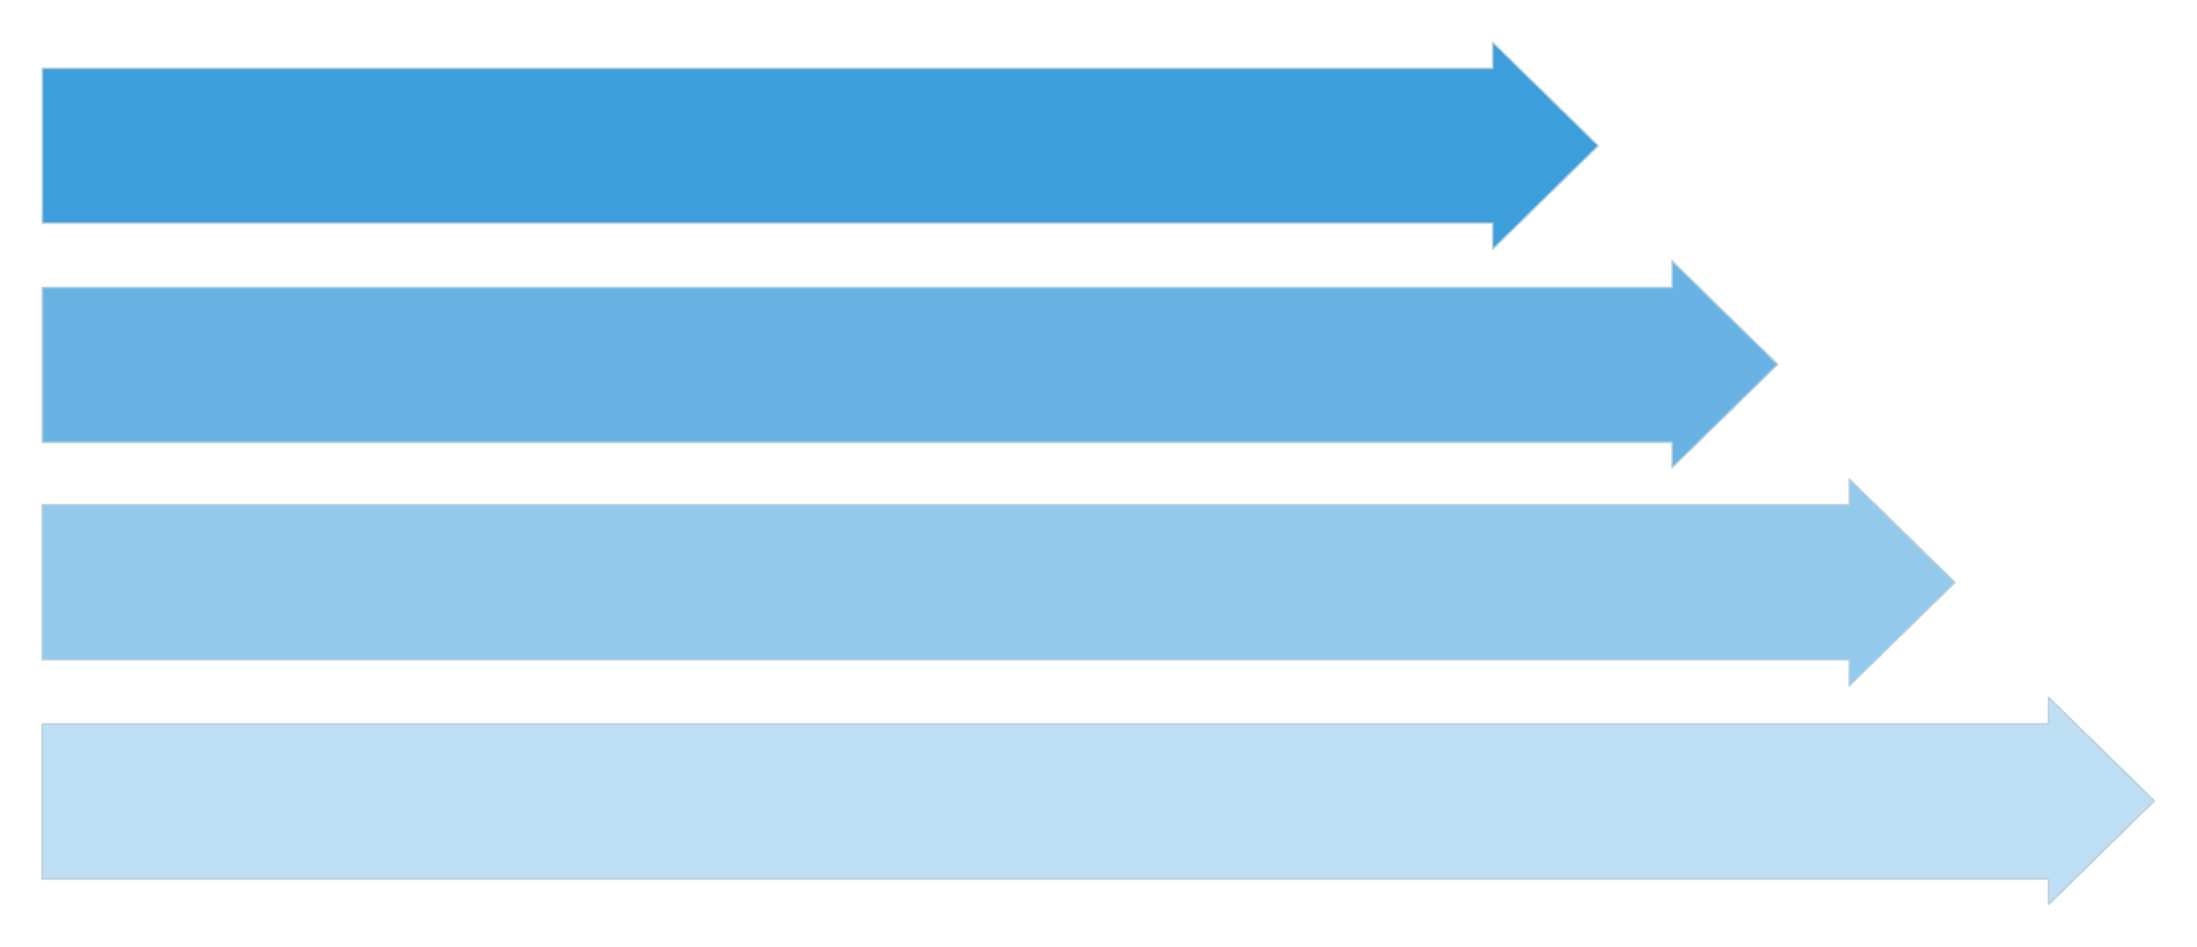
DataFlow AI: Multi-Agent Architecture Overview
DataFlow AI's consolidated multi-agent architecture is designed for scalable and intelligent data analytics. Each layer plays a crucial role in transforming raw data into actionable insights through seamless, conversational interactions.
Orchestration
Processing
Intelligence
Distribution
This layered approach ensures robust data handling, from initial discovery and ingestion to advanced analysis, insight generation, and automated reporting.

Slide 6
Agentic Workflow Summary (Step-by-Step)
Step 1: User Interaction via Conversational Agent
User types a question or request (e.g., “Show sales trend for Q2 2023”).
Natural language gets parsed and routed to orchestration.
Step 2: Orchestration Layer
Discovery Agent finds the right data sources and available BI tools.
Integration Agent handles auth/API setup.
Monitoring Agent tracks performance and failures.
Step 3: Data Processing
Ingestion Agent pulls raw data (CSV, DB, S3, APIs).
Transformation Agent cleans, standardizes, and prepares data.
Analysis Agent runs stats, finds patterns, and detects anomalies.
Step 4: Intelligence Layer
Recommendation Agent suggests chart types or KPIs.
Generation Agent builds dashboards.
Narrative Agent adds contextual summaries (e.g., “Sales dropped by 12% in Q2”).
Step 5: Distribution Layer
Export Agent sends visualizations to Tableau, Power BI, Qlik, Excel, Looker, Incorta, etc.
Report Agent schedules recurring reports or exports in formats like PDF/Excel.
Step 6: Output & Feedback
The Conversational Agent presents the output in the UI.
User can refine or follow up, continuing the loop.

Slide 7





Milestone 1: Ready for AWS Credits
To secure AWS credits and transition our project to the cloud, Milestone 1 focuses on completing all feasible local development. This ensures we've maximised offline progress before leveraging AWS services for scalable architecture and real-world integration.
Functional Agent Framework
Basic Data Ingestion
Establish the foundational communication protocols and basic inter-agent messaging system.
Implement initial data ingestion pipelines from at least two local sources (e.g., CSV, dummy database).
Simple Conversational Prototype
Local Simulation Complete
Develop a basic natural language interface that can accept rudimentary queries and return predefined responses.
All modules capable of local testing have been thoroughly validated and are ready for cloud-based scalability.
Upon achieving these milestones, we will be poised to move our scalable components to AWS, leveraging the allocated credits for advanced services.

Slide 8




Overall Timeline: 4-Week Development Breakdown
Our comprehensive 4-week timeline is designed to ensure the successful delivery of DataFlow AI, considering MVP development typically takes 4-8 weeks for complex systems and API integrations range from days to weeks. This detailed plan maximises efficiency within the capstone timeframe.
Week 1: Foundation & Core Architecture
Set up AWS EC2/Docker, implement basic agent communication, create S3 data lake, develop supervisor logic, build React/Vue UI, and establish BI API authentication.
Week 2: Core Agent Development
Develop Discovery, Ingestion, Transformation agents, basic analysis, inter-agent protocols, integrate LLM APIs for query parsing, and conduct unit testing.
Week 3: Intelligence & Visualization
Complete Analysis, Recommendation, Generation (dashboard creation), and Export agents; develop Tableau/Power BI connectors, Excel/PDF export, and dashboard preview.
Week 4: Integration, Polish & Deployment
End-to-end testing, performance optimisation, UI/UX improvements, documentation, AWS deployment configuration, production setup, and final bug fixes.
This aggressive yet realistic timeline prioritises core functionality, ensuring a functional MVP by the credit expiry on August 31st.

Slide 9
Feasibility & Risk Mitigation
Our thorough assessment indicates that DataFlow AI is achievable within the 4-week timeframe, supported by existing infrastructure and robust mitigation strategies for potential challenges.
Factors Supporting Feasibility
Risk Mitigation Strategies
Existing Infrastructure: AWS EC2/S3 provides a scalable foundation.
MVP Approach: Focus on 2-3 core BI integrations initially, expand if time permits.
Available APIs: Major BI tools offer well-documented APIs.
Modular Design: Each agent can be developed and tested independently.
Open Source Libraries: Extensive Python ecosystem for data processing and BI integrations.
Existing Libraries: Utilise proven libraries like tableauserverclient, openpyxl.
LLM APIs: Leverage existing conversational AI services, no custom model training needed.
Simplified Conversational AI: Prioritise structured queries over complex NLU for initial build.
Parallel Development: Multi-agent architecture enables concurrent team work.
Technical validation from research confirms multi-agent systems can be developed within 4-8 weeks for MVPs, and API integrations typically take 1-4 weeks.

Slide 10


Team Structure & Success Metrics
Team Members-
Abhishek Karn, Amitabh Gupta, Shubhangi Mishra and Vibhanshu Ray. Link to GitHub Repo: https://github.com/SHMISHRA666/DataFlow-AI-Unified-Conversational-Data-Analytics-Platform
Key Success Deliverables
Week 1
Functional Agent Framework
Week 2
Working Data Pipeline
Week 3
Dashboard & Export
Week 4
Complete System

Slide 11








Conclusion: DataFlow AI - Achievable & Impactful
DataFlow AI is a technically sound and highly achievable capstone project within the 4-week timeframe. Our strategic focus on core functionality, parallel development, and leveraging existing tools ensures a successful outcome. This project will deliver a significant, practical application in the realm of conversational data analytics.
Scope Management
Parallel Development
Focus on core functionality first, expanding features incrementally to meet deadlines.
Leverage the multi-agent architecture for simultaneous team work and faster progress.
MVP Mindset
Existing Tools
Prioritise delivering a working system first, then enhance features incrementally.
Utilise proven libraries and APIs to accelerate development and reduce complexities.
We are confident that DataFlow AI will be a valuable and compelling capstone project, demonstrating advanced skills in AI, cloud computing, and data engineering.

