Slide 1
CSCE 3110
Data Structures & Algorithm Analysis
Rada Mihalcea
http://www.cs.unt.edu/~rada/CSCE3110
Graphs (I)
Reading: Chap.9, Weiss

Slide 2
What is a Graph?
A graph G = (V,E) is composed of:
V: set of vertices
E: set of edges connecting the vertices in V
An edge e = (u,v) is a pair of vertices
Example:
a
b
V= {a,b,c,d,e}
E= {(a,b),(a,c),(a,d),
(b,e),(c,d),(c,e),
(d,e)}
c
d
e

Slide 3
Applications
electronic circuits
networks (roads, flights, communications)
CS16
JFK
LAX
LAX
STL
HNL
DFW
FTL

Slide 4

Terminology:
Adjacent and Incident
If (v0, v1) is an edge in an undirected graph,
  v0 and v1 are adjacent
  The edge (v0, v1) is incident on vertices v0 and v1
If <v0, v1> is an edge in a directed graph
  v0 is adjacent to v1, and v1 is adjacent from v0
  The edge <v0, v1> is incident on v0 and v1

Slide 5
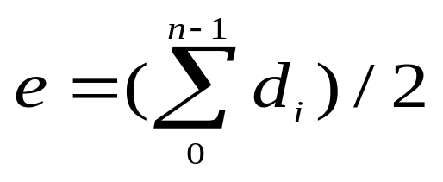
Terminology:
Degree of a Vertex
The degree of a vertex is the number of edges incident to that vertex
For directed graph,
  the in-degree of a vertex v is the number of edges
  that have v as the head
  the out-degree of a vertex v is the number of edges
  that have v as the tail
  if di is the degree of a vertex i in a graph G with n vertices and e edges, the number of edges is
Why? Since adjacent vertices each
count the adjoining edge, it will be
counted twice

Slide 6
Examples
0
3
2
0
1
2
3
3
3
1
2
3
3
4
5
6
G1
1
1
1
3
G2
1
3
0
in:1, out: 1
directed graph
in-degree
out-degree
1
in: 1, out: 2
2
in: 1, out: 0
G3

Slide 7
Terminology:
Path
path: sequence of vertices v₁,v₂,. . .v_{k} such that consecutive vertices v_{i} and v_{i+1} are adjacent.
3
2
3
3
3
a
b
a
b
c
c
d
e
d
e
a b e d c
b e d c

Slide 8
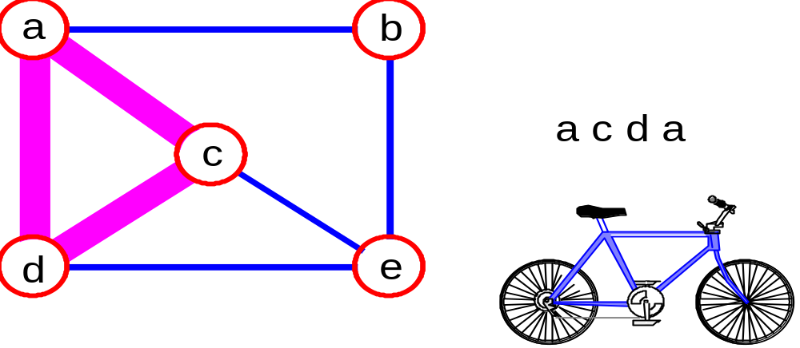
More Terminology
simple path: no repeated vertices
cycle: simple path, except that the last vertex is the same as the first vertex
a
b
b e c
c
d
e

Slide 9
Even More Terminology
connected graph: any two vertices are connected by some path
connected
not connected
subgraph: subset of vertices and edges forming a graph
connected component: maximal connected subgraph. E.g., the graph below has 3 connected components.

Slide 10
Subgraphs Examples
0
0
0
1
2
0
1
2
1
2
3
1
2
3
G1
(i) (ii) (iii) (iv)
(a) Some of the subgraph of G₁
3
0
0
0
0
0
1
1
1
1
2
2
2
(i) (ii) (iii) (iv)
(b) Some of the subgraph of G₃
G3

Slide 11
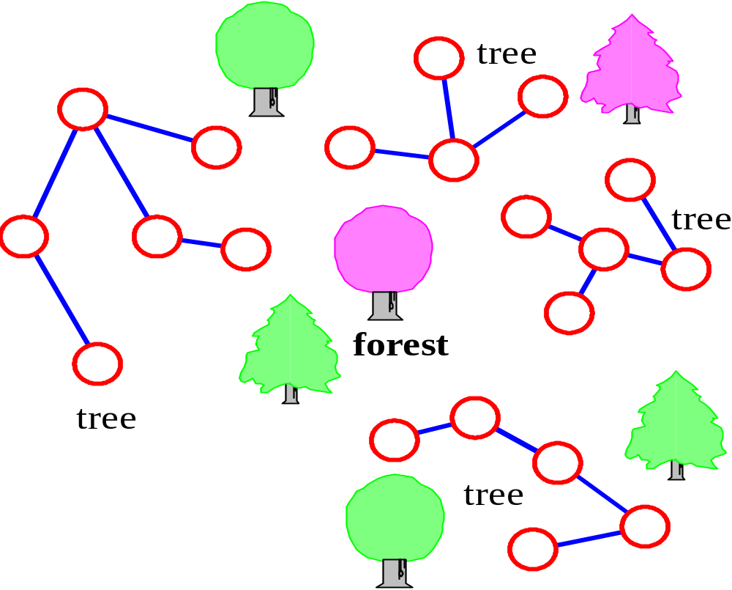
More…
tree - connected graph without cycles
forest - collection of trees

Slide 12
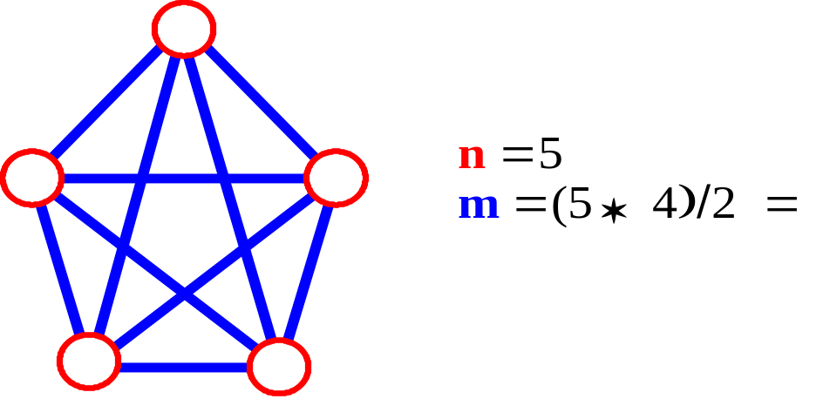

Connectivity
Let n = #vertices, and m = #edges
A complete graph: one in which all pairs of vertices are adjacent
How many total edges in a complete graph?
  Each of the n vertices is incident to n-1 edges, however, we would have counted each edge twice! Therefore, intuitively, m = n(n -1)/2.
Therefore, if a graph is not complete, m < n(n -1)/2

Slide 13
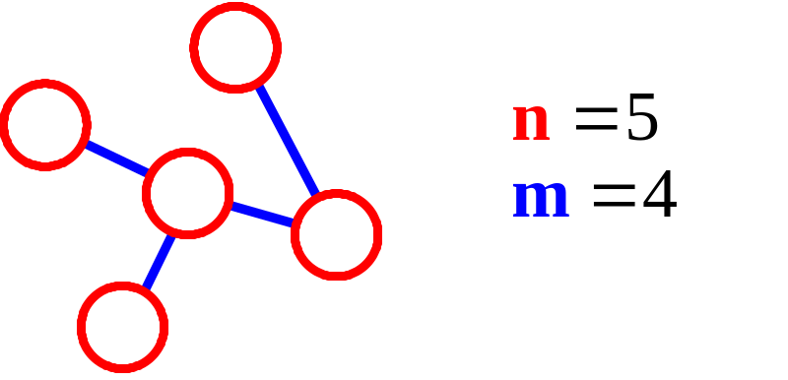
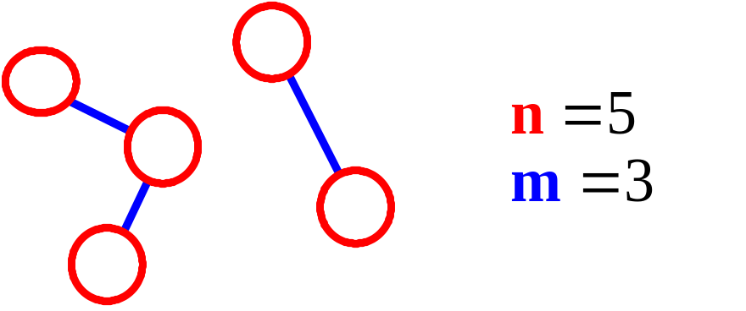
More Connectivity
n = #vertices
m = #edges
For a tree m = n - 1
If m < n - 1, G is not connected

Slide 14
Oriented (Directed) Graph
A graph where edges are directed

Slide 15
Directed vs. Undirected Graph
An undirected graph is one in which the pair of vertices in a edge is unordered, (v0, v1) = (v1,v0)
A directed graph is one in which each edge is a directed pair of vertices, <v0, v1> != <v1,v0>
tail
head

Slide 16
ADT for Graph
objects: a nonempty set of vertices and a set of undirected edges, where each
edge is a pair of vertices
functions: for all graph ∈ Graph, v, v₁ and v₂ ∈ Vertices
Graph Create()::=return an empty graph
Graph InsertVertex(graph, v)::= return a graph with v inserted. v has no
incident edge.
Graph InsertEdge(graph, v1,v2)::= return a graph with new edge
between v1 and v2
Graph DeleteVertex(graph, v)::= return a graph in which v and all edges
incident to it are removed
Graph DeleteEdge(graph, v1, v2)::=return a graph in which the edge (v1, v2)
is removed
Boolean IsEmpty(graph)::= if (graph==empty graph) return TRUE
else return FALSE
List Adjacent(graph,v)::= return a list of all vertices that are adjacent to v

Slide 17
Graph Representations
Adjacency Matrix
Adjacency Lists

Slide 18
Adjacency Matrix
Let G=(V,E) be a graph with n vertices.
The adjacency matrix of G is a two-dimensional
n by n array, say adj_mat
If the edge (vi, vj) is in E(G), adj_mat[i][j]=1
If there is no such edge in E(G), adj_mat[i][j]=0
The adjacency matrix for an undirected graph is symmetric; the adjacency matrix for a digraph
need not be symmetric

Slide 19
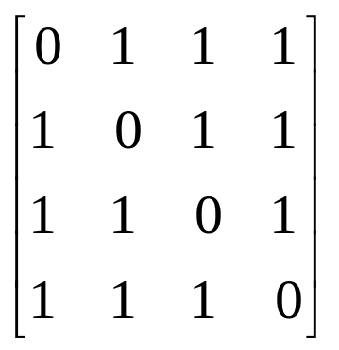
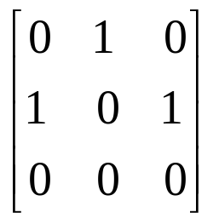
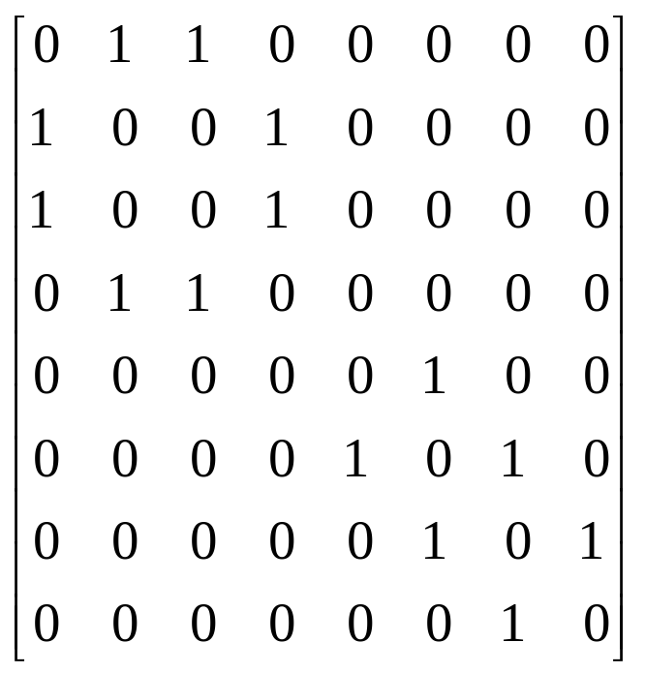
Examples for Adjacency Matrix
0
0
4
0
2
1
5
1
2
3
6
3
1
7
2
G2
G1
symmetric
undirected: n²/2
directed: n²
G4

Slide 20
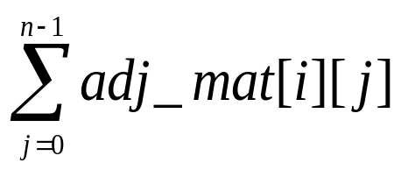
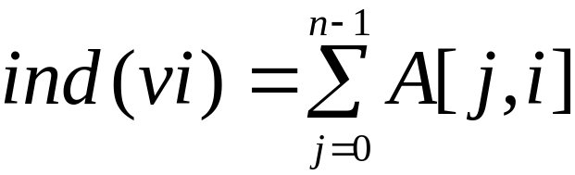
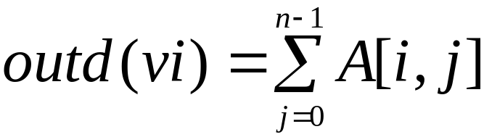
Merits of Adjacency Matrix
From the adjacency matrix, to determine the connection of vertices is easy
The degree of a vertex is
For a digraph (= directed graph), the row sum is the out_degree, while the column sum is the in_degree

Slide 21
Adjacency Lists (data structures)
Each row in adjacency matrix is represented as an adjacency list.

Slide 22
0
0
4
2
1
5
1
2
3
6
3
7
0
1
2
3
1
2
3
0
1
2
3
4
5
6
7
1
2
0
2
3
0
3
0
1
3
0
3
0
1
2
1
2
G1
0
5
4
6
0
1
2
1
5
7
0
2
1
6
G3
G4
2
An undirected graph with n vertices and e edges ==> n head nodes and 2e list nodes

Slide 23
Some Operations
degree of a vertex in an undirected graph
  # of nodes in adjacency list
# of edges in a graph
  determined in O(n+e)
out-degree of a vertex in a directed graph
  # of nodes in its adjacency list
in-degree of a vertex in a directed graph
  traverse the whole data structure

Slide 24
Graph Traversal
Problem: Search for a certain node or traverse all nodes in the graph
Depth First Search
  Once a possible path is found, continue the search until the end of the path
Breadth First Search
  Start several paths at a time, and advance in each one step at a time

Slide 25
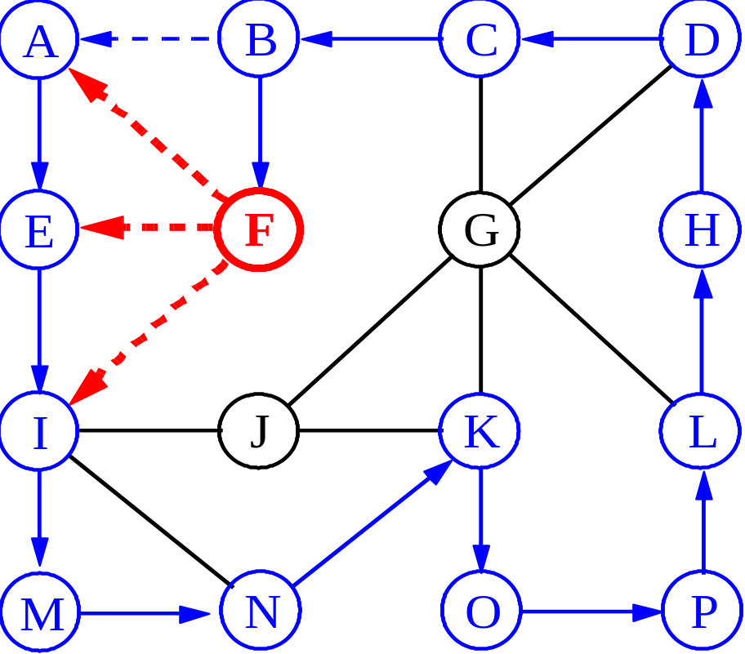
Depth-First Search

Slide 26
Exploring a Labyrinth
Without Getting Lost
A depth-first search (DFS) in an undirected graph G is like wandering in a labyrinth with a string and a can of red paint without getting lost.
We start at vertex s, tying the end of our string to the point and painting s “visited”. Next we label s as our current vertex called u.
Now we travel along an arbitrary edge (u, v).
If edge (u, v) leads us to an already visited vertex v we return to u.
If vertex v is unvisited, we unroll our string and move to v, paint v “visited”, set v as our current vertex, and repeat the previous steps.

Slide 27
Depth-First Search
Algorithm DFS(v); Input: A vertex v in a graph
Output: A labeling of the edges as “discovery” edges and “backedges”
for each edge e incident on v do
if edge e is unexplored then let w be the other endpoint of e
if vertex w is unexplored then label e as a discovery edge
recursively call DFS(w)
else label e as a backedge

Slide 28
Breadth-First Search
Like DFS, a Breadth-First Search (BFS) traverses a connected component of a graph, and in doing so defines a spanning tree with several useful properties.
The starting vertex s has level 0, and, as in DFS, defines that point as an “anchor.”
In the first round, the string is unrolled the length of one edge, and all of the edges that are only one edge away from the anchor are visited.
These edges are placed into level 1
In the second round, all the new edges that can be reached by unrolling the string 2 edges are visited and placed in level 2.
This continues until every vertex has been assigned a level.
The label of any vertex v corresponds to the length of the shortest path from s to v.

Slide 29
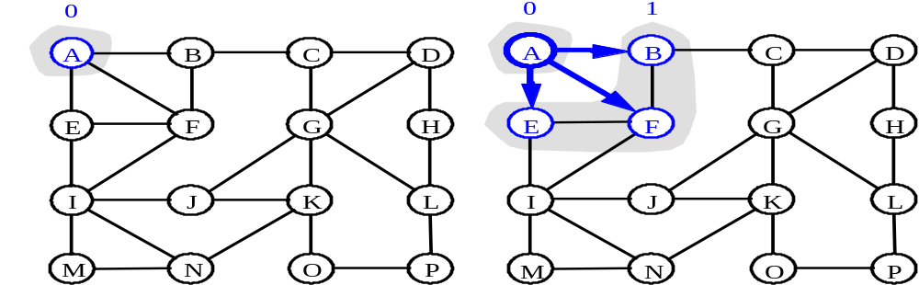
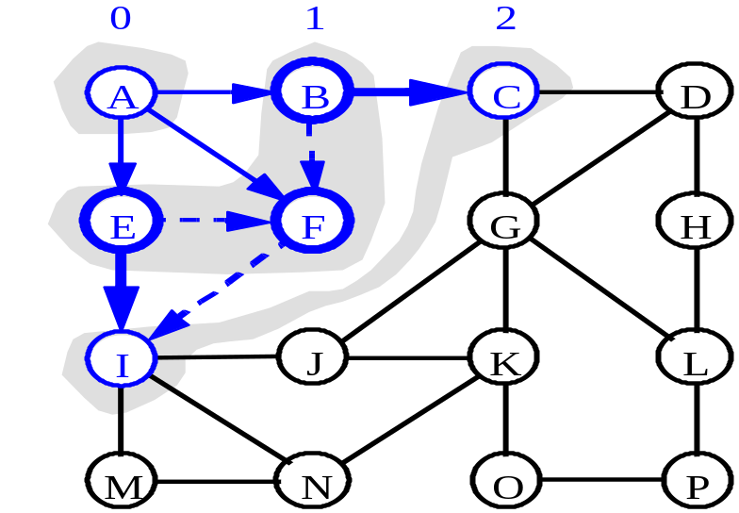
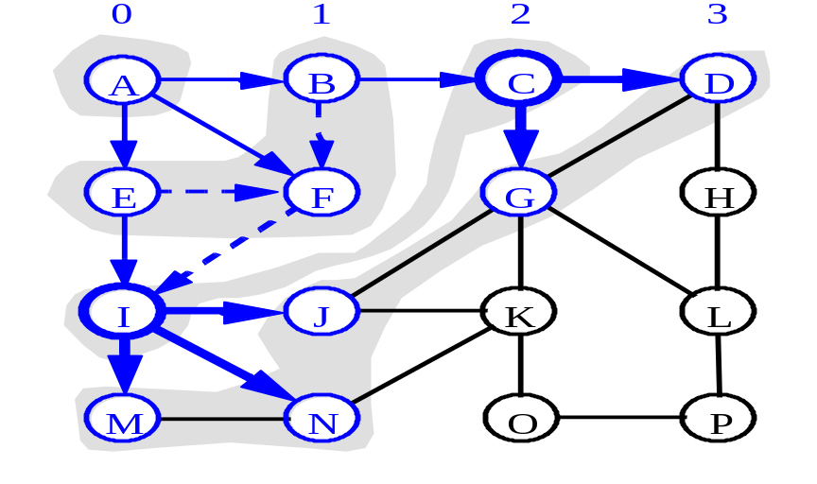
BFS - A Graphical Representation
a)
b)
c)
d)

Slide 30
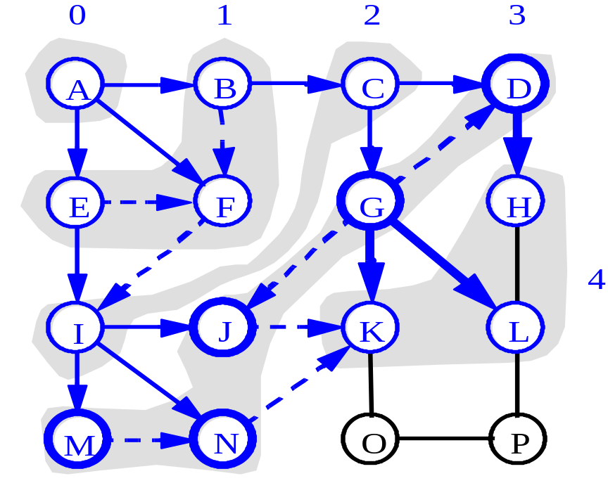
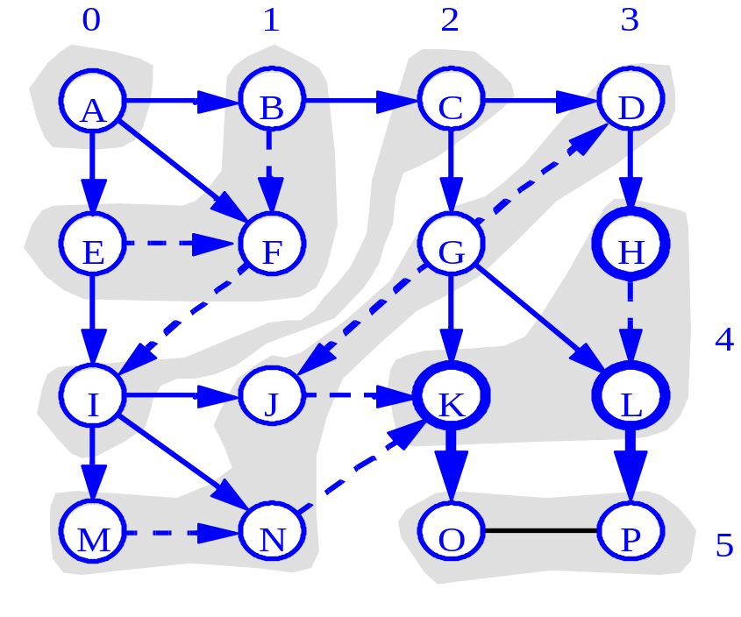
More BFS

Slide 31
BFS Pseudo-Code
Algorithm BFS(s): Input: A vertex s in a graph
Output: A labeling of the edges as “discovery” edges and “cross edges”
initialize container L₀ to contain vertex s
i ← 0
while L_{i} is not empty do
create container L_{i+1} to initially be empty
for each vertex v in L_{i} do
if edge e incident on v do
let w be the other endpoint of e
if vertex w is unexplored then
label e as a discovery edge
insert w into L_{i+1}
else label e as a cross edge
i ← i + 1

Slide 32
Applications: Finding a Path
Find path from source vertex s to destination vertex d
Use graph search starting at s and terminating as soon as we reach d
  Need to remember edges traversed
Use depth – first search ?
Use breath – first search?

Slide 33
DFS vs. BFS
DFS Process
F
B
A
start
E
G
D
C
destination
C
DFS on C
D
Call DFS on D
B
DFS on B
B
B
Return to call on B
A
DFS on A
A
A
A
G
Call DFS on G
found destination - done!
Path is implicitly stored in DFS recursion
Path is: A, B, D, G
D
B
A

Slide 34
DFS vs. BFS
F
B
A
start
E
BFS Process
G
D
C
destination
rear
front
rear
front
rear
front
rear
front
A
B
D
C
D
Initial call to BFS on A
Add A to queue
Dequeue A
Add B
Dequeue B
Add C, D
Dequeue C
Nothing to add
rear
front
G
found destination - done!
Path must be stored separately
Dequeue D
Add G

