Slide 1
Trees
From: Saurav Karmakar
5
3
7
1
2
8

Slide 2

TREE
A tree is a widely-used data structure that emulates a tree structure with a set of linked nodes.
A
B
C
D
E
F
G
H

Slide 3
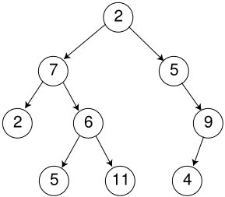
Some Trees
Root nodes
The topmost node in a tree is called the root node. Being the topmost node, the root node will not have parents. It is the node at which operations on the tree commonly begin.
Leaf nodes
Nodes at the bottom most level of the tree are called leaf nodes. Since they are at the bottom most level, they will not have any children.
Subtrees
A subtree is a portion of a tree data structure that can be viewed as a complete tree in itself. Any node in a tree T, together with all the nodes below it, comprise a subtree of T. The subtree corresponding to the root node is the entire tree

Slide 4

General Trees
Nonrecursive definition: a tree consists of a set of nodes and a set of directed edges that connect pairs of nodes.
Recursive definition: Either a tree is empty or it consists of a root and zero or more nonempty subtrees T₁, T₂, … T_{k}, each of whose roots are connected by an edge from the root.
Root
T₁
T₂
T_{k}
•••
subtrees

Slide 5
Rooted Trees
In this class, we consider only rooted trees. A rooted tree has the following properties:
One node is distinguished as the root.
Every node c, except the root, is connected by an edge from exactly one other node p.
Node p is c’s parent, and c is one of p’s children. – acyclic property
A unique path traverses from the root to each node.

Slide 6
General Terms
A
Path length: the number of edges on the path from a node to another.
Depth of a node: the length of the path from the root to the node.
Height of a node: the length of the path form the node to the deepest leaf.
Siblings: Nodes with the same parent.
Size of a Node: the number of descendants the node has (including the node itself). The size of root is the size of a tree. The size of a leaf is 1.
B
C
D
E
F
G
H
Node Height Depth Size
A 3 0 8
B 1 1 3
C 0 1 1
D 2 1 3
E 0 2 1
F 0 2 1
G 1 2 2
H 0 3 1

Slide 7
Representation Of a General Tree -- first child/next sibling
A
Example for this tree:
B
C
D
First child
A
Next sibling
E
F
G
null
H
B
C
D
null
null
E
F
G
null
null
null
null
ParentPtr
H
Key value
null
null
1st child
sibling
Cannot directly access D from A.

Slide 9
Binary tree (BT)
A binary tree is either empty, or it consists of a node called the root together with TWO binary trees called the left subtree and the right subtree of the root.
A binary tree is a tree in which no node can have more than two children.

Slide 10
Representation of Binary Trees
Parent Node: is the one between the node and the root of the tree.
parent
root
ParentPtr
Key value
Left C
Right C
left child
right child
leaves
Leaves are nodes that have no children.
Child Node: is the one between the node and the leaves of the tree.

Slide 11
Small binary trees
Empty tree
Tree of size 1
Tree of size 2
Tree of size 3

Slide 12
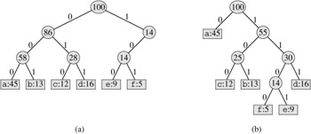
Binary Tree Applications
Expression tree
A central data structure in compiler design. The leaves of an expression tree are operands; the other nodes contain operators.
Huffman coding tree
Implement a simple but relatively effective data compression algorithm.
Binary Search Tree (BST)
Will discuss later.
+
*
a
-
d
b
c

Slide 13
Example Code of Recursion
#include<iostream>
using namespace std;
void recur(int x)
{
if (x>0)
{
cout<<x<<endl;
recur(x-1);
}
}
int main()
{
recur(10);
return 0;
}

Slide 14
Binary Tree Object
template <class Object>
class BinaryNode
{
public:
BinaryNode( const Object & the element= Object(), BinaryNode *lt = NULL, BinaryNode *rt=NULL );
public:
Object element;
BinaryNode *left;
BinaryNode *right;
};

Slide 15
Recursion and Trees
Because tress can be defined recursively, many tree routines, not surprisingly, are most easily implemented by using recursion.
Any non-empty tree consists of the root node, its left subtree and its right subtree. (The subtree may be empty). Because the subtrees are also tree, if an operation works for tree, we can also apply it on the subtrees.
L
R

Slide 16
Tree size
int TreeSize (root: TreePointer)
begin
if root==null //this is left/right child point of a leaf
then return 0;
else
return 1 + TreeSize(root->left) + TreeSize(root->right);
end;
Size of a Node: the number of descendants the node has (including the node itself). The size of root is the size of a tree. The size of a leaf is 1.

Slide 17
Tree height
Int height ( root )
begin
if root==null //this is left/right child point of a leaf
return -1;
else
return 1 + max(height(root->left), height(root->right));
endif
end;
H_{R}+1
Height of a node: the length of the path from the node to the deepest leaf.
H_{L}
H_{R}
H_{L}+1

Slide 18
Traversal
Three standard traversal order
preorder - V L R
inorder - L V R
postorder - L R V
V
L
R
Inorder: traverse all nodes in the LEFT subtree first, then the node itself, then all nodes in the RIGHT subtree.
Preorder: traverse the node itself first, then all nodes in the LEFT subtree , then all nodes in the RIGHT subtree.
Postorder: traverse all nodes in the LEFT subtree first, then all nodes in the RIGHT subtree, then the node itself,

Slide 19
Recursive Traversal Implementation
1
Void PrintPreorder (root)
if root != null
print(root->data);
PrintPreorder(root->left);
PrintPreorder(root->right);
endif;
2
3
4
5
6
preorder : 1 2 4 5 3 6
inorder : 4 2 5 1 3 6
postorder : 4 5 2 6 3 1
Void PrintInorder (root)
if root != null
PrintInorder(root->left);
print(root->data);
PrintInorder(root->right);
endif;
Void PrintPostorder (root)
if root != null
PrintPostorder(root->left);
PrintPostorder(root->right);
print(root->data);
endif;
The difference is the order of the three statements in the ‘IF’.

Slide 20
Traversal
preorder : 1 2 4 5 3 6
inorder : 4 2 5 1 3 6
postorder : 4 5 2 6 3 1
1
2
3
4
5
6
1
2
3
preorder : 1 … ...
inorder : … 1 ...
postorder : … … 1
4
5
6
7
8
9
10

Slide 21
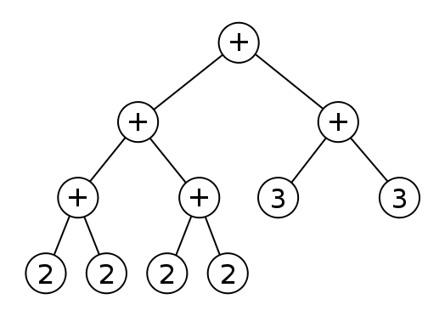
Perform In-Order, Pre-Order and Post-Order traversal on following expression tree

Slide 22
Designing a Nonrecursive Traversal
Consider the algorithm for an inorder traversal
If the current node is not null traverse the left subtree process the current node traverse the right subtree
End if
When traversing the left subtree, the stack of activation records remembers the postponed obligations of processing the current node and traversing the right subtree
A nonrecursive version of the algorithm would have to use an explicit stack to remember these obligations

Slide 23
A Nonrecursive Preorder Traversal
Recursion is a convenient way to postpone tasks that will be completed at a later time
For example, in a preorder traversal, the task of traversing the right subtree is postponed while the left subtree is being traversed
To eliminate recursion, you must use a stack to remember postponed obligations

Slide 24
A non-recursive preorder traversal
Stack S
push root onto S
repeat until S is empty
v = pop S
If v is not NULL
visit v
push v’s right child onto S
push v’s left child onto S
1
2
3
4
5
6
preorder : 1 2 4 5 3 6
inorder : 4 2 5 1 3 6
postorder : 4 5 2 6 3 1

Slide 25
A non-recursive inorder traversal
Stack S
Initialize all nodes to white
push root onto S
repeat until S is empty
v = pop S
If v is black
visit v
else if v is not NULL
push v’s right child onto S
change v to black
push (black) v onto S
push v’s left child onto S
1
2
3
4
5
6
preorder : 1 2 4 5 3 6
inorder : 4 2 5 1 3 6
postorder : 4 5 2 6 3 1

Slide 26
Level-Order Traversal -- Breadth First Search (BFS)
Level order: 1,2,3,4,5,6
1
Queue Q
enqueue root onto Q
repeat until Q is empty
v = dequeue Q
If v is not NULL
visit v
enqueue v’s left child onto Q
enqueue v’s right child onto Q
2
3
4
5
6

