Slide 1

A MAJOR PROJECT PRESENTATION ON
FASHIONPRICEX
A Smart Dynamic Pricing System for Fashion Products
Submitted by: SHOBHA RANI SH & Registration Number: 24SUPMCAGL079
Guide: Ms. Sowndarya AM, Assistant professor
MCA AI/DS • Sapthagiri NPS University • 2025-26

Slide 2
THE PROBLEM
Problem Statement
1
Fast-changing fashion trends
2
Unsold inventory loses value
Styles, sizes, and colours go out of demand within weeks
Static prices don't react to falling demand or ageing stock
3
Fragmented existing systems
4
No real-time order visibility
Admin, customer, and delivery are usually separate, disconnected apps
Most projects show only static order status, no live tracking
FashionPriceX | Major Project Presentation
1

Slide 3
GOALS
Objectives
1
Build an RL-based dynamic pricing engine that reacts to demand & inventory
2
Combine Product Admin, Customer & Delivery Person into ONE application
3
Auto-send order confirmation email to the customer's registered email
4
Enable real-time GPS delivery tracking for customers
5
6
FashionPriceX | Major Project Presentation
2

Slide 4
OVERVIEW
Abstract
FashionPriceX is a full-stack fashion e-commerce application built around a reinforcement-learning-driven dynamic pricing engine. It continuously observes demand, inventory, and seasonal signals to adjust prices — aiming to maximise revenue while keeping stock moving and prices fair.
Unlike typical projects that build only a storefront, FashionPriceX is a single unified application with three role-based logins — Product Admin, Customer, and Delivery Person — sharing one consistent backend. On checkout, an order confirmation email is sent automatically, and once dispatched, the delivery person's live GPS location is shared with the customer in real time.
FashionPriceX | Major Project Presentation
3

Slide 5
BACKGROUND
Literature Survey
Study | Focus | Key Finding
Nowak & Pawłowska-Nowak (2024) | ML classifiers for e-commerce pricing | Linear SVM most reliable for price direction
Ferreira, Lee & Simchi-Levi (2016) | Demand forecasting + price optimisation | ~10% revenue increase, no volume drop
Liu et al. (2020) | Deep RL pricing on Alibaba Tmall | Gains in both revenue and conversion
Apte, Kale, Datar & Deshmukh (2024) | Q-learning for retail pricing | Adapted better to price-elasticity than baseline
Mussi et al. (2022) | Online learning for volume discounts | Higher turnover vs human-set discounts
FashionPriceX | Major Project Presentation
4

Slide 6
COMPARISON
Existing System vs. Proposed System
Aspect
Existing Systems
FashionPriceX
Pricing
Static price or manual rules
RL-based dynamic pricing engine
Application structure
Separate apps for admin & customer
One app, 3 role-based logins
Order confirmation
Auto-message to registered Number
Auto-emailed to registered email
Delivery visibility
Static status (Packed/Shipped)
Live GPS tracking in real time
FashionPriceX | Major Project Presentation
5

Slide 7
APPROACH
Methodology
1
2
3
Requirement Analysis
System Design
Dataset Preparation
4
5
6
Demand Forecasting Model
RL Pricing Engine
Application Development
7
8
Notification & Tracking
FashionPriceX | Major Project Presentation
7

Slide 8
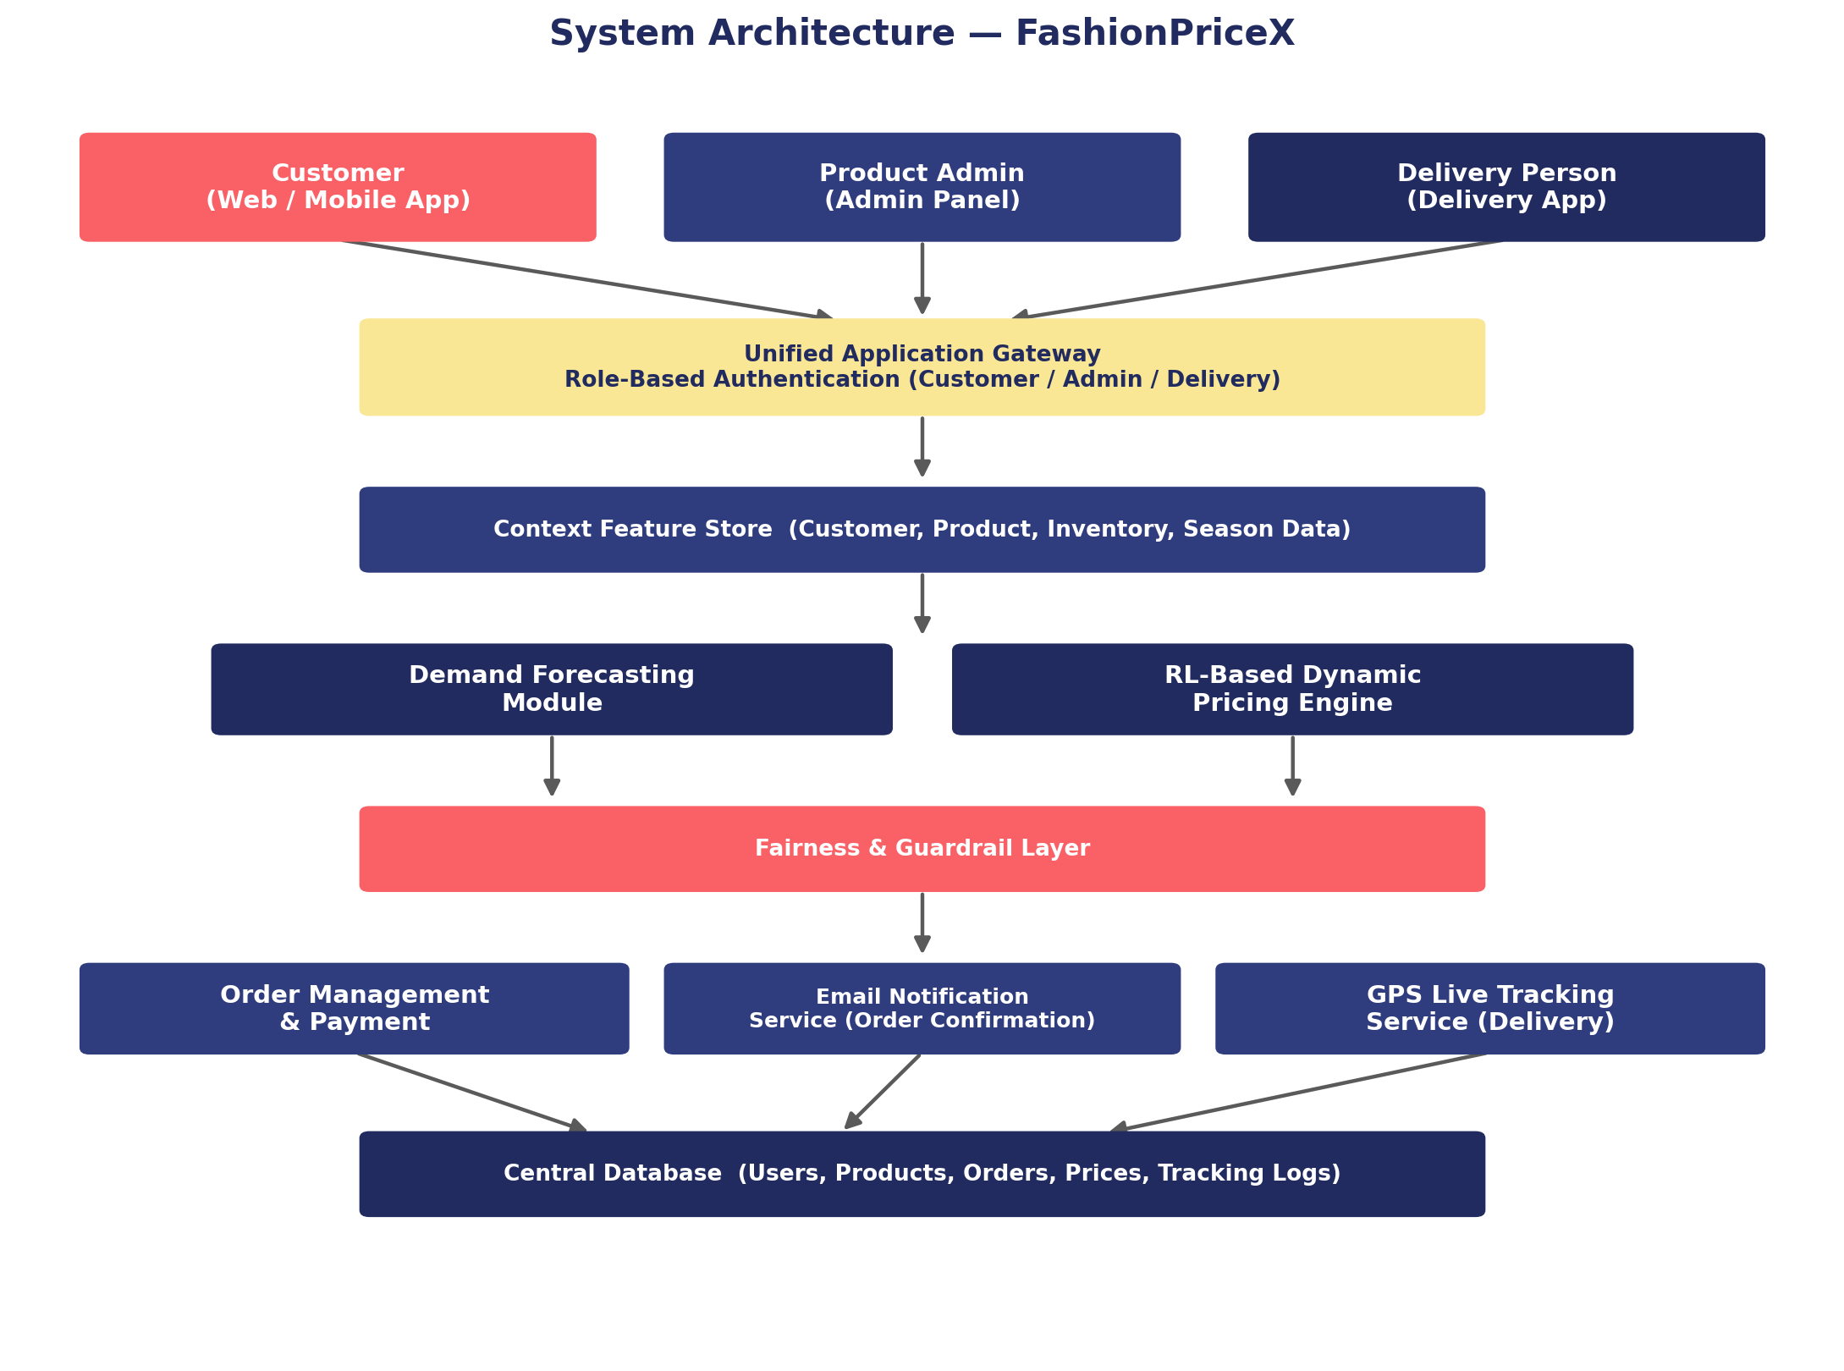
DESIGN
System Architecture
FashionPriceX | Major Project Presentation
8

Slide 9
BREAKDOWN
Modules & Their Description
Customer Module
Product Admin Module
Register/login, browse dynamic prices, cart, checkout, email confirmation, GPS tracking
Manage products & inventory, configure pricing rules, confirm orders, assign delivery
Delivery Person Module
Dynamic Pricing Engine
View assignments, accept orders, share live GPS, update delivery status
Demand forecasting + RL pricing + fairness guardrails
FashionPriceX | Major Project Presentation
11

Slide 10
TECH STACK
Tools & Technologies Used
Frontend
Backend
Database
HTML, CSS, JavaScript
Python (Flask)
MySQL
Authentication
Email Service
GPS & Maps
Role-based JWT / session auth
SMTP / Transactional Email API
Geolocation API + Google Maps / OSM
FashionPriceX | Major Project Presentation
12

Slide 11
RESULTS
Results & Discussion
+17.4%
+11.2%
+15.8%
Revenue
Gross Margin
Fewer Stockouts
Compared against static pricing baseline, on a simulated fashion-retail environment.
✓ All 3 role-based logins work correctly within one application
✓ Order confirmation emails delivered within seconds of checkout
✓ GPS location updates reflected with minimal delay on tracking screen
FashionPriceX | Major Project Presentation
13

Slide 12
WRAP UP
Conclusion & Future Scope
Conclusion
Future Scope
FashionPriceX combines a reinforcement-learning pricing engine with a single application supporting three role-based logins, automated order confirmation emails, and real-time GPS delivery tracking — improving revenue, margin, and stock efficiency versus static pricing.
• Customer reviews & ratings as pricing signal
• Formal fairness audit across customer segments
• AI-assistant for better product reference.
FashionPriceX | Major Project Presentation
14

Slide 13
CITATIONS
References
[1] M. Nowak & M. Pawłowska-Nowak, “Dynamic Pricing Method in E-Commerce Using ML,” Appl. Sci., 2024.
[2] K. J. Ferreira, B. H. A. Lee & D. Simchi-Levi, “Analytics for an Online Retailer,” Manuf. Serv. Oper. Manag., 2016.
[3] J. Liu et al., “Dynamic Pricing on E-Commerce Platform with Deep RL,” arXiv:1912.02572, 2020.
[4] M. Apte, K. Kale, P. Datar & P. R. Deshmukh, “Dynamic Retail Pricing via Q-Learning,” arXiv:2411.18261, 2024.
[5] M. Mussi et al., “Dynamic Pricing with Volume Discounts in Online Settings,” arXiv:2211.09612, 2022.
[6] K. Safonov, “Neural Network Approach to Demand Estimation & Dynamic Pricing,” arXiv:2412.00920, 2024.
[7] Q. Zhao, Y. Zhang, D. Friedman & F. Tan, “E-Commerce Recommendation with Personalized Promotion,” RecSys, 2015.
[8] R. S. Sutton & A. G. Barto, Reinforcement Learning: An Introduction, 2nd ed., MIT Press, 2018.
FashionPriceX | Major Project Presentation
15

Slide 14
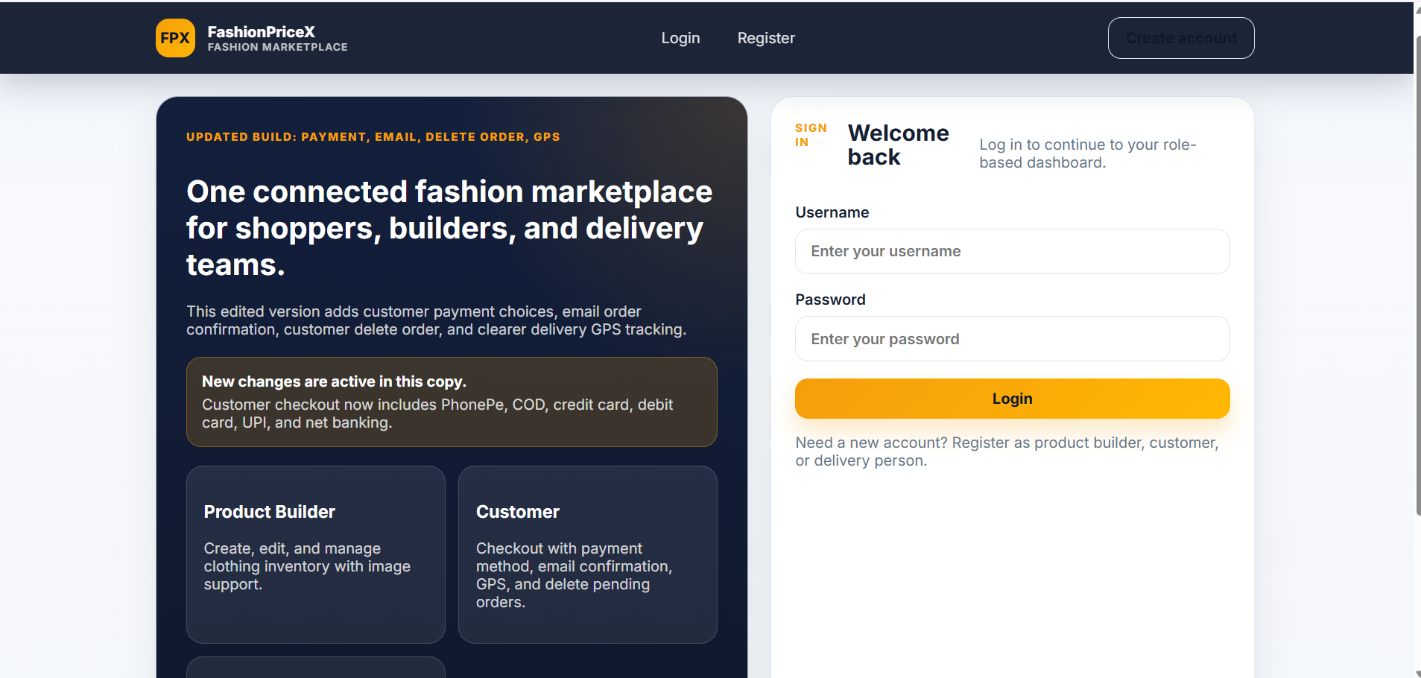

Slide 15
