Slide 1
Model Comparison & Selection Summary
Predicting Employee Performance Using Machine Learning
Shobhit Jaiswal
shobhitjaiswal425@gmail.com

Slide 2
1. Objective
To build a machine learning model that predicts whether an employee will exceed a performance KPI of 80%, using historical HR data.

Slide 3
2. Models Evaluated
We trained and evaluated the following classification models:
- XGBoost
- LightGBM
- CatBoost

Slide 4
3. Evaluation Metric
We used the ROC AUC score as the primary evaluation metric, as it measures the model's ability to distinguish between classes across all thresholds.

Slide 5
4. Results Summary
Model | AUC Score | Notes
CatBoost | 0.90 | Best performer, handles categorical features well
XGBoost | 0.89 | Fast and accurate, slightly behind CatBoost
LightGBM | 0.87 | Very efficient, slightly lower AUC

Slide 6
5. Best Model: CatBoost
CatBoost was selected as the best model based on:
- Highest ROC AUC score
- Better handling of categorical features (e.g., Department, Recruitment Source)
- No need for heavy preprocessing

Slide 7
6. Business Justification
Choosing the most accurate model improves:
- Predictive power (early identification of top/low performers)
- Strategic HR decision-making (data-driven recruitment, coaching)
- Operational efficiency (retaining top talent, reducing attrition risk)

Slide 8
7. Next Steps
- Integrate the model into HR analytics dashboards
- Monitor model performance on new data
- Consider model retraining quarterly

Slide 9
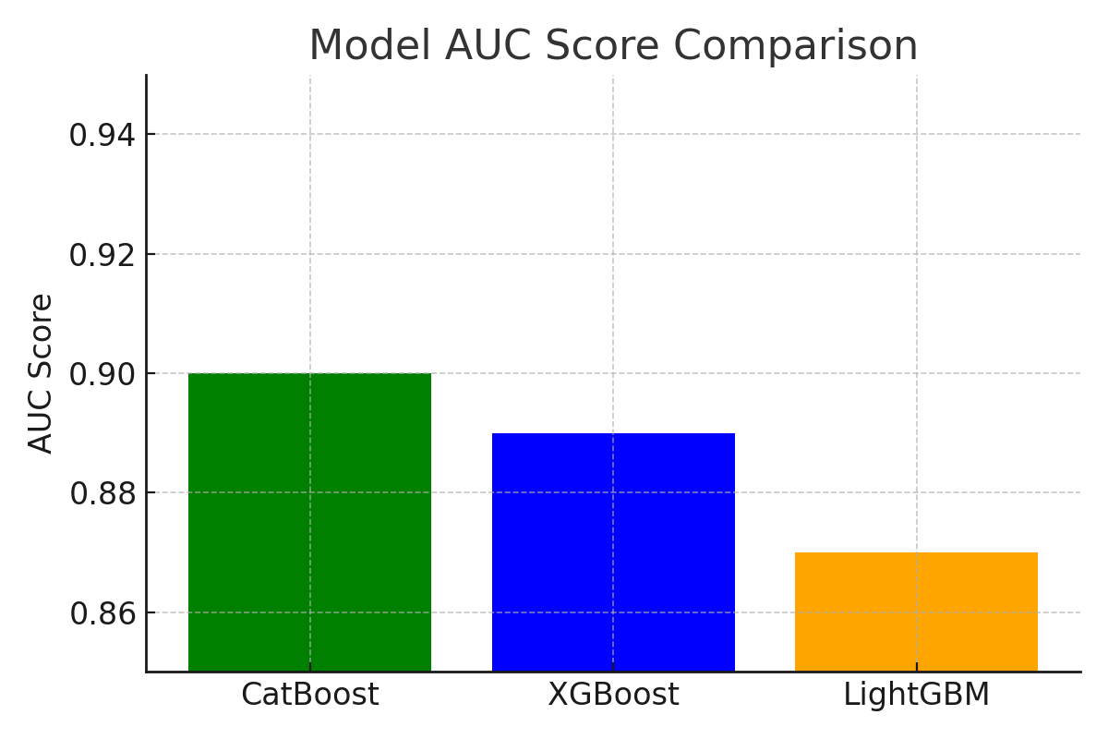
AUC Score Comparison

