Slide 1
Machine learning hackathon
Team Name - Scooby Doo
Team Leader - Varun Raskar
varunraskar22@gmail.com

Slide 2
problem statement
The objective of this hackathon is to develop a robust model that can accurately predict whether a user belongs to the Healthcare Professional (HCP) category and identify their specialization based on the provided ad server logs. The ad server logs contain various types of information, such as browser details, IP addresses, geographic locations, search patterns, site URLs, and other relevant data.
Participants are expected to build a machine learning model that can effectively analyse the ad server logs and classify users accurately. The model should be able to identify whether a user belongs to the HCP category and, if so, determine their specialization taxonomy. The challenge lies in developing a robust and accurate model that can handle different types of data and user behaviours to make reliable predictions.

Slide 3
Solution
our proposed solution involves the development of two machine learning models to predict the characteristics of healthcare professionals.
Model 1: Healthcare Professional Prediction
We have created a machine learning model that aims to predict whether a person is a healthcare professional or not.
Model 2: Specialization Prediction
In addition to identifying healthcare professionals, we have also developed a second machine learning model that focuses on predicting the specialization or field of expertise of healthcare professionals.
By combining these two models, we aim to provide valuable insights and predictions regarding healthcare professionals.
Overall, our solution offers a predictive framework that enables the identification of healthcare professionals and provides insights into their specialization, contributing to more efficient and targeted decision-making in the healthcare industry.

Slide 4
PROJECT STAGES
To develop the machine learning models for predicting healthcare professional status and specialization, we followed the following approach:
1. Data ( given )
2. Data Pre-processing
3. Feature Engineering
4. Model Development
5. Model Refinement
6. Specialization Prediction
7. Model Evaluation and Validation

Slide 5
Approach
Data Preprocessing and Feature Engineering
We performed thorough data preprocessing to handle missing values, outliers, and inconsistencies in the dataset.
Rows with IS_HCP as null values were dropped from the train dataset and converted to int from float.
USERPLATFORMID and USERAGENT had only few missing values so they were also dropped.
Then train dataset and test dataset were joined together for easier data preprocessing.
CHANNELTYPE column has only single consistent values and would not have had any impact on the model so it was also dropped.
We found out all the numerical columns and categorical columns to separate preprocessing on both the sets.
USERZIPCODE and USERCITY had a direct relation with each other and hence a mapping was created to address the missing values of both the columns
Rest of missing values in the categorical and numerical columns were filled by using mode of the columns and a separate column of flag was created corresponding to the missing values.
All the categorical columns were encoded using label encoding and were ready to be used as training data for Model 1 (IS_HCP)

Slide 6
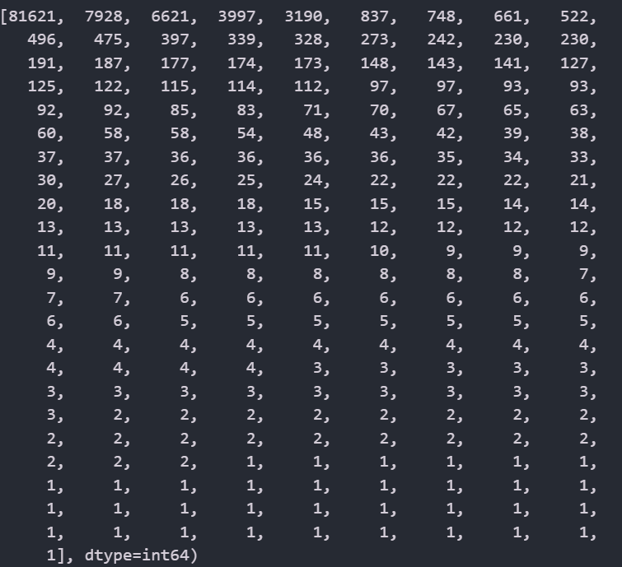
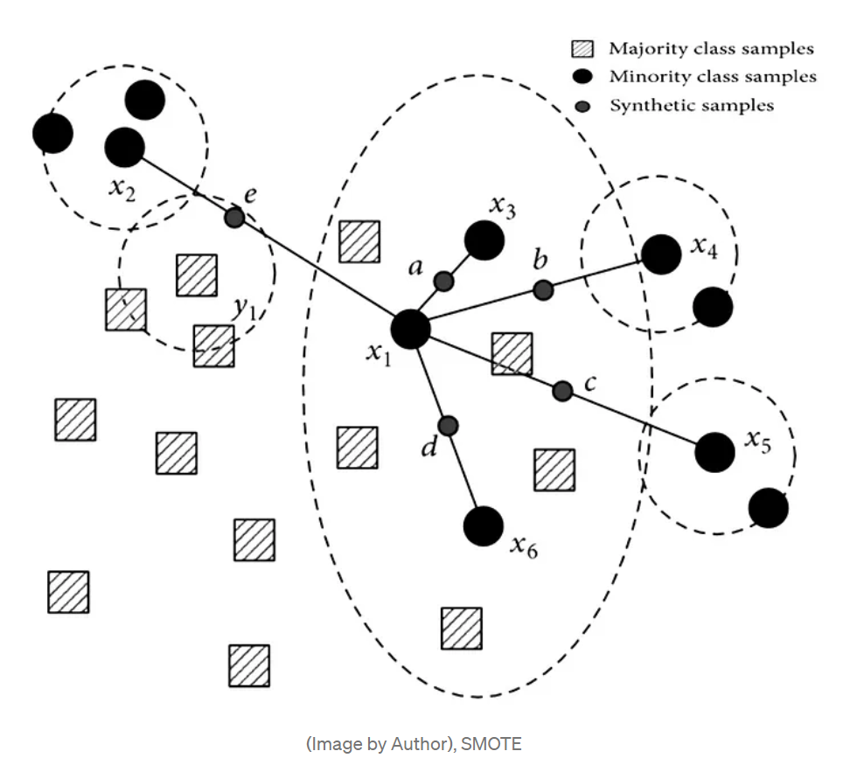
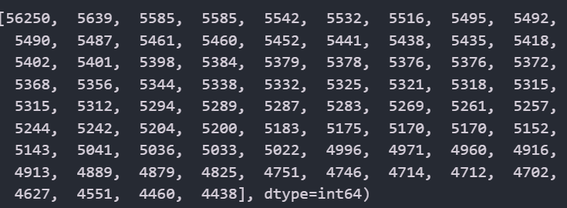
Approach
SMOTE (Synthetic Minority Over-sampling Technique) & Tomek
SMOTE is an over-sampling technique and creates new minority class synthetic samples, and Tomek Links is an under-sampling technique.
As we know some TAXONOMY had very few data instances and it’s very difficult to make an accurate model to predict those we had to use over-sampling and under-sampling to deal with unbalanced data.
First SMOTE is applied to create new synthetic minority samples to get a balanced distribution. Further, Tomek Links is used in removing the samples close to the boundary of the two classes, to increase the separation between the two classes.
(Before over & under sampling)
(After over & under sampling)

Slide 7
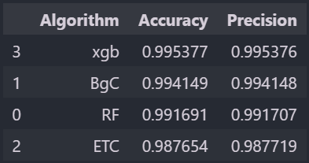

Approach
Model Development
For predicting healthcare professional status, we experimented with various classification algorithms such as Random Forest, Logistic Regression, Decision Tree, Bagging Classifier, XGB Classifier, Gradient Boosting, etc.
The model was trained and evaluated on labeled data, ensuring accurate prediction of the specific specialization or field of expertise.
Out of which four models with highest accuracy and precision were taken (Random Forest, XGB Classifier, Extra Trees Classifier and Bagging Classifier.
These were used to create a Stacking Classifier as Model 1 to predict IS_HCP.
Model Refinement
We refined the healthcare professional prediction model by conducting additional analysis on misclassified instances.
This analysis helped identify potential areas of improvement and fine-tuning of the model.
We iteratively adjusted the model based on these insights to enhance its predictive capabilities.
Overall Score of Stacking Classifier (IS_HCP)

Slide 8
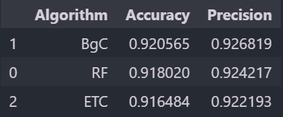

Approach
Specialization Prediction
For predicting healthcare professional specialization, we again experimented with various classification algorithms such as Random Forest, Logistic Regression, Decision Tree, Bagging Classifier, XGB Classifier, Gradient Boosting, etc.
The model was trained and evaluated on labeled data, ensuring accurate prediction of the specific specialization or field of expertise.
Out of which three models with highest accuracy and precision were taken (Random Forest, Extra Trees Classifier and Bagging Classifier.
These were used to create a Voting Classifier as Model 2 to predict TAXONOMY.
Model Evaluation
To assess the performance and generalization capability of our models, we employed techniques like cross-validation and held-out validation.
We used appropriate evaluation metrics, such as accuracy, precision, recall and F1-score to measure the effectiveness of the models.
Overall Score of Voting Classifier (TAXONOMY)

Slide 9
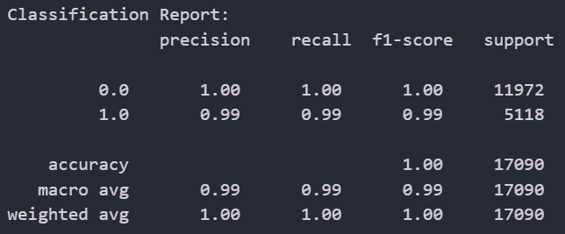
Classification Report
Model 1 (IS_HCP)
Model 2 (TAXONOMY)

Slide 10
Github url
https://github.com/SHOCKWAVE07/Doceree_Hackathon

Slide 11
OUR TEAM
Aakriti
Abhay
Singh
Varun
raskar
Dhruv Choudhary
Natasha
Sanyal

Slide 12
THANKS

