Slide 1
Online voting system
Guided by: done by:
K.Radhika sk.b.SHOHEB AKTHAR

Slide 2
introduction
The online voting system is a PHP project created for a specific school
As a part of the final year project for KITS college in guntur.
This system provides an online platform for students to vote for their chosen candidates.
The system stores candidate and voter details, and each voter must register with their system account and provide their student id number before they can vote. Once registered,
The system admin user activates the student accounts, and they can then vote for their candidates.
The system has three types of users: admin, staff, and voters.

Slide 3
Existing System:
There may have been existing manual voting systems in place, which can be time-consuming, error-prone, and less secure.

Slide 4
Problems of the Existing Systems:
The manual voting systems may suffer from issues such as vote tampering, double voting, vote counting errors, and long queues at the polling stations. It can also be challenging to manage the data manually, and there may be delays in generating the final election report.

Slide 5
Proposed System:
The proposed online voting system provides a more efficient, secure, and accurate way of conducting elections. The system stores all candidate and voter information in a database, making it easier to manage and track. The system allows students to vote from anywhere with an internet connection, and the voting process is quick and simple. The system generates an automatic and accurate election report that can be accessed by the admin, staff, and voters.

Slide 6
Benefits of the Proposed System:
The benefits of the proposed online voting system include increased security, speed, and accuracy of the voting process, reduced errors in counting votes, and reduced waiting time for the voters. The system also provides a more convenient way for the students to vote, and it saves time and effort in managing the election data. Overall, the proposed system is a more efficient and effective way of conducting elections in schools or other similar organizations.

Slide 7
Features

Slide 8
Admin
Login/Logout
Manage Candidate
Activate/Deactivate Voters
Manage Students
-Generate Election Report
Manage User/Staff List
-View User Time Logs

Slide 9
features
Staff side
Voters
- Login/Logout
- Manage Candidate
- View Voters List
- Manage Students Generate Election Report
View User/Staff List
- Register to the system
- Vote

Slide 10
System Requirements
System requirements involve identifying the hardware and software resources needed to run the online voting system. This includes the need for a web server, a database management system, and appropriate software tools and libraries for development

Slide 11
Modules Description
The modules of the online voting system include the registration and login module, candidate management module, voter management module, election report generation module, user and staff management module, and time logs management module. These modules provide the functionality needed to manage the voting process and ensure that it is accurate and reliable.

Slide 12
Hardware and Software Requirements
The hardware and software requirements for the online voting system include a web server, a database management system (mysql), and appropriate software tools and libraries for development (PHP/mysql, HTML, CSS, javascript (jquery and ajax), and bootstrap for the design).

Slide 13
Architectural design

Slide 14
Sample Coding
User authentication and authorization: the system uses PHP functions to authenticate users based on their login credentials and authorize them based on their user type (admin, staff, or voter).
Candidate and voter management: the system uses mysql queries to store and retrieve candidate and voter data from the database. Admin and staff users can manage candidate and voter data, while voters can register and vote for candidates.

Slide 15
Voting process: the system uses PHP functions and mysql queries to handle the voting process. When a voter casts their vote, the system updates the candidate's vote count in the database and generates a printable report for the total counts ofthe vote for all candidates. Reporting: the system generates a printable report for the total counts of the vote for all candidates. This report can be viewed and printed by admin and staff users.

Slide 16
-- phpMyAdmin SQL Dump
-- version 4.7.4
-- https://www.phpmyadmin.net/
-- Host: 127.0.0.1
-- Generation Time: Feb 14, 2019 at 07:09 PM
-- Server version: 10.1.30-MariaDB
-- PHP Version: 7.2.1

Slide 17
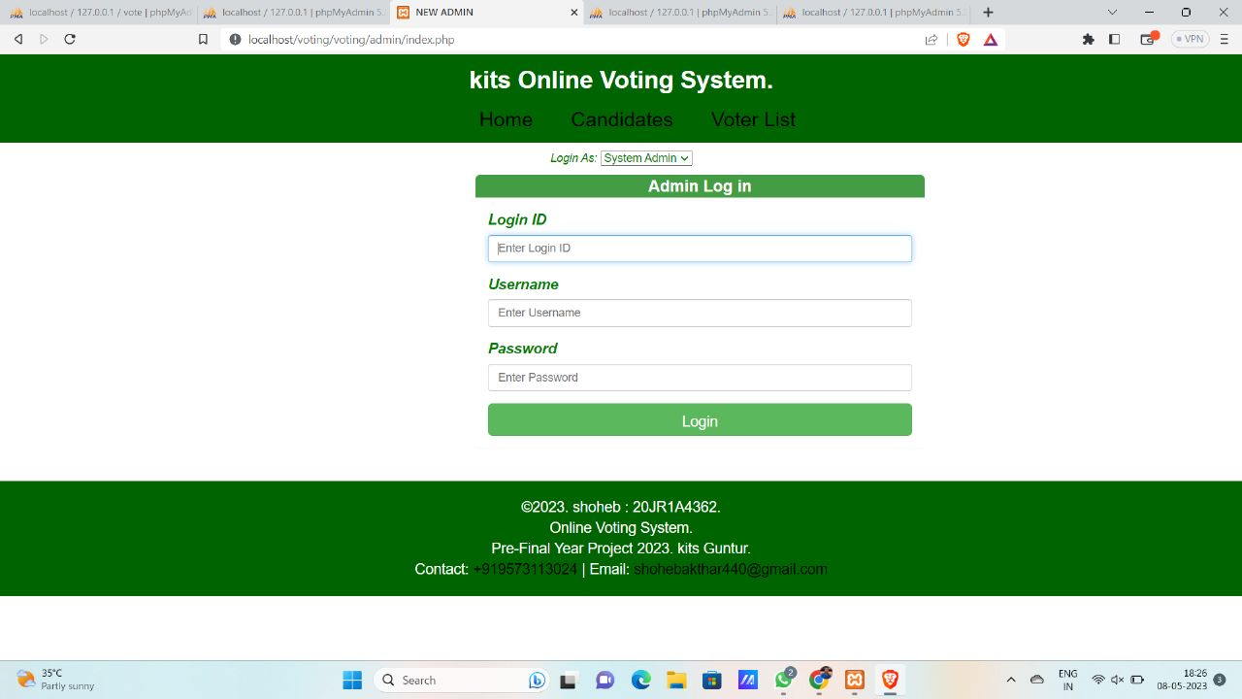
Output screens

Slide 18
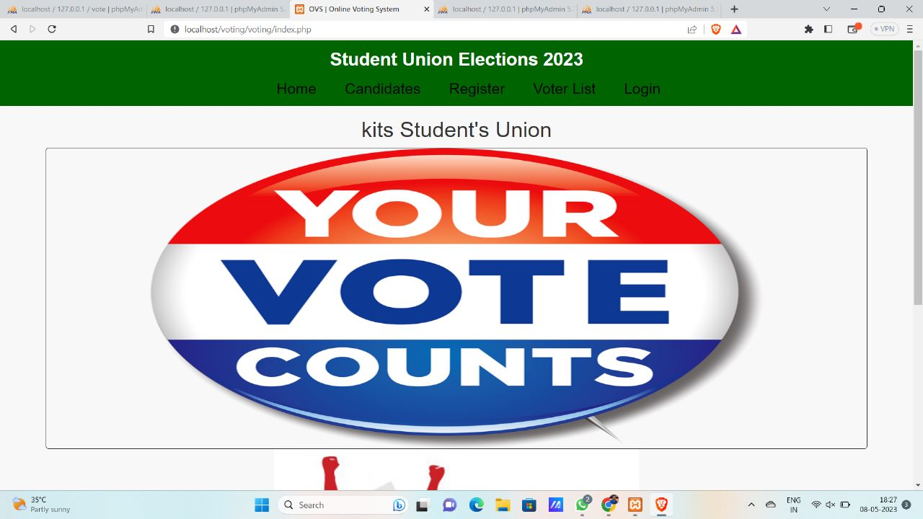
View of website

Slide 19
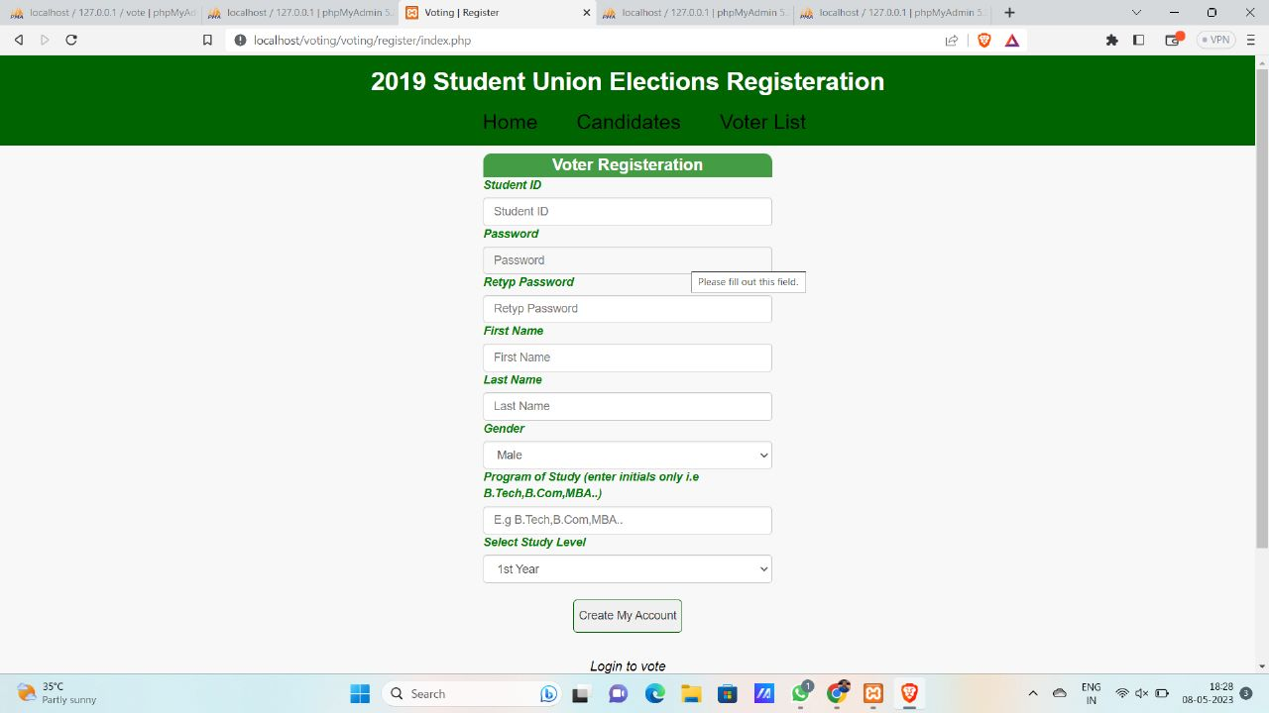
Student registration

Slide 21
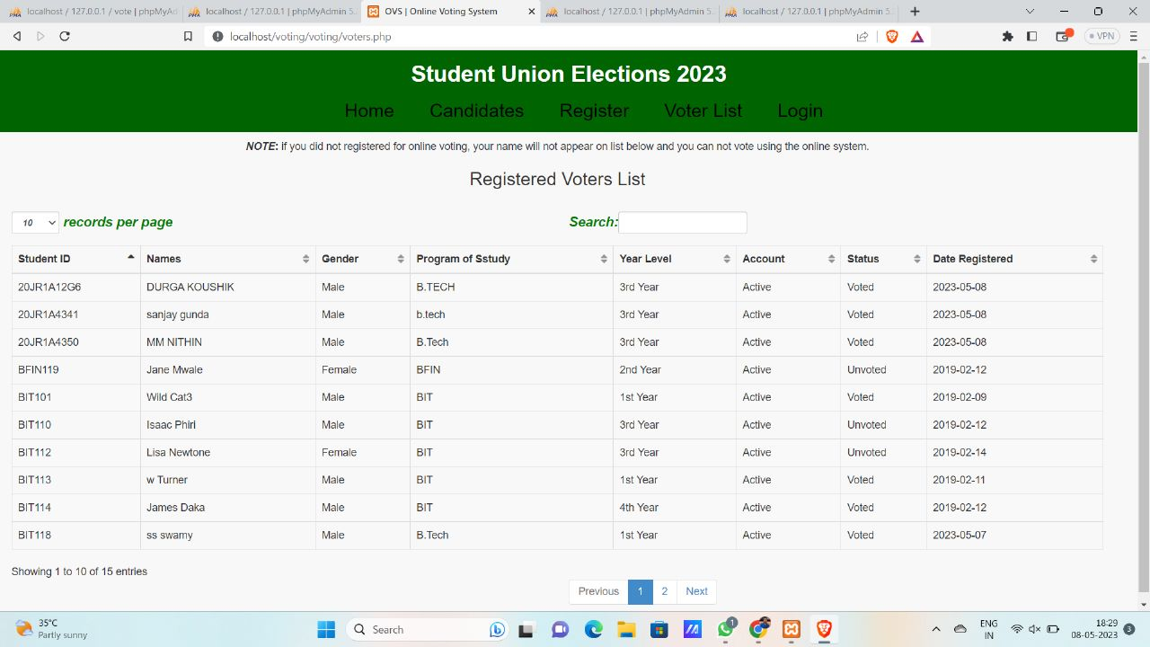
Over view

Slide 22
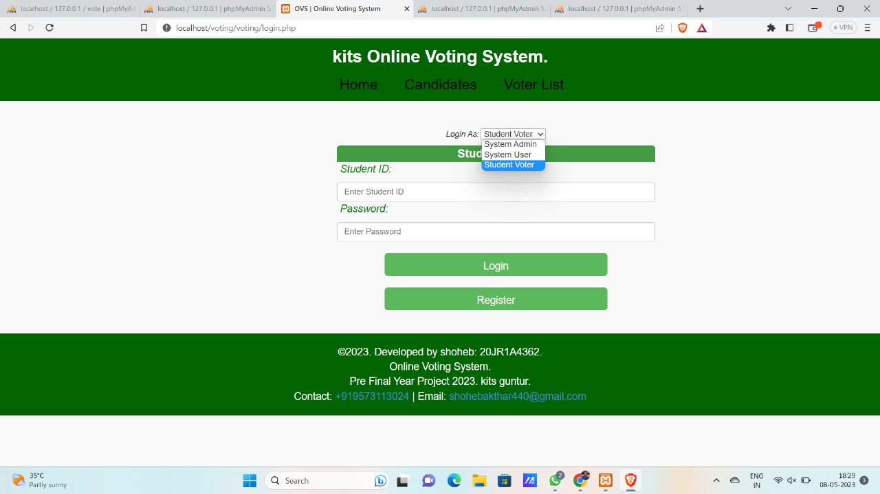
Login interface

Slide 23
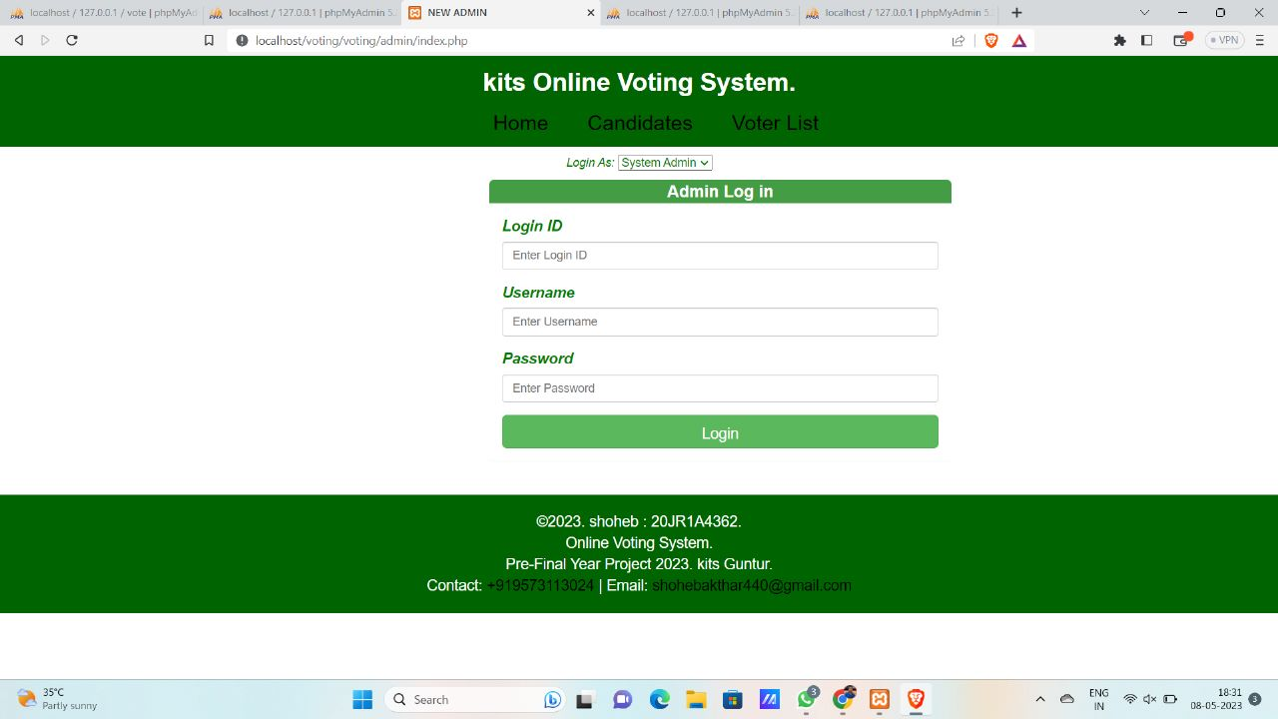
Kits online voting interface

Slide 24
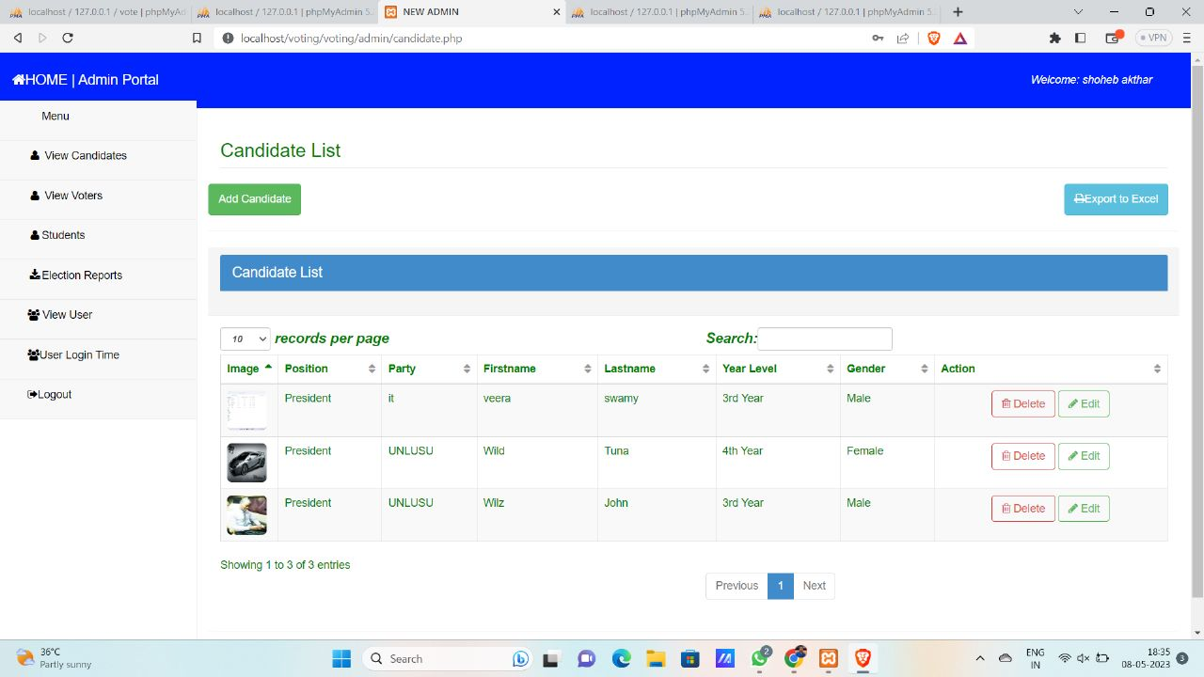
Data base of registrees

Slide 25
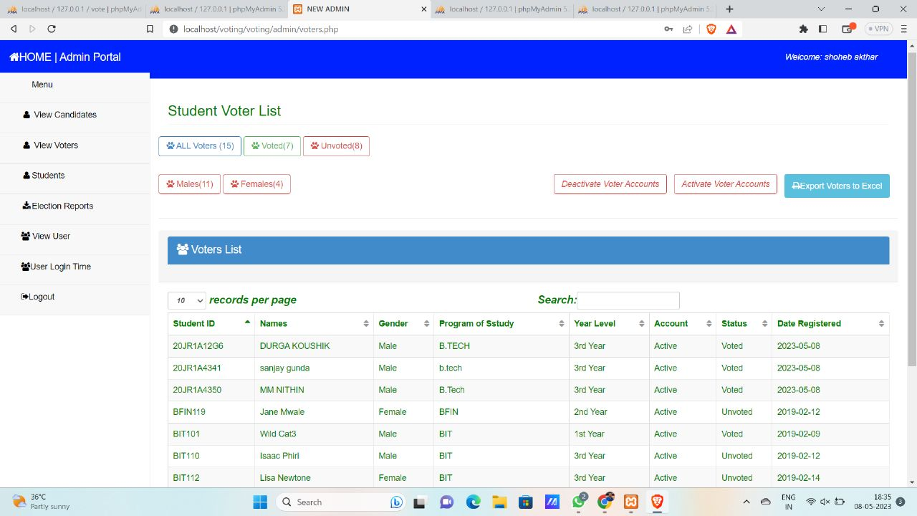
Voter list

Slide 26
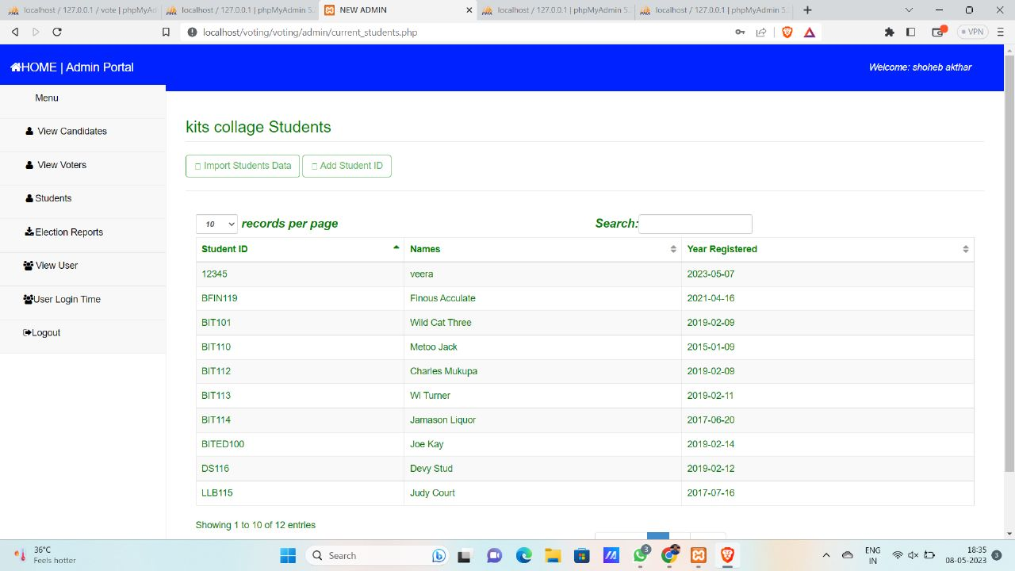
Admin portal of kits

Slide 27
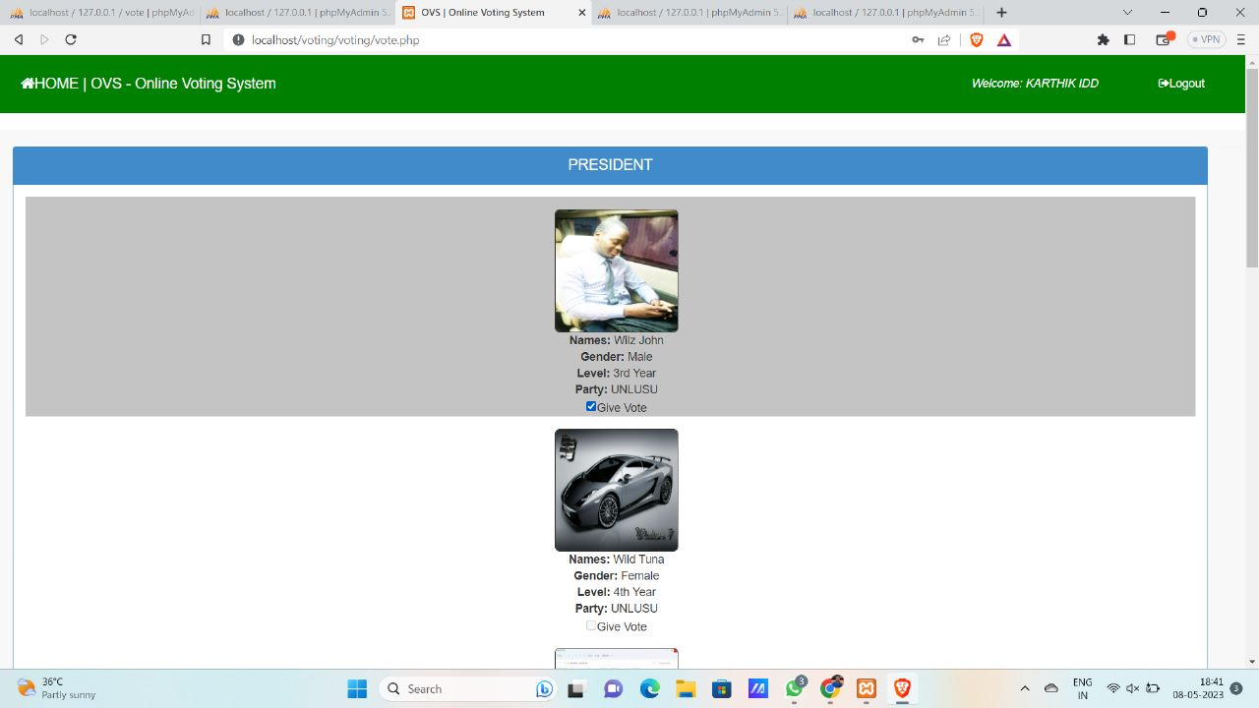
OVS ONLINE VOTING SYSTEM

Slide 28
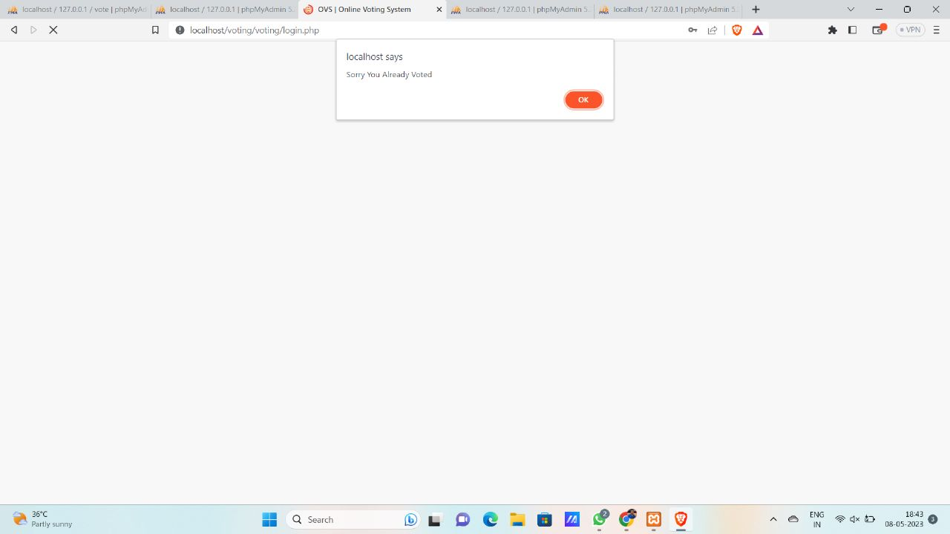
ERROR DISPLAY FOR MULTIPLE VOTING

Slide 29
testing
Test cases are a set of conditions or steps used to validate the functionality of the software system. Test reports are documents that record the results of tests and provide information on the quality of the software system. Test cases and reports are used to track defects, monitor progress, and provide information for decision making throughout the software development lifecycle. They are important tools for ensuring the quality and reliability of software systems

Slide 30
Implementation Steps
Step 1: installation of required software
The first step in implementing the online voting system is the installation of the required software, including PHP/mysqli, mysql database, HTML, CSS, javascript (jquery and ajax), and bootstrap for the design.
Step 2: configuration of the system
After the installation of the software, the system needs to be configured according to the specifications of the project. This includes setting up the database, configuring the web server, and configuring the application settings.

Slide 31
Step 3: testing of the system
Once the system has been configured, it needs to be tested to ensure that it is working properly. Testing involves checking that all the functionalities of the system are working correctly, and that there are no bugs or errors.
Step 4: deployment of the system
After the testing phase is complete, the system is ready to be deployed. This involves making the system available to the users and ensuring that it is accessible from all devices

Slide 32
conclusion
In conclusion, the online voting system is a highly efficient tool that ensures a secure and easy online voting experience for students. It has been developed using various technologies, and its features have been designed to meet the specific requirements of a school.

Slide 33
Future Enhancements:
. Integration with biometric authentication: this feature would allow voters to authenticate their identity using their biometric data such as fingerprints, iris scans, or face recognition.
Integration with blockchain technology: this feature would ensure complete transparency and security in the voting process, making it virtually impossible to tamper with the voting results.

Slide 34
Integration with social media platforms: this feature would allow voters to share their voting experience on social media platforms, thereby increasing awareness and participation.
Integration with machine learning algorithms: this feature would allow the system to analyze voting patterns and generate predictions, helping in better decision making.
Mobile application development: developing a mobile application for the online voting system would increase accessibility and convenience, allowing students to vote from their mobile devices.

Slide 35
THANK YOU

