Slide 1




DATA Structure
ZOMBIE OUTBREAK SIMULATION

Slide 2








SUBMITTED BY
MD Sirajul Islam
2024-1-60-291

Slide 3




INTRODUCTION
In this project, we simulate a zombie outbreak using a C program and core data structures. The goal is to model how an infection spreads through a city represented as a 2D grid. Each infected cell (zombie) can spread the infection to its adjacent neighbors (up, down, left, right) over time. We calculate how many hours it takes for the infection to reach the entire city or determine if some areas remain uninfected. The simulation uses structs, arrays, and a custom queue to implement the logic, similar to the Breadth-First Search (BFS) algorithm.

Slide 4


REAL-WORLD ANALOGY
Imagine a city where each house is part of a grid, like a big chessboard. Some houses are already infected (zombies = 1), while others are safe (humans = 0). Each zombie can infect the four neighboring houses — up, down, left, and right — in one hour.
If a zombie is at position (i, j), it tries to infect:
  (i-1, j) – above
  (i+1, j) – below
  (i, j-1) – left
  (i, j+1) – right
Just like in a real outbreak:
  The infection spreads gradually from one area to the next.
  Some parts of the city might get infected later than others.
  Our goal is to track this spread over time, and calculate how many hours it takes to infect everyone, or determine if any safe zones survive.
This analogy helps us understand how graph traversal (like BFS) is used to model real-life problems using data structures.

Slide 5


KEY CONCEPTS USED
This project applies several important data structure concepts learned in this couse to simulate the zombie outbreak efficiently
2D Array
Structure
Queue
Loops and Conditionals
  Used to represent the city layout.
  Each cell holds either:
  0 → safe (human)
  1 → infected (zombie)
  Custom struct ZombieLocation stores:
  X and Y positions (row, col)
  Time (hours since infection)
  Helps in organizing zombie data neatly.
  Implements Breadth-First Search (BFS) logic.
  Zombies are processed level by level (hour by hour).
  Newly infected zones are enqueued for the next infection wave.
Used to scan the city, process infection logic, and simulate the time flow.

Slide 6






Algorithm Overview
The simulation follows a step-by-step process similar to Breadth-First Search (BFS) to spread infection:
Input and Setup
01
  Take the grid size and city layout as input.
  0 = safe (human), 1 = infected (zombie).
  Add all infected cells to the queue.
Start Spreading
02
  Use a queue to spread infection hour by hour.
  A zombie infects its 4 neighbors (up, down, left, right) if they are safe.
Track Time
03
  Each new infection increases the time by 1.
  Keep updating the maximum time it takes to infect.
Final Result
04
  If all zones are infected → print total hours.
  If any safe zones are left → print "Some areas survived!"

Slide 7
Code Snapshot
Structure to Store Zombie Info
Directions for Infection Spread
Infection Spread Logic
typedef struct {
int row, col, time;
} Cell;
int directions[4][2] = {
{-1, 0}, {1, 0}, {0, -1}, {0, 1}
};
if (grid[x][y] == 0) {
grid[x][y] = 1;
enqueue(&q, (Cell){x, y, time + 1});
}
Each zombie’s position and time since infection is stored.
Used to infect up, down, left, right neighbors.
Spreads infection to all valid neighboring safe zones.
Uses queue to process each infected cell in order.

Slide 8


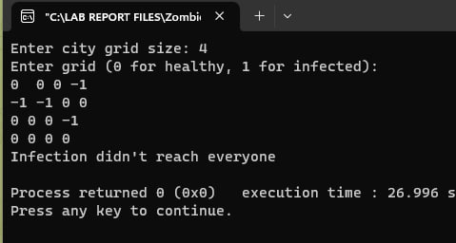
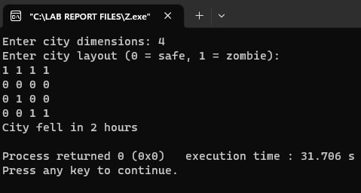

SAMPLE INPUT & OUTPUT

Slide 9

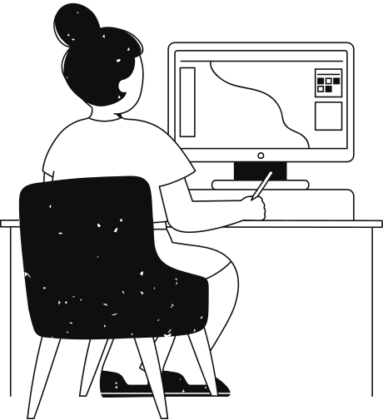
Features
Dynamic infection simulation
Models the spread of infection in real-time across the grid.
Easy to test with different grid sizes
Adaptable to various grid dimensions for flexible experimentation.
Accurate BFS-style spread
Utilizes Breadth-First Search algorithm to simulate realistic infection propagation.
Realistic zombie outbreak behavior
Captures detailed and believable patterns of outbreak dynamics.

Slide 10
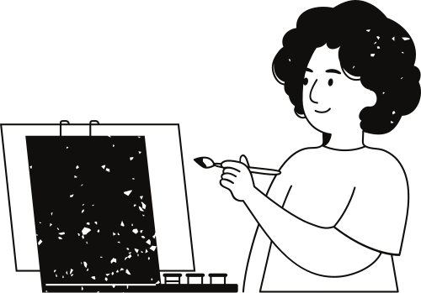
Limitations
No simultaneous multi-direction infection:
The model does not handle cases where multiple zombies infect neighbors from different directions at the exact same time in real-time scenarios.
No cure or recovery:
Once a cell or person is infected, there is no possibility of healing or recovering in the simulation.
Fixed spread directions:
Infection spreads only to the four adjacent neighbors (up, down, left, right), ignoring diagonal or more complex transmission patterns.
Instant infection assumption:
The model assumes that infection happens instantly after exactly one hour per move, which may oversimplify real-world disease dynamics.

Slide 11


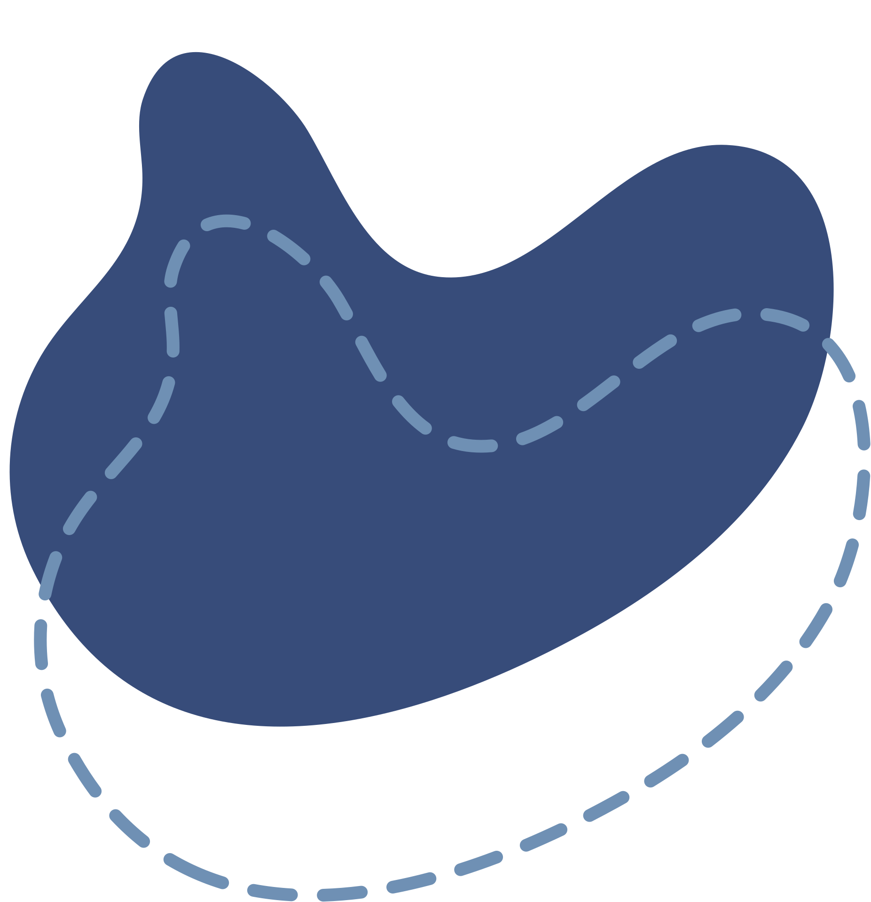

CONCLUSION
Through this project, we gained practical experience with the Breadth-First Search (BFS) algorithm by implementing it using a queue to navigate a 2D grid. This allowed us to simulate the spread of a zombie infection across a population in a logical and structured way. We deepened our understanding of how simulations work—how infection propagates over time, and how rules can be applied to control behavior in a system. Most importantly, we saw how core data structures such as arrays, queues, and nodes can be used to solve a real-world inspired problem, turning theoretical knowledge into a working, meaningful application.

Slide 12
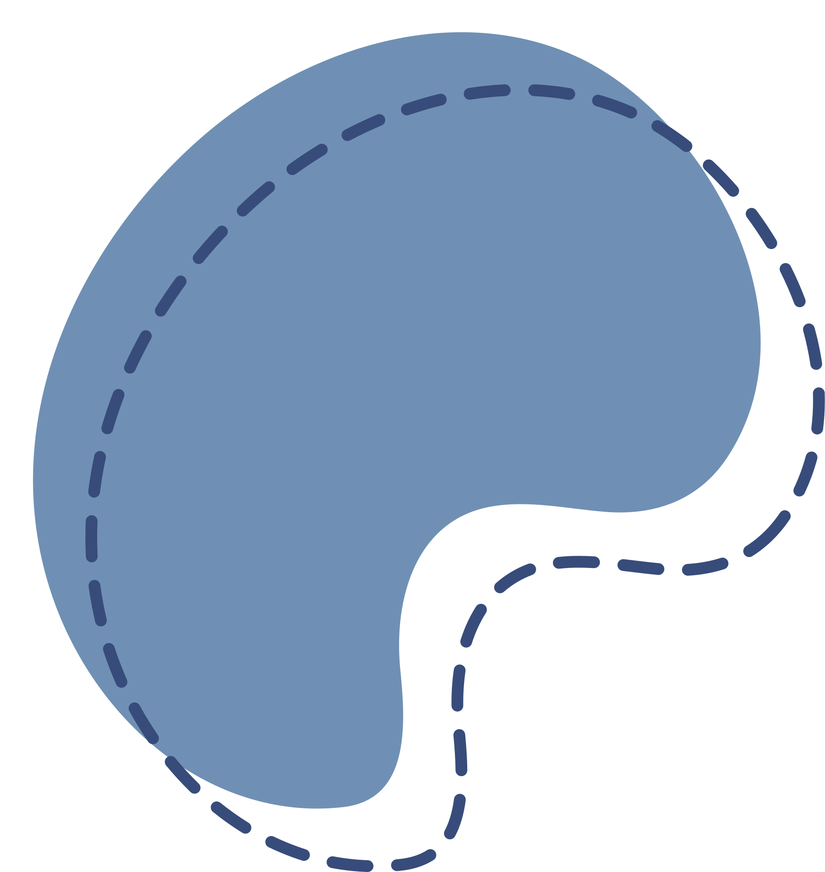
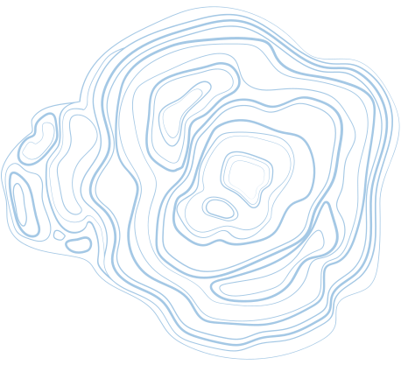




Thank You

