Slide 1
DESIGN AND ANALYSIS OF ALGORITHMS
Introduction to
Dynamic Programming
Design and Analysis of Algorithms (DAA)
Generated using Gamma AI

Slide 2

THE CORE IDEA
Dynamic programming reduces repeated work
1
Definition
Solve complex problems by breaking them into simpler subproblems and caching their results.
2
Optimal substructure
An optimal solution can be built from optimal solutions to smaller subproblems.
3
Overlapping subproblems
The same smaller problems recur across the solution.
Generated using Gamma AI

Slide 3
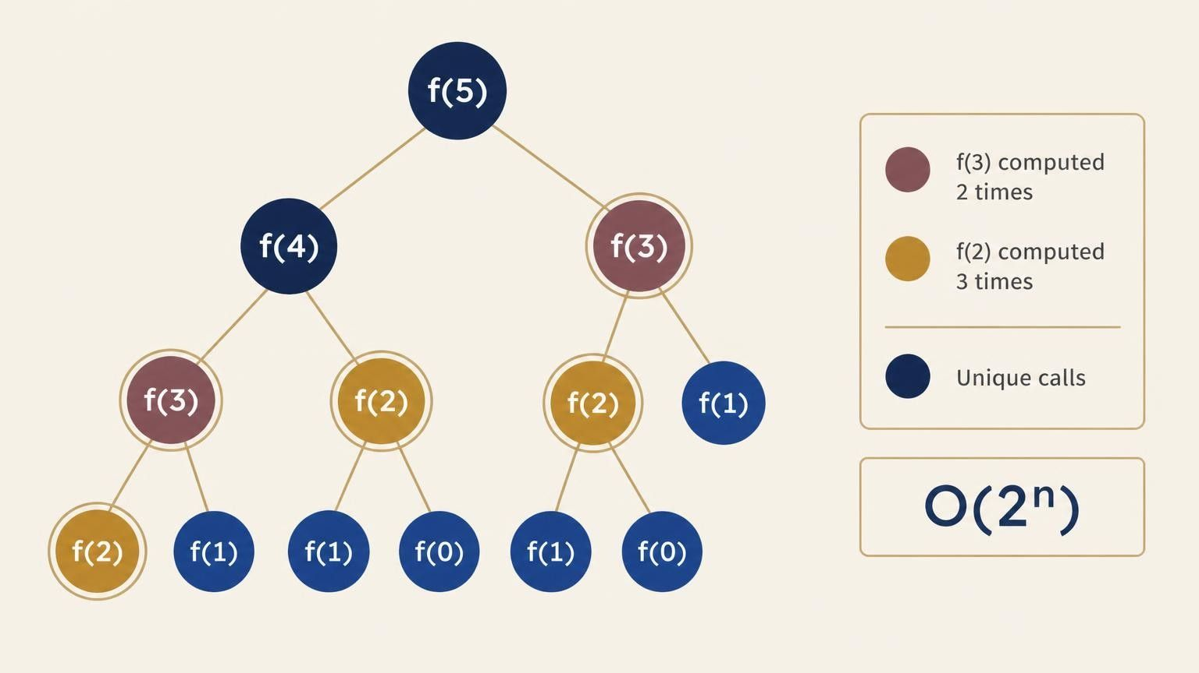
Plain recursion recomputes the same Fibonacci values
F(0) = 0 and F(1) = 1.
For f(5), f(3) is computed 2 times and f(2) 3 times.
The overlapping call tree drives naive recursion to exponential time: O(2^n).
Generated using Gamma AI

Slide 4
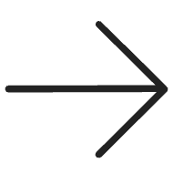
Memoization turns repeated calls into lookups
BEFORE
AFTER
Plain recursion
Memoization
O(2^n)
Top-down dynamic programming uses an auxiliary cache.
reuse
O(n)
Before computing a subproblem, look it up; if cached, reuse the result. For Fibonacci, complexity drops from O(2^n) to O(n).
Generated using Gamma AI

Slide 5
Weighted interval scheduling is a 1D DP problem
Jobs
Order
Compatibility
Select compatible jobs with start sᵢ, finish fᵢ, and value vᵢ to maximize total weight.
Sort jobs by finish time.
Compute compatibility index p(j), the last job compatible with job j, in O(n log n).
Generated using Gamma AI

Slide 6
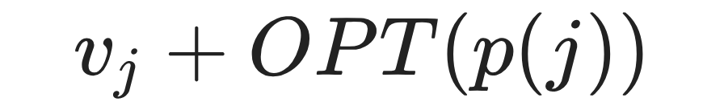

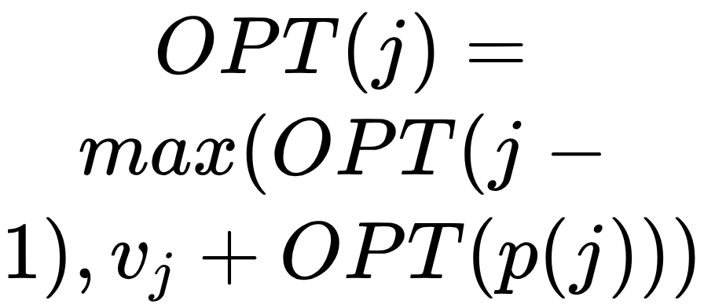
THE DECISION AT EACH JOB
Each job is either included or excluded
01
02
03
IN
OUT
Choose the better path
Include job j.
Exclude job j.
Optimal substructure: job j is either IN or OUT.
State dimensionality: a 1-dimensional array dp[j].
Generated using Gamma AI

Slide 7
WHEN ONE INDEX IS NOT ENOUGH
LCS uses a 2D state space to compare two sequences
Condition | Recurrence
X[i] = Y[j] | c[i,j] = c[i−1,j−1] + 1
X[i] ≠ Y[j] | c[i,j] = max(c[i−1,j], c[i,j−1])
LCS
Problem
Find the longest shared subsequence between X[1..m] and Y[1..n].
State: matrix dp[0..m][0..n].
O(m · n)
Time and space are O(m · n).
Generated using Gamma AI

Slide 8

THE DESIGN PATTERN
Choose the state, cache the work, reuse the result
1D DP
2D DP
Tracks one index, as in weighted interval scheduling.
Tracks two, as in LCS.
dp[0..m][0..n]
dp[j]
Memoization
Tabulation
Top-down: recurse, then cache.
Bottom-up: fill a table from base cases to the final answer.
Generated using Gamma AI

