Slide 1
Assignment-based Subjective Questions with Answers

Slide 2
Ques1. From your analysis of the categorical variables from the dataset, what could you infer about their effect on the dependent variable?
Answer : Observations from above box plots for categorical variables:
The year box plots indicates that more bikes are rent during 2019.
The season box plots indicates that more bikes are rent during fall season.
The working day and holiday box plots indicate that more bikes are rent during normal working days than on weekends or holidays.
The month box plots indicates that more bikes are rent during September month.
The weekday box plots indicates that more bikes are rent during Saturday.
The weather condition box plots indicates that more bikes are rent during Clear, Few clouds, Partly cloudy weather.

Slide 3
QUES2. Why is it important to use drop_first=True during dummy variable creation?
Answers: drop_first=True is important to use ,it help in reducing the extra columns create the dummy variable,Hence it reduces the correlation .
We have 5 types of values in Categorical column and we want to create dummy variable for that column.
Ex: season , month , year , weekday , weather_condition.
Hence if we have categorical variable with n-levels, then we need to use n-1 columns to represent the dummy variables.

Slide 4
QUES3. Looking at the pair-plot among the numerical variables, which one has the highest correlation with the target variable?
Answers: By looking at the pair plot temp variable has the highest (0.63) correlation with target variable 'total_count'.
Final reporting the model temp is shows the higher correlation in positive way.

Slide 5
Ques4. How did you validate the assumptions of Linear Regression after building the model on the training set?
In linear Regression model on the training set we saw the p value is higher correlation atemp(0.838) , month_7 , month_11 , month_12 ,weekdays_1,weekdays_2,weekdays_3,weekdays_4,weekdays_5,weekdays_6.
Validating the assumption of Linear Regression Model on the training set:
1.Linear Relationship: we check the most preferable variable temp ,windspeed .
The plots shown below represents the relationship between the model and the predictor variables. As we can see, linearity is well preserved.

Slide 6
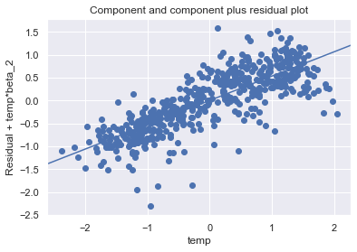
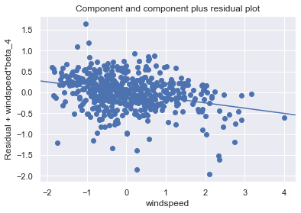

Slide 7
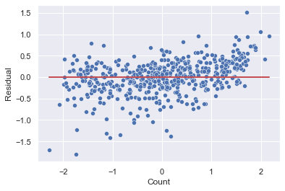
Homoscedasticity
There is no visible pattern in residual values, thus homoscedacity is well preserved.

Slide 8
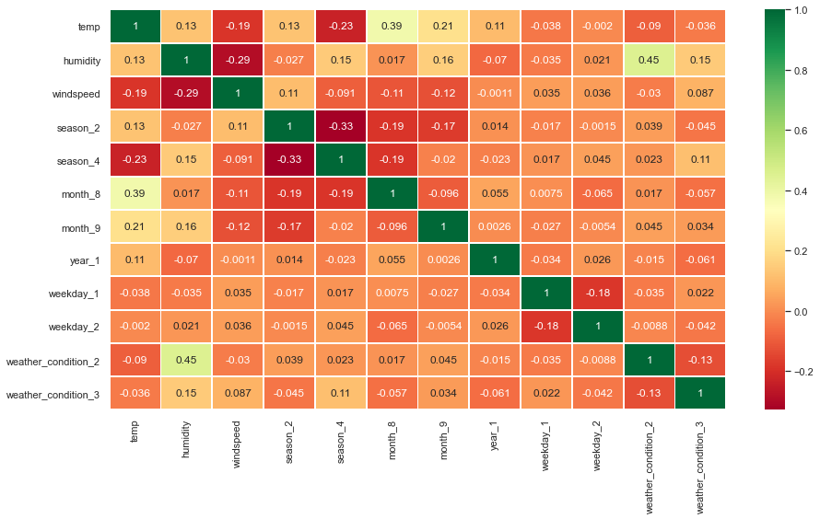
Absence of Multicollinearity
Multicollinearity is the occurrence of high intercorrelations among two or more independent variables in a multiple regression model.
For ex: weather_condition_2,humidity,temp

Slide 9
Independence of residuals:
Autocorrelation refers to the fact that observations’ errors are correlated. To verify that the observations are not auto-correlated, we can use the Durbin-Watson test. The test will output values between 0 and 4. The closer it is to 2, the less auto-correlation there is between the various variables.
In the plot its show the residual value is 2.0395.

Slide 10
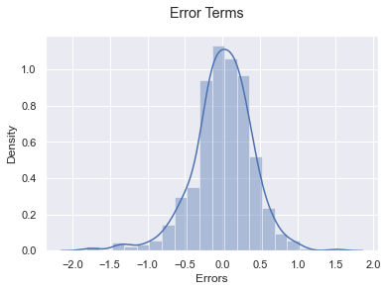
Normality of Errors:
Based on the histogram, we can conclude that error terms are following a normal distribution.

Slide 11
QUES5. Based on the final model, which are the top 3 features contributing significantly towards explaining the demand of the shared bikes?
Answer : The Top 3 features contributing significantly towards the demands of share bikes are: weathercondition_Light_Snow(negative correlation), year_1(2019)(Positive correlation), temp(Positive correlation).

Slide 12
General Subjective Questions-Answers

Slide 13
1. Explain the linear regression algorithm in detail?
Linear regression is probably the most important model in Data Science.
It is a form of predictive modelling technique which tells us the relationship between the dependent (target variable) and independent variables (predictors).
There are two types of linear regression under this module:
● Simple linear regression
● Multiple linear regression

Slide 14
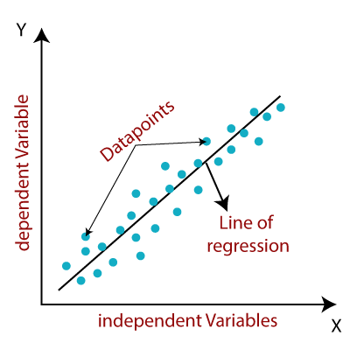

Slide 15
Simple linear regression :The most elementary type of regression model is the simple linear regression which explains the relationship between a dependent variable and one independent variable using a straightline. The straight line is plotted on the scatter plot of these two points.
Simple linear regression has standard equation of the regression line is given by the following expression:
Y = β₀+ β₁X; β₀ is intercept & β₁ is slope.
For example we saw the graph below there is higher correlation b/w temperature and total count in bike rental assignment . One is dependent variable another one is independent.
Assumptions of Linear Regression:
1. Linear relationship between X and Y .
2. Error terms are normally distributed (not X, Y).
3. Error terms are independent of each other.
4. Error terms have constant variance (homoscedasticity).

Slide 16
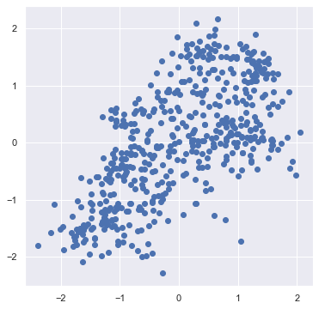

Slide 17
Next we check the regression line is positive or negative .
We check the best fit line that means the error between predicted values and actual values should be minimized. The best fit line will have the least error. Using cost function we analysis the best fit line.
Multiple linear regression : If more than one independent variable is used to predict the value of a numerical dependent variable, then such a Linear Regression algorithm is called Multiple Linear Regression. Simple linear regression has standard equation of the regression line is given by the following expression.
Y = β₀+ β₁X1+ β2x2 +......+ ε.
Assumptions for Multiple Linear Regression:
A linear relationship should exist between the Target and predictor variables.
The regression residuals must be normally distributed.
MLR assumes little or no multicollinearity (correlation between the independent variable) in data.

Slide 18
2. Explain the Anscombe’s quartet in detail?
Anscombe's quartet comprises four data sets that have nearly identical simple descriptive statistics , yet have very different distributions and appear very different when graphed. Each dataset consists of eleven (x , y) points.
Anscombe's quartet highlights “ the importance of plotting data to confirm the validity of the model fit.”
For example: The graph shown below
In the first one(top left) if you look at the scatter plot you will see that there seems to be a linear relationship between x and y.

Slide 19
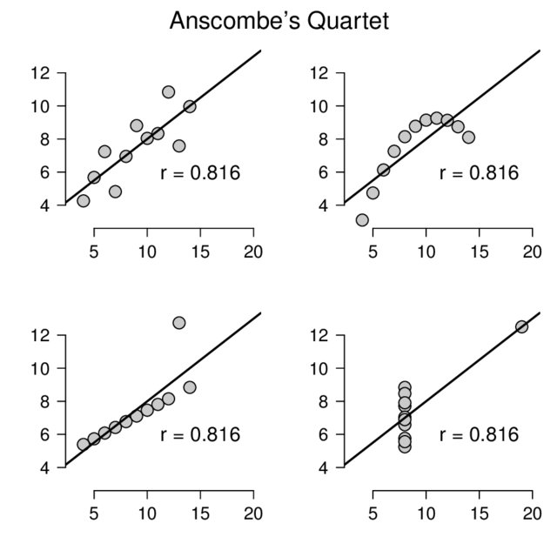
In the second one(top right) if you look at this figure you can conclude that there is a non-linear relationship between x and y.
In the third one(bottom left) you can say when there is a perfect linear relationship for all the data points except one which seems to be an outlier which is indicated be far away from that line.
Finally, the fourth one(bottom right) shows an example when one high-leverage point is enough to produce a high correlation coefficient.

Slide 20
3. What is Pearson’s R?
Is a measure of linear correlation between two sets of data.
It is the covariance of two variables, divided by the product of their standard deviations; thus it is essentially a normalised measurement of the covariance, such that the result always has a value between −1 and 1.
The Pearson's correlation coefficient varies between -1 and +1 where:
r = 1 means the data is perfectly linear with a positive slope ( i.e., both variables tend to change in the same direction).
r = -1 means the data is perfectly linear with a negative slope ( i.e., both variables tend to change in different directions)
r = 0 means there is no linear association.
r > 0 < 5 means there is a weak association.
r > 5 < 8 means there is a moderate association.
r > 8 means there is a strong association.

Slide 21
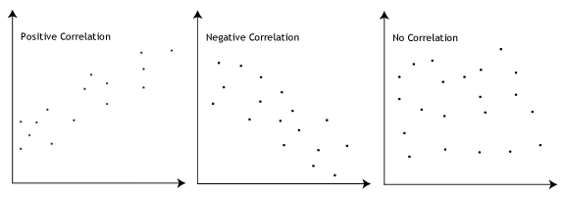

Slide 22
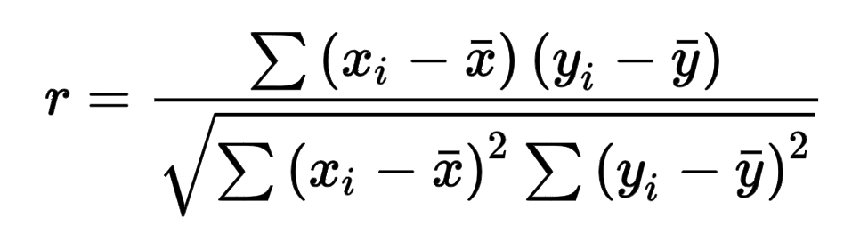
Here, r=correlation coefficient xi=values of the x-variable in a sample x=mean of the values of the x-variable yi=values of the y-variable in a sample y=mean of the values of the y-variable

Slide 23
4. What is scaling? Why is scaling performed? What is the difference between normalized scaling and standardized scaling?
It is a step of data pre-processing which is applied to independent variables to normalize the data within a particular range. It also helps in speeding up the calculations in an algorithm.
Most of the times, collected data set contains features highly varying in magnitudes, units and range. If scaling is not done then algorithm only takes magnitude in account and not units hence incorrect modelling. To solve this issue, we have to do scaling to bring all the variables to the same level of magnitude.
It is important to note that scaling just affects the coefficients and none of the other parameters like t-statistic, F-statistic, p-values, R-squared, etc.

Slide 24
Normalization/Min-Max Scaling:
It brings all of the data in the range of 0 and1.
sklearn.preprocessing.MinMaxScaler helps to implement normalization in python.
MINMAX: X= x-min(x)/max(x)-min(x)
Standardization Scaling:
Standardization replaces the values by their Z scores. It brings all of the data into a standard normal distribution which has mean (μ) zero and standard deviation one (σ).
sklearn.preprocessing.scale helps to implement standardization in python.
Standardization Scaling: x = x-mean(x) / sd (x)
One disadvantage of normalization over standardization is that it loses some information in the data, especially about outliers.

Slide 25
5. You might have observed that sometimes the value of VIF is infinite. Why does this happen?
If there is perfect correlation, then VIF = infinity. This shows a perfect correlation between two independent variables. In the case of perfect correlation, we get R2 =1, which lead to 1/(1-R2) infinity. To solve this problem we need to drop one of the variables from the dataset which is causing this perfect multicollinearity.
An infinite VIF value indicates that the corresponding variable may be expressed exactly by a linear combination of other variables (which show an infinite VIF as well).
In this plot we saw the VIF value is 1.88.

Slide 26
6. What is a Q-Q plot? Explain the use and importance of a Q-Q plot in linear regression?
In statistics ,a Q-Q(quantile-quantile) plot is a probability plot, Which is graphically compared the two quantiles against each other.
A q-q plot is used to compare the shapes of distributions ,providing a graphical views of how properties such as location ,scale and skewness are similar or different in the two distributions.
Q-Q plot importance are:
1. It can be used with sample sizes .
2.Many distributional aspects like shifts in location , shifts in scale, changes in symmetry ,and the presence of outliers can all be detected from this plot.
For ex: Shown below

Slide 27
