Slide 1
Medical Recommendation Chatbot
Shraddha Laddha
Semester 4, B.Sc. (Hons.) Data Analytics and AI
IIS (Deemed to be) University, Jaipur

Slide 2
Abstract
A web-based chatbot offering OTC suggestions based on user-described symptoms. Uses keyword detection and a predefined dataset to provide recommendations.

Slide 3
Introduction
Chatbots can provide scalable basic medical guidance. This project develops a chatbot that recommends medicines for common symptoms before professional consultation.

Slide 4
Methodology
- Extract keywords
- Match with symptoms
- Recommend medicines
- Fallback if no match

Slide 5
Design
Built with HTML and CSS. Features include:
- Chat interface
- Symptom input field
- Mobile and desktop support

Slide 6
Backend & Privacy
Backend: JavaScript-only logic using dummy data.
Privacy: No data stored or transmitted. For educational use only.

Slide 7
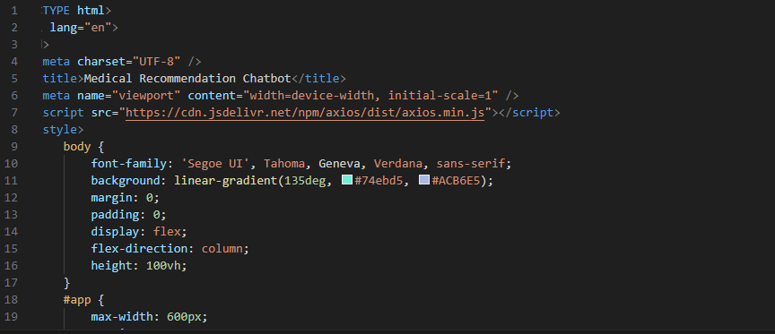
Code snippets

Slide 8
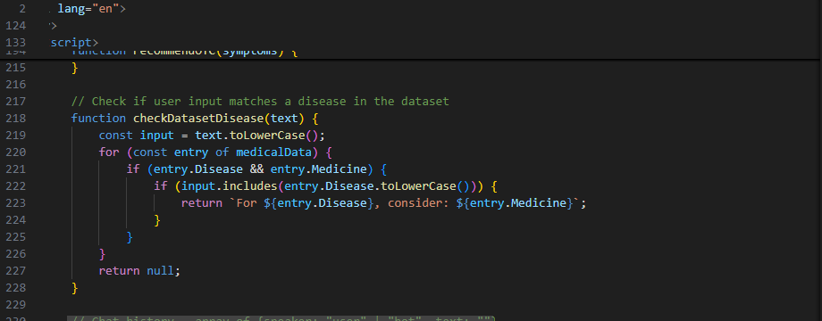

Slide 9
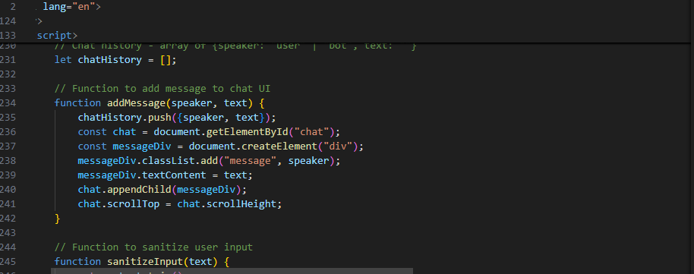

Slide 10
Testing & Results
Tested with known symptoms. Users found it relevant and helpful.
Limitations:
- Static dataset
- No NLP for complex inputs

Slide 11
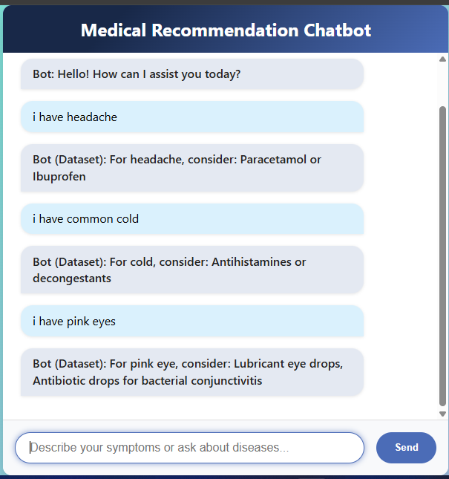

Slide 12
References & Conclusion
References:
- Kaggle Datasets
- MDN Docs, W3Schools, Stack Overflow
Conclusion: Effective for basic medical help, room for AI/NLP enhancement.

