Slide 1
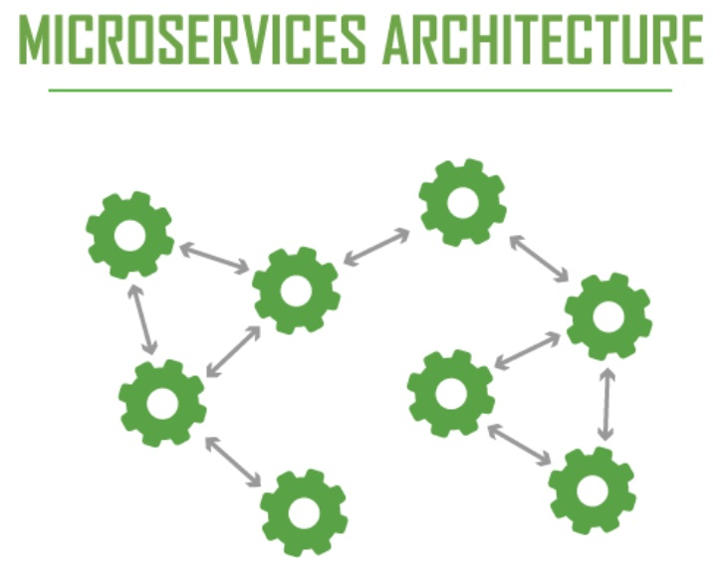
Microservices
PowerPoint Template Genpact2014.8

Slide 2
Agenda
Agenda
Introduction to Microservices
Monolith vs. Microservices architecture
Challenges with Microservices
Spring cloud Service Discovery and Registry
Why use Service Discovery
The Client‑Side Discovery Pattern
The Server‑Side Discovery Pattern
The Service Registry
Spring cloud Circuit Breaker using Hystrix

Slide 3
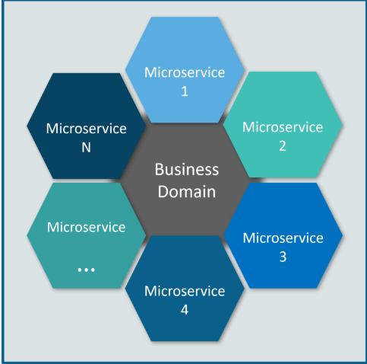
Introduction to Microservices:
Microservices, aka Microservices Architecture, is an architectural style that structures an application as a collection of small autonomous services, modeled around a business domain.

Slide 4
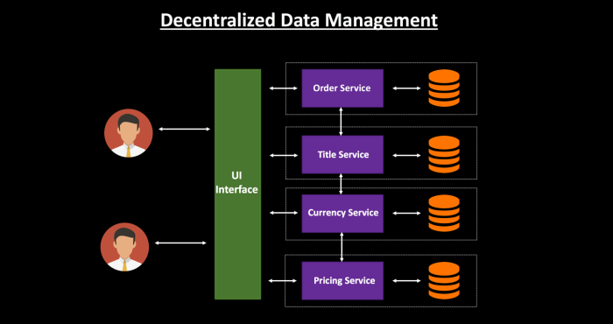
Introduction to Microservices
In Microservice Architecture, each service is self-contained and implements a single business capability.
Each microservice should have its own database and should contain data relevant to that microservice itself. This will allow you to deploy individual services independently.

Slide 5
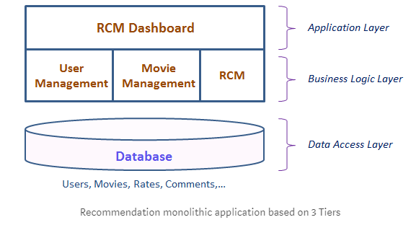
Monolith vs. Microservices Architecture:
Monolith vs Microservices Architecture
Monolith Architecture: A monolithic application has single code base with multiple modules. Modules are divided as either for business features or technical features. It has single build system which build entire application. It also has single executable or deployable binary.

Slide 6
Monolith vs Microservices
Advantages of Monolith:
Fewer Cross-cutting Concerns: The major advantage of the monolithic architecture is that most apps typically have a large number of cross-cutting concerns, such as logging, rate limiting, and security features such audit trails and DOS protection. When everything is running through the same app, it’s easy to hook up components to those cross-cutting concerns.
Testing is very simple. Just launch the application and start end-to-end testing. We can also do test automation using Selenium without any difficulty.
Deploying the monolithic application is straightforward; just copy the packaged application to the server.
Disadvantages of Monolith:
Flexibility: Monolithic architecture is not flexible. We can’t use different technologies. The technology stack is decided at the start and followed throughout.

Slide 7
Monolith vs Microservices:
Reliability: It's not reliable. If one feature goes down, the entire application might go down.
Development speed: Development is really slow in monolithic architecture. It's difficult for new team members to understand and modify the code of a large monolithic application
Continuous deployment: Continuous deployment is extremely difficult. Large monolithic applications are actually an obstacle to frequent deployments. In order to update one component, we have to redeploy the entire application.

Slide 8
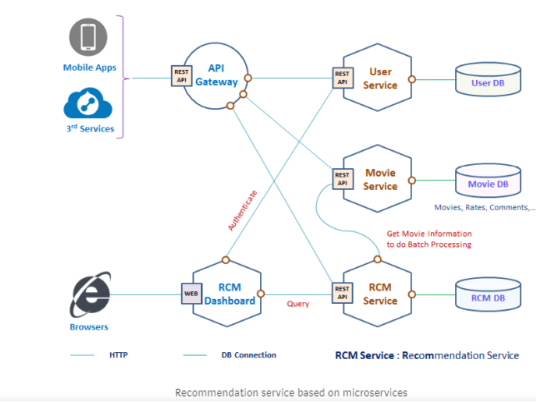
Microservices Architecture: A Microservices architecture consists of a collection of small, autonomous services. Each service is self-contained and should implement a single business capability
Monolith vs Microservices Architecture

Slide 9
Monolith Vs. Microservices:
Advantages of Microservices:
Flexibility: Microservices architecture is quite flexible. Different Microservices can be developed in different technologies
Reliability: Microservices architecture can be very reliable. If one feature goes down, the entire application doesn’t go down.
Development speed: Development is pretty fast in Microservices architecture. Since the volume of code is much less for a Microservice, it’s not difficult for new team members to understand and modify the code.
Development speed: Development is pretty fast in Microservices architecture. Since the volume of code is much less for a Microservice, it’s not difficult for new team members to understand and modify the code.

Slide 10
Monolith Vs. Microservices:
Challenges with Microservices:
Inter Service Communication: It's complex to communicate between Microservices. There are the different way to communicate - Point to point using API Gateway and pub/sub event driven model
Data Synchronization (Consistency) — We have event sourcing architecture to address this issue using the async messaging platform. The SAGA design pattern can address this challenge.
Monitoring: The traditional forms of monitoring and diagnostics will not align well with Microservices since you have multiple services making up the same functionality previously supported by a single application. When a problem arises in the application, finding the root cause can be challenging if you do not have a means of monitoring and tracking the path a specific request took
Fault Tolerance: It is important that individual services do not bring down the overall system. Fault tolerance at the service level, and more importantly, at the overall solution level, is critical. Given the complexity of a microservices environment and the complex dependency chains, failure is inevitable. Microservices need to be able to withstand both internal and external failures

Slide 11
Monolith Vs. Microservices:
Testing is much more complex in a Microservices environment due to the different services, their integration, and interdependencies. The team members responsible for quality assurance need to be knowledgeable on the order and channels of communications between services to have full coverage in their test cases.0

Slide 12
Spring cloud Service Discovery and Registry:
Spring cloud Service Discovery and Registry
Why Service Discovery:
Let’s imagine that you are writing some code that invokes a service that has a REST API. In order to make a request, your code needs to know the network location (IP address and port) of a service instance. In a traditional application running on physical hardware, the network locations of service instances are relatively static.
In a modern, cloud‑based microservices application, however, this is a much more difficult problem to solve as shown in the following diagram

Slide 13
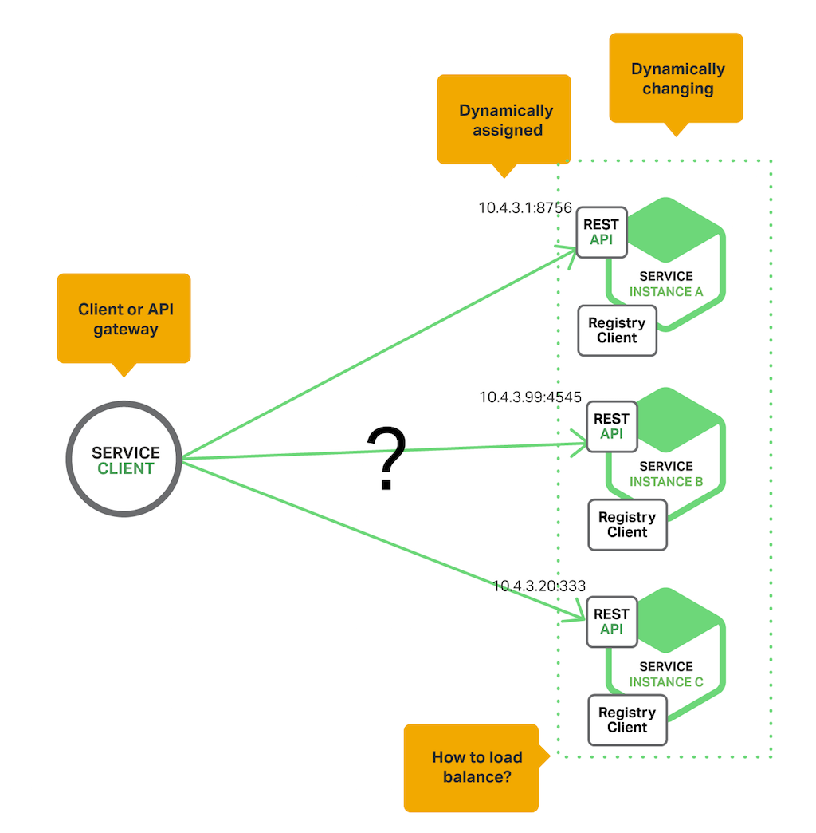
Spring cloud Service Discovery and Registry

Slide 14
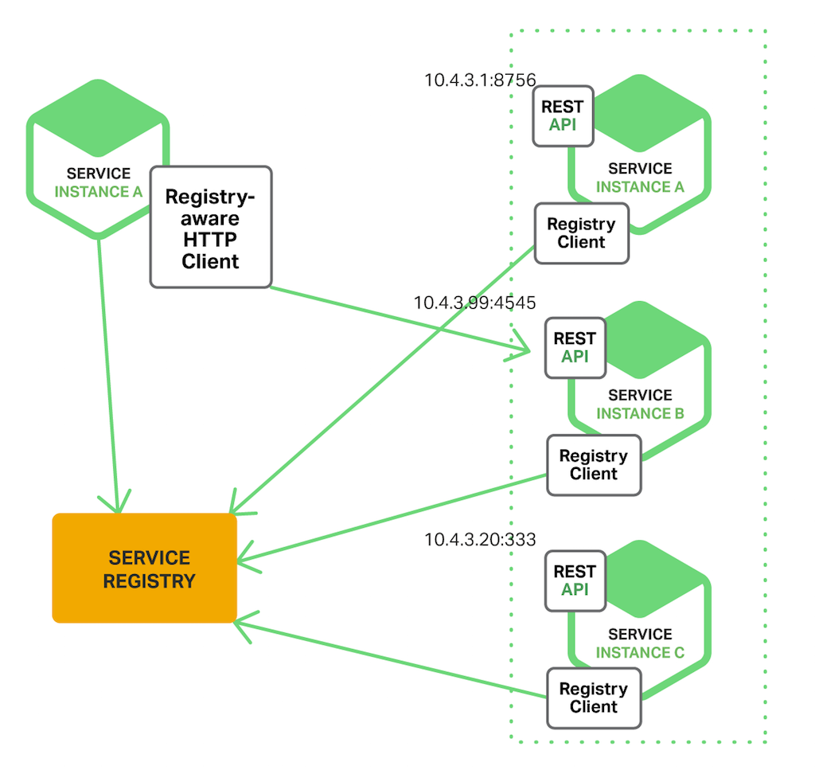
The Client‑Side Discovery Pattern: When using client‑side discovery, the client is responsible for determining the network locations of available service instances and load balancing requests across them. The client queries a service registry, which is a database of available service instances. The client then uses a load‑balancing algorithm to select one of the available service instances and makes a request

Slide 15
Spring cloud Service Discovery and Registry
Netflix OSS provides a great example of the client‑side discovery pattern
Netflix Ribbon is an IPC client that works with Eureka to load balance requests across the available service instances

Slide 16
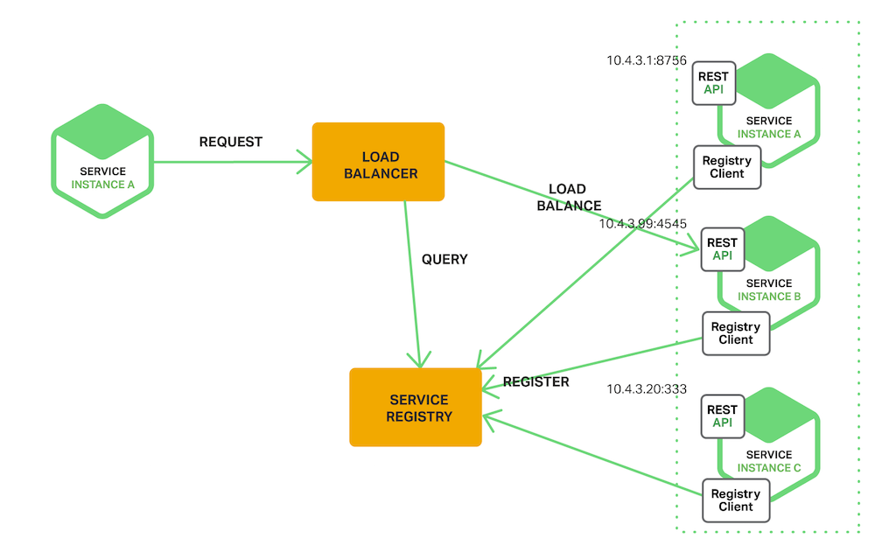
Spring cloud Service Discovery and Registry
The Server‑Side Discovery Pattern: The other approach to service discovery is the server-side discovery pattern.
The client makes a request to a service via a load balancer. The load balancer queries the service registry and routes each request to an available service instance. As with client‑side discovery, service instances are registered and deregistered with the service registry

Slide 17
Spring cloud Service Discovery and Registry
The Service Registry: The service registry is a key part of service discovery. It is a database containing the network locations of service instances
Clients can cache network locations obtained from the service registry.
Netflix Eureka is good example of a service registry. It provides a REST API for registering and querying service instances. A service instance registers its network location using a POST request. Every 30 seconds it must refresh its registration using a PUT request. A registration is removed by either using an HTTP DELETE request or by the instance registration timing out.
Consul is also a great example of Service Registery.

Slide 18
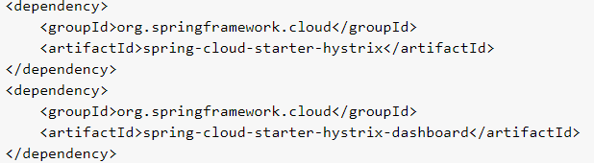
Spring cloud Circuit Breaker using Hystrix:
Spring cloud Circuit Breaker using Hystrix: One of the Spring cloud Netflix stack component called Hystrix to implement circuit breaker while invoking underlying microservices.
It is generally required to enable fault tolerance in the application where some underlying service is down/throwing error permanently
Steps to configure Hystrix:
Step1. Add Hystrix starter and dashboard dependencies.
Step2. Add @EnableCircuitBreaker annotation
Step3. Add @EnableHystrixDashboard annotation
Step4. Add annotation @HystrixCommand(fallbackMethod = "myFallbackMethod")

