Slide 1
23CSE301 MACHINE LEARNING CAPSTONE
US Accidents — Accident Distance Regression
& Severity Classification
Review 1 Evaluation — An end-to-end empirical study of spatio-temporal, environmental and roadway-infrastructure factors influencing accident impact.
AMRITA VISHWA VIDYAPEETHAM
Vibin Ragav S
Shre Raam P J
Nitin Pranav
CB.SC.U4CSE24556
CB.SC.U4CSE24548
CB.SC.U4CSES24539
Course: 23CSE301 Machine Learning

Slide 2
01 · PROBLEM
02 / 18
Problem Statement & Motivation
Two supervised-learning tasks are defined on the same US Accidents feature space — one continuous, one multiclass — to study what pre-incident information can (and cannot) tell us about an accident's outcome.
TASK 1 — REGRESSION
Predict the physical road-impact distance of an accident using strictly pre-incident environmental, temporal and spatial attributes.
US Accident Data
(42,768 records)
Informs expected traffic disruption extent
Supports congestion / lane-closure planning
ML Preprocessing Pipeline
TASK 2 — CLASSIFICATION
REGRESSION
Distance(mi)
Continuous
CLASSIFICATION
Severity
1 – 4
Predict the discrete severity tier (1–4) of a traffic incident from contextual predictors available at report time.
Prioritises emergency-response dispatch
Feeds severity-aware transportation management
Both tasks study temporal, geographic, environmental and roadway-infrastructure factors associated with accident impact.
23CSE301 · US ACCIDENTS ML CAPSTONE

Slide 3
02 · DATA
03 / 18
Dataset Overview & Statistical Properties
42,768
47
49
2
RAW RECORDS
FEATURE COLUMNS
US STATES COVERED
PREDICTION TARGETS
US_Accidents_Dec20_Updated.csv — nationwide traffic-accident data (2016–2020) capturing temporal, geographic, weather and road-infrastructure attributes for each incident.
Temporal
Geographic
Weather
Infrastructure
Start_Time
Start_Hour*
Day_of_Week*
Month*
Start_Lat / Lng
State, City
Zipcode, Airport
Temperature(F)
Humidity(%)
Visibility, Wind
Traffic_Signal
Crossing, Junction
Roundabout, Stop
Targets: Distance(mi) — regression • Severity (1–4) — classification. *Engineered temporal features (Section 03).
23CSE301 · US ACCIDENTS ML CAPSTONE

Slide 4
02 · DATA
04 / 18
Exploratory Data Analysis
Distance(mi) is strongly right-skewed
Severity is heavily class-imbalanced
82% of accidents affect ≤ 0.5 miles of road
Long-tail outliers extend to ≈148 miles
Motivates log-scale inspection & robust metrics
Severity 2 alone accounts for 73.1% of records
Severity 1 is rare: only 433 of 42,768 records
Detailed on the next slide — this drives evaluation design
23CSE301 · US ACCIDENTS ML CAPSTONE

Slide 5
02 · DATA
05 / 18
Class Imbalance: Why Accuracy Alone Fails
Severity class distribution (n = 42,768)
THE NAIVE-CLASSIFIER TRAP
A model that predicts “Severity 2” for every record achieves ≈73.1% accuracy — with zero ability to discriminate minority classes.
SO WE EVALUATE WITH:
Weighted F1-score — balances precision & recall per class, weighted by support
Confusion Matrices — expose exactly which severity tiers are confused
Stratified train/test split — preserves class ratios in both partitions
Severity 1
433
1.0%
Severity 2
31,273
73.1%
Severity 3
9,304
21.8%
Severity 4
1,758
4.1%
23CSE301 · US ACCIDENTS ML CAPSTONE

Slide 6
03 · PIPELINE
06 / 18
Data Cleaning
Raw Data
(42,768)
Invalid-record
Removal
Duplicate
Check
Missing-value
Handling
High-cardinality
Reduction
Leakage
Removal
Feature
Engineering
Model-ready
Dataset
0
1
Median
Most-Frequent
Duplicate rows found in the raw 42,768-row dataset
Invalid record removed — null Distance(mi) target & near-empty row
Imputation strategy for numerical missing values
Imputation strategy for categorical & boolean missing values
Top missing-value columns (raw data audit)
Number
Precipitation(in)
Wind_Chill(F)
Wind_Speed(mph)
End_Lng / End_Lat
65.2%
44.9%
41.1%
10.6%
9.8%
23CSE301 · US ACCIDENTS ML CAPSTONE

Slide 7
03 · PIPELINE
07 / 18
Data Leakage Prevention
Excluded from the feature matrix X
BAD
Distance(mi), Severity
Target variables
Future / post-event
information → Model
End_Lat, End_Lng
Mark the end of the impact zone — Distance(mi) is derived from start/end coordinates
End_Time
Post-event: congestion-resolution time unknown at incident onset
ID
Arbitrary record identifier
GOOD
Description
Free-text narrative written after incident resolution
Only information available
at prediction time → Model
Street, City, Zipcode, Airport_Code
High cardinality (>1,000–17,000+ levels) — overfitting risk
Country, Turning_Loop
Zero variance (constant 'US' / False)
Number
65.1% missing
GOLDEN RULE
Train/test split is performed BEFORE fitting any transformer.
23CSE301 · US ACCIDENTS ML CAPSTONE

Slide 8
03 · PIPELINE
08 / 18
Feature Engineering
Start_Time (raw timestamp)
Numerical (11)
Start_Lat, Start_Lng
Temperature(F), Humidity(%)
Pressure(in), Visibility(mi)
Wind_Speed(mph)
Start_Hour, Day_of_Week, Month
Start_Hour
Day_of_Week
Month
0–23 hr · 0–6 (Mon–Sun) · 1–12
Categorical (5)
Start_Hour:
Captures diurnal traffic peaks — 7–9 AM & 4–6 PM rush hours vs. low-traffic night
Side, Timezone
Sunrise_Sunset
Weather_Condition
State (top-20)
Day_of_Week:
Differentiates weekday commuter traffic from weekend leisure patterns
Month:
Captures seasonal effects — winter snow/ice vs. summer travel volume
Boolean (≈13)
Traffic_Signal, Crossing
Junction, Stop, Roundabout, …
Empirical validation: Start_Hour and Day_of_Week rank among the top-6 most important features in the Random Forest importance analysis (Slide 13).
23CSE301 · US ACCIDENTS ML CAPSTONE

Slide 9
03 · PIPELINE
09 / 18
Preprocessing Pipeline
X (27 cols)
80% / 20%
STRATIFIED TRAIN / TEST SPLIT
Numerical
Categorical
Boolean
34,214
Median
Impute
Most-Frequent
Impute
Most-Frequent
Impute
CLASSIFICATION TRAINING SAMPLES
Standard
Scale
One-Hot
Encode
Pass-Through
8,554
TEST SAMPLES (BOTH TRACKS)
Processed Feature Matrix
67
StandardScaler, SimpleImputer & OneHotEncoder(handle_unknown='ignore') are fit ONLY on X_train, then applied to X_test.
PREPROCESSED FEATURE DIMENSIONS
Note: the regression track drops 1 record with a null Distance(mi) target → 34,213 training samples (vs. 34,214 for classification).
23CSE301 · US ACCIDENTS ML CAPSTONE

Slide 10
04 · REGRESSION
10 / 18
Regression Track — 10 Algorithms Compared
Target: Distance(mi) — continuous, non-negative. All 10 mandated regression algorithms are trained on the identical preprocessed 67-dimensional split.
01
02
03
04
05
Linear Regression
Ridge
Lasso
ElasticNet
Polynomial (deg=2)
Baseline OLS
L2-regularised
L1-regularised
L1 + L2 blend
Non-linear terms
06
07
08
09
10
Decision Tree
Random Forest
Gradient Boosting
SVR
KNN (k=7)
Recursive splits
Bagged ensemble
Boosted ensemble
Margin-based, RBF
Instance-based
Evaluated with R², RMSE and MAE on an identical 20% held-out test partition (8,554 samples).
23CSE301 · US ACCIDENTS ML CAPSTONE

Slide 11
04 · REGRESSION
11 / 18
Regression Results — Model Comparison
R² score by model (test set, ranked)
Random Forest
#1 by R²
R² 0.0485 · RMSE 1.508 · MAE 0.532
Gradient Boosting
#2 by R²
R² 0.0417 · RMSE 1.513 · MAE 0.529
SVR
Lowest MAE
R² -0.0141 · RMSE 1.556 · MAE 0.473
Overall R² is low across the board — accident distance is difficult to predict from available pre-incident variables alone.
HONEST READ
Tree ensembles lead, but explained variance stays under 5%. Impact distance is governed by factors beyond what pre-incident features capture.
23CSE301 · US ACCIDENTS ML CAPSTONE

Slide 12
04 · REGRESSION
12 / 18
Hyperparameter Tuning & Cross-Validation
GridSearchCV: baseline vs. tuned R²
5-Fold Cross-Validation R² (top-2 models)
Best parameters (GridSearchCV)
Random Forest: max_depth=10, min_samples_split=5, n_estimators=100
Gradient Boosting: learning_rate=0.05, max_depth=3, n_estimators=100
Model Mean R² Std Dev
Random Forest
-0.0431
0.0972
Gradient Boosting
-0.1043
0.1546
Gradient Boosting improved (0.0417 → 0.0455). Random Forest tuning slightly reduced test R² (0.0485 → 0.0419).
Key finding: tuning does NOT guarantee better generalisation — cross-validated R² turns negative, showing high fold-to-fold variance on this weak signal.
23CSE301 · US ACCIDENTS ML CAPSTONE

Slide 13
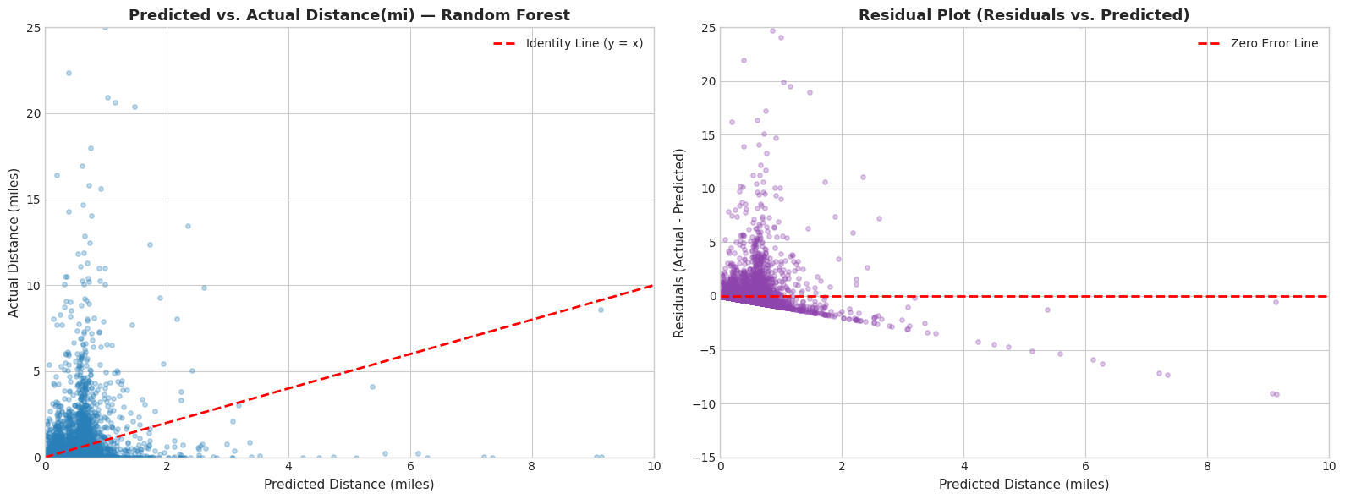
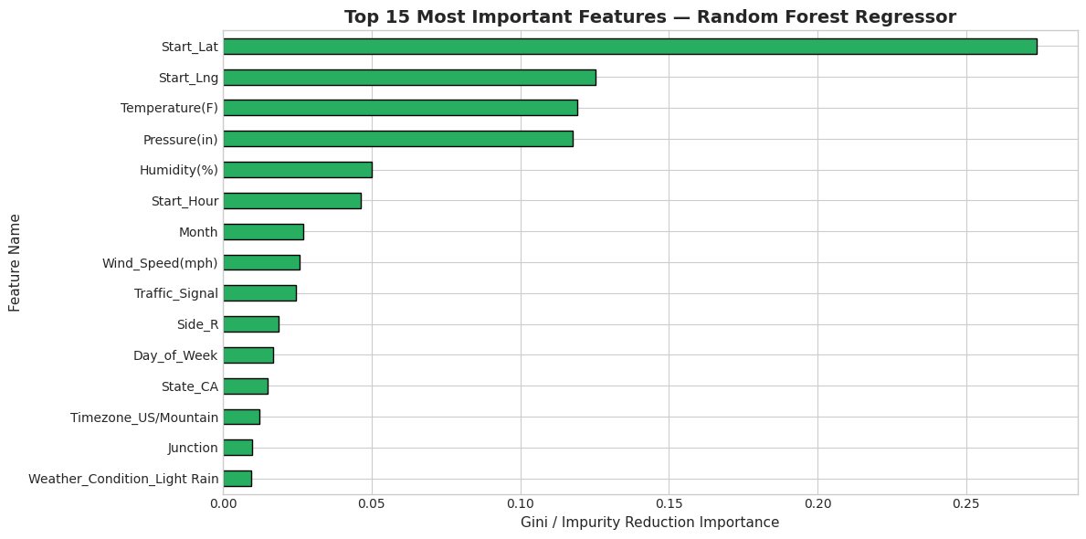
04 · REGRESSION
13 / 18
Regression Diagnostics
OBSERVATIONS (Random Forest)
Predictions cluster near low-distance accidents (0–2 mi); the model shrinks toward the mean for long-tail cases
Residual spread widens as predicted distance grows — heteroscedasticity
Start_Lat & Start_Lng are the dominant importance drivers
Start_Hour and Day_of_Week (engineered) rank in the top 6
Temperature, Pressure and Humidity contribute steadily
23CSE301 · US ACCIDENTS ML CAPSTONE

Slide 14
05 · CLASSIFICATION
14 / 18
Classification Approach
Preprocessed Accident
Features (67-dim)
1
Logistic Regression
Multinomial linear baseline
Stratified Train / Test
Split (80 / 20)
2
K-Nearest Neighbors
k = 7
5 Classifiers
(Part A)
Gaussian Naive Bayes
3
Conditional-independence assumption
Predicted Severity
(1 – 4)
4
Decision Tree
max_depth = 10
Accuracy
Weighted F1
Confusion Matrix
5
SVC
All 5 models train and evaluate on the SAME preprocessed split for a fair comparison.
RBF kernel
23CSE301 · US ACCIDENTS ML CAPSTONE

Slide 15
05 · CLASSIFICATION
15 / 18
How the Classifiers Work
Decision Tree
K-Nearest Neighbors
Logistic Regression
Recursive, feature-based splits that partition the data into severity-homogeneous regions.
Classifies by majority vote among the k = 7 nearest observations in feature space.
Estimates class probabilities via a linear decision boundary (multinomial softmax).
SVC (RBF Kernel)
Gaussian Naive Bayes
Finds a maximum-margin, non-linear decision boundary using kernel-transformed features.
Applies Bayes' theorem assuming features are conditionally independent given the class.
One concise mechanism statement per algorithm — full derivations are covered verbally during the viva.
23CSE301 · US ACCIDENTS ML CAPSTONE

Slide 16
05 · CLASSIFICATION
16 / 18
Classification Results
Accuracy (%)
Weighted F1-score
MODEL
ACCURACY
WEIGHTED F1
TRAIN TIME
Decision Tree
73.71%
0.6747
0.23 s
KNN (k=7)
71.80%
0.6725
0.004 s
Logistic Regression
73.38%
0.6598
1.25 s
SVC (RBF)
62.43%
0.6171
21.65 s
Gaussian NB
14.17%
0.1608
0.035 s
Decision Tree records the highest observed accuracy and weighted F1 in this experiment — not a universal claim, but the outcome on this held-out split.
23CSE301 · US ACCIDENTS ML CAPSTONE

Slide 17
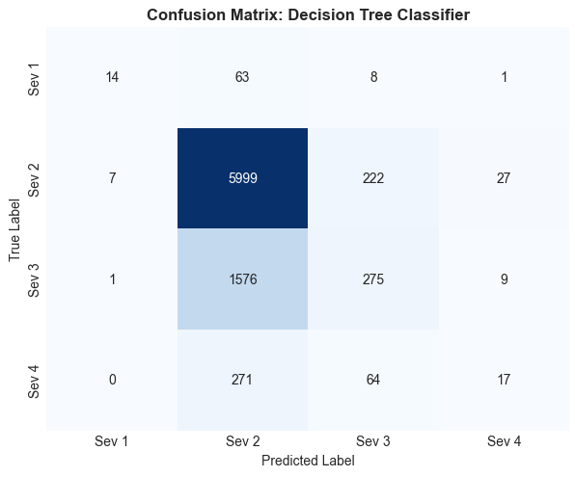
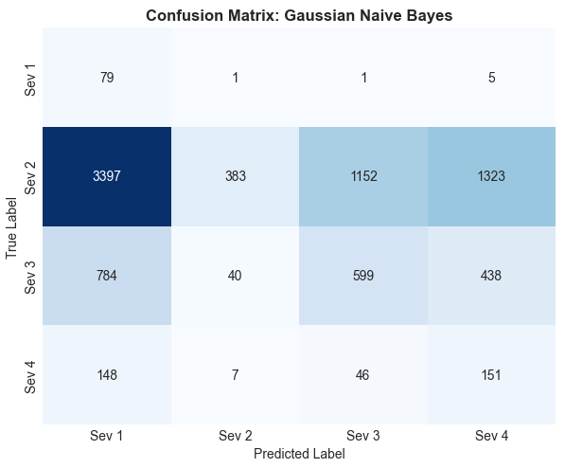
05 · CLASSIFICATION
17 / 18
Classification Analysis & Confusion Matrices
READING A CONFUSION MATRIX
Diagonal = correct predictions per class
Off-diagonal = misclassifications between severity tiers
Decision Tree: strong majority-class recall, some minority (Sev 1/4) recognition
Gaussian NB: over-predicts Sev 3/4 and under-predicts the dominant Sev 2 class
Best: Decision Tree
Weakest: Gaussian NB
WHY GAUSSIAN NAIVE BAYES UNDERPERFORMS
Naive Bayes assumes conditional independence among features given the class. In this data, geographic coordinates, weather variables and infrastructure indicators are strongly correlated — an interpretation consistent with its 14.2% accuracy and 0.16 weighted F1, not a proven causal explanation.
23CSE301 · US ACCIDENTS ML CAPSTONE

Slide 18
06 · FINDINGS
18 / 18
Final Results, Limitations & Review 2 Roadmap
REGRESSION
CLASSIFICATION
LIMITATIONS
10 models evaluated on an identical split
Random Forest / Gradient Boosting strongest by R²
SVR lowest MAE (outlier-robust)
Overall predictive signal for Distance is weak
Tuning + 5-fold CV performed
5 Part-A models evaluated on a stratified split
Decision Tree: highest observed Accuracy / F1
Severe class imbalance (Sev 2 = 73.1%)
Confusion matrices used for class-level insight
Gaussian NB substantially underperformed
Severe class imbalance in Severity
Low regression explanatory power
Long-tail Distance distribution
Minority classes are hard to classify
Pre-incident features miss causal factors
REVIEW 2 ROADMAP
Random Forest Classifier • AdaBoost • Gradient Boosting • Bagging • MLP Neural Network • full Clustering track • potential deployment component
From Raw Accident Data → Leakage-Safe Features → Comparative ML Models → Interpretable Evaluation
Thank You
Questions?
23CSE301 · US ACCIDENTS ML CAPSTONE

