Slide 1
23CSE301 MACHINE LEARNING CAPSTONE | REVIEW 2
US Accidents:
Accident Distance Regression
and Severity Classification
Ten classifiers compared, the best one tuned, and accident clusters found without labels
Vibin Ragav S
Shre Raam P J
Nitin Pranav
CB.SC.U4CSE24556
CB.SC.U4CSE24548
CB.SC.U4CSE24539
Amrita Vishwa Vidyapeetham, Coimbatore
Notes:
Introduce the project and the team. Review 1 covered regression and five classifiers. Today: the other five classifiers, a single comparison of all ten, tuning of the final model, and the clustering track.

Slide 2
Where we are: Review 1 and Review 2
Review 1 (done)
Review 2 (this talk)
Data audit, EDA and cleaning
Regression: 10 models, tuning and cross-validation
Classification Part A: Logistic Regression, KNN, Naive Bayes, Decision Tree, SVC
Best Part A model: Decision Tree (accuracy 73.71%, weighted F1 0.6747)
Classification Part B: Random Forest, AdaBoost, Gradient Boosting, Bagging, MLP
One table that compares all 10 classifiers
Choose the final model and tune it
Clustering: K-Means and Agglomerative, with elbow curve, dendrogram, PCA and t-SNE
Same dataset, same targets and the same 80/20 split as Review 1.
US Accidents | ML Capstone | Review 2
2
Notes:
Review 1 results are unchanged. The Part A numbers here match the Review 1 slides.

Slide 3
The dataset
42,768 accident records, 47 columns, 49 US states, February 2016 to December 2020
Inputs: time, location, weather and road features near the accident
Regression target: Distance(mi), the road length affected
Classification target: Severity, classes 1 to 4
Clustering uses no target at all
Share of accidents by severity (%)
Always guessing "Severity 2" is right 73.1% of the time, so accuracy alone can mislead. We also use weighted F1 and confusion matrices.
US Accidents | ML Capstone | Review 2
3
Notes:
Counts: severity 1 = 433, severity 2 = 31,273, severity 3 = 9,304, severity 4 = 1,758. The last record of the supplied file is cut off, which we mention in the limitations.

Slide 4
Preparing the data without leaking information
1
Split first
2
Fit on train only
3
Apply to test
80% train (34,214 rows) and 20% test (8,554 rows). Stratified, random_state = 42.
Imputer, scaler and one-hot encoder learn their values from the training rows only.
The fitted steps transform the test rows. Result: 67 features.
Columns we removed, and why
End_Lat, End_Lng, End_Time: only known after the accident
Distance(mi), Severity: they are the targets
ID, Description: identifier and free text
Street, City, Zipcode, Airport_Code: too many categories
Country, Turning_Loop: constant values
Number: 65% missing
US Accidents | ML Capstone | Review 2
4
Notes:
In the notebook we check with an assertion that the scaler saw exactly 34,214 rows. Cross-validation uses pipelines, so preprocessing is re-fitted inside every fold.

Slide 5
The 10 classification algorithms
# | Algorithm | Part | Main setting
1 | Logistic Regression | A | Linear baseline
2 | K-Nearest Neighbors | A | k = 7
3 | Gaussian Naive Bayes | A | Assumes independent features
4 | Decision Tree | A | max_depth = 10
5 | Support Vector Classifier | A | RBF kernel, stopped at 3,000 iterations
6 | Random Forest | B | 200 trees
7 | AdaBoost | B | 100 decision stumps
8 | Gradient Boosting | B | 100 trees, depth 3, learning rate 0.1
9 | Bagging | B | 50 decision trees (depth 10)
10 | MLP neural network | B | Layers (64, 32), ReLU, early stopping
Part A = Review 1 (white rows). Part B = new in Review 2 (shaded rows). All ten use the same train and test split.
US Accidents | ML Capstone | Review 2
5
Notes:
Part B settings are sensible starting values. Tuning is applied only to the model we select later.

Slide 6
How we compare the classifiers
Metrics for every model
How we rank
Accuracy
Precision, recall and F1, weighted by class size
Confusion matrix
ROC-AUC, One-vs-Rest: each severity class against the rest, then the average of the four AUC values
1st: weighted F1
2nd (tie-break): ROC-AUC
Accuracy is shown but not used to rank
About the SVC
It was trained without probabilities, so we use its decision scores for ROC-AUC. AUC only needs a ranking, so this is valid. Every model has a real AUC value.
US Accidents | ML Capstone | Review 2
6
Notes:
Our One-vs-Rest helper was checked against scikit-learn roc_auc_score for the nine models that give probabilities, and the values were identical.

Slide 7
Results: all 10 classifiers on the same test set
Rank | Model | Accuracy | Precision | Recall | F1 | ROC-AUC
1 | Random Forest | 0.7490 | 0.7160 | 0.7490 | 0.6953 | 0.8170
2 | Gradient Boosting | 0.7495 | 0.7198 | 0.7495 | 0.6807 | 0.8181
3 | MLP (neural net) | 0.7430 | 0.6997 | 0.7430 | 0.6790 | 0.7997
4 | Decision Tree | 0.7371 | 0.6791 | 0.7371 | 0.6747 | 0.7154
5 | KNN | 0.7180 | 0.6622 | 0.7180 | 0.6725 | 0.6889
6 | Bagging | 0.7473 | 0.7184 | 0.7473 | 0.6707 | 0.7848
7 | Logistic Regression | 0.7336 | 0.6579 | 0.7336 | 0.6597 | 0.7745
8 | AdaBoost | 0.7312 | 0.6327 | 0.7312 | 0.6252 | 0.6981
9 | SVC | 0.6243 | 0.6156 | 0.6243 | 0.6171 | 0.6856
10 | Gaussian Naive Bayes | 0.1417 | 0.7257 | 0.1417 | 0.1608 | 0.6667
Test set: 8,554 accident records. Precision, recall and F1 are weighted. Ranked by F1, then ROC-AUC. Accuracy of always guessing Severity 2: 0.731.
US Accidents | ML Capstone | Review 2
7
Notes:
Random Forest is first on weighted F1 (0.6953). Gradient Boosting has the highest ROC-AUC (0.8181). The gaps between the top models are small.

Slide 8
Weighted F1 and ROC-AUC side by side
Weighted F1 (higher is better)
ROC-AUC, One-vs-Rest (higher is better)
The ensembles and the neural network lead. Gaussian Naive Bayes is far behind (accuracy only 14.2%).
US Accidents | ML Capstone | Review 2
8
Notes:
Gradient Boosting is first on AUC; Random Forest is second by 0.001. F1 and AUC do not always rank the models the same way.

Slide 9
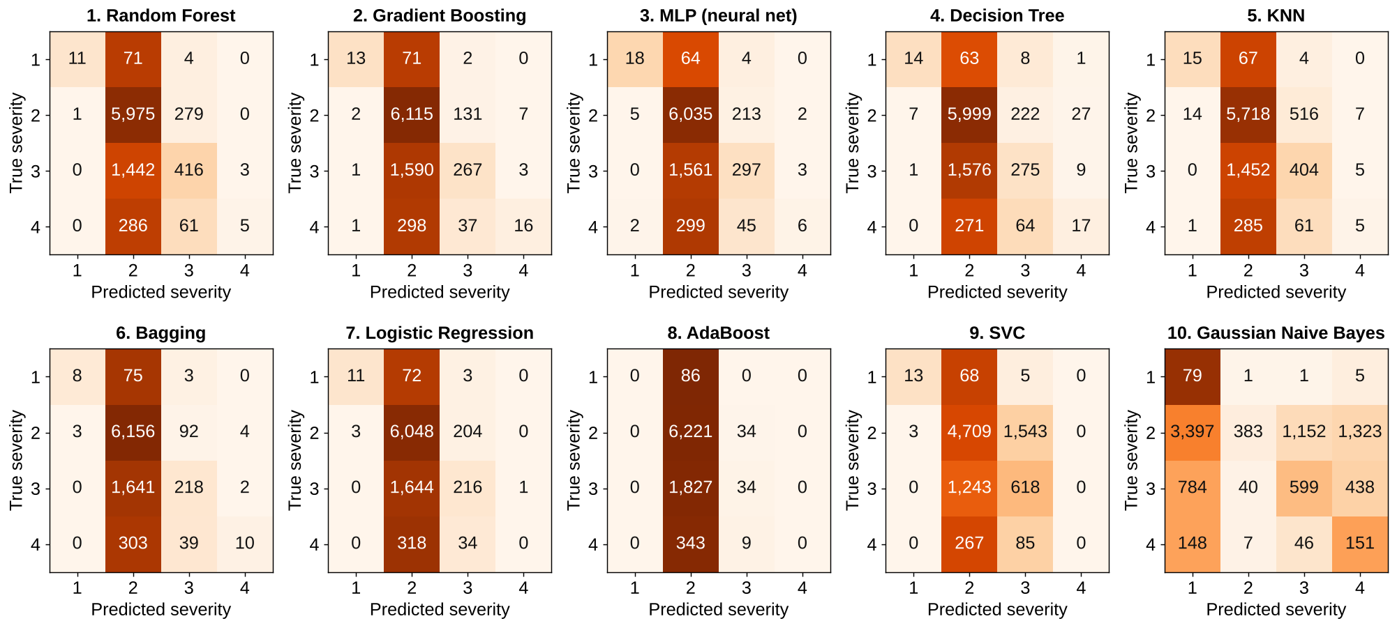
Confusion matrices: where each model goes wrong
Rows: true severity. Columns: predicted severity. Numbers are record counts; darker orange means a larger share of that true class. Almost every model predicts Severity 2 for most records, so Severity 3 and 4 are rarely found.
US Accidents | ML Capstone | Review 2
9
Notes:
Gaussian Naive Bayes is the exception: it predicts Severity 1 for 3,397 of the 6,255 Severity 2 test records. Gradient Boosting and the Decision Tree find the most Severity 4 accidents (16 and 17 of 352).

Slide 10
Choosing the final model
5-fold cross-validation, weighted F1 (training data)
Random Forest ranks first: 0.6938 (spread 0.0030)
Cross-validation uses the training data only
Preprocessing is re-fitted inside every fold
The test set was not used to choose the model
Random Forest is also first on the test table
US Accidents | ML Capstone | Review 2
10
Notes:
The SVC has a large spread between folds (0.048), which fits with the fact that it stops at 3,000 iterations and does not fully converge.

Slide 11
Tuning the Random Forest
Test metric | Before | After | Change
Accuracy | 0.7490 | 0.7547 | +0.0057
Precision (weighted) | 0.7160 | 0.7272 | +0.0112
Recall (weighted) | 0.7490 | 0.7547 | +0.0057
F1 (weighted) | 0.6953 | 0.7067 | +0.0114
ROC-AUC | 0.8170 | 0.8170 | -0.000003
Is the improvement real?
Weighted F1 0.6953 to 0.7067 (+0.0114), measured once on the test set
95% bootstrap interval: +0.0049 to +0.0179, which excludes zero
ROC-AUC did not change
Train minus test F1 gap fell from 0.305 to 0.156, but the model still overfits
Search: RandomizedSearchCV, 12 of 240 combinations, 3-fold CV, scored on weighted F1.
Best settings: 200 trees, max_depth 30, min_samples_leaf 5, max_features 0.5.
US Accidents | ML Capstone | Review 2
11
Notes:
The bootstrap interval only reflects noise from the test sample, because the model is fixed. The gain is about one point of F1, so we describe it as modest.

Slide 12
What the final model still gets wrong
Recall for each severity class (tuned Random Forest)
Severity 2 is found well (recall 0.952)
Severity 1 and 4 are rarely found (recall 0.105 and 0.040)
Weighted F1 is 0.707, but macro F1 is only 0.367
Per-class ROC-AUC is 0.76 to 0.94, so the probabilities carry signal
Next step: class weights or probability thresholds
US Accidents | ML Capstone | Review 2
12
Notes:
Recall is the share of real accidents of a class that the model finds. The support in the test set is 86, 6,255, 1,861 and 352 records for severity 1 to 4.

Slide 13
02
Clustering
Can we find groups of similar accidents without using any label?
Notes:
Switch to the clustering track. Severity and Distance are never given to the algorithms.

Slide 14
Clustering: the question and the data
Question: do accidents form natural groups by where, when, weather and nearby road features?
No labels: Severity and Distance(mi) are not used for the features, for choosing k or for sampling. We look at them only afterwards.
Features: latitude and longitude, five weather values, hour, weekday and month as sine and cosine pairs, night flag, six road flags
Preparation: median imputation, standard scaling for continuous features
Algorithms: K-Means and Agglomerative (Ward)
42,767
records (one cut-off record removed)
20
features after preparation
8,000
5,000
sample for Agglomerative
points in t-SNE
Random sample with seed 42. Chosen without looking at any label.
US Accidents | ML Capstone | Review 2
14
Notes:
Agglomerative clustering needs all pairwise distances, about 7 GB for 42,767 records, so it runs on a fixed random sample of 8,000. K-Means runs on all records.

Slide 15
K-Means: choosing k with the elbow curve
The curve bends gently, so there is no sharp elbow
Rule: pick the point farthest from the straight line between the two ends of the curve. That gives k = 6
Check: silhouette at k = 6 is 0.120, close to its best value 0.121 at k = 7
Final K-Means (all 42,767 records)
0.1195
Silhouette (higher is better)
1.929
Davies-Bouldin (lower is better)
4,345
Calinski-Harabasz (higher is better)
US Accidents | ML Capstone | Review 2
15
Notes:
Silhouette values stay between 0.106 and 0.121 for every k from 2 to 12, so no k separates the data strongly. Single-start K-Means runs agree with the final model only moderately (ARI 0.50 to 0.99), which is why the final fit uses 20 starts.

Slide 16
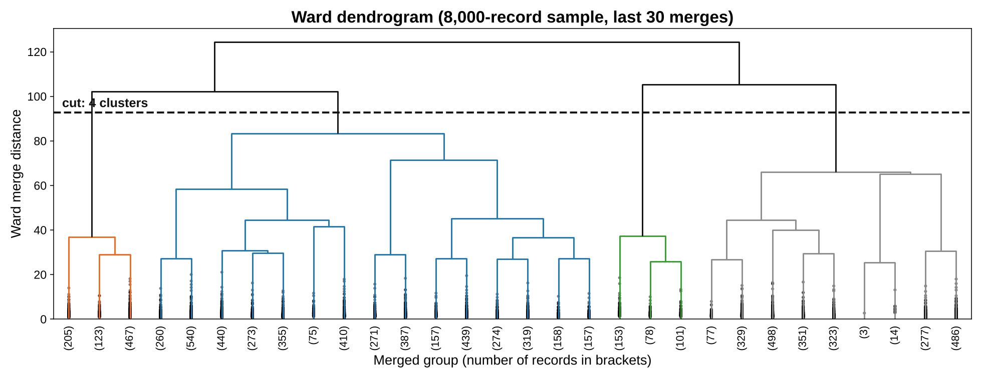
Agglomerative clustering: the dendrogram
Ward linkage on a random sample of 8,000 records (last 30 merges shown). The dashed line cuts the tree into 4 clusters, at the largest gap between merge heights.
US Accidents | ML Capstone | Review 2
16
Notes:
The gap before the 4-cluster cut (18.9) is almost as large as the gap before the 2-cluster cut (19.0), so the choice of 4 is not clear-cut.

Slide 17
Choosing the linkage
Linkage | Silhouette | Largest cluster | Smallest cluster
Ward | 0.080 | 29.5% | 4.15%
Complete | 0.236 | 94.9% | 0.04%
Average | 0.351 | 99.5% | 0.03%
Single | 0.468 | 99.8% | 0.01%
Single, average and complete linkage put 95% to 99.8% of the points into one cluster
Their higher silhouette comes from isolating a few outliers, so it is misleading
Ward gives balanced clusters
Same 8,000 records, k = 6 for all four linkages.
Final Agglomerative model: Ward, k = 4, fitted on the 8,000-record sample
Silhouette 0.1157 | Davies-Bouldin 2.179 | Calinski-Harabasz 756
US Accidents | ML Capstone | Review 2
17
Notes:
Ward minimizes within-cluster variance, the same goal as K-Means. The scikit-learn labels are identical to the SciPy cut (ARI 1.0).

Slide 18
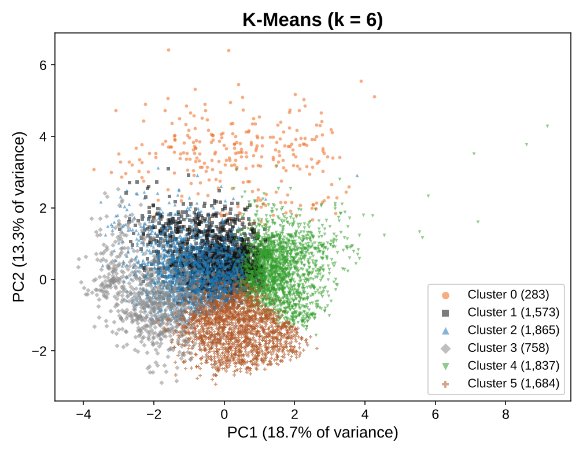
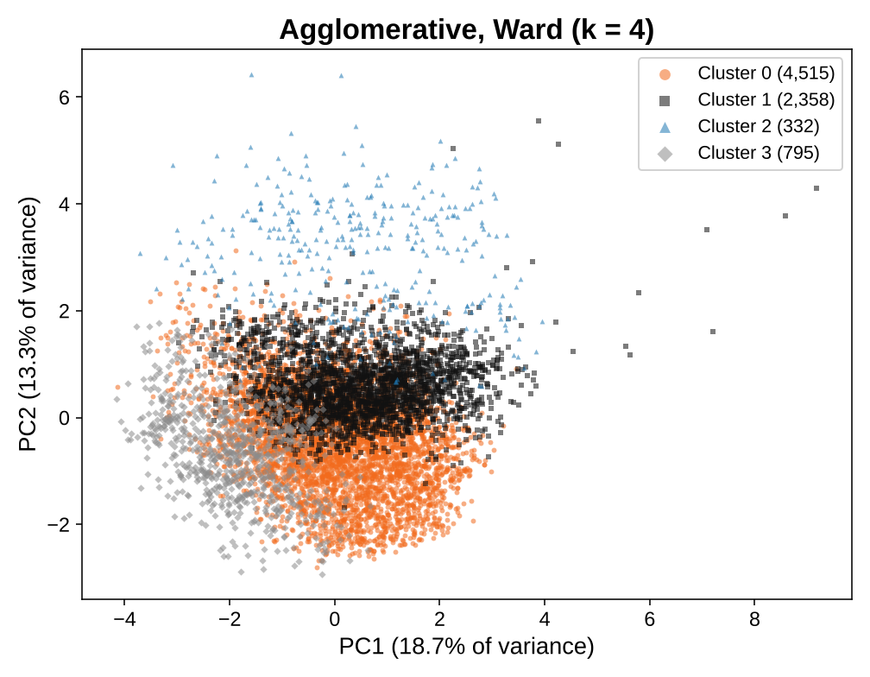
PCA view of the clusters
Left: K-Means (k = 6). Right: Agglomerative (k = 4). PC1 and PC2 keep only 32.0% of the variance (18.7% and 13.3%), so clusters overlap in two dimensions.
US Accidents | ML Capstone | Review 2
18
Notes:
PCA is fitted on all records. The 8,000-record sample is plotted because the Agglomerative model exists only for those records.

Slide 19
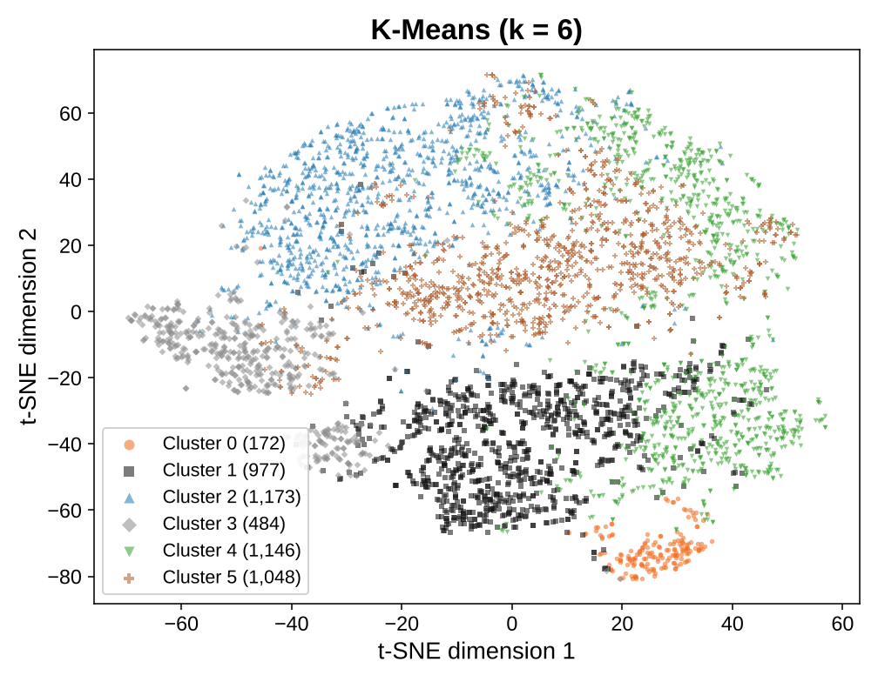
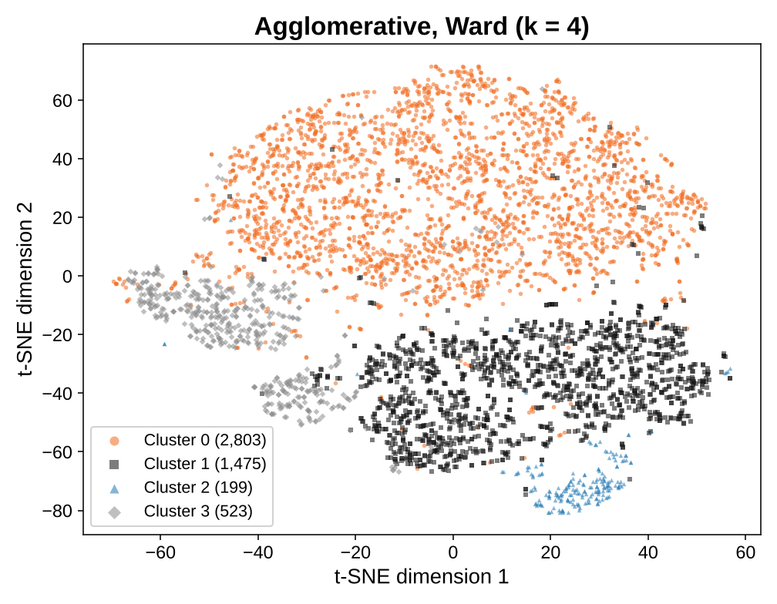
t-SNE view of the clusters
5,000 records, perplexity 30, seed 42, colored by each algorithm. Local groups look coherent. t-SNE distances and cluster sizes are not meaningful, so we use it only as a visual check.
US Accidents | ML Capstone | Review 2
19
Notes:
The same t-SNE embedding is colored twice, once by K-Means and once by Agglomerative.

Slide 20
Comparing the two clustering algorithms
Algorithm | k | Fitted on | Evaluated on | Silhouette | Davies-Bouldin | Calinski-Harabasz
K-Means | 6 | all 42,767 | all 42,767 | 0.1195 | 1.929 | 4,345
K-Means | 6 | all 42,767 | 8,000 sample | 0.1202 | 1.918 | 836
Agglomerative (Ward) | 4 | 8,000 sample | 8,000 sample | 0.1157 | 2.179 | 756
K-Means (same k as Ward) | 4 | 8,000 sample | 8,000 sample | 0.1156 | 2.098 | 911
Agglomerative (same k as K-Means) | 6 | 8,000 sample | 8,000 sample | 0.0797 | 2.304 | 662
Silhouette and Calinski-Harabasz: higher is better. Davies-Bouldin: lower is better. Do not compare the numbers of different indices.
On the same 8,000-record sample and the same k = 4, the two algorithms tie on silhouette; K-Means is better on the other two.
Calinski-Harabasz grows with the number of records, so 42,767 and 8,000 records cannot be compared
US Accidents | ML Capstone | Review 2
20
Notes:
The shaded rows are the two required results: K-Means on all records and Agglomerative on the sample. The other rows are controls that use the same sample or the same k.

Slide 21
What the K-Means clusters look like
Cluster | Records | Avg lat. | Avg long. | Temp (F) | Humidity % | Pressure | Visibility | Our reading
0 | 1,432 | 39.2 | -112.4 | 54 | 49 | 25.6 | 9.7 | Mountain West, high altitude
1 | 8,452 | 37.3 | -119.1 | 56 | 69 | 29.8 | 9.5 | California and Pacific coast
2 | 10,122 | 40.0 | -81.9 | 45 | 69 | 29.8 | 9.9 | Ohio Valley, cold
3 | 3,957 | 38.2 | -92.2 | 49 | 92 | 29.7 | 2.9 | Central, humid, low visibility
4 | 9,789 | 36.2 | -101.1 | 77 | 40 | 29.7 | 10.1 | Southern Plains, warm, daytime
5 | 9,015 | 30.9 | -85.5 | 72 | 76 | 29.9 | 9.7 | Southeast, humid
The clusters mostly separate regions and climate. "Our reading" is our interpretation of the averages and still needs checking on a map.
Compared with Severity afterwards, the clusters show no link (adjusted Rand index -0.0002). Every cluster is 70% to 79% Severity 2.
Structure is weak overall (silhouette about 0.12)
US Accidents | ML Capstone | Review 2
21
Notes:
Pressure is in inches of mercury. Cluster 0 has an average pressure of about 25.6, which points to high altitude. Severity was used only after fitting, never to build the clusters.

Slide 22
Conclusions and limitations
What we found
Limitations
All 10 classifiers are compared in one table. Random Forest is best (F1 0.6953)
Tuning raised weighted F1 to 0.7067
Clustering finds regional and climate groups, not severity groups
K-Means (k = 6) and Ward (k = 4) were both fitted and scored with all three indices
Severity 1 and 4 are rarely detected
The SVC stopped at 3,000 iterations and did not converge
The tuning search was small (12 random combinations)
Agglomerative clustering uses a sample of 8,000 records
Cluster structure is weak (silhouette about 0.12)
The last record of the dataset file is cut off
US Accidents | ML Capstone | Review 2
22
Notes:
Be ready to say these limitations before they are asked. Next steps: class weights or thresholds for rare severities, an SVC run with more iterations, and a map check of the clusters.

Slide 23
Project deliverables
# | Deliverable | Where to find it | Status
D1 | Jupyter notebooks: regression, classification, clustering | Run from start to end, outputs saved | Done
D2 | GitHub repository with commit history | Project folder is ready; team pushes it | Team to do
D3 | Comparison tables | Regression, classification, clustering | Done
D4 | Required plots | EDA, residuals, importance, confusion matrices, ROC | Done
D5 | README file | Dataset, setup, how to run, results | Done
D6 | Table of all 10 classifiers | Slide 7 and the classification notebook | Done
D7 | Cluster plots | Elbow, dendrogram, PCA, t-SNE | Done
D8 | GUI or deployment (bonus) | Not built | Not done
Also included: results folder (tables and figures) and a viva preparation guide.
US Accidents | ML Capstone | Review 2
23
Notes:
D2: the repository history must be created by the team in its own GitHub account.

Slide 24
Thank you
Questions?
Vibin Ragav S | Shre Raam P J | Nitin Pranav

