Slide 1

Deep Learning & Neural Networks

Slide 2
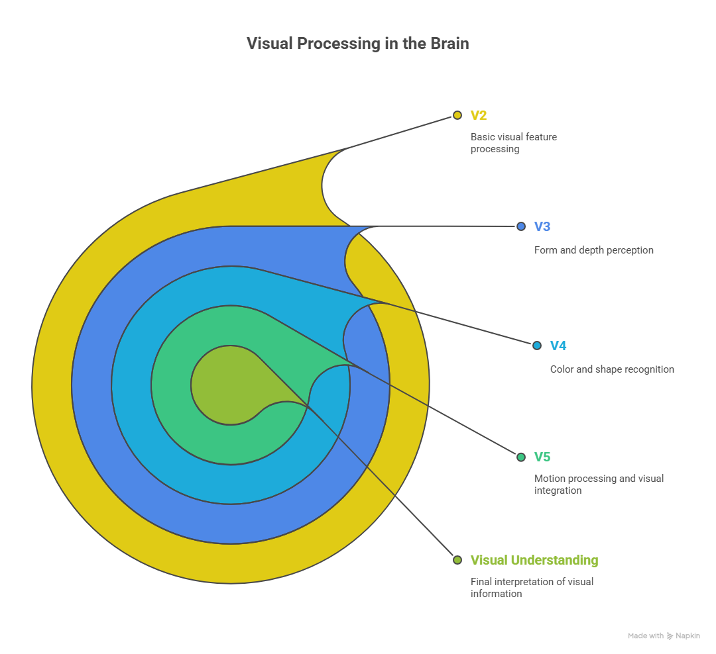

Slide 3
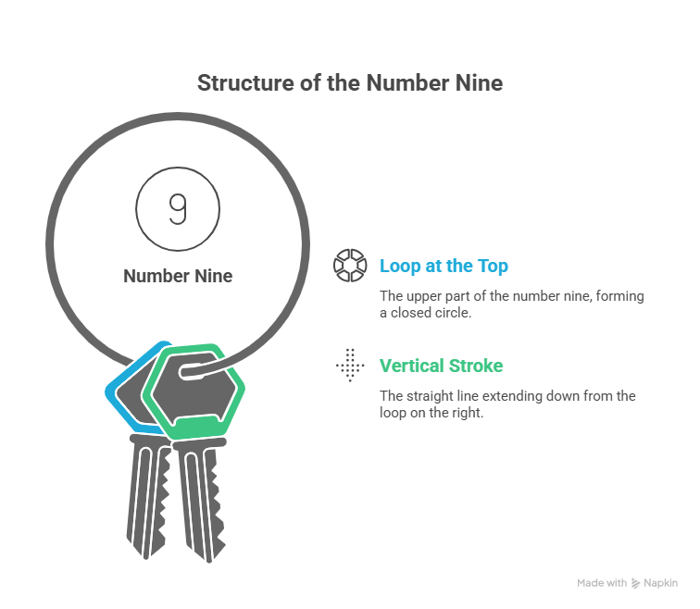

Slide 4
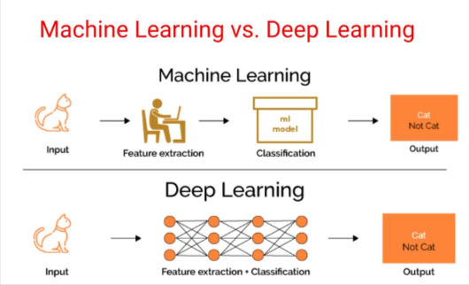
DL is a particular kind of machine learning that achieves great power and flexibility by learning to represent the world as a nested hierarchy of concepts, with each concept defined in relation to simpler concepts and more abstract representations computed in terms of less abstract ones

Slide 5
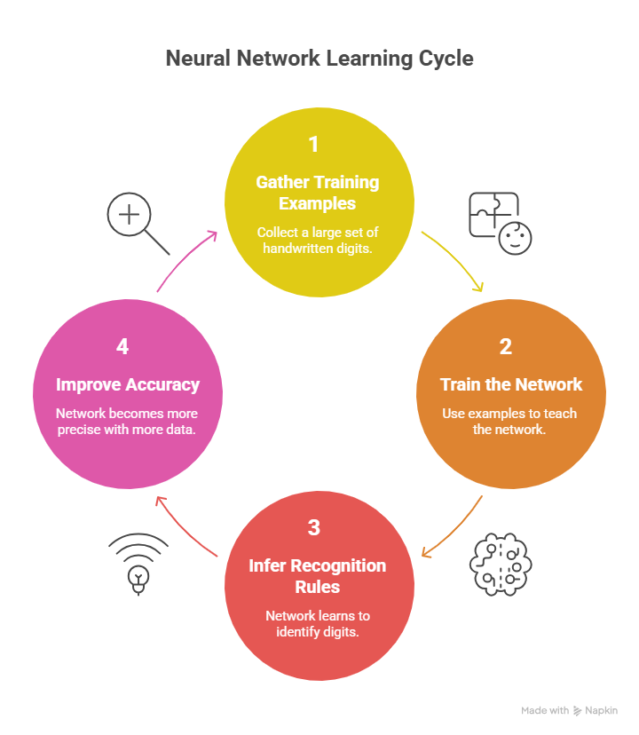

Slide 6
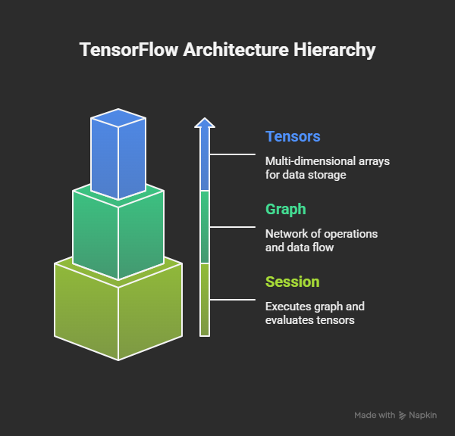
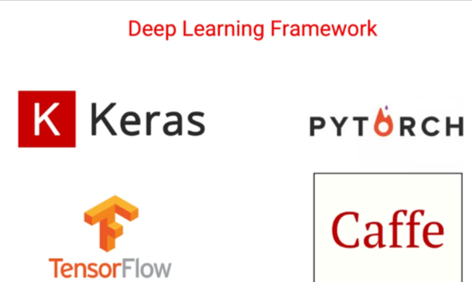

Slide 7
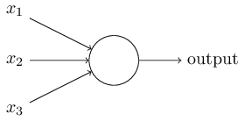
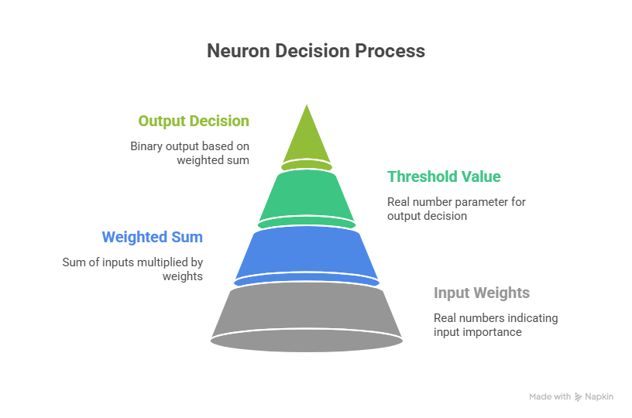
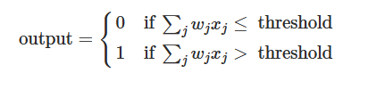

Slide 8
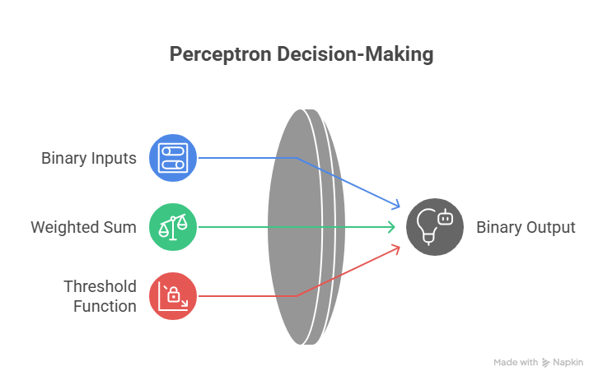

Slide 9
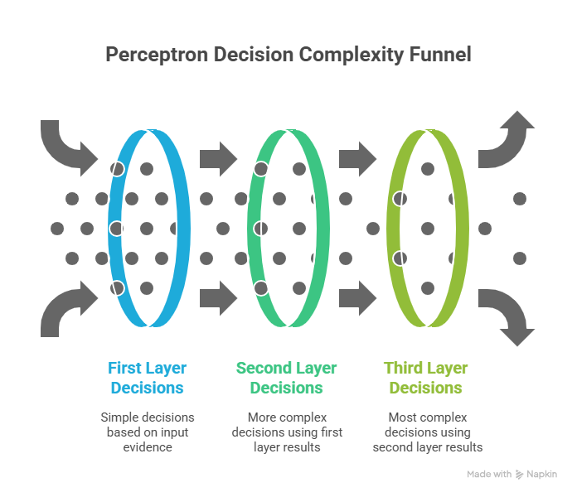

Slide 10
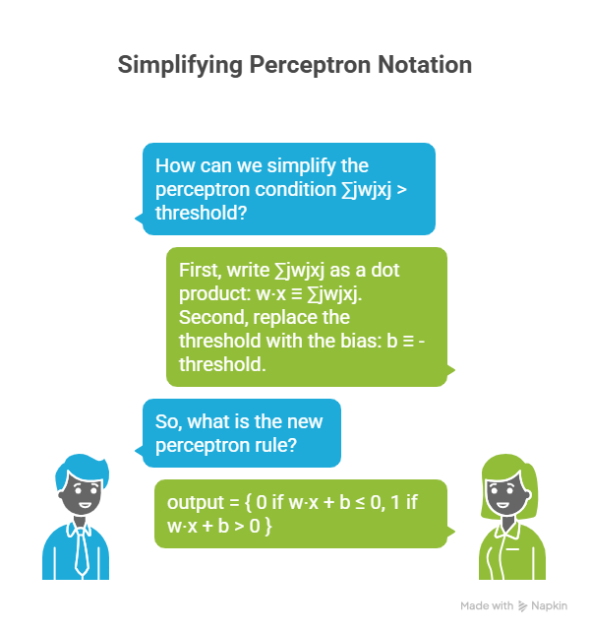

Slide 11
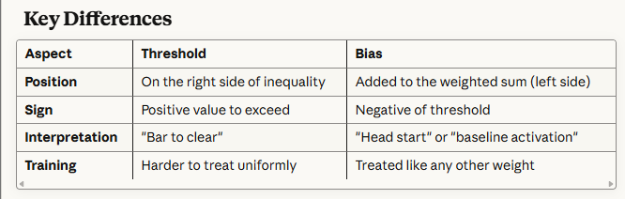
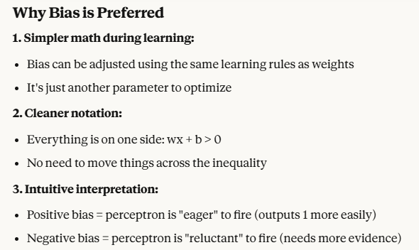

Slide 12
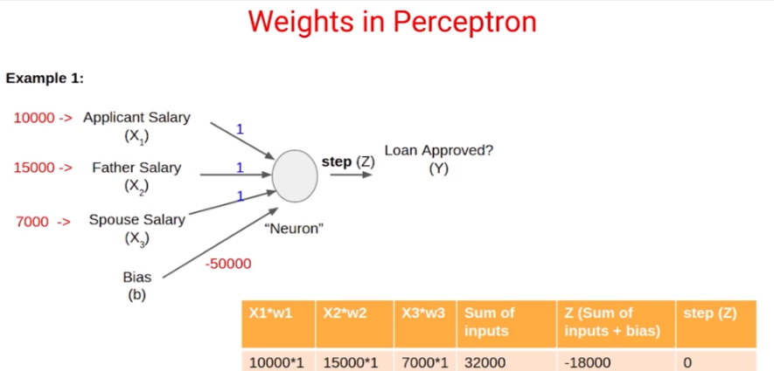
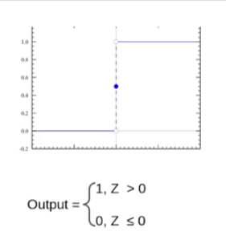

Slide 13
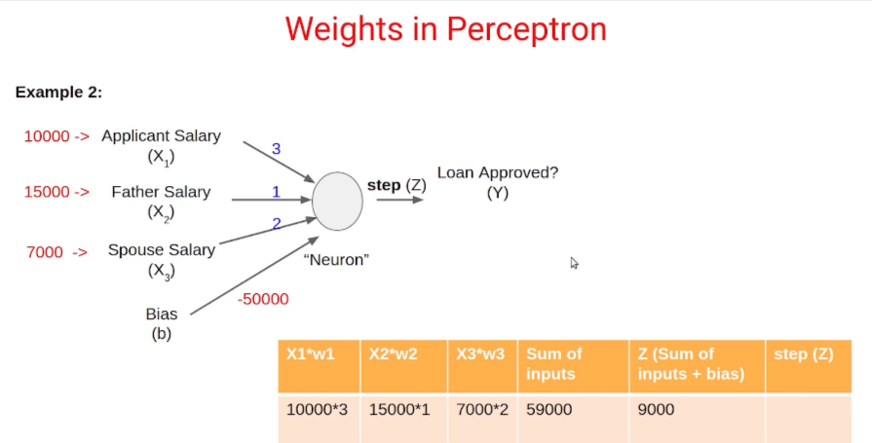

Slide 14
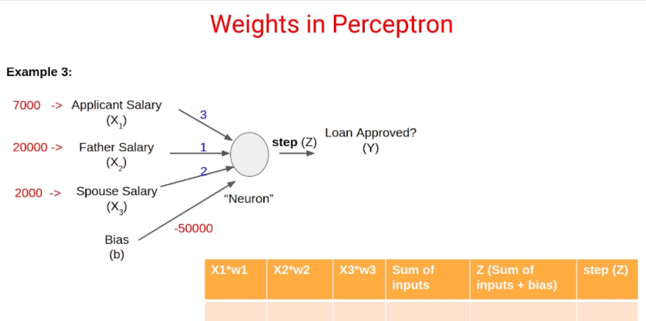

Slide 15
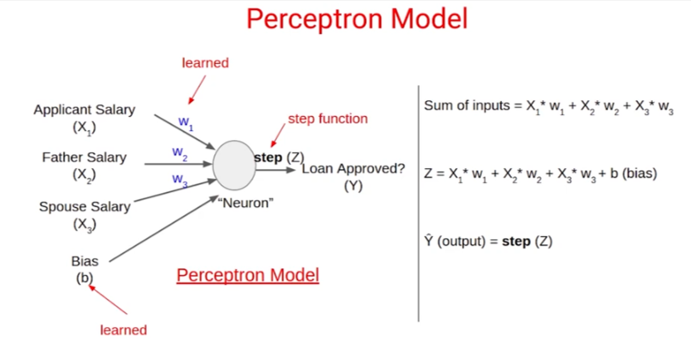

Slide 16
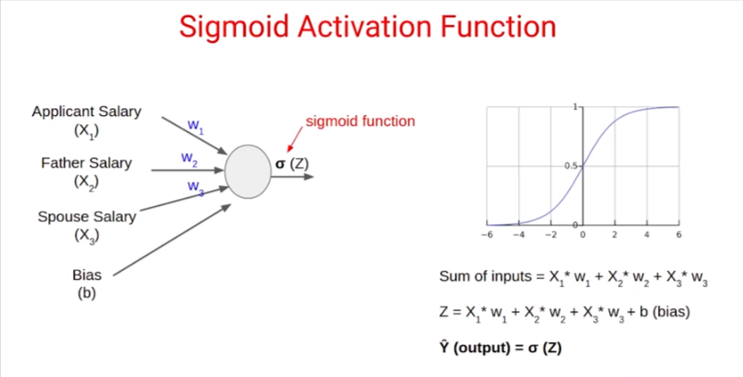

Slide 17
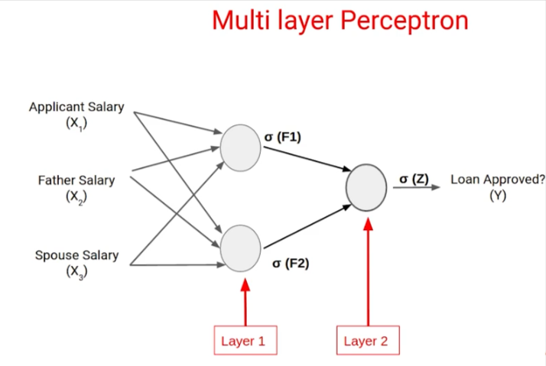

Slide 18
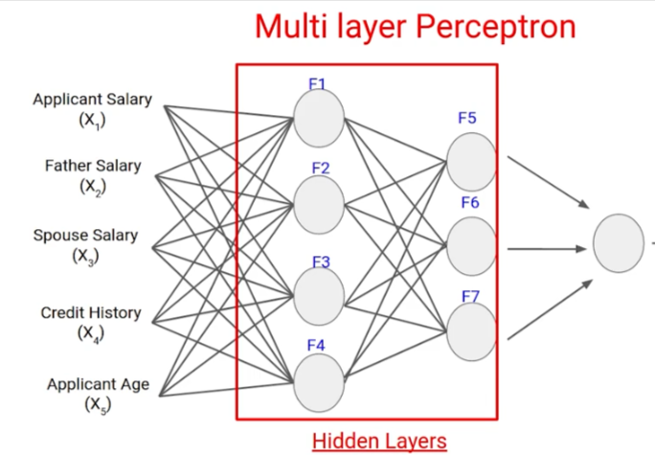

Slide 19
TFP:-https://playground.tensorflow.org/

Slide 20
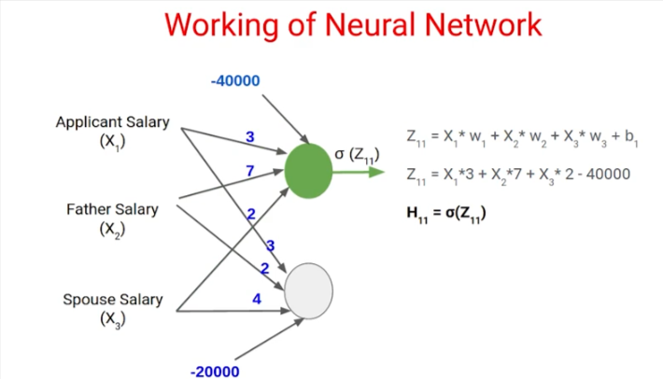
Forward Propagation

Slide 21
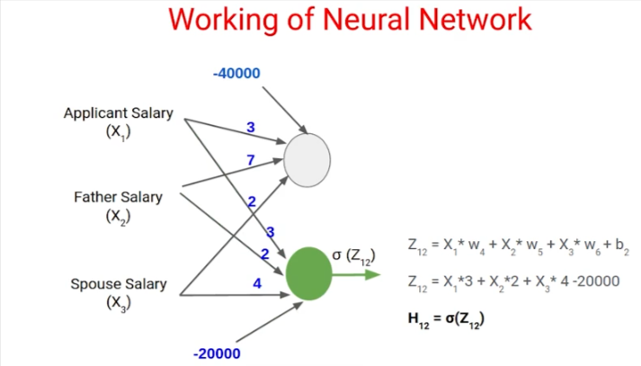
Forward Propagation

Slide 22
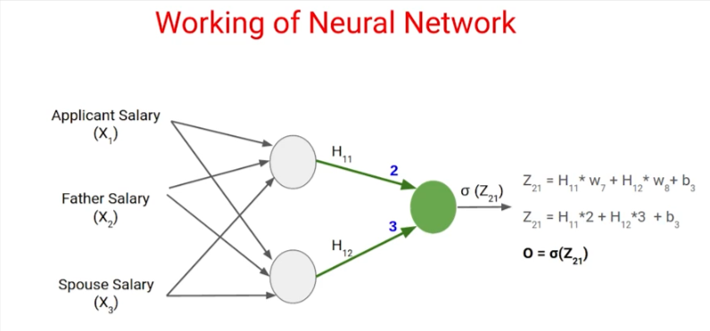
Forward Propagation

Slide 23
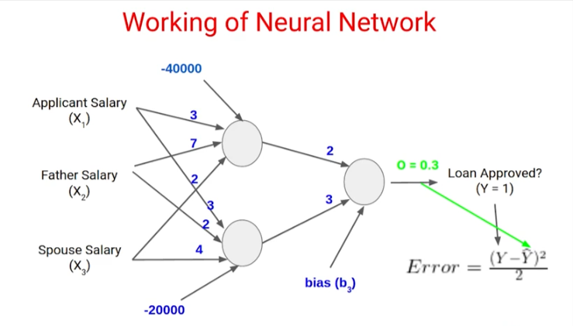
Backward Propagation

Slide 24
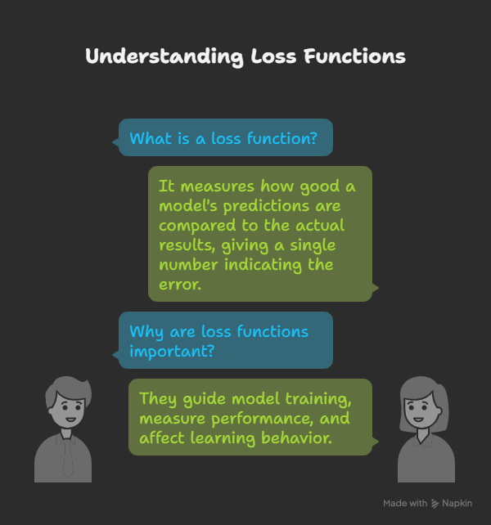
A loss function is a mathematical way to measure how good or bad a model’s predictions are compared to the actual results. It gives a single number that tells us how far off the predictions are. The smaller the number, the better the model is doing. Loss functions are used to train models.

Slide 25
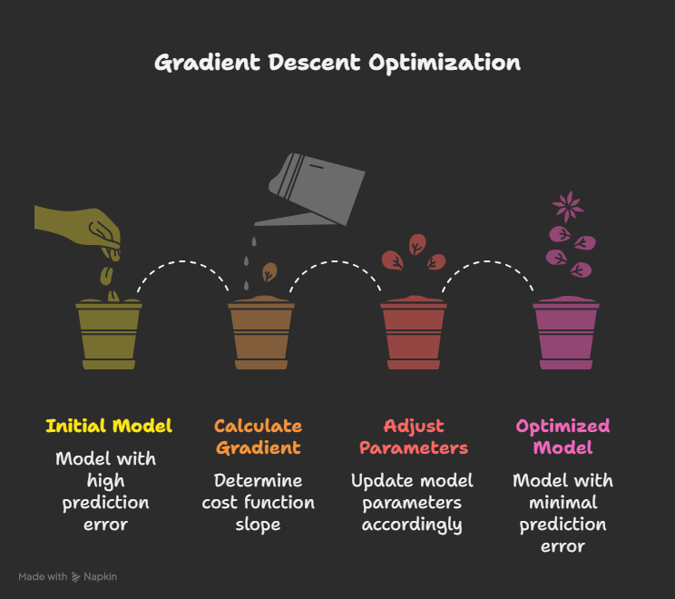
GD serves as a fundamental optimization technique to minimize the cost function of a model by iteratively adjusting the model parameters to reduce the difference between predicted and actual values, improving the model's performance.

Slide 26
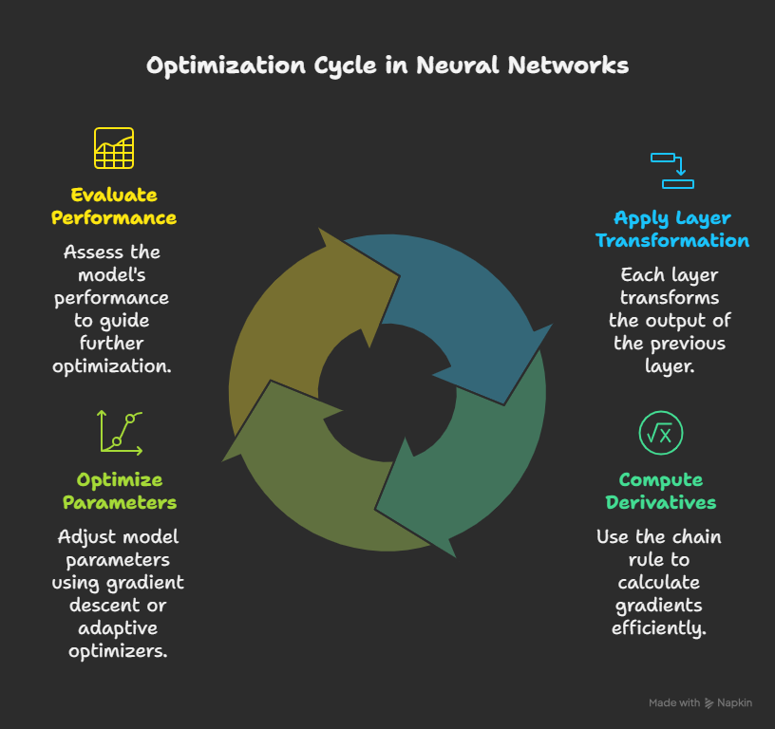
Models are built from multiple layers where each layer applies a transformation to the output of the previous layer. The chain rule allows us to efficiently compute derivatives (gradients) of complex, composite functions, which is important for optimizing model parameters using methods such as gradient descent and adaptive optimizers (Adam, RMSProp).

Slide 27

if we have a function, y=f(g(x)), where g is a function of x and f is a function of g, then the derivative of y with respect to x is given by:
This means that the chain rule enables us to compute:
The derivative of the loss with respect to output.
The derivative of output with respect to weights (and biases), layer by layer.

Slide 28
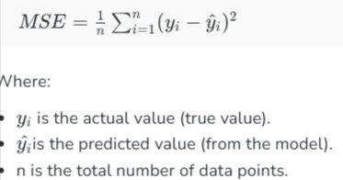
REGRESSION LOSS FUNCTIONS
These are used when your model needs to predict a continuous number, such as predicting the price of a product or the age of a person.
Mean Squared Error:- It measures the average of the squares of the errors—that is, the average squared difference between the predicted and actual values.

Slide 29


Mean Absolute Error (MAE) Loss:-It calculates the average of the absolute differences between the predicted values and the actual values
Huber Loss:- combines the advantages of MSE and MAE. It is less sensitive to outliers than MSE and differentiable everywhere unlike MAE. It requires tuning of the parameter δ

Slide 30
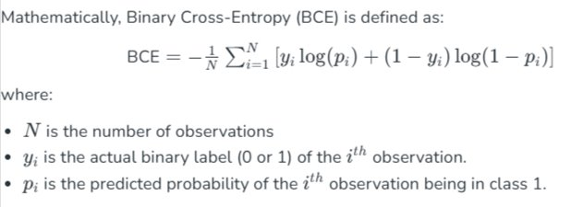
Binary Cross Entropy/Log Loss for Binary Classification
It quantifies the difference between the actual class labels (0 or 1) and the predicted probabilities output by the model. The lower the binary cross-entropy value, the better the model’s predictions align with the true labels.

Slide 31
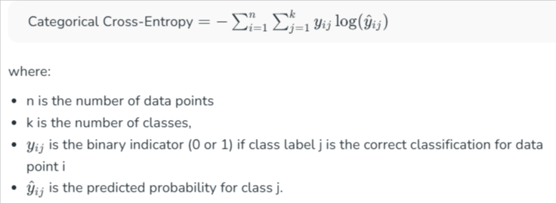
Categorical Cross-Entropy Loss
Used for multiclass classification problems. It measures the performance of a classification model whose output is a probability distribution over multiple classes.

Slide 32
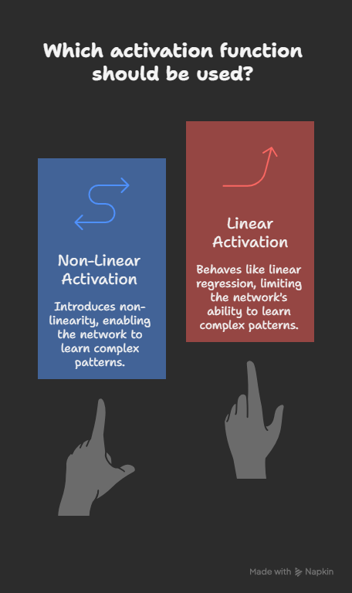
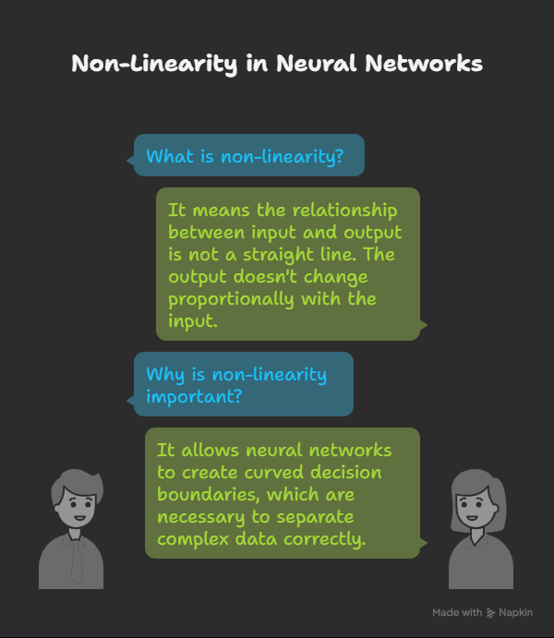

Slide 33
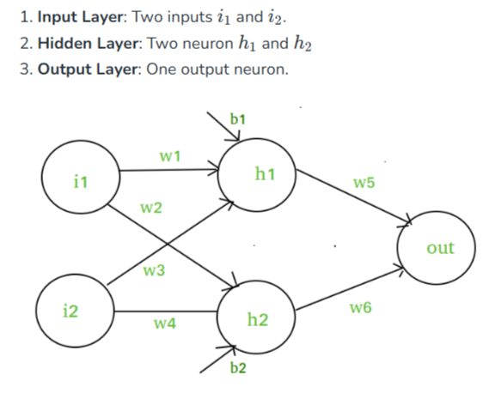
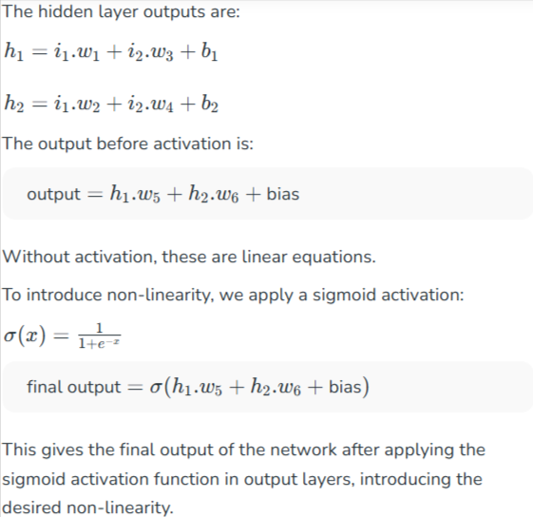

Slide 34
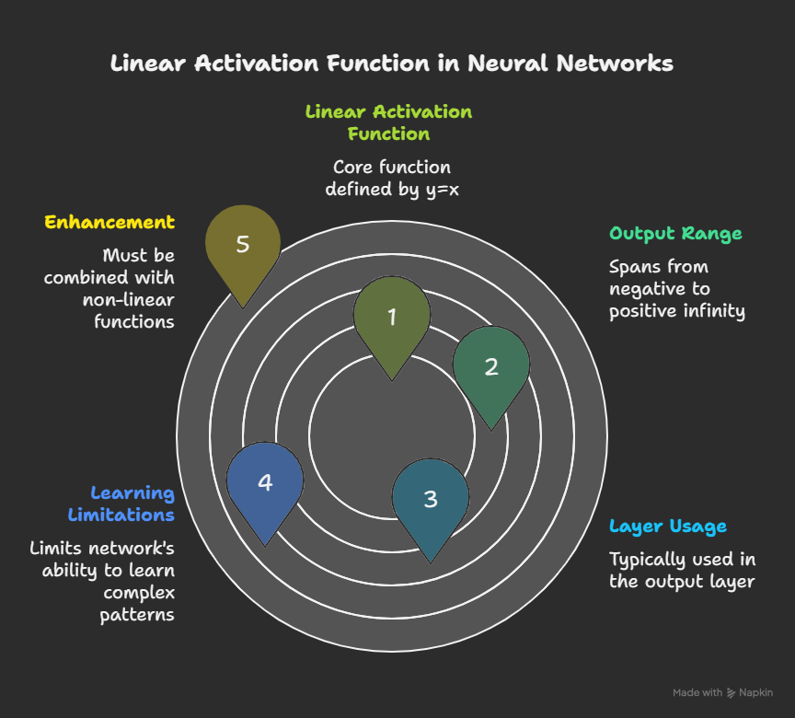
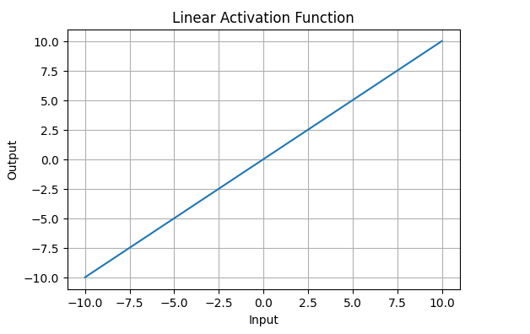

Slide 35
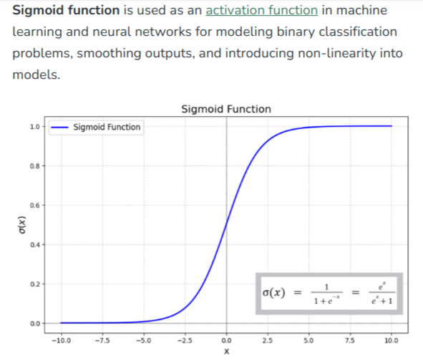

Slide 36
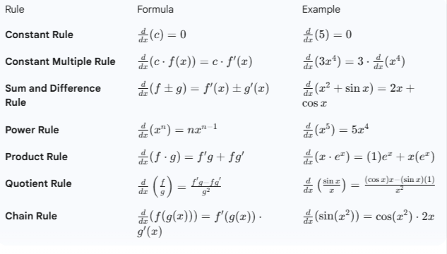

Slide 37
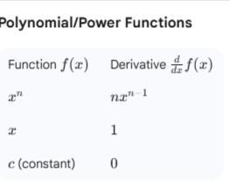
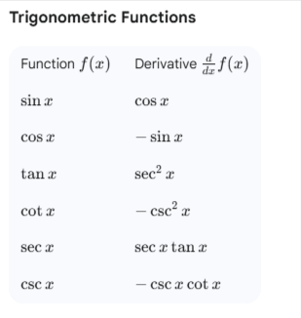
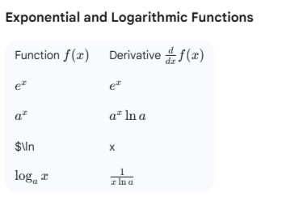

Slide 38
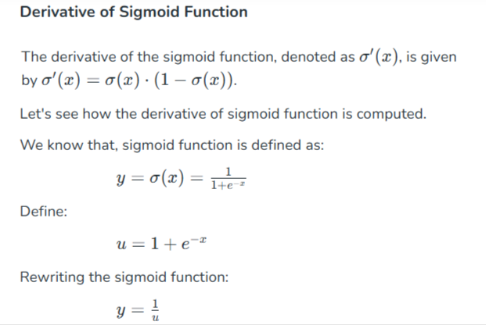
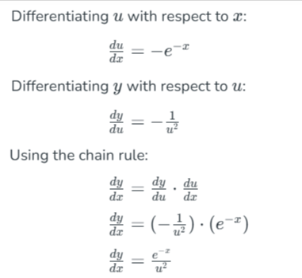

Slide 39
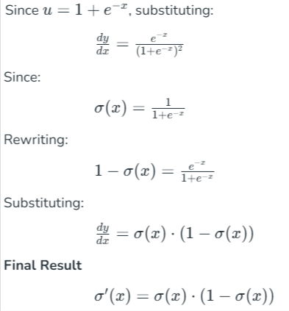
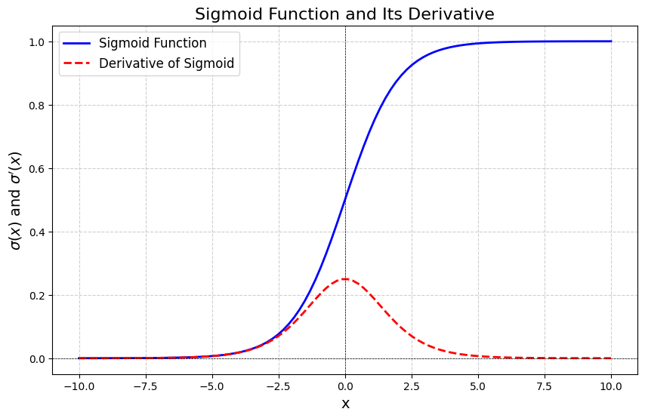

Slide 40
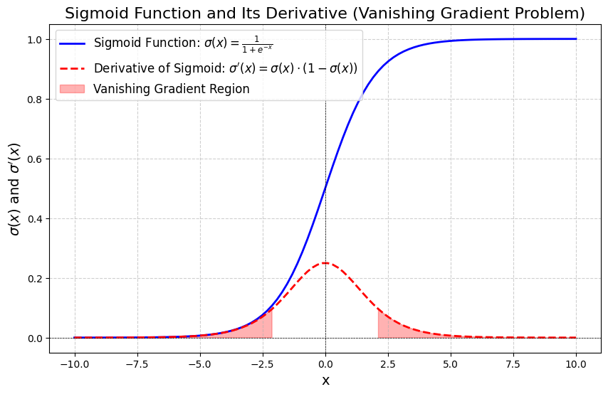
The shades red region highlights the areas where the derivative σ′(x)σ′(x) is very small (close to 0). In these regions, the gradients used to update weights and biases during backpropagation become extremely small. As a result, the model learns very slowly or stops learning altogether, which is a major issue in deep neural networks.

Slide 41
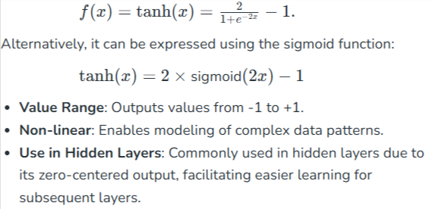
Tanh Activation Function
The hyperbolic tangent function is a shifted version of the sigmoid, allowing it to stretch across the y-axis.

Slide 42
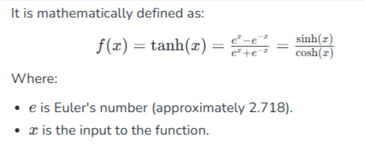


Slide 43




Slide 44



Slide 45
When to Use Tanh?
The tanh function is useful when:
The data is already normalized or centered around zero.
You are building shallow neural networks (i.e., networks with fewer layers).
You are working with data where negative values are significant and should be retained.

Slide 46

Rectified Linear Unit (ReLU)
Is defined by A(x)=max⁡(0,x) this means that if the input x is positive, ReLU returns x, if the input is negative, it returns 0.

Slide 47




Slide 48
OPTIMIZER
A loss function evaluates a model's effectiveness by computing the difference between expected and actual outputs. Common loss functions include log loss, hinge loss and mean square loss.
An optimizer improves the model by adjusting its parameters (weights and biases) to minimize the loss function value. Examples include RMSProp, ADAM and SGD (Stochastic Gradient Descent).
The optimizer’s role is to find the best combination of weights and biases that leads to the most accurate predictions.
wnew =wold −learning rate×gradient

Slide 49
Learning Rate Value | Effect on Training | Issues
Too Large (High η) | Fast convergence initially. | Overshooting the minimum, causing the loss to diverge, oscillate widely, or get stuck in suboptimal valleys.
Too Small (Low η) | Slow but stable convergence. | Training takes too long, and the model might get stuck in a shallow local minimum because the steps aren't large enough to escape it.
Just Right | Optimally fast and stable approach to the minimum. | Finding this value often requires experimentation and tuning.

Slide 50
Techniques for Management
Instead of using a single fixed learning rate throughout training (a static learning rate), modern practice often involves using learning rate schedulers (also called decay or adaptive learning rates) to change η dynamically:
Step Decay: Reduces the learning rate by a factor (e.g., 0.1) every few epochs.
Exponential Decay: Reduces the learning rate exponentially over time.
Cosine Annealing: Gradually decreases the learning rate following a cosine curve, often resetting periodically.
Adaptive Optimizers (e.g., Adam, Adagrad, RMSprop): These optimizers calculate individual, adaptive learning rates for each weight/parameter based on the historical gradients. While they manage the "rate" internally, they still require a base learning rate hyperparameter to be set.

Slide 51


Gradient Descent
Works by iteratively adjusting the model parameters in the direction that minimizes the loss function.
Key Steps in Gradient Descent
Initialize parameters: Randomly initialize the model parameters.
Compute the gradient: Calculate the gradient (derivative) of the loss function with respect to the parameters.
Update parameters: Adjust the parameters by moving in the opposite direction of the gradient, scaled by the learning rate.

Slide 52
Stochastic Gradient Descent (SGD)
In traditional gradient descent, the gradients are computed based on the entire dataset which can be computationally expensive for large datasets.
In Stochastic Gradient Descent, the gradient is calculated for each training example (or a small subset of training examples) rather than the entire dataset.

Slide 53


Slide 54


Slide 55


Slide 56


