Slide 1
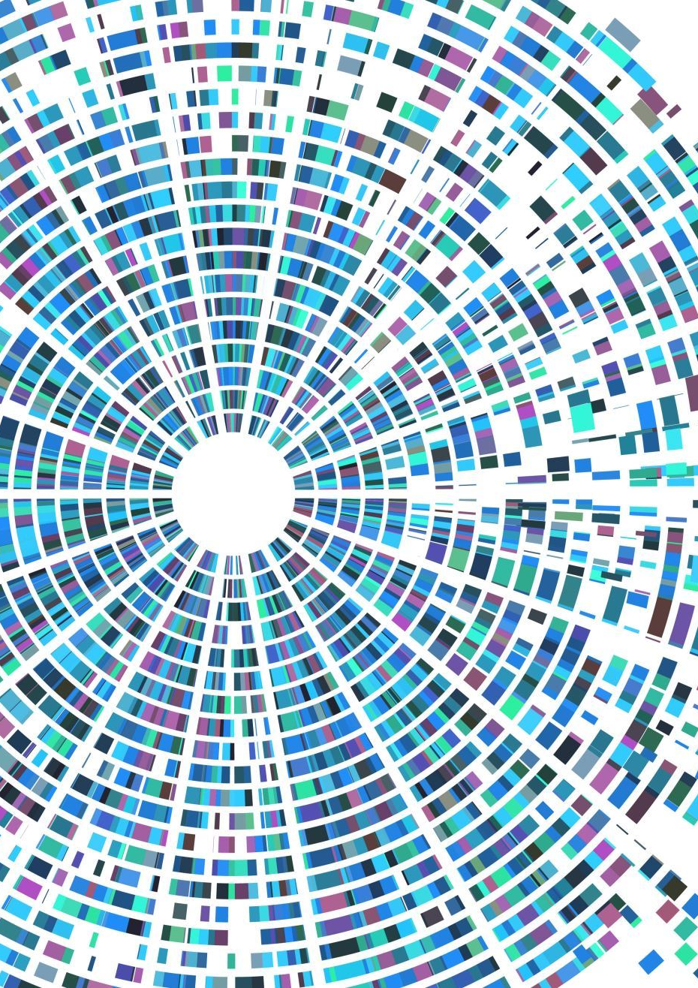
FEED-FORWARD NETWORKS
A multi-layer neural network.
The information is passed in the forward direction—from left to right.
In the forward pass, the information comes inside the model through the input layer, passes through the series of hidden layers, and finally goes to the output layer.
The information does not loop with two hidden layers.
The later layers give no feedback to the previous layers.
The basic learning process of feed-forward networks remain the same as the perceptron.

Slide 2
Residual Networks (ResNet)
How to decide on the number of layers in our neural network architecture?
A naive answer would be: The greater the number of hidden layers, the better is the learning process. More layers enrich the levels of features.
Training very deep "plain" neural networks (simply stacking layers), two major issues often arose:
Vanishing/Exploding Gradients: This is a common problem in deep networks where the gradients during backpropagation become either extremely small (vanish) or extremely large (explode), making the network difficult or impossible to train effectively.
Degradation Problem: as the network depth increased, training accuracy first increased, but then started to saturate and even quickly degrade (training error increased).Because deeper networks were harder to optimize than shallower ones.

Slide 3
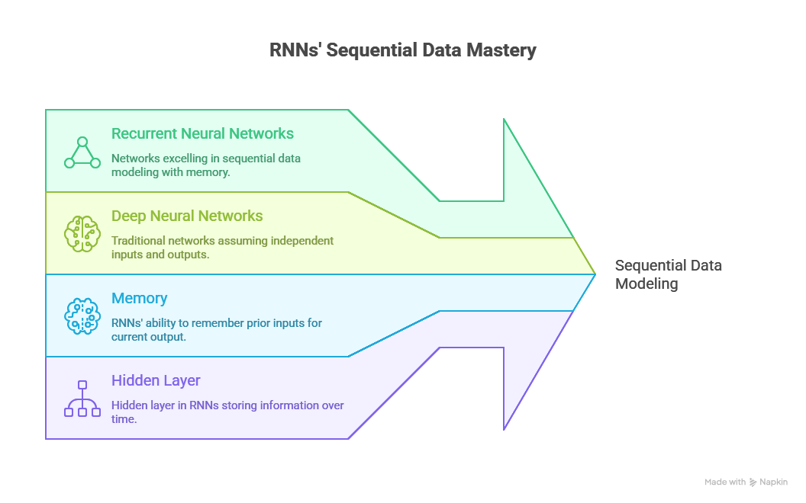
Recurrent Neural Networks (RNNs)

Slide 4
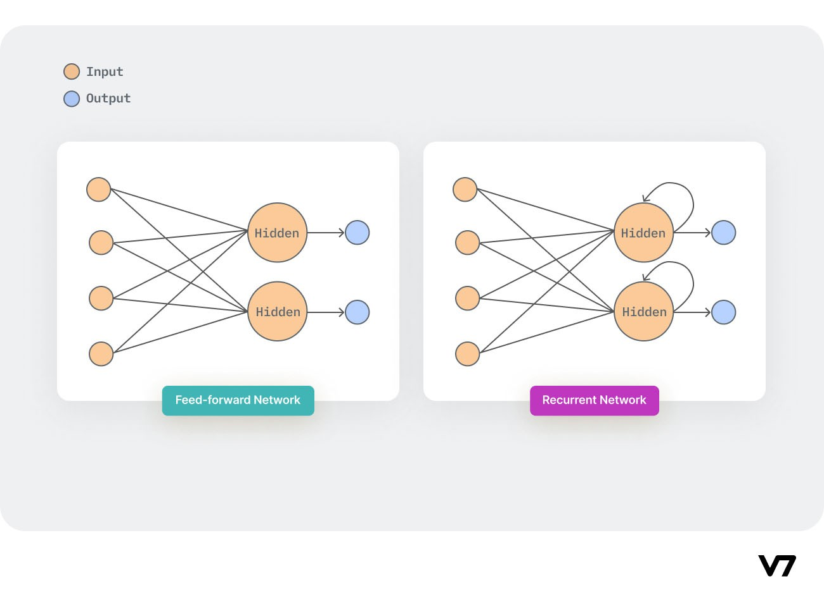
Recurrent neural networks vs. Feedforward neural networks

Slide 5
Feature | Feedforward Artificial Neural Network (FFANN) | Recurrent Neural Network (RNN)
Data Flow | Only in one direction (input to output). | Signals travel in both directions (forward and backward).
Architecture | Follows a top-down approach, no loops. | Has feedback loops in the network.
Layer Influence | Output of any layer does not affect that same layer. | Features from earlier input are fed back into the network.
Memory/State | Has no ability to memorize earlier input. | Has an ability to memorize features derived from earlier input.
Dynamism | Static (implied by "no loops" and one-way flow). | Dynamic due to the ever-changing state until reaching an equilibrium point.
Primary Use Case | Pattern recognition. | Sequential autocorrelative data (e.g., time series).

Slide 6
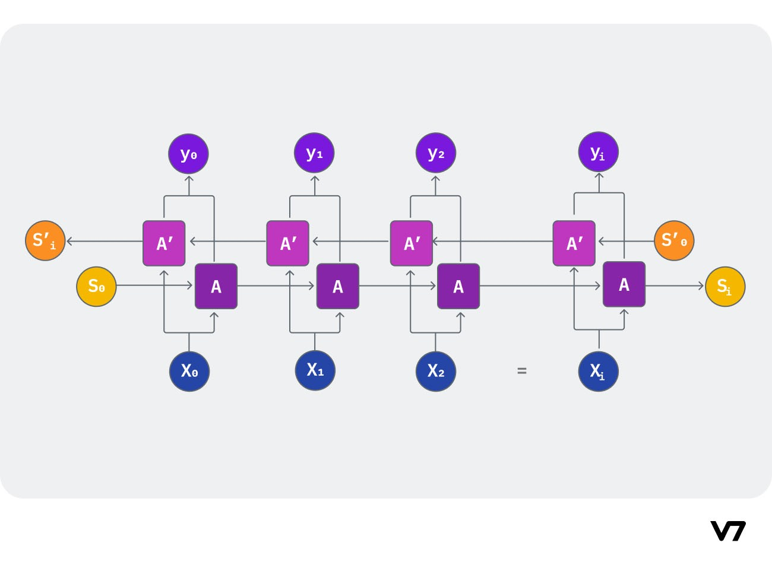
Bidirectional recurrent neural networks (BRNN)

Slide 7
Convolutional Neural Networks
Computer Vision (CV): A subfield of Deep Learning and Artificial Intelligence (AI).
Goal: To teach computers to see, interpret, and perceive the world around them.
Analogy: Giving machines the sense of sight and the ability to understand what they see.
2. The Core Challenge
Human Vision: Humans and animals acquire the ability to see and interpret the world naturally from a very young age.
Machine Vision Status: Helping machines interpret and perceive their surroundings via vision remains a largely unsolved problem.
3. Complexity Factors
Infinite Variability: The world has an infinitely varying scenery and is constantly dynamic (changing light, angles, occlusions, etc.).
Limited Human Perception: The perception modeled for machines is inherently based on the limited understanding of the human vision process.
Result: This variability and complexity at the core make Machine Vision a challenging and complex problem in AI.

Slide 8
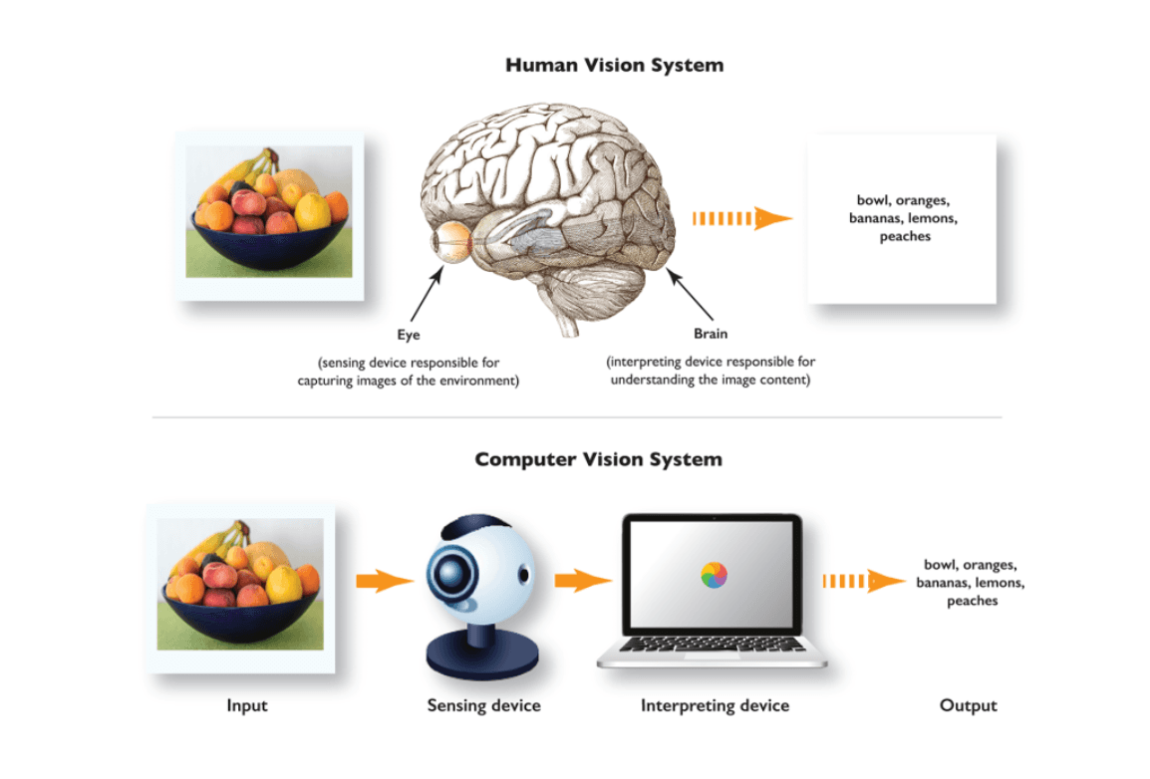

Slide 9
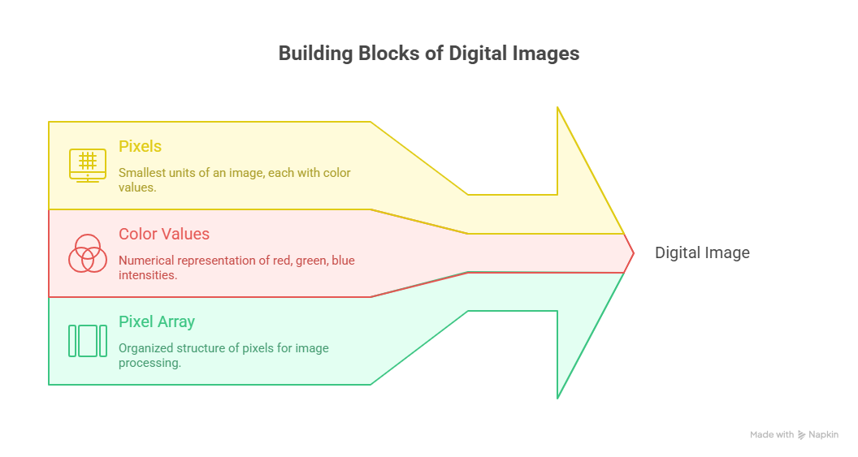

Slide 10
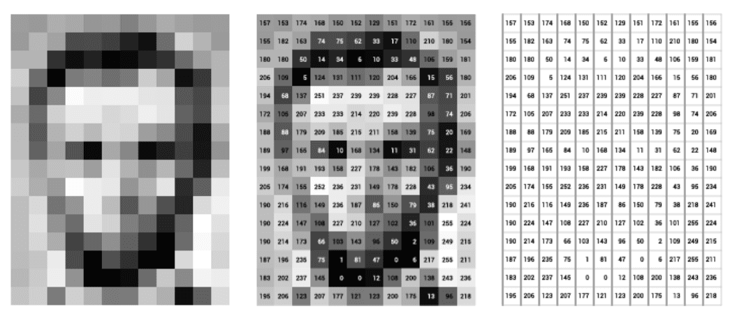

Slide 11
Understanding Image Complexity for Computers
1. The Computer's View (The Problem)
Human Perception: It's easy for us to get an idea of an image just by looking at it (e.g., "This is a person's face").
Computer Input: A computer only sees a pixel matrix (a grid of numbers).
Looking at the raw pixel values provides no direct information on the image content.
2. The Computational Task
Requirement: The computer must perform complex calculations on these matrices.
Goal: To formulate relationships with neighboring pixel elements (e.g., finding edges, textures, shapes).
Output: Only after these complex steps can the algorithm confidently state that "this image represents a person’s face."
3. Takeaway
Algorithm Complexity: Developing algorithms for recognizing complex patterns in images is incredibly difficult.
Brain Power: This process helps us realize how complex our own brains are to excel at pattern recognition so naturally and effortlessly.

Slide 12
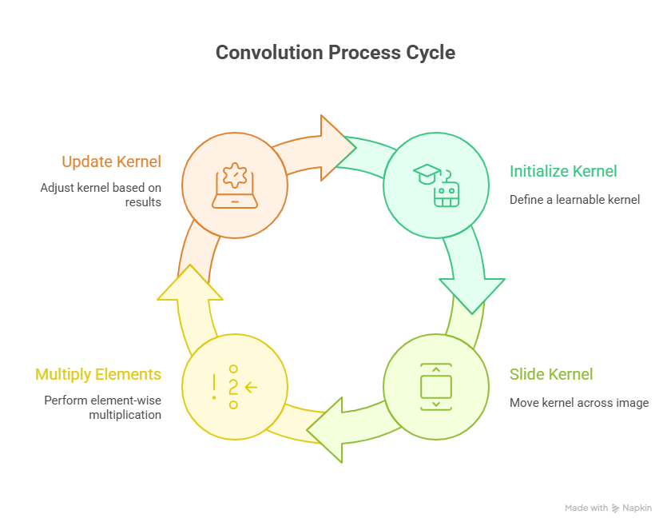
Convolution

Slide 13
Convolution Visualization
https://ezyang.github.io/convolution-visualizer

Slide 14
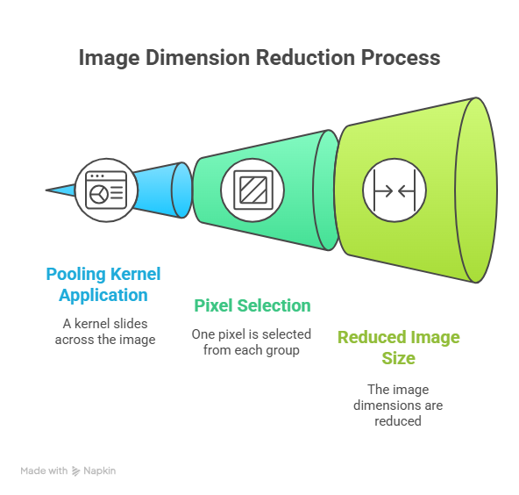
Pooling

Slide 15
Component | Description
Input | A Feature Map
Kernel Size | The size of the sliding window
Stride | How many steps the window moves (usually 2).
Operation | The fixed mathematical rule applied within the window (e.g., finding the maximum value).
Pooling is an operation used to reduce the dimensions of an image by performing operations at a pixel level. A pooling kernel slides across the image, and only one pixel from the corresponding pixel group is selected for further processing, thus reducing the image size., eg., Max Pooling, Average Pooling.

Slide 16
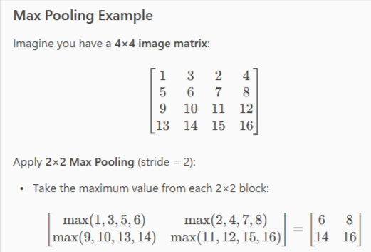
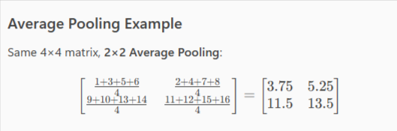

Slide 17
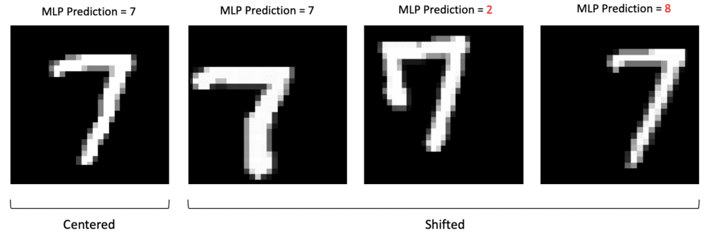
MLPs are Not Translation Invariant
The network reacts differently if the main content of the image is shifted.

Slide 18
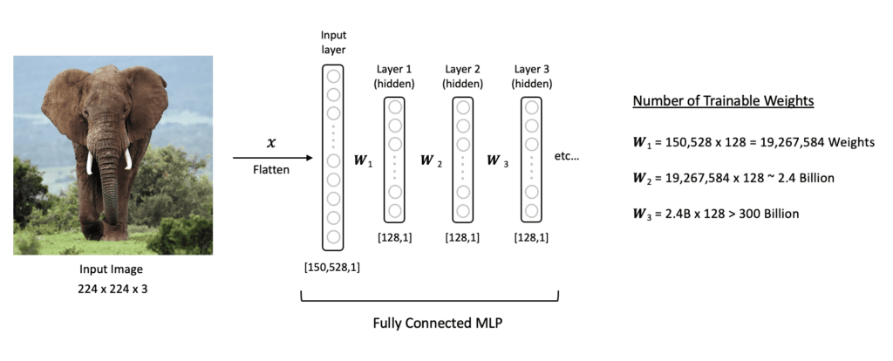
MLPs are Prone to Overfitting

Slide 19
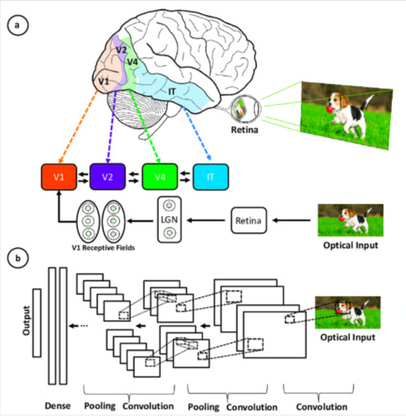
Convolutional Neural Network (CNN)
A Convolutional Neural Network (CNN), also known as ConvNet, is a specialized type of deep learning algorithm mainly designed for tasks that necessitate object recognition, including image classification, detection, and segmentation.

Slide 20
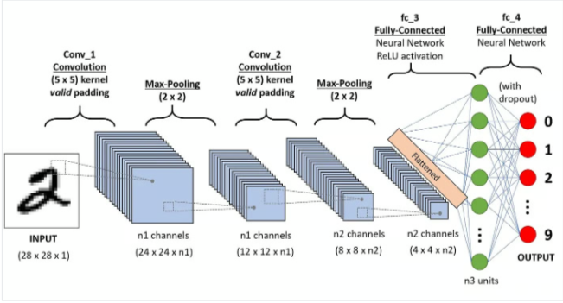
Key Components of a CNN
The convolutional neural network is made of four main parts.
Convolutional layers
Rectified Linear Unit (ReLU for short)
Pooling layers
Fully connected layers

Slide 21
Convolution layers
Application of a sliding window function to a matrix of pixels representing an image
The sliding function applied to the matrix is called kernel or filter
Several filters of equal size are applied, and each filter is used to recognize a specific pattern from the image, such as the curving of the digits, the edges, the whole shape of the digits, and more.
Small grids (called filters or kernels) that move over the image.
Each small grid is like a mini magnifying glass that looks for specific patterns in the photo, like lines, curves, or shapes.
As it moves across the photo, it creates a new grid that highlights where it found these patterns.
One filter might be good at finding straight lines, another might find curves, and so on.
By using several different filters, the CNN can get a good idea of all the different patterns that make up the image.

Slide 22
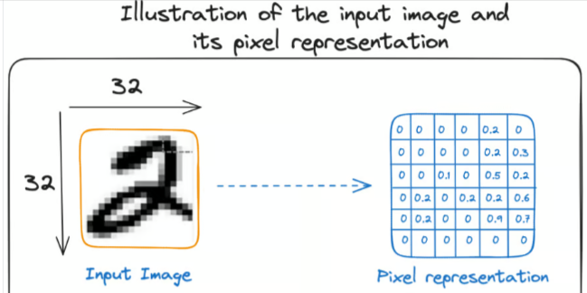
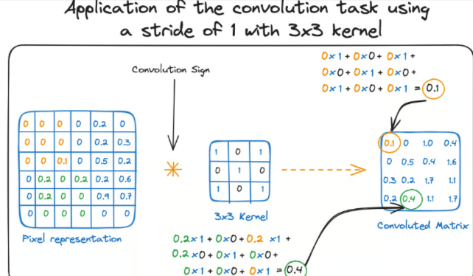

Slide 23
Activation function
Relu activation function is applied after each convolution operation.
Function helps the network learn non-linear relationships between the features in the image, hence making the network more robust for identifying different patterns.
Also helps to mitigate the vanishing gradient problems.

Slide 24
Pooling layer
Is to pull the most significant features from the convoluted matrix.
Done by applying some aggregation operations, which reduce the dimension of the feature map (convoluted matrix), hence reducing the memory used while training the network.
Also relevant for mitigating overfitting.
The most common aggregation functions that can be applied are:
Max pooling, which is the maximum value of the feature map
Sum pooling corresponds to the sum of all the values of the feature map
Average pooling is the average of all the values.

Slide 25
Fully connected layers
These layers are in the last layer of the convolutional neural network, and their inputs correspond to the flattened one-dimensional matrix generated by the last pooling layer.
Relu activations functions are applied to them for non-linearity.
A softmax prediction layer is used to generate probability values for each of the possible output labels, and the final label predicted is the one with the highest probability score.

Slide 26
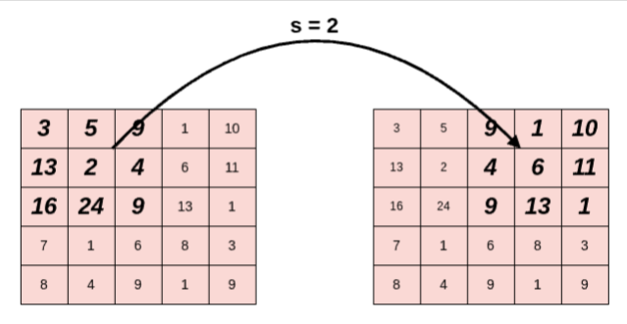
STRIDE
A parameter that dictates the movement of the kernel, or filter, across the input data, such as an image.
Determines how many units the filter shifts at each step. This shift can be horizontal, vertical, or both, depending on the stride's configuration.

Slide 27
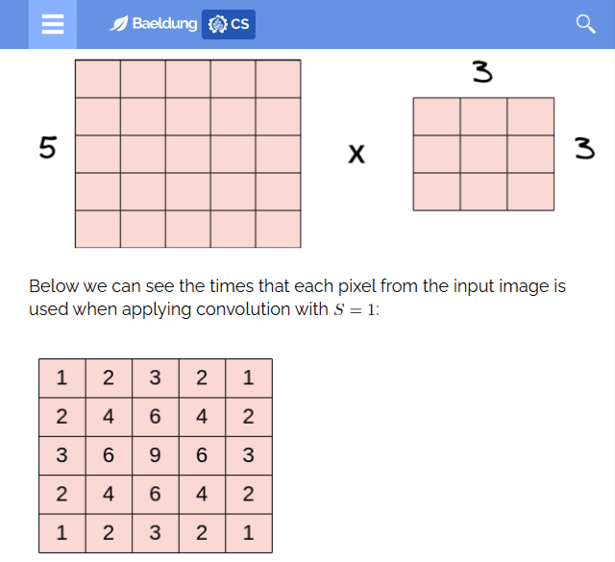
PADDING
The pixels located on the corners and the edges are used much less than those in the middle.
Increase the contribution of pixels at the corners and the edges to the learning procedure.

Slide 28
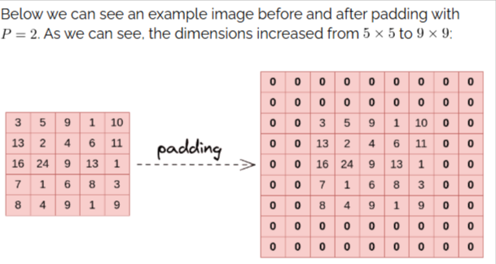
Pixels located in the middle are used more often than pixels on edges and corners.
Therefore, the information on the borders of images is not preserved as well as the information in the middle.
A simple and powerful solution to this problem is padding, which adds rows and columns of zeros to the input image.
If we apply padding P in an input image of size W x H, the output image has dimensions (W+2P) x (H+2P).

Slide 29
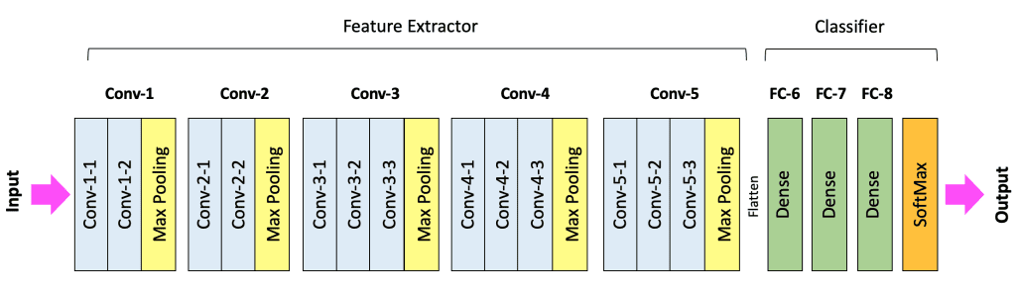

Slide 30
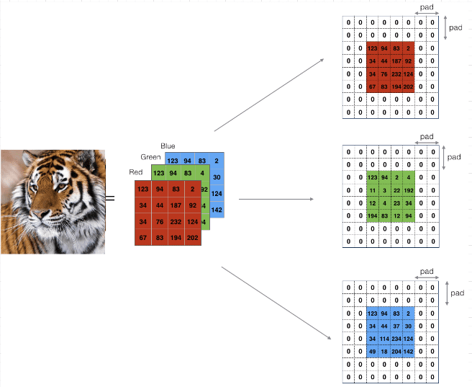

Slide 31
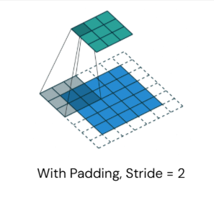
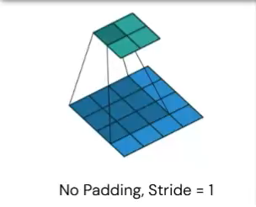
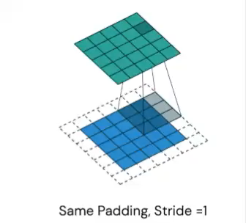

Slide 32
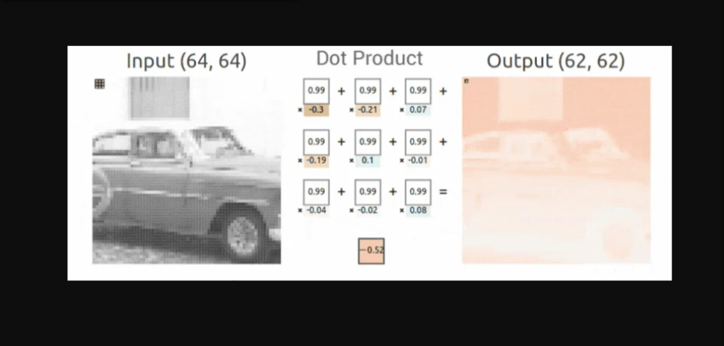

Slide 33
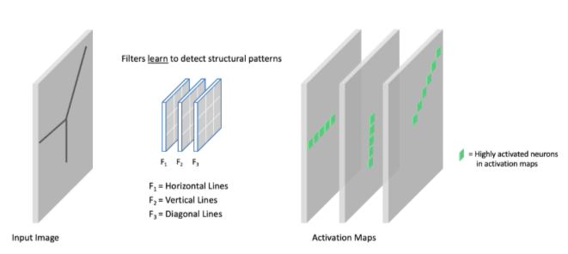

Slide 34
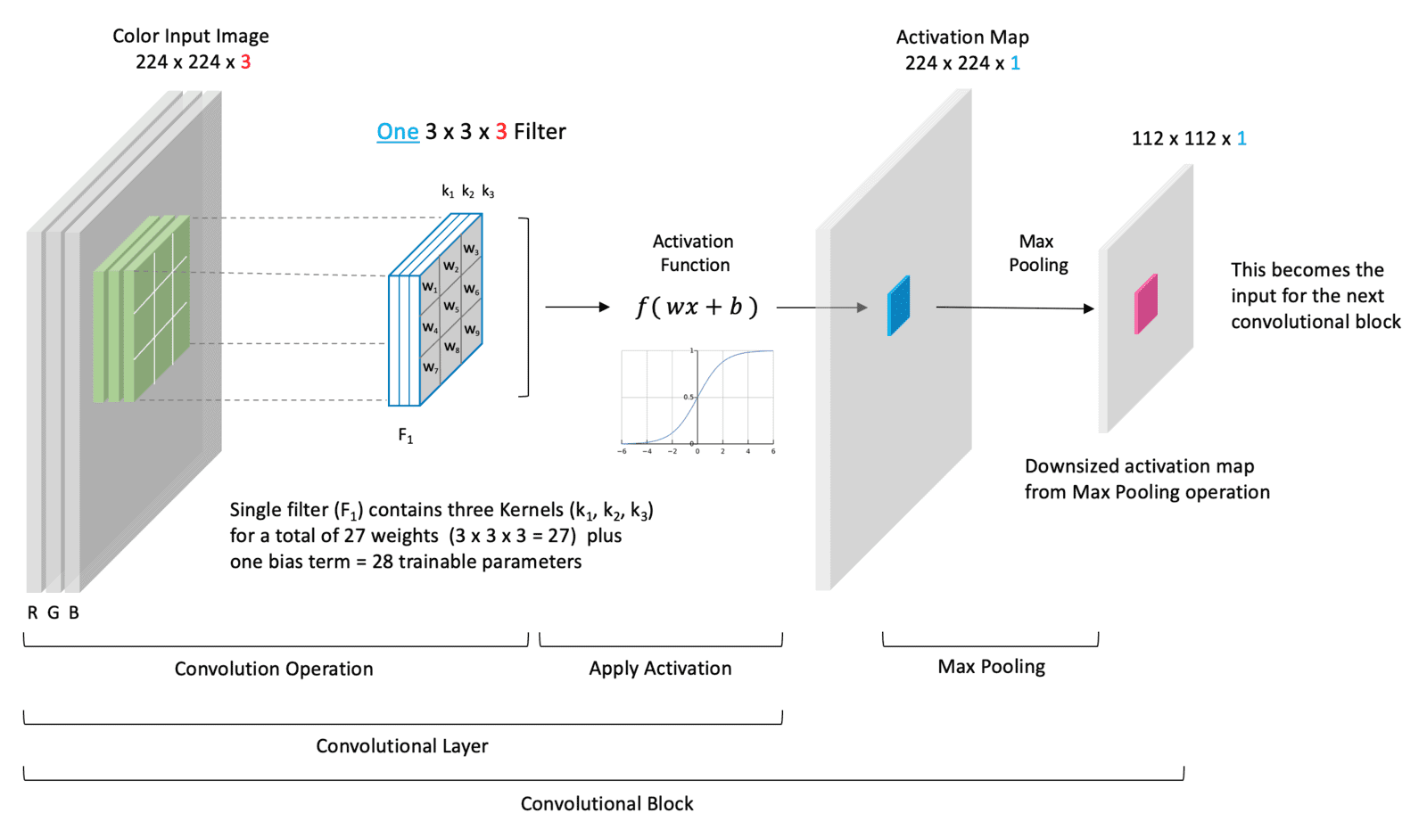

Slide 35
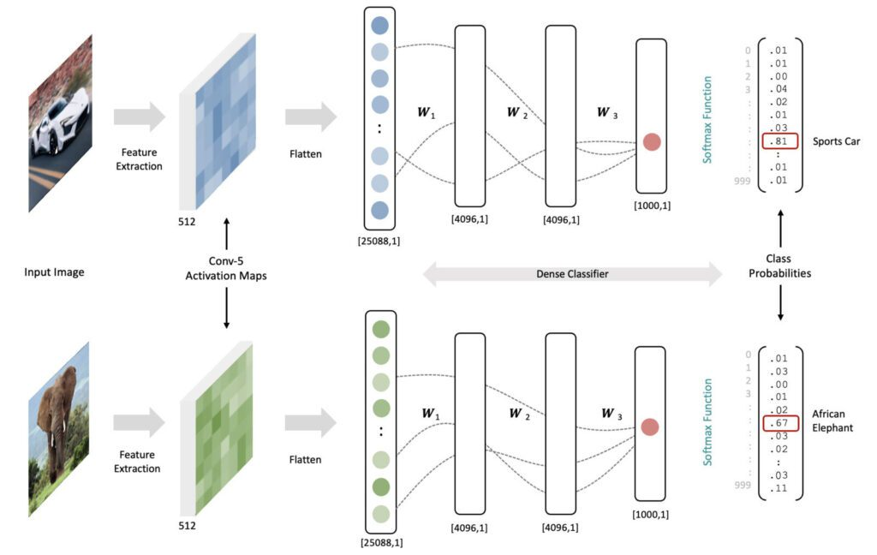

Slide 36
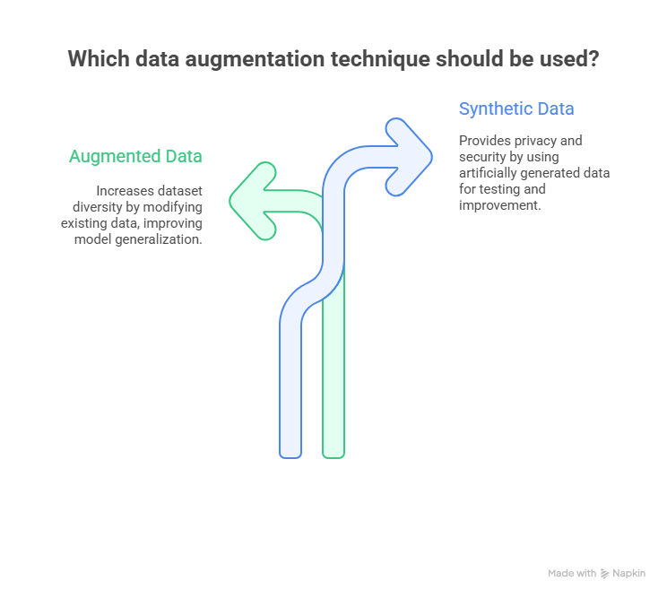
Augmented vs. synthetic data
Data augmentation is a technique of artificially increasing the training set by creating modified copies of a dataset using existing data. It includes making minor changes to the dataset or using deep learning to generate new data points.

Slide 37
