Slide 1
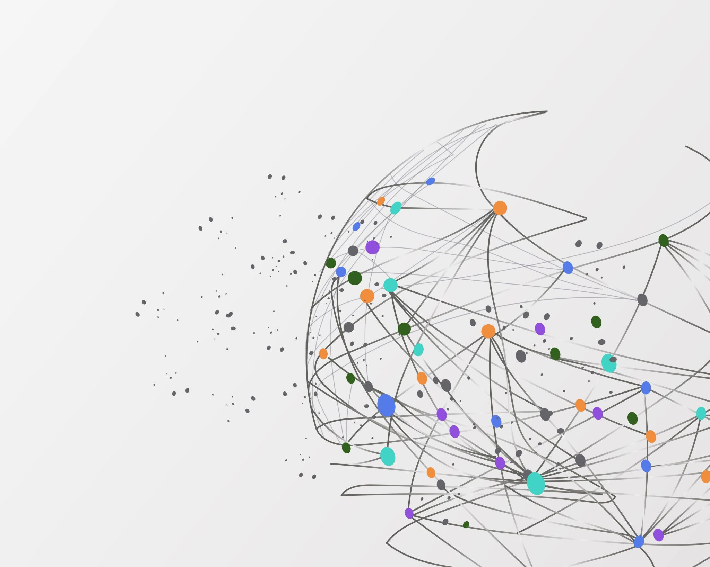
ARTIFICIAL INTELLIGENCE (AI)

Slide 2
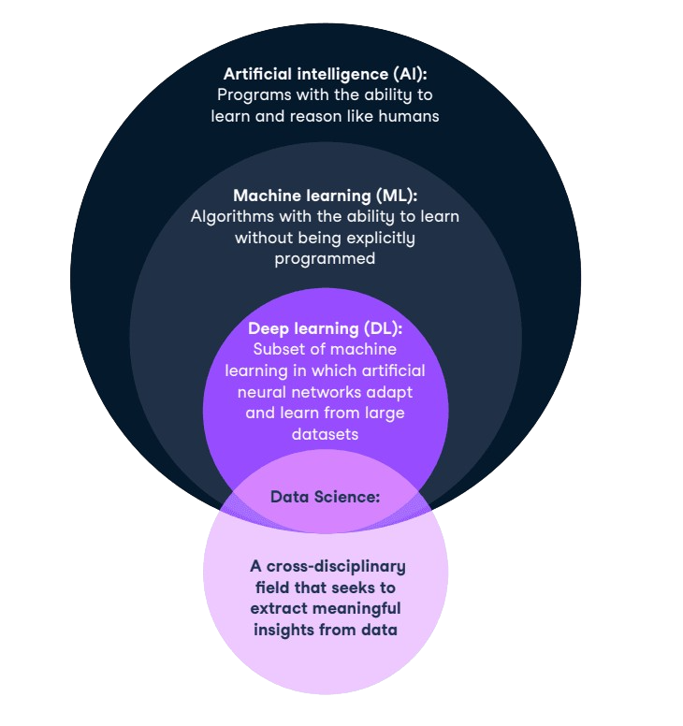
AI = Machines + Data + Learning → Decisions like humans
Artificial Intelligence is like giving a computer a brain – not a human brain, but one that can learn from experience, solve problems, and make decisions.
It’s teaching machines to think a little like us, so they can help us in smarter
and faster ways.
AI is an interdisciplinary science with many approaches; it can be rule-based and operate under a predefined set of conditions, or it can use machine learning algorithms to adapt to its environment.

Slide 3
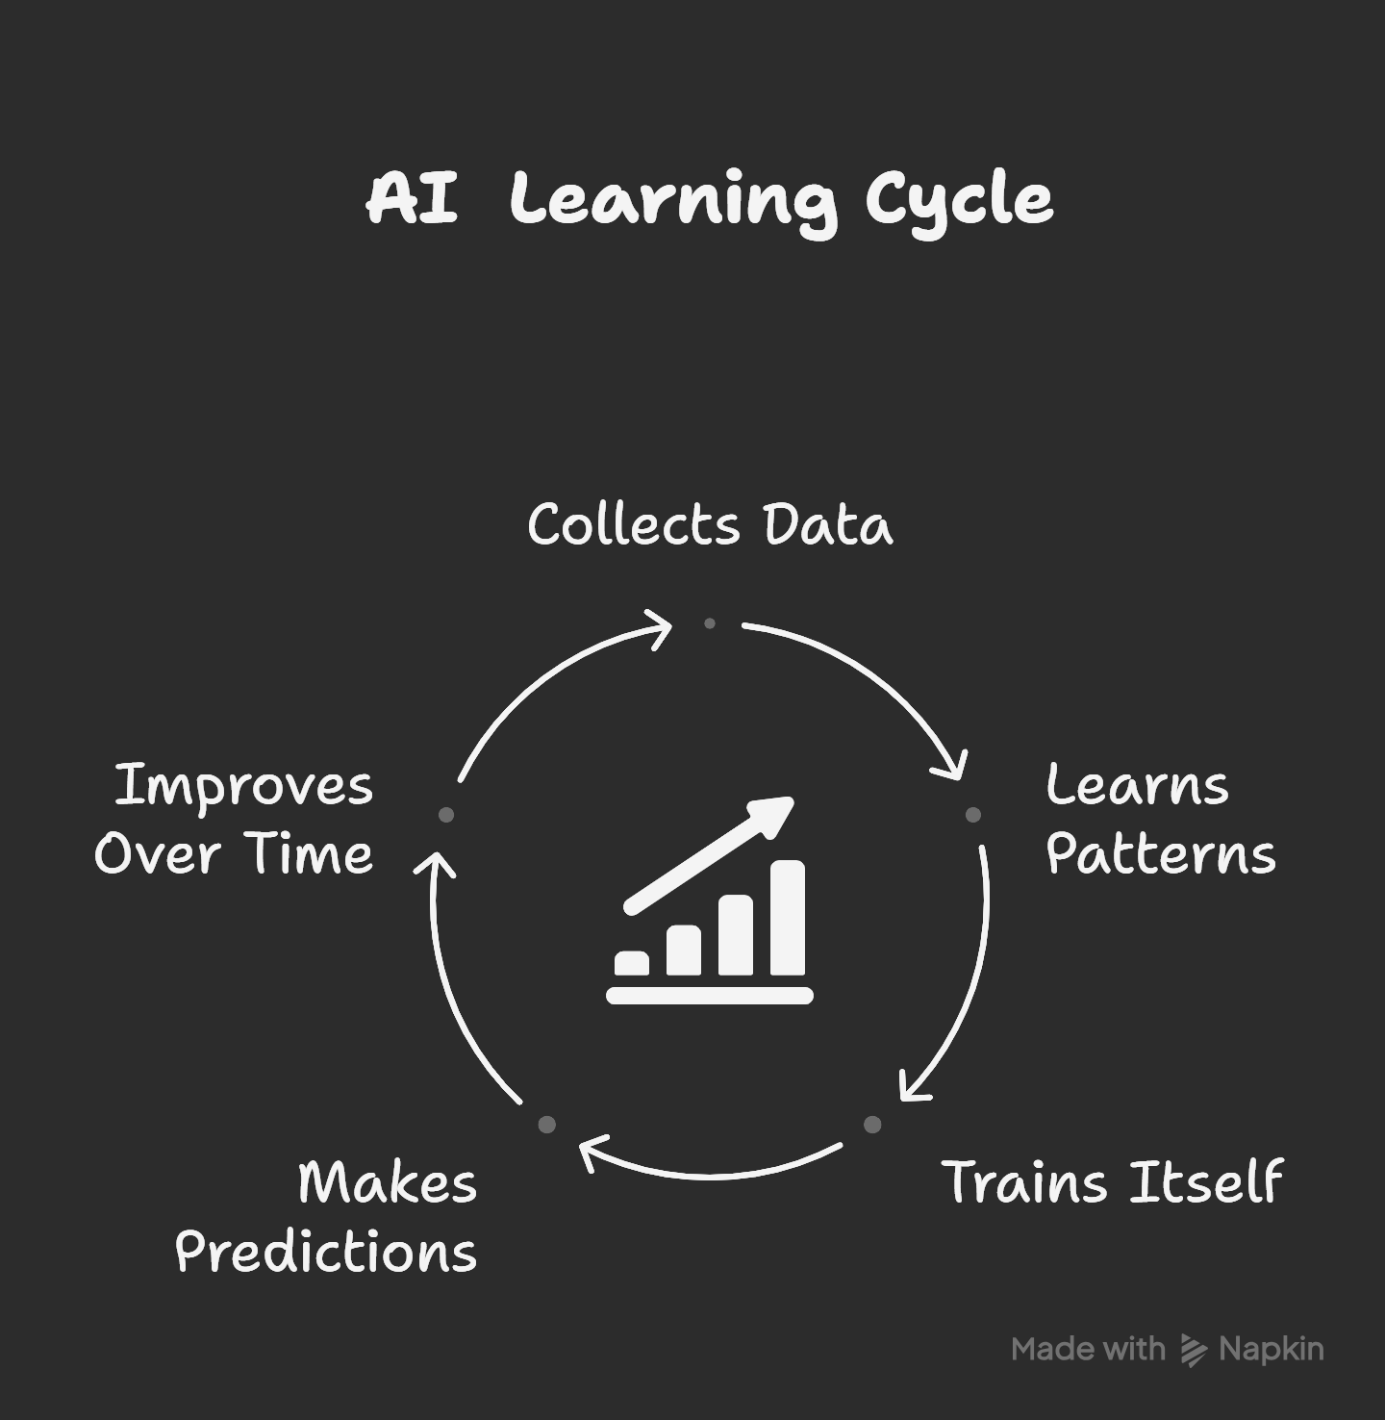
How does AI work?
AI works by watching, learning, and practicing, just like a child learning to ride a bicycle—falling, trying again, and eventually riding smoothly.

Slide 4
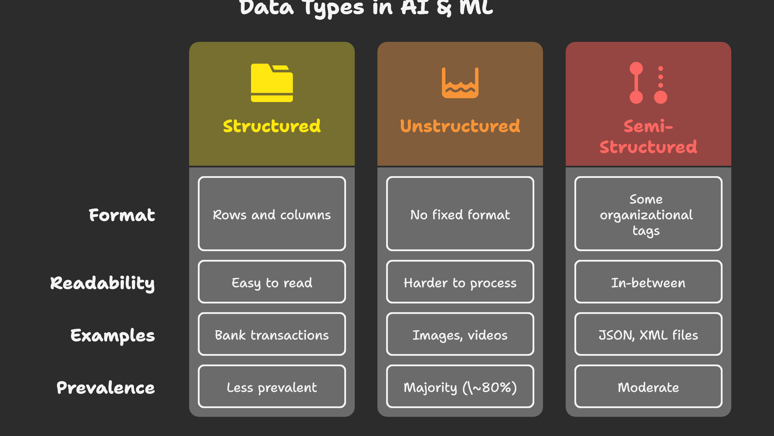

Slide 5
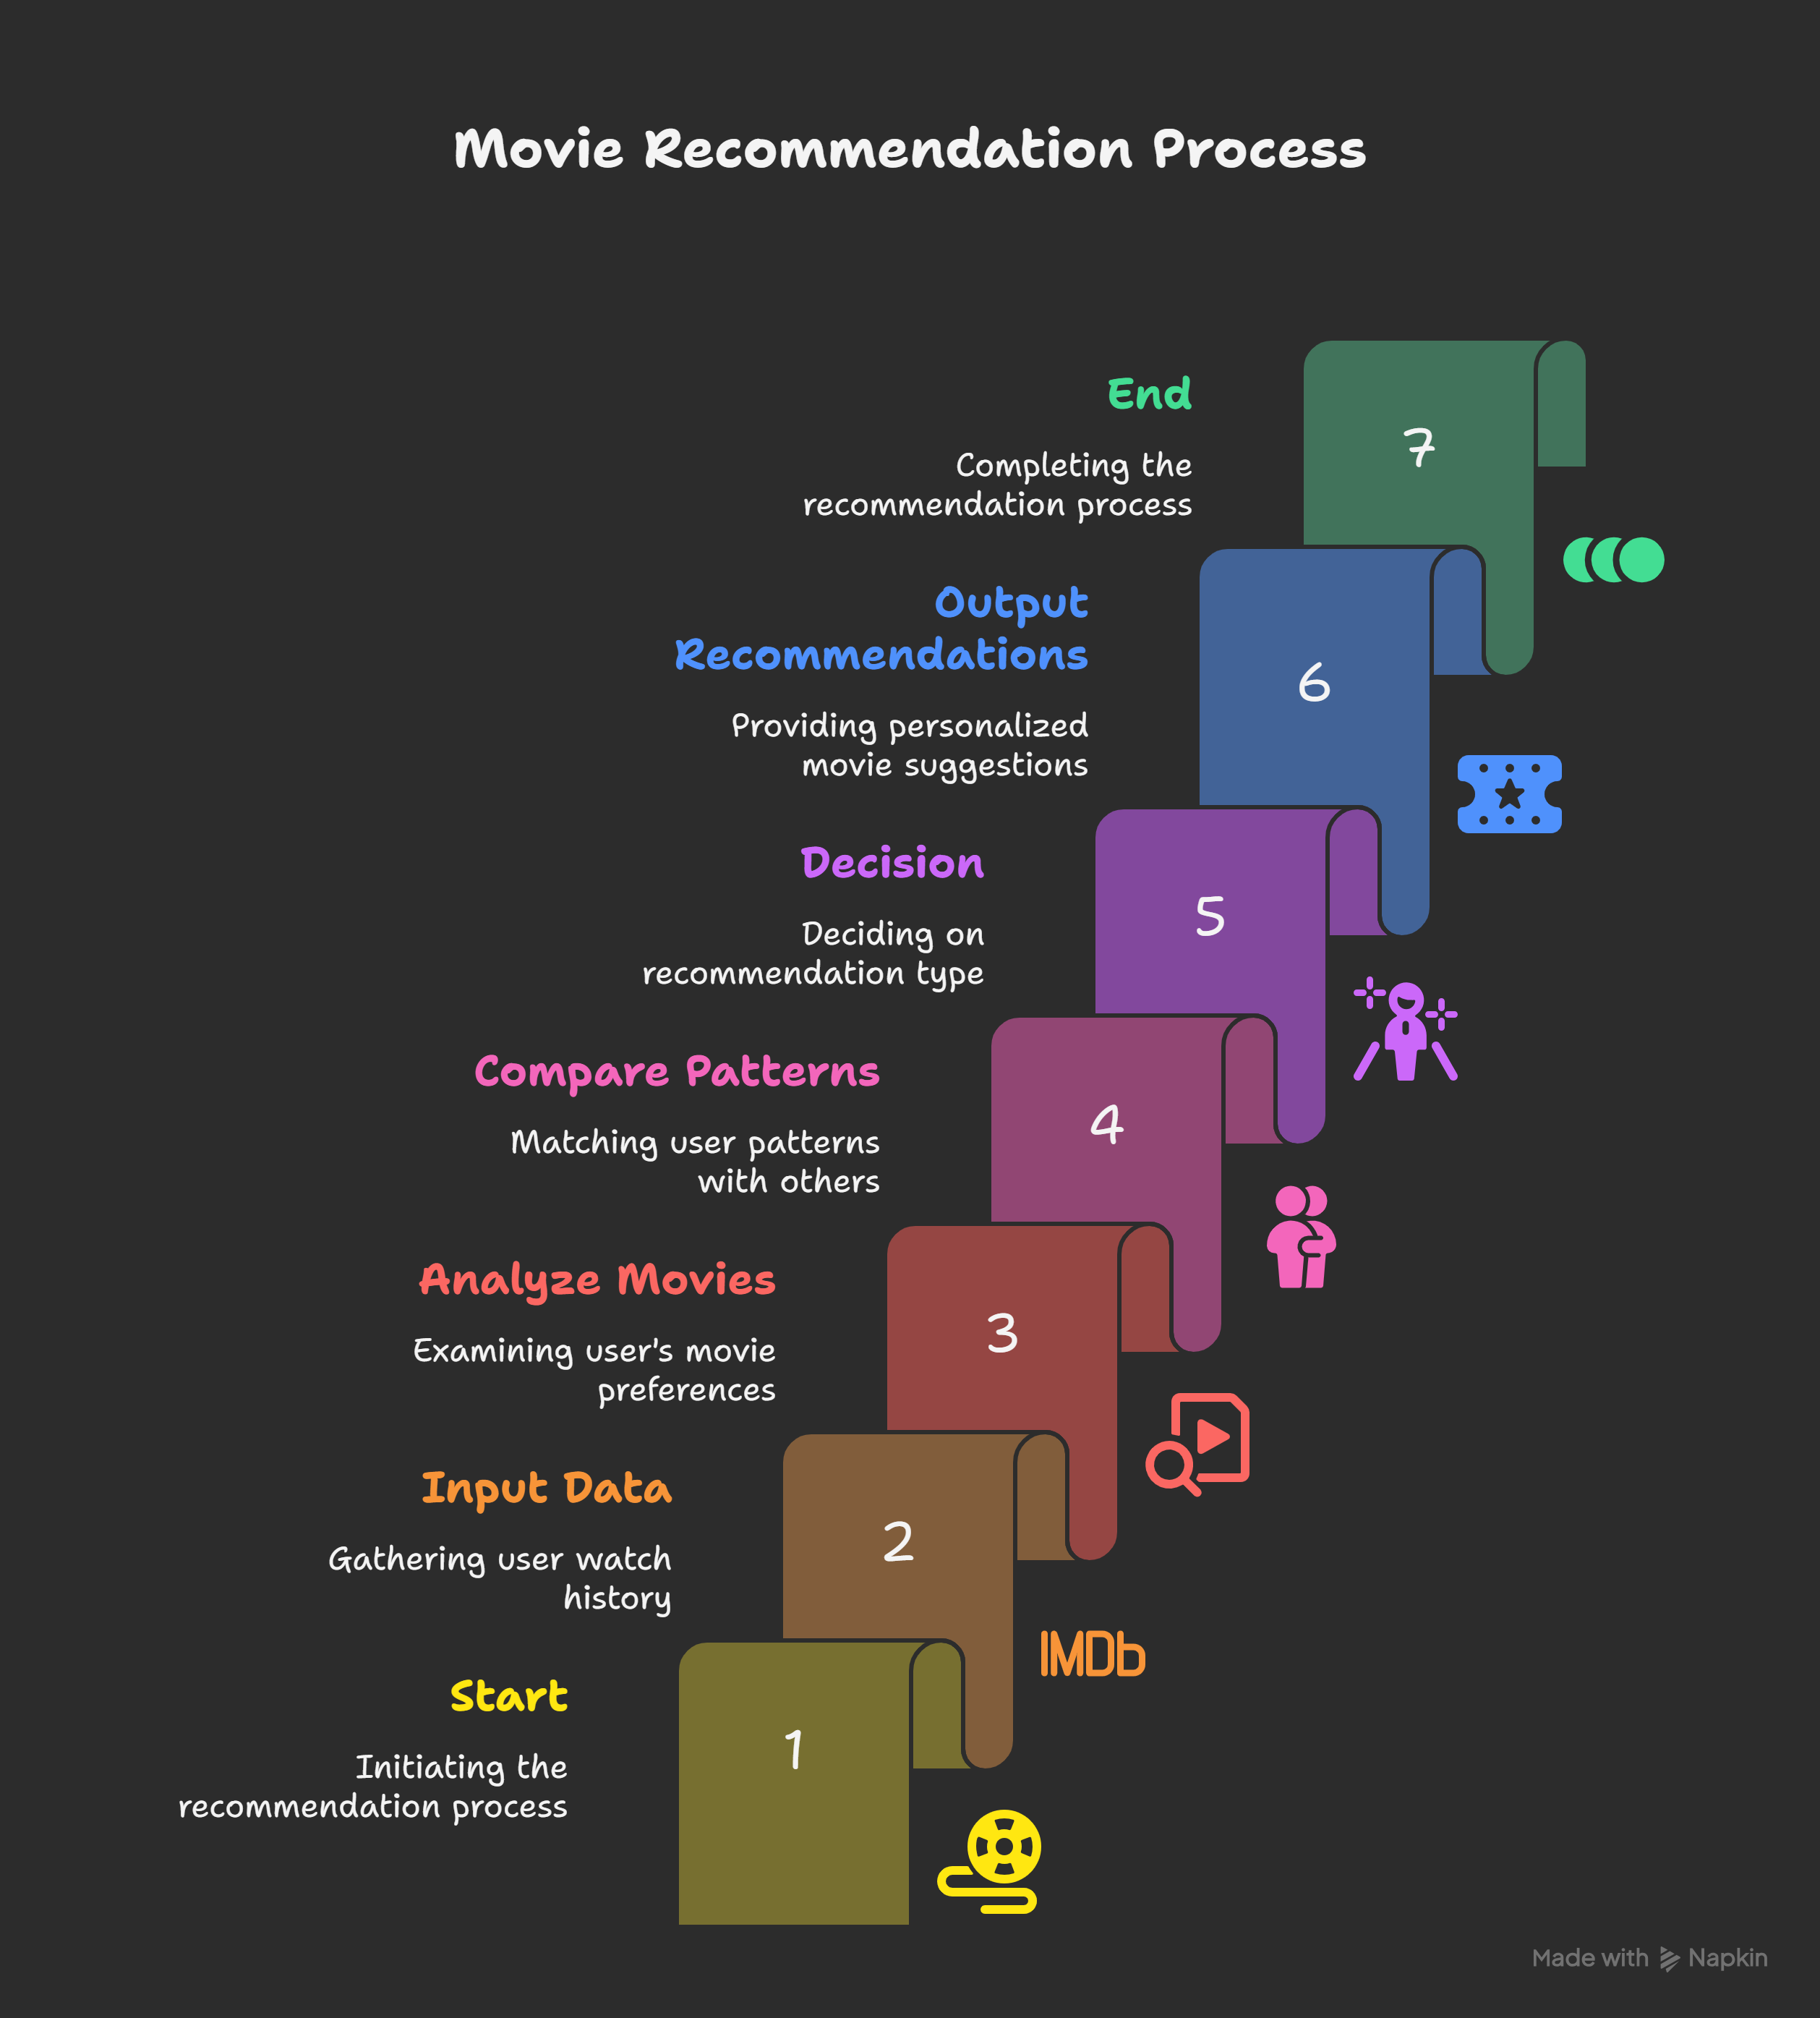

Slide 6
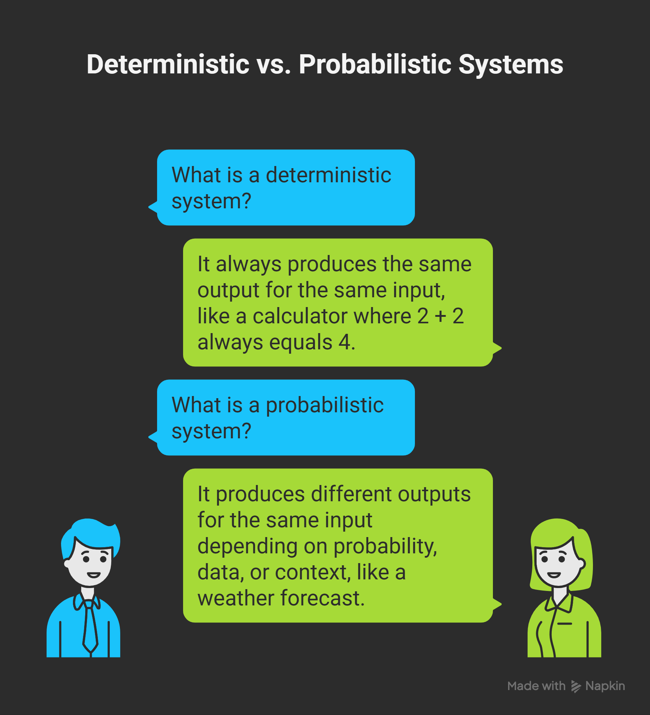
Deterministic System vs Probabilistic System

Slide 7
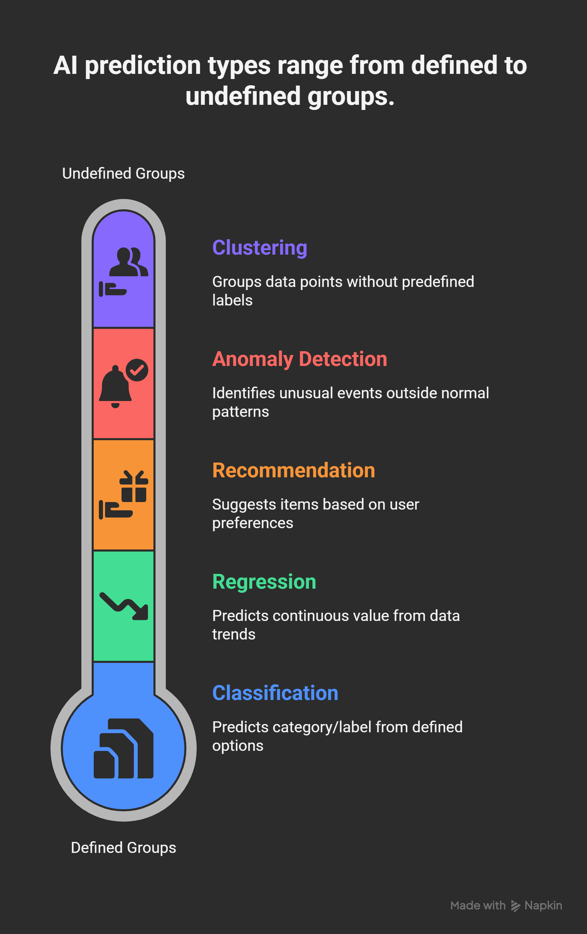
Types of Prediction in AI

Slide 8
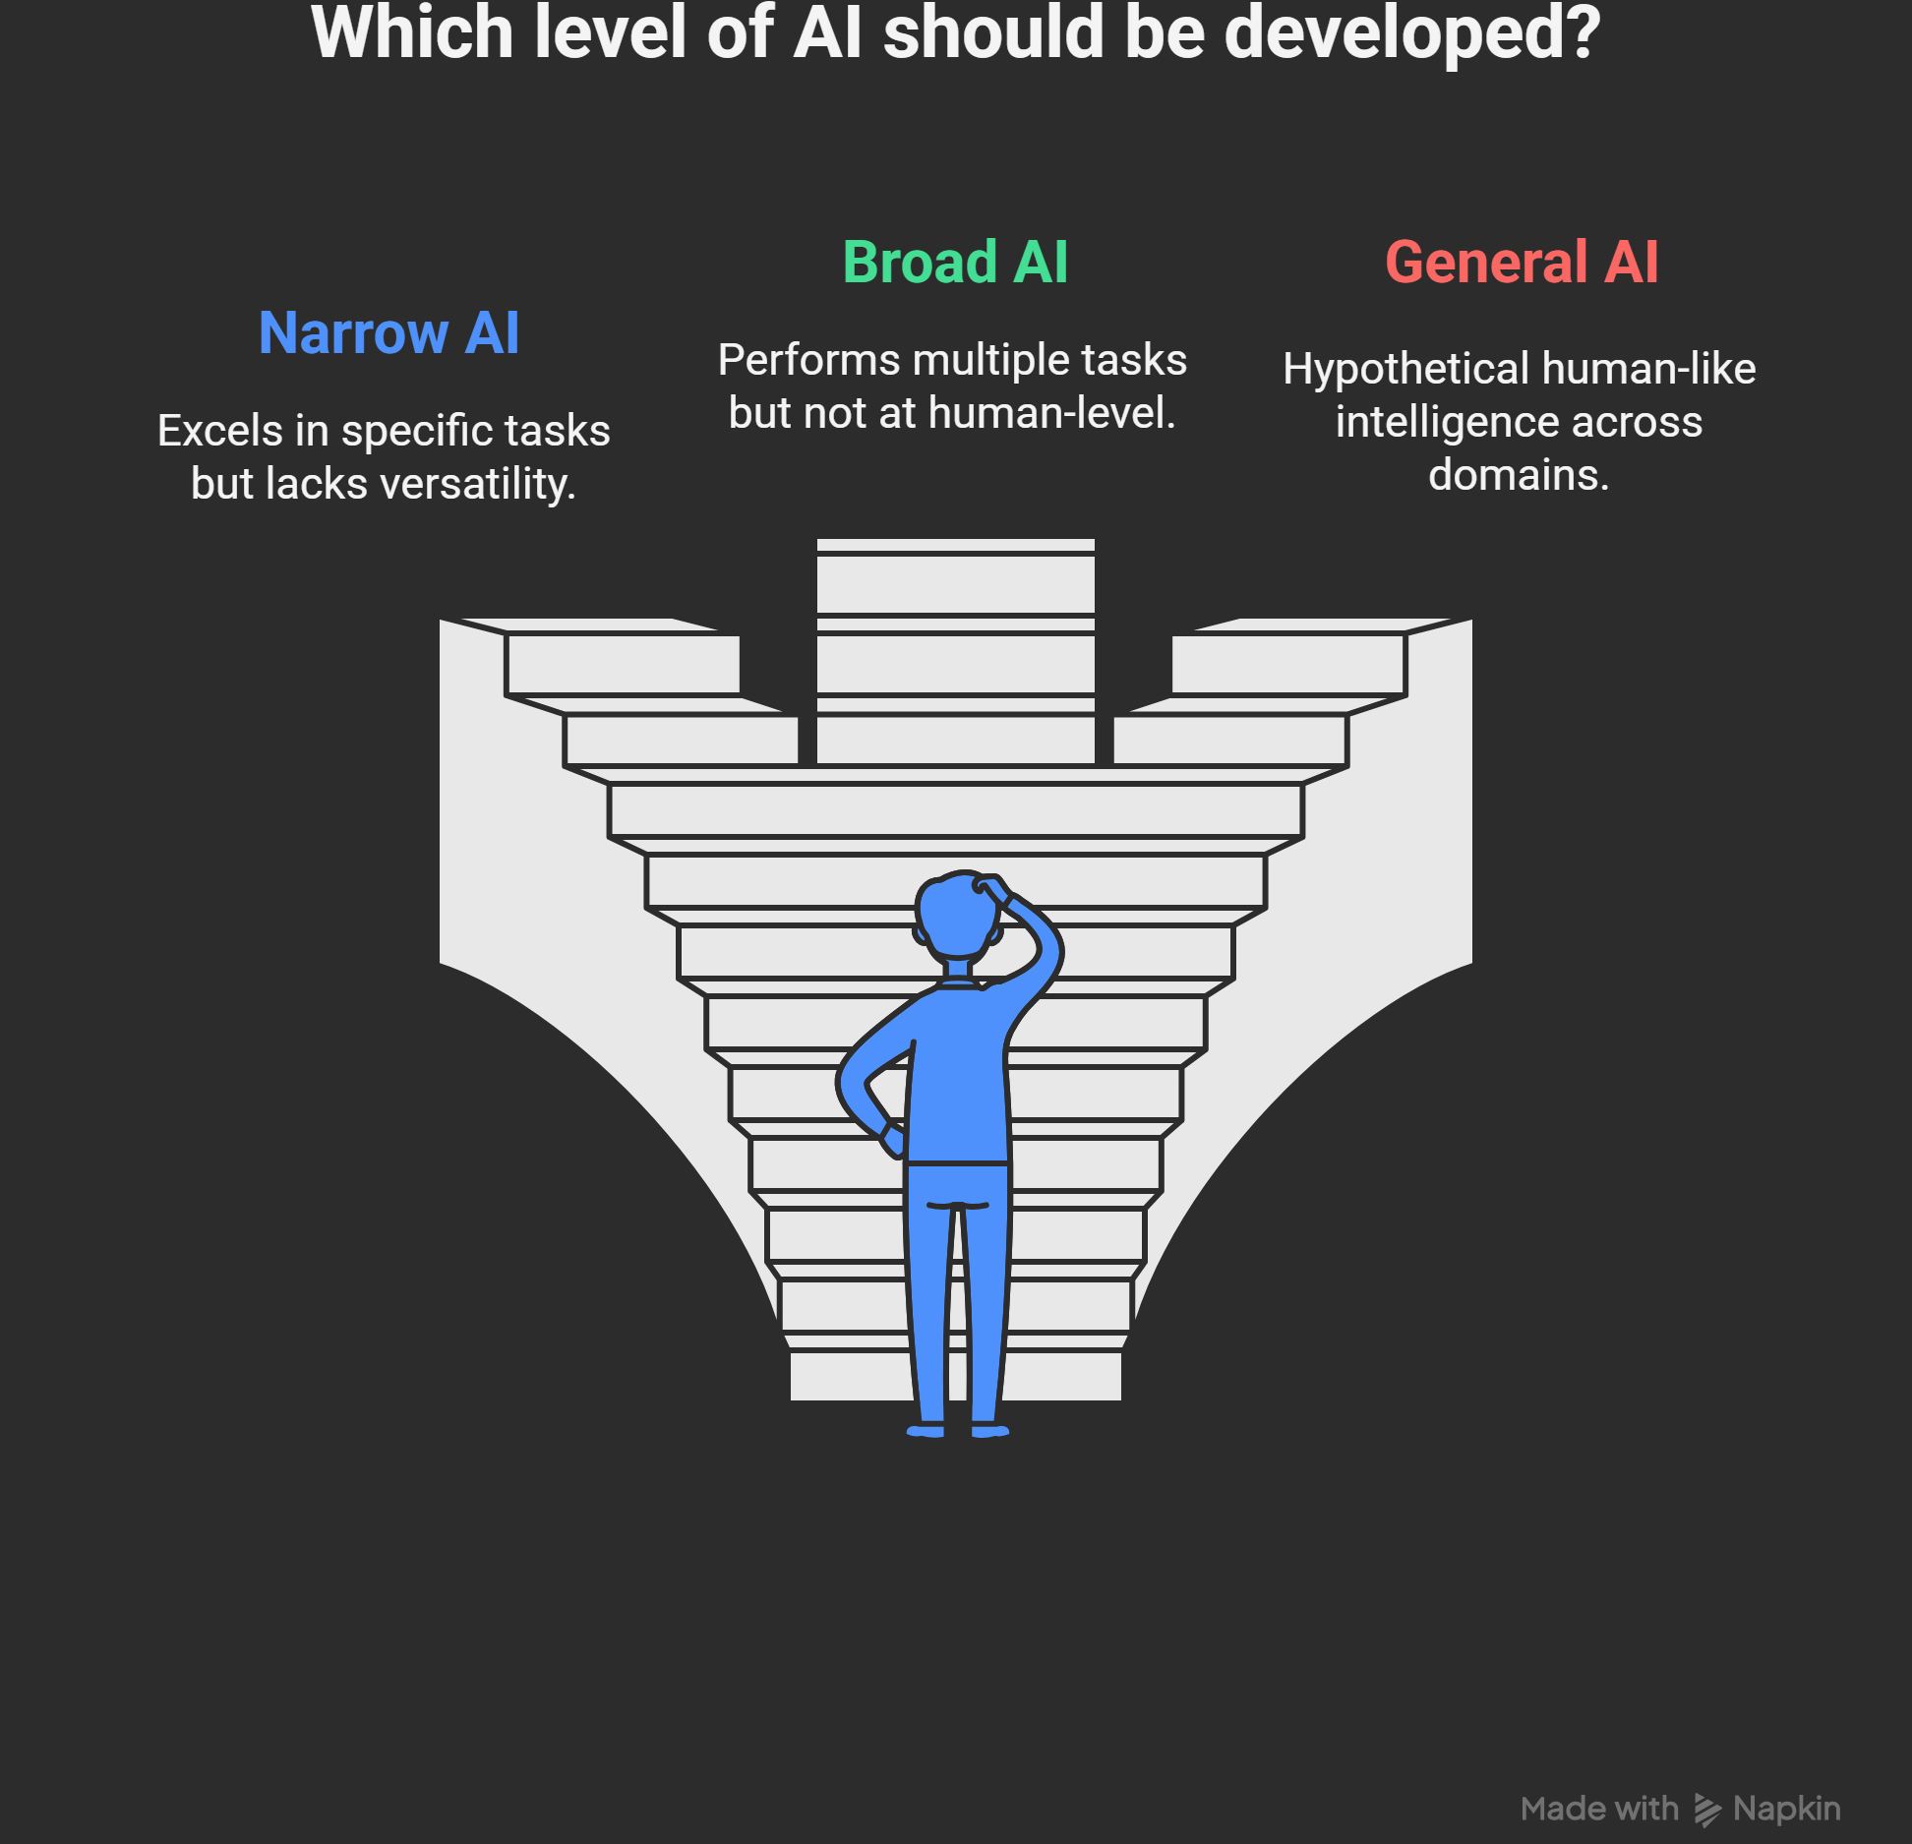
Three Levels of AI

Slide 9
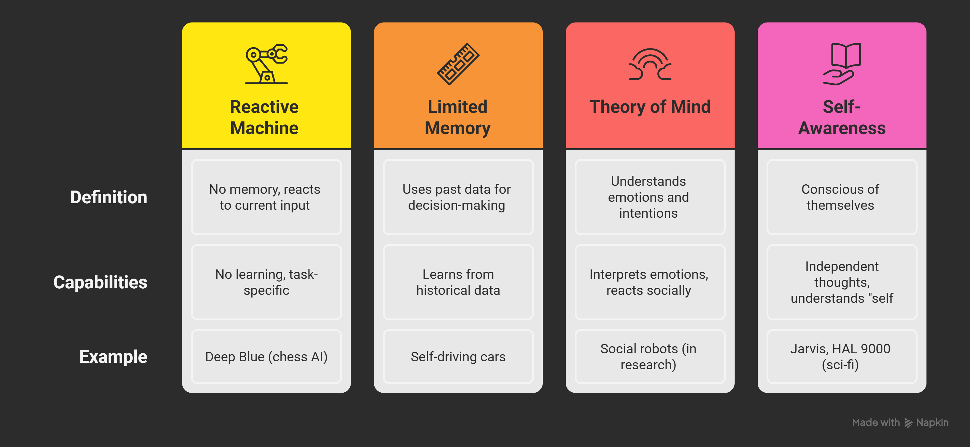
Artificial Intelligence Based on Functionality

Slide 10
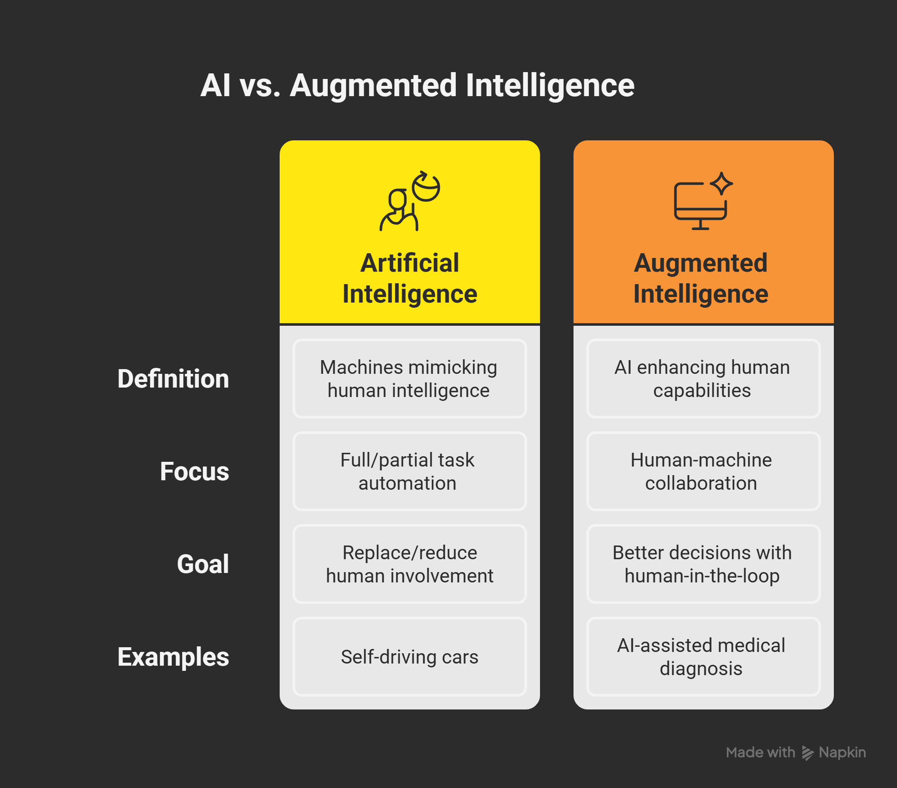
AI vs Augmented Intelligence

