Slide 1

From Theory to Magic: Advanced LLM Secrets

Slide 2
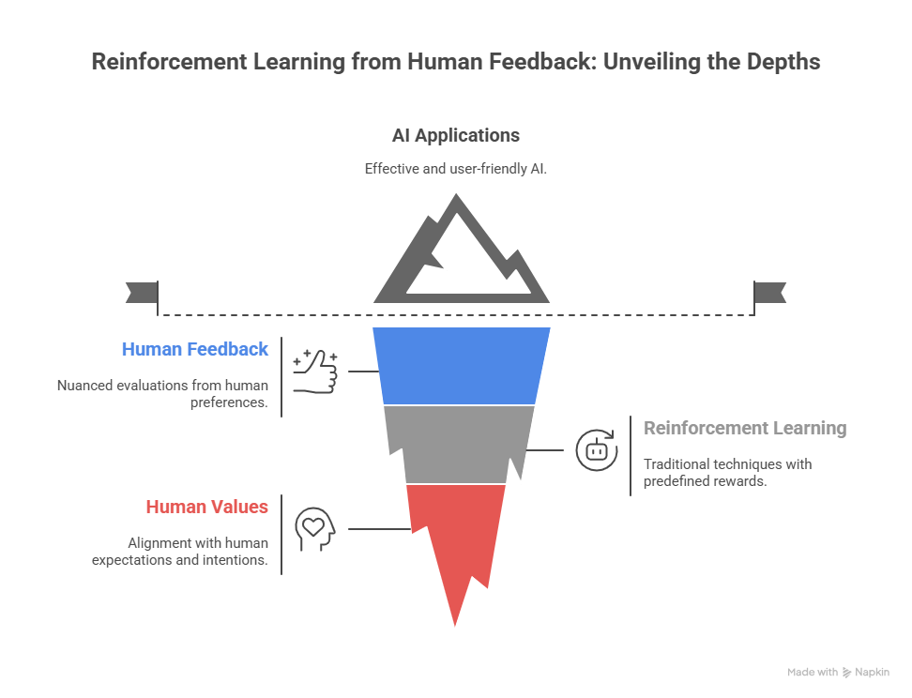

Slide 3
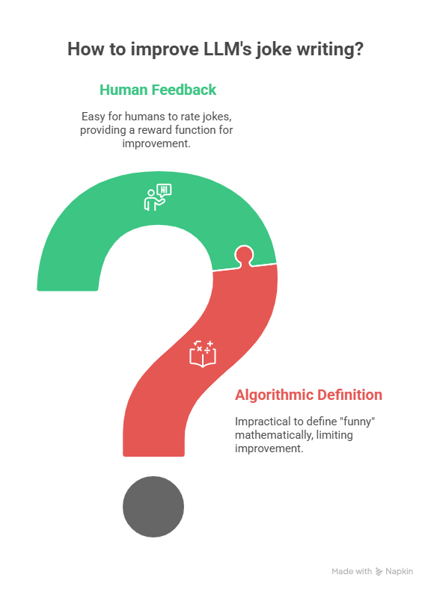
Reinforcement learning from human feedback (RLHF) is a machine learning technique in which a “reward model” is trained with direct human feedback, then used to optimize the performance of an artificial intelligence agent through reinforcement learning.

Slide 4
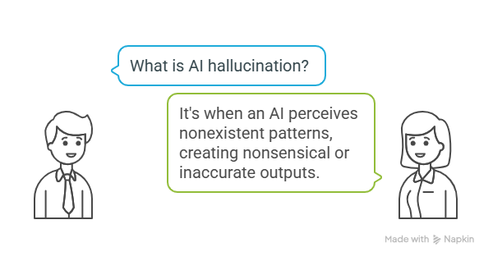
AI HALLUCINATIONS

Slide 5
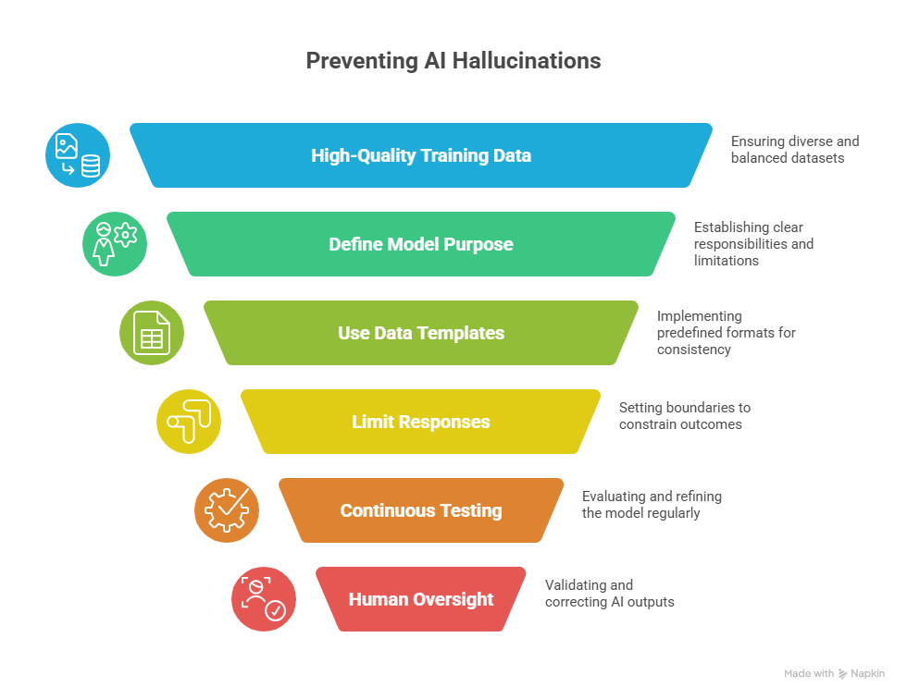

Slide 6
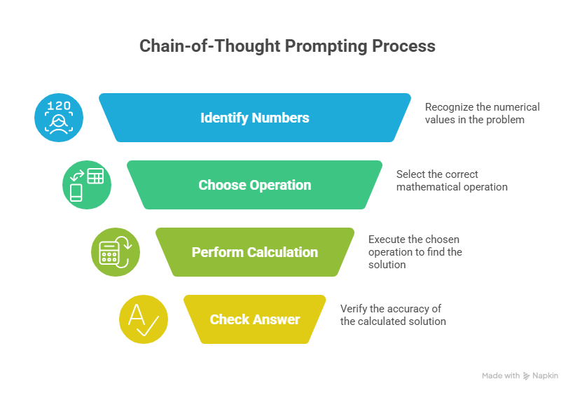

Slide 7
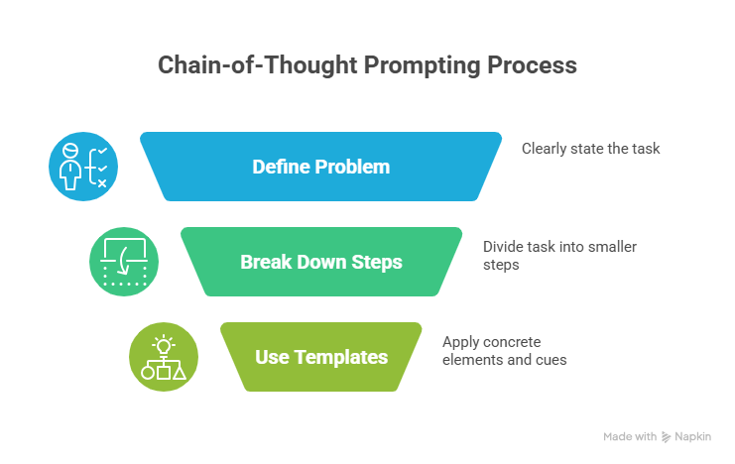

Slide 8
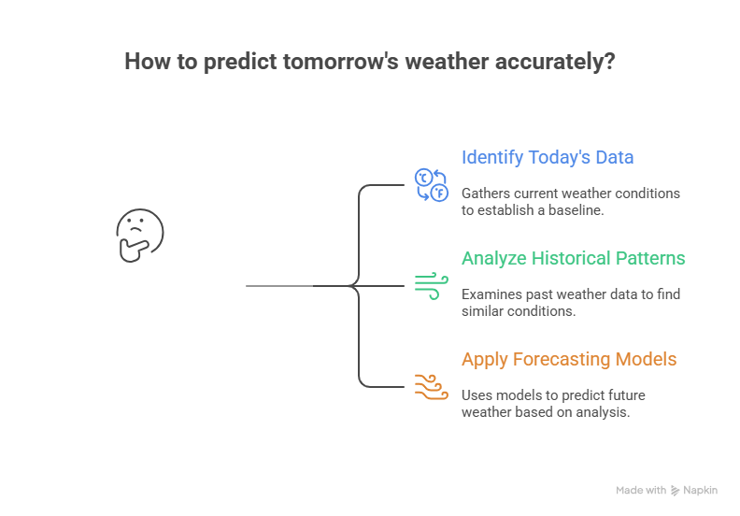

Slide 9
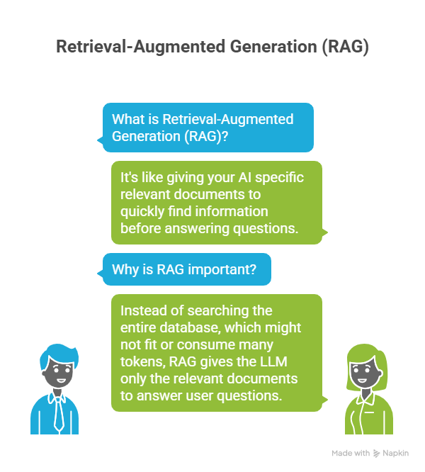

Slide 10
