Slide 1

Spotify Data Analyst Case Study

Slide 2
Spotify Schema
Spotify database contais Activity table
In the Activity table user_id, event_name , event_date and country details are provided
Spotify needs to understand the Daily active user, Weekly active users etc.
Create the Schema by using following command:
CREATE SCHEM Spotify_db;

Slide 3
CREATE TABLE
Create the Activity tabel by using following command
CREATE TABLE Activity(
user_id varchar(20),
event_name varcharr(20),
event_date DATE,
Country varchar(20)
);

Slide 4
insert into activity
values
(1,'app-installed','2022-01-01','India')
,(1,'app-purchase','2022-01-02','India')
,(2,'app-installed','2022-01-01','USA')
,(3,'app-installed','2022-01-01','USA')
,(3,'app-purchase','2022-01-03','USA')
,(4,'app-installed','2022-01-03','India')
,(4,'app-purchase','2022-01-03','India')
,(5,'app-installed','2022-01-03','SL')
,(5,'app-purchase','2022-01-03','SL')
,(6,'app-installed','2022-01-04','Pakistan')
,(6,'app-purchase','2022-01-04','Pakistan');

Slide 5
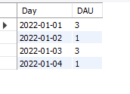
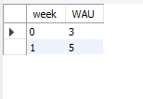
Spotify Queries
Q1) Find the total active users each day.
select Date(event_date) as Day, count(distinct user_id) as DAU
from activity
Group by Date(event_date);
Q2) Find the total actove users each week.
select week(event_date) as week, count(distinct user_id) as WAU
from activity
Group by week(event_date);

Slide 6
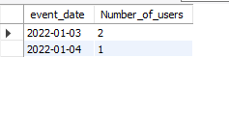
Q3) Find the datewise total number of user who made the purchase, the same day they installed the app
select event_date, count(user_id) as Number_of_users from
(
select user_id,event_date, count(event_name) from activity
group by user_id,event_date
having count(event_name)=2
) x
group by event_date;

Slide 7
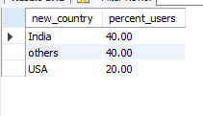
Q4) percentage of paid users in india, USA, and other countries where other countries other than India and USA are tagged as others
with country_users as
( select case when country in ('USA', 'India') then country else 'others' end as new_country, count(distinct user_id) as user_count from activity
where event_name = 'app-purchase'
group by case when country in ('USA', 'India') then country else 'others' end),
total_users as
(select sum(user_count) as total_no_users from country_users)
select new_country, round(user_count/total_no_users,2)*100 as percent_users
from country_users,total_users;

Slide 8
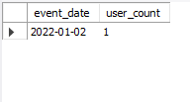
Q5) Among all the users who installed the app on any given day, how many did in app purchase on the very next day (give day wise result)
WITH prev_data as (
Select *,
lag(event_name,1) Over (partition by user_id order by event_date) as prev_event_name,
lag(event_date,1) Over (partition by user_id order by event_date) as prev_event_date
from activity)
select event_date, count(distinct user_id) as user_count from prev_data
where event_name = 'app-purchase' and prev_event_name = 'app-installed' and datediff(event_date,prev_event_date)=1
Group by event_date;

