Slide 1

FIN BUDDY
By
Dona
Khaviya
Swetha
Shreyah
sudhakar

Slide 2
Introduction
Managing your finances can be complex and overwhelming. Our goal is to make it easier by providing a smart, user-friendly web app that helps you manage your money more effectively.

Slide 3
Key Features
User Interaction
Personalized Budgeting
Savings Advice
User-Friendly Interface

Slide 4
Technology Stack
HTML
FLASK
API

Slide 5
User Flow
Registration/Login:
Secure user registration and login process
Dashboard:
Overview of financial status
Income and Expense Input:
Easy input methods for tracking financial transactions
Budget and Savings Recommendations:
AI-driven insights and recommendations
Reports and Analytics:
Visual representation of financial data

Slide 6
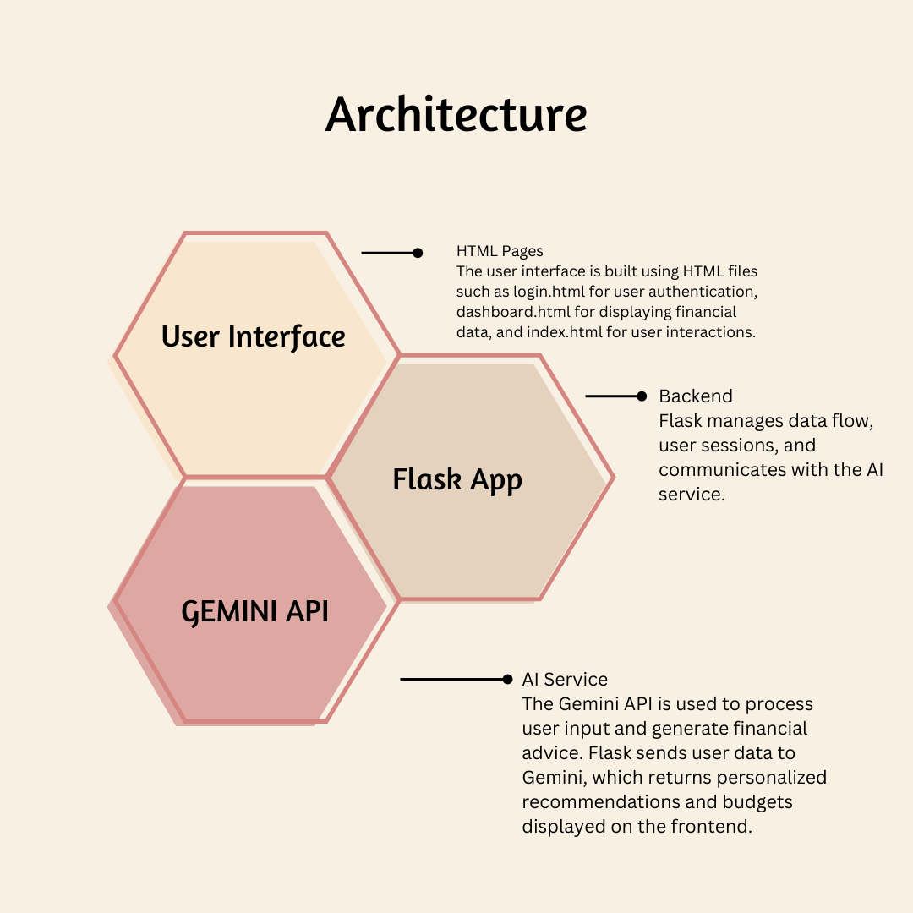

Slide 7
Benefits
Improved Financial Management
Personalized Advice and Budgeting
Easy to Use and Accessible

Slide 8
Future Enhancements
Adding More Advanced Financial Analytics
Integrating Additional Data Sources
Enhancing the User Interface and Experience

Slide 9



APPLICATIONS

Slide 10
Conclusion
The Smart AI Financial Advisor revolutionizes personal finance with AI-driven budgeting and savings advice. It offers a user-friendly interface for easy financial planning and informed decision-making. Start using the app today to enhance your financial management and achieve your goals.

