Slide 1
Smart Task Manager
FULL-STACK WEB APPLICATION
SYSTEM ARCHITECTURE & PLANNING
Smart Task Manager is a full-stack web application designed to help users organize and manage their daily tasks efficiently. This document outlines the complete project planning and system architecture — covering project objectives, functional and non-functional requirements, user flowcharts, wireframes, technical architecture, database schema, API design, design rationale, and conclusion. The application provides a simple and intuitive interface where users can create, update, delete, and monitor their tasks from a centralized dashboard, with secure user authentication and personalized task lists.

Slide 2
Project Brief & Objectives
Smart Task Manager is a full-stack web application designed to help users organize and manage their daily tasks efficiently. The application provides a simple and intuitive interface where users can create, update, delete, and monitor their tasks from a centralized dashboard. It supports secure user authentication, allowing each user to maintain a personalized task list. Users can categorize tasks, assign priorities, set due dates, and monitor their progress. The primary goal of the application is to improve productivity by providing a structured and organized task management system.
Many individuals struggle to organize their daily work and often forget important deadlines due to poor task management. Existing productivity applications may include unnecessary complexity or paid features that discourage regular use. The Smart Task Manager aims to provide a simple, secure, and user-friendly solution that enables users to effectively organize, prioritize, and monitor their daily tasks without unnecessary complications.
Modern Full-Stack App
Secure Authentication
Complete CRUD Operations
Develop a modern full-stack web application using React, Node.js, Express, and MongoDB with a unified JavaScript stack.
Implement secure user authentication using JWT tokens and bcrypt password hashing to protect user accounts.
Allow users to perform complete create, read, update, and delete operations on tasks through a RESTful API.
Task Categorization & Prioritization
Productivity & Deadlines
Responsive UI
Provide task categorization, priority assignment, and due date management to help users stay organized.
Improve productivity through deadline management, progress tracking, and a clean dashboard overview.
Design a responsive and intuitive user interface with optional dark mode, accessible to all target users.
Practical Experience
Gain practical, hands-on experience in full-stack web development through a real-world project.
The application is intended for students, working professionals, freelancers, small business owners, and individuals managing personal daily activities. Key features include user registration, login, and secure authentication; a centralized dashboard; task creation, editing, and deletion; task categories, due dates, and priorities; search and filter functionality; progress tracking; responsive design; and optional dark mode.

Slide 3
Functional & Non-Functional Requirements
Functional Requirements
Non-Functional Requirements
User Management
Performance
User Registration & Login
User Logout
Password Encryption
JWT Authentication
Fast page loading
Efficient API responses
Optimized database queries
Security
Task Management
JWT Authentication
Password hashing using bcrypt
Protected API routes
Input validation
Secure data transmission
Create, Edit & Delete Tasks
Mark Tasks as Completed
View, Search, Filter & Sort Tasks
Assign Categories & Priorities
Set Due Dates
Reliability
Dashboard
Proper error handling
Consistent API responses
Stable database operations
Total & Completed Tasks
Pending Tasks
Upcoming Deadlines
Progress Statistics
Usability
Easy navigation
Responsive interface
Clean dashboard
Accessible design
Scalability
Modular architecture
RESTful APIs
Easy feature expansion
The Smart Task Manager should provide comprehensive functionality across user management, task management, and a centralized dashboard. On the user management side, the application supports user registration, login, logout, password encryption, and JWT authentication to ensure secure access. For task management, users should be able to create a new task, edit an existing task, delete tasks, mark tasks as completed, view all tasks, search tasks, filter tasks, sort tasks, assign categories, set priorities, and set due dates. The dashboard should display total tasks, completed tasks, pending tasks, upcoming deadlines, and progress statistics to give users a clear overview of their workload and productivity.
Non-functional requirements are equally critical to the application's success. Performance requirements include fast page loading, efficient API responses, and optimized database queries. Security is addressed through JWT authentication, password hashing using bcrypt, protected API routes, input validation, and secure data transmission. Reliability is ensured through proper error handling, consistent API responses, and stable database operations. Usability focuses on easy navigation, a responsive interface, a clean dashboard, and accessible design. Finally, scalability is achieved through a modular architecture, RESTful APIs, and an architecture designed for easy feature expansion.

Slide 4
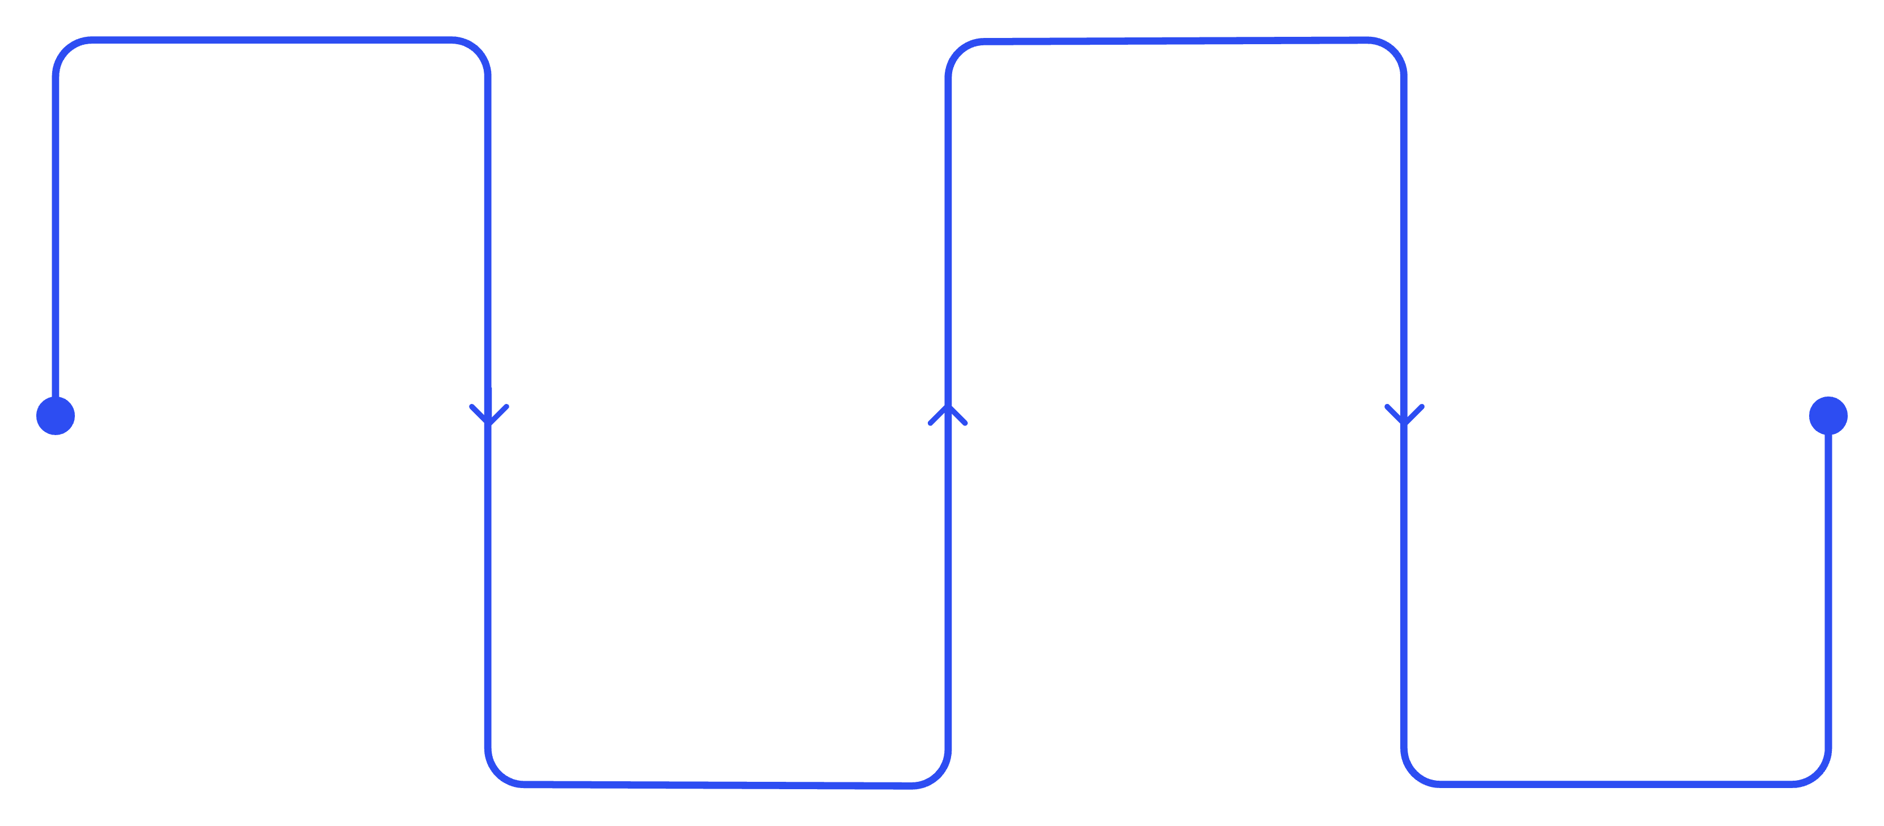
User Flowcharts
The user flowcharts below illustrate the three primary interaction paths within the Smart Task Manager: the overall user flow from landing page to logout, the task creation flow, and the login authentication flow. Each flow is designed to be intuitive and straightforward, minimizing the number of steps required for users to accomplish their goals while ensuring proper validation and error handling at each stage.
Landing
Dashboard
Explore features and CTA
Create and view tasks
Auth
Logout
Login or register securely
End session and exit
The overall user flow begins at the landing page, where users can choose to log in or register. After authentication, users are directed to the dashboard, where they can either create new tasks or view and manage existing tasks. Creating a task involves entering task details, validation, saving to the database, and updating the dashboard. Viewing tasks allows users to edit or delete existing tasks, which also updates the dashboard. Users can log out at any time to end their session securely.
Task Creation Flow
Login Flow
The task creation flow starts from the dashboard when the user clicks "Add Task." The user then enters task details such as title, description, category, priority, and due date. The system performs validation on the entered data to ensure all required fields are complete and properly formatted. If validation passes, the task is saved to the database, and the dashboard is updated to reflect the new task. If validation fails, the user is prompted to correct the input before resubmitting.
The login flow begins at the home page, where the user selects the login option. The user enters their email and password, which are submitted for authentication. The system verifies the credentials against the database. If authentication succeeds, the user is directed to the dashboard with full access to their task list. If authentication fails — due to incorrect credentials or a system error — an error message is displayed, and the user is prompted to try again or use the registration option if they do not yet have an account.

Slide 5
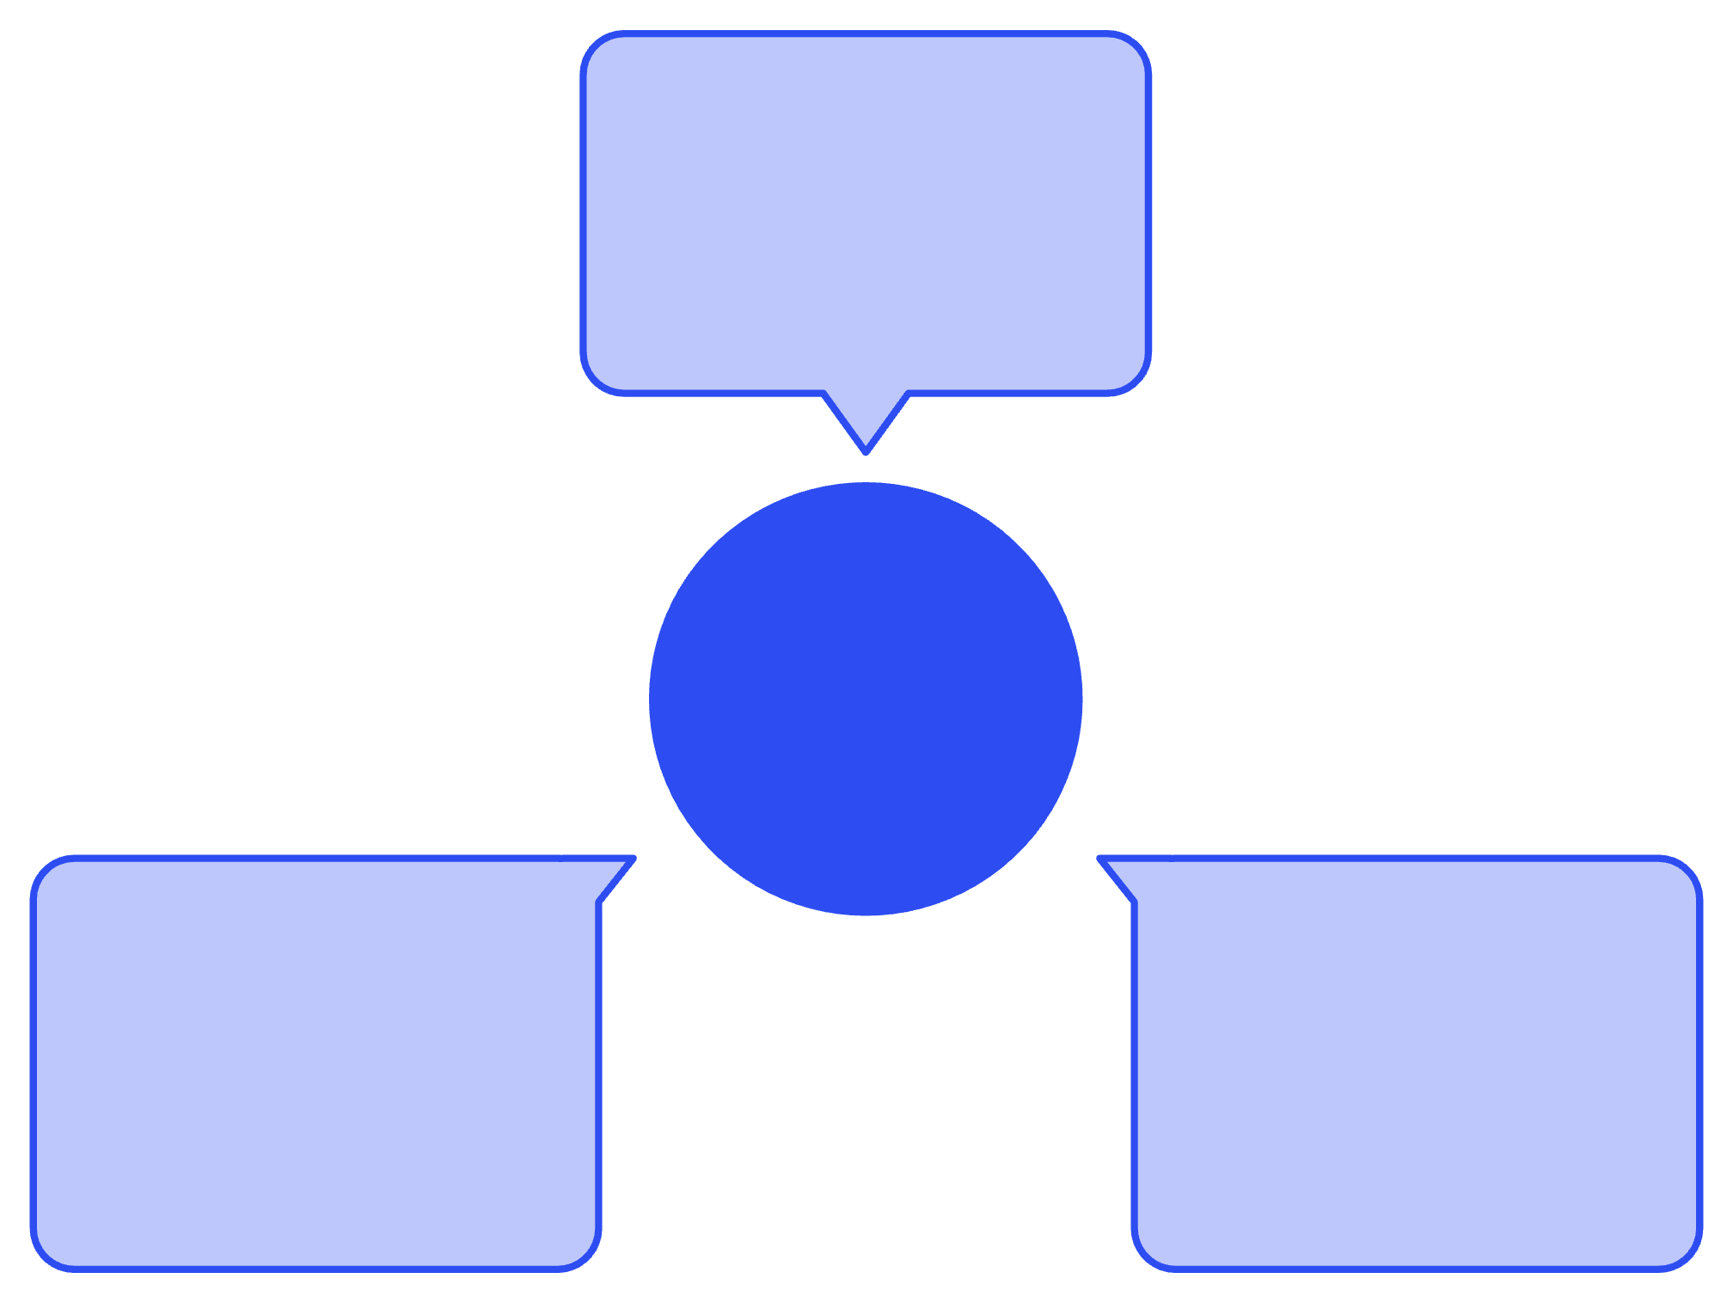
Technical Architecture
The Smart Task Manager uses a three-tier architecture consisting of a Presentation Layer (React Frontend), an Application Layer (Node.js/Express REST API), and a Data Layer (MongoDB Database). This separation ensures modularity, scalability, and maintainability — each layer can be developed, tested, and updated independently. The frontend communicates with the backend via Axios HTTP requests, while the backend processes requests through JWT authentication middleware and business logic before interacting with the database.
React Frontend
Presentation layer using Axios
Three-tier Architecture
MongoDB Database
Express REST API
Data layer for persistent storage
Application layer with JWT middleware
The frontend layer is built with React and React Router for component-based UI and client-side routing, Axios for HTTP communication with the backend, and CSS/Tailwind CSS for responsive styling. The backend layer uses Node.js as the JavaScript runtime and Express.js as the lightweight framework for building RESTful APIs. Authentication is handled through JWT for stateless token-based sessions and bcrypt for secure password hashing. The data layer uses MongoDB, a NoSQL database that stores data in flexible JSON-like documents, integrating seamlessly with the Node.js stack.
Component
Technology
Description
Frontend
React, React Router, Axios, CSS / Tailwind CSS
Component-based UI with client-side routing, HTTP requests, and responsive styling
Backend
Node.js, Express.js
High-performance JavaScript runtime with a lightweight RESTful API framework
Authentication
JWT, bcrypt
Stateless token-based authentication with secure password hashing
Database
MongoDB
NoSQL document database with flexible JSON-like storage, well-suited for evolving data structures

Slide 6

Database Schema
The Smart Task Manager uses two primary MongoDB collections: Users and Tasks. MongoDB stores data in flexible JSON-like documents, which integrates well with Node.js and is suitable for applications where the data structure may evolve over time. The Users collection stores account information with encrypted passwords, while the Tasks collection stores all task-related data linked to the owning user via a foreign key reference (userId). This one-to-many relationship means one user can have multiple tasks, and each task belongs to exactly one user.
Users Collection
Tasks Collection
Field
Type
Description
Field
Type
Description
_id
ObjectId
Unique ID
_id
ObjectId
Task ID
name
String
User name
title
String
Task title
email
String
User email
description
String
Task description
password
String
Encrypted password
category
String
Task category
createdAt
Date
Registration date
priority
String
Low, Medium, High
dueDate
Date
Due date
status
Boolean
Completed / Pending
userId
ObjectId
Owner of task
createdAt
Date
Created date
The Users collection contains five fields: _id (ObjectId, unique identifier), name (String, user's display name), email (String, used for login authentication), password (String, encrypted using bcrypt for security), and createdAt (Date, timestamp of account registration). The Tasks collection contains nine fields: _id (ObjectId, unique task identifier), title (String, the task name), description (String, detailed task notes), category (String, for grouping tasks), priority (String, with values Low, Medium, or High), dueDate (Date, deadline for the task), status (Boolean, indicating Completed or Pending), userId (ObjectId, reference to the owning user), and createdAt (Date, timestamp of task creation).
Database Relationship: One User → Many Tasks. Each task document includes a userId field that references the owning user's _id, enabling efficient querying of a user's personalized task list.

Slide 7
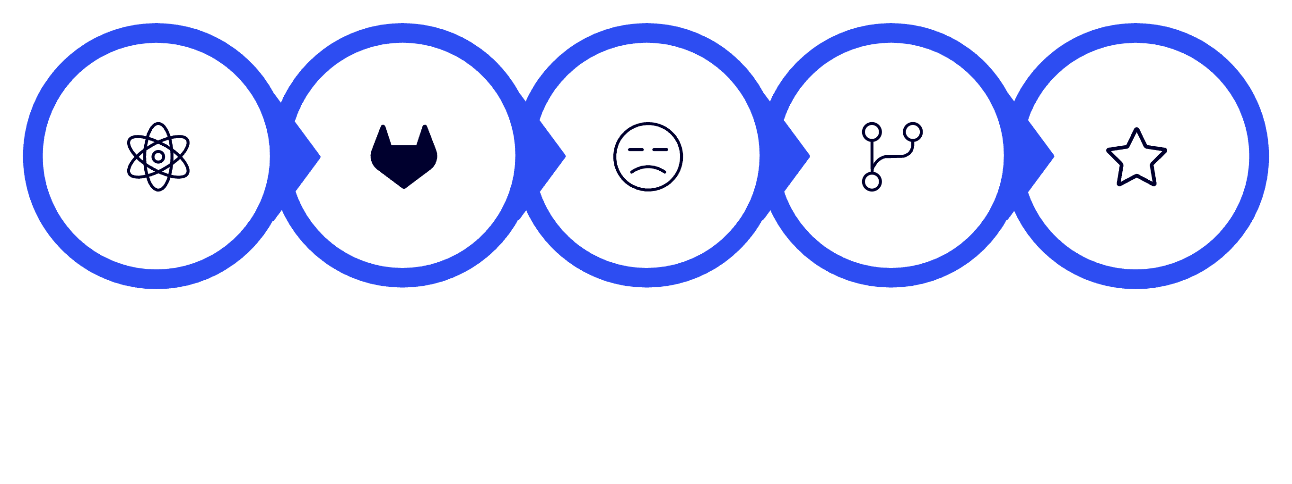
API Design
The Smart Task Manager exposes a RESTful API organized into two resource groups: Authentication APIs for user registration, login, and profile access, and Task APIs for full CRUD operations on tasks. All task-related endpoints are protected by JWT authentication middleware, ensuring that users can only access and modify their own data. The API follows standard HTTP method conventions — POST for creation, GET for retrieval, PUT for updates, and DELETE for removal — returning consistent JSON responses for both success and error cases.
Authentication APIs
Method
Endpoint
Purpose
POST
/api/auth/register
Register user
POST
/api/auth/login
Login user
GET
/api/auth/profile
User profile
Task APIs
Method
Endpoint
Purpose
GET
/api/tasks
Get all tasks
GET
/api/tasks/:id
Get task details
POST
/api/tasks
Create task
PUT
/api/tasks/:id
Update task
DELETE
/api/tasks/:id
Delete task
React UI
Axios Request
Express Route
Controller
MongoDB
The example API flow illustrates the complete request-response cycle. When a user performs an action in the React UI — such as creating a new task — Axios sends an HTTP request to the appropriate Express route. The route handler passes the request to a controller, which contains the business logic. The controller interacts with MongoDB to read or write data, then returns a JSON response. Axios receives this response and updates the React UI accordingly, providing immediate feedback to the user. This clean separation of concerns ensures that the frontend remains decoupled from the backend, making the application easier to test, maintain, and extend.

Slide 8





Design Rationale
The Smart Task Manager was selected because task management is a common real-world problem. It demonstrates essential full-stack development concepts — including authentication, CRUD operations, API development, database management, and responsive UI design — while remaining manageable within the project timeline. The following sections explain the rationale behind each technology choice and the overall three-tier architecture.
Why React?
Why Node.js & Express?
Why MongoDB?
React enables the development of reusable UI components, efficient state management, and fast rendering through its virtual DOM. It is widely adopted in modern web development and simplifies building responsive user interfaces. React's component-based architecture aligns well with the modular design goals of the Smart Task Manager, allowing individual UI elements — such as task cards, forms, and the dashboard — to be developed and tested independently.
Node.js provides a high-performance JavaScript runtime, while Express.js offers a lightweight framework for building RESTful APIs. Together, they enable efficient communication between the frontend and backend with a unified JavaScript stack. Using JavaScript across both layers reduces context switching for developers and simplifies the overall technology stack, making the project more approachable for learning full-stack development.
MongoDB is a NoSQL database that stores data in flexible JSON-like documents. It integrates well with Node.js and is suitable for applications where the data structure may evolve over time, making development faster and more adaptable. The document-based model maps naturally to JavaScript objects, reducing the need for complex data transformation between the application and database layers.
Why JWT Authentication?
Overall Architecture
JWT (JSON Web Token) enables secure, stateless authentication between the client and server. It reduces server-side session management and is widely used in modern web applications. Because JWT tokens are self-contained and can be verified without querying the database on each request, they improve API performance while maintaining security through cryptographic signing.
A three-tier architecture — Presentation Layer, Application Layer, and Data Layer — was chosen to ensure modularity, scalability, and maintainability. Separating the frontend, backend, and database allows each layer to be developed, tested, and updated independently, supporting future enhancements. This separation of concerns also makes the codebase easier to understand and extend as new features are added to the application.

Slide 9
Conclusion
The Smart Task Manager project provides a comprehensive foundation for learning full-stack web development. The planning phase establishes clear objectives, system architecture, database design, API specifications, and user interface concepts that will guide the implementation in the following weeks. By following a modular architecture and industry-standard technologies, the application is designed to be secure, scalable, maintainable, and user-friendly.
The project addresses a real-world problem — helping individuals organize their daily work and avoid forgotten deadlines — while demonstrating the essential concepts of modern web application development. The three-tier architecture, RESTful API design, JWT-based authentication, MongoDB schema, and React frontend work together to create a cohesive system that is both functional and educational. Each design decision, from the choice of bcrypt for password hashing to the use of Tailwind CSS for responsive styling, reflects a commitment to industry best practices.
Secure
Scalable
JWT authentication and bcrypt password hashing protect user data at every layer of the application.
Modular three-tier architecture and RESTful APIs support easy feature expansion and independent layer updates.
Maintainable
User-Friendly
Clear separation of concerns across frontend, backend, and database layers simplifies testing and future development.
Responsive design, intuitive navigation, and a clean dashboard ensure an accessible experience for all target users.
The planning documented in this architecture overview — including functional and non-functional requirements, user flowcharts, database schema, API design, and technology rationale — provides a solid blueprint for the implementation phase. As development progresses, the modular structure will allow each component to be built, tested, and refined independently, ensuring that the final application meets the objectives of improving productivity through a structured and organized task management system.

