Slide 1
Genesis Ideathon: Final Presentation
QuickER
One accident report. Every responder. Zero lost minutes.
Team ID: GEN26-A0H-I140
Team Name: QuickER
Domain: Healthcare, Biotechnology and Human Well-being
Amrita Vishwa Vidyapeetham, Coimbatore Campus
Date: 11th October 2026

Slide 2
Presentation Outline
Problem Statement
Problem Understanding
Existing Gaps & Challenges
Our Proposed Solution
Technical Approach
Innovation & Uniqueness
Feasibility & Scalability
Cost for Product
Use Cases
Impacts and Benefits
Sustainable Development Goals
Individual Member Contribution

Slide 3
Problem Statement
When a road accident happens in India, the ambulance, the hospital, the traffic police and the family are informed one phone call at a time, and the victim is taken to the nearest hospital, not the one that is ready for them. The golden hour is lost to coordination, not just distance.
Our problem statement: build one platform that turns a single accident report into simultaneous action: the right ambulance, the right hospital, a cleared route, nearby help and an informed family, all inside the golden hour.
20
55%
2 in 3
road deaths every hour in India (1.72 lakh in 2023)
of victims reached any hospital within the golden hour
victims were referred in from another hospital first
Our motive: no accident victim should lose the golden hour to phone calls and the wrong hospital.

Slide 4
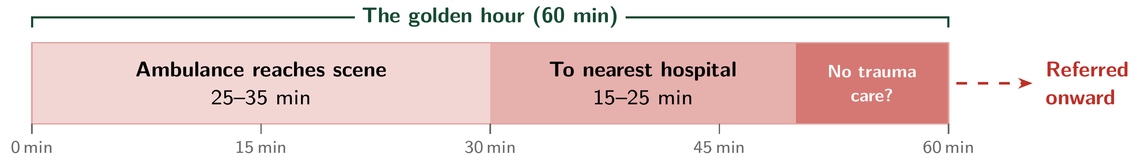
Problem Understanding
Where the golden hour goes on a national highway
Survey of 225 victims, relatives and rescuers: total time to emergency care was about 60 minutes or more.
Who is affected
Why victims missed the golden hour
Victims: minutes lost before treatment starts
Families: told late; can't share medical history
Ambulance crews: no view of free beds or specialists
Hospitals: unprepared arrivals, overload, re-referrals
Traffic police: hear of the ambulance only when it is stuck
Insight: every one of these is an information or coordination gap, which is exactly what software can close.

Slide 5
Existing Gaps & Challenges
Nearest ≠ ready – Victims go to the closest hospital whether or not it has trauma care, then get referred again. In Delhi, about 35% of crashes are 30+ min from a trauma centre.
No live view of capacity – India has about 0.6 beds per 1,000 people, yet no shared, live view of free beds, ICUs or specialists. Bed portals exist only as pilots.
Everyone is called separately – 108/112, police, hospital and family are told one by one. In disaster tele-consult systems, credentialing an outside specialist took 25–72 hours.
Tools solve one piece – SOS apps alert contacts; bed trackers show beds; research systems (MediPath, CARESYNC, EMCON) each cover one subsystem.
The unsolved challenge
After reviewing 130+ studies, we found no deployed platform that runs the whole chain as one workflow: one report → dispatch → right hospital → police, volunteers, doctors and family. Evidence for integrating traffic police and verified volunteers is the thinnest of all.

Slide 6
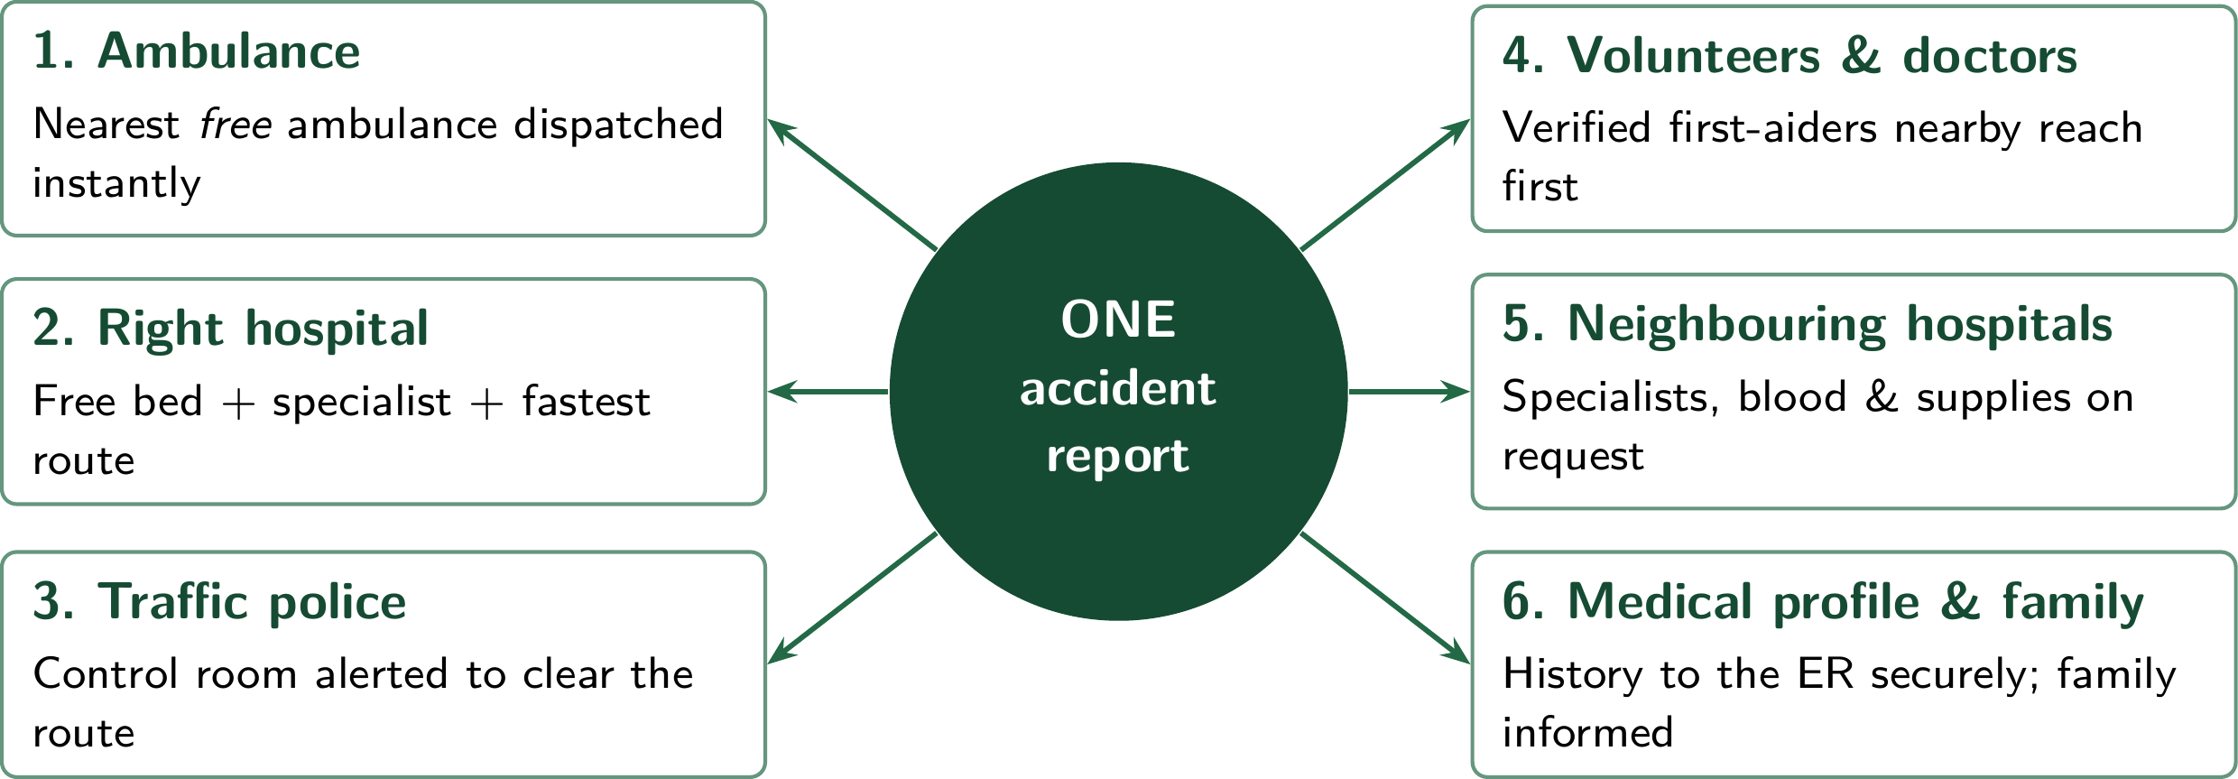
Our Proposed Solution
QuickER is an integrated emergency-coordination platform: one accident report sets every responder in motion at the same time.
Parallel, not sequential – all six start from one report
Ready, not nearest – the right hospital the first time
Live and accountable – every minute & access logged

Slide 7
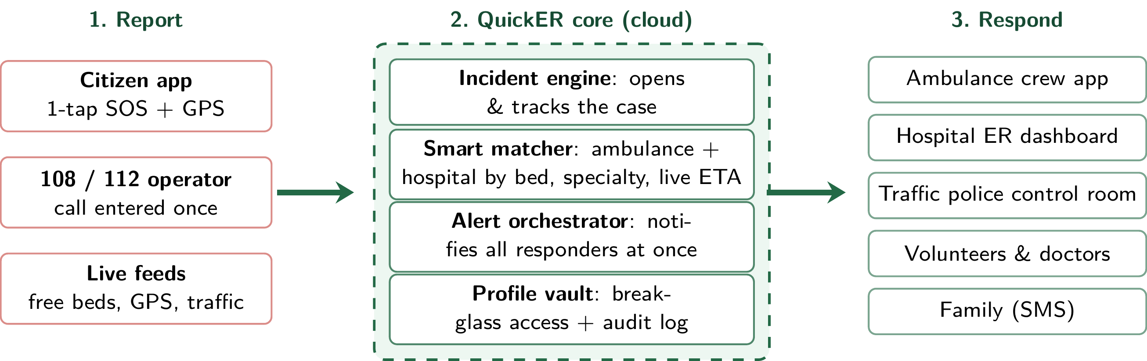
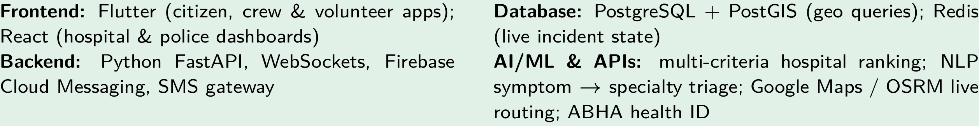
Technical Approach
A report opens an incident; the matcher ranks hospitals by free beds, specialty and live-traffic ETA (not distance); the orchestrator alerts all responders in parallel; the ER sees the victim's profile through audited break-glass access.
Tech Stack (planned)

Slide 8
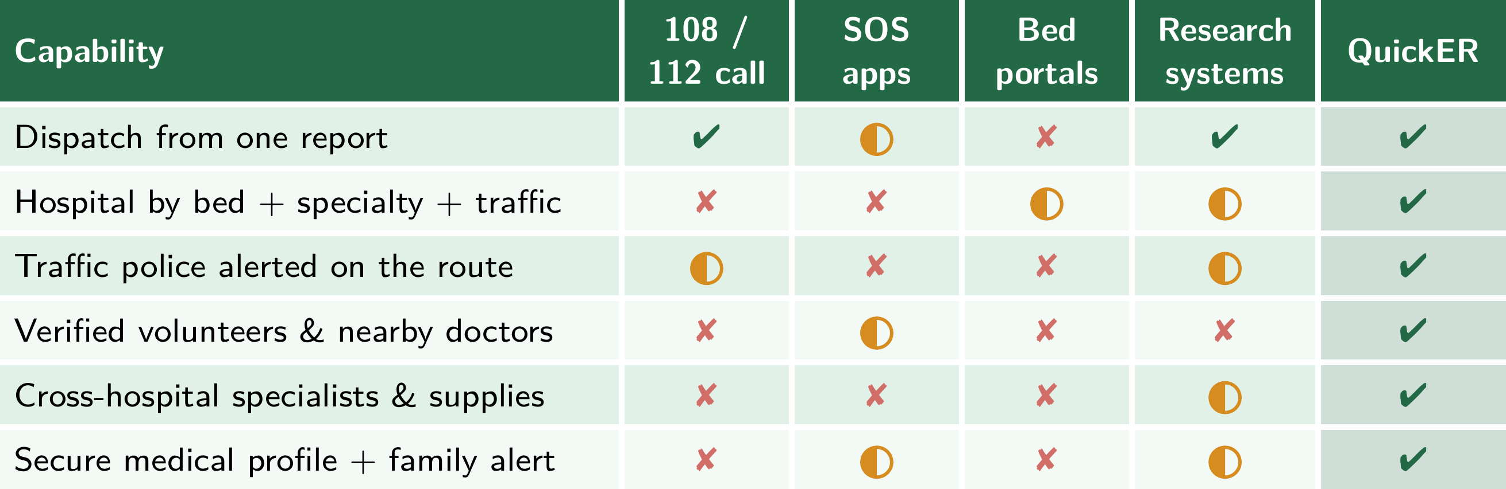
Innovation & Uniqueness
Parallel, not sequential: One report triggers all six responders together, not a chain of calls.
Ready, not nearest: Hospital picked on free beds, specialist on duty and live ETA.
Fast but auditable: Break-glass medical access in seconds, every access logged.

Slide 9
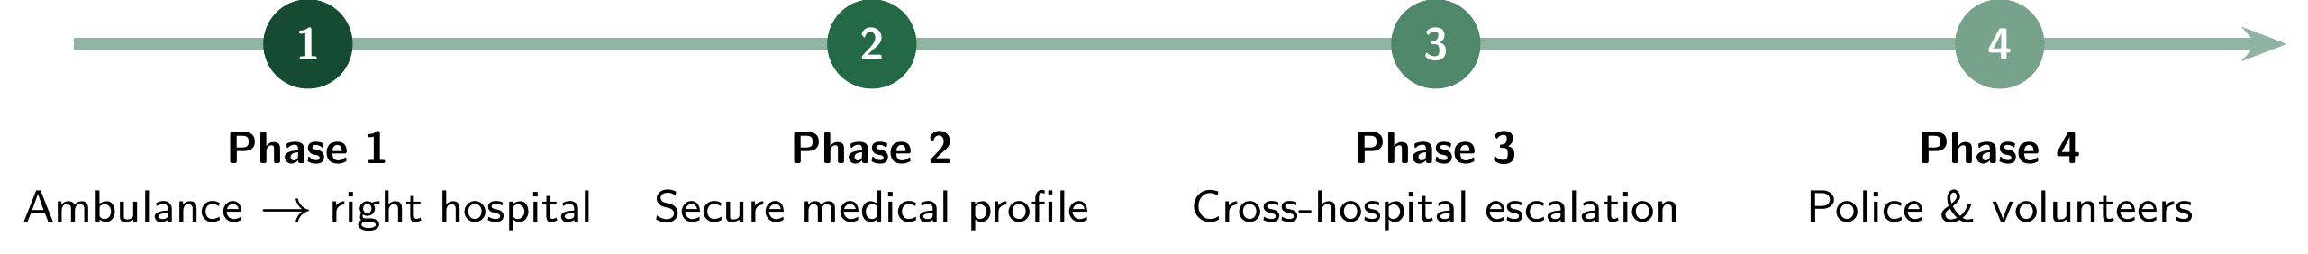
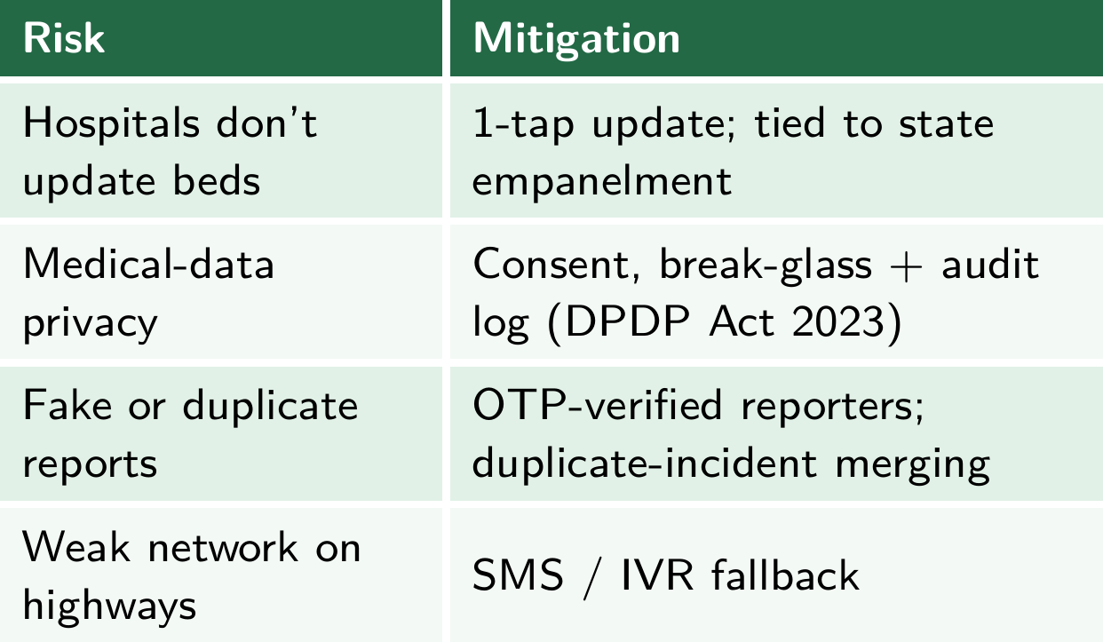
Feasibility & Scalability
Rollout in 4 phases (the order our research recommends)
Future scope: biotech layer (wearable auto-alerts, snakebite → antivenom-hospital routing, outbreak hotspot detection) and traffic-signal pre-emption.
Feasibility
Risks & mitigations
Each module is already proven on its own: hospital matching in under 30 s with 95% symptom-to-specialty accuracy; emergency record access in under 500 ms.
Runs on India's existing rails: 108/112, ABHA health IDs, map and SMS APIs. No new hardware.
Software-only MVP that our team can build on an open-source stack.
Scalability
City → district → state on cloud services; a hospital joins through a web dashboard.
The same engine extends to the future-scope modules above.

Slide 10
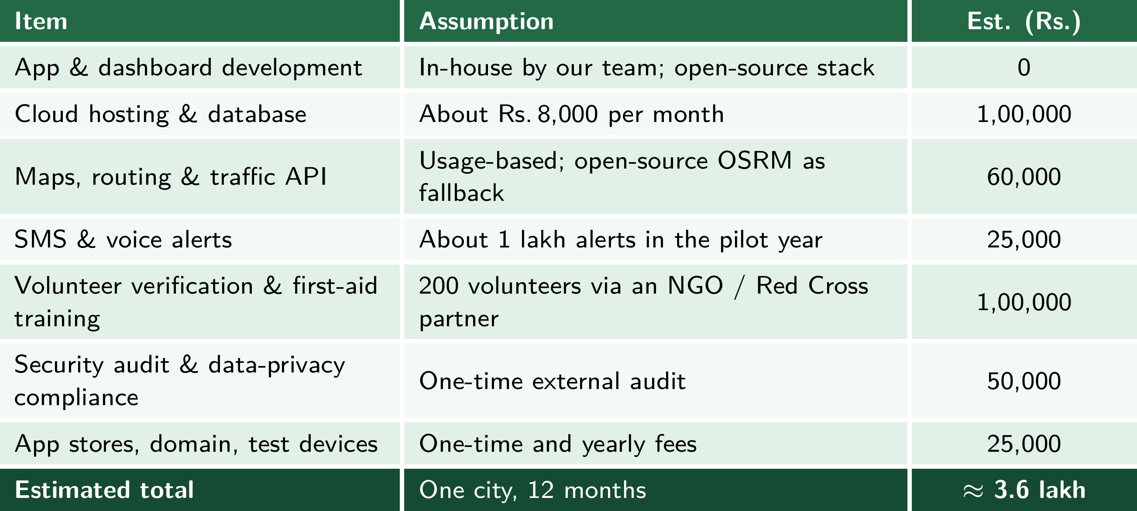
Cost for Product
Estimated cost of a 12-month pilot in one city (software only, built by our team):
Sustainability: free for citizens, always. Funded through state 108/112 and health-department integration, a hospital dashboard subscription, and CSR / insurer partnerships. Each extra city mainly adds hosting, API, SMS and training costs (≈ Rs. 3 lakh per year).
All figures are planning estimates for an idea-stage pilot and will be refined with partner quotes.

Slide 11
Use Cases
Use Case 1 | Road
Use Case 2 | Home
Use Case 3 | Surge
Highway crash at night
Situation: A bike rider is hit on a national highway; a passing truck driver taps Report.
What QuickER does
Nearest free ambulance dispatched; its route goes to the traffic police control room.
Skips the clinic with no CT scan; picks the trauma centre with a free ICU bed and a neurosurgeon.
ER gets blood group & allergies; family gets an SMS with the hospital name.
Outcome: right hospital the first time, no re-referral.
Cardiac arrest at home
Situation: A 58-year-old collapses in his flat; his daughter taps SOS.
What QuickER does
A CPR-trained verified volunteer 300 m away is alerted and arrives first.
A nearby doctor is looped in to guide the volunteer by phone.
Ambulance routed to the hospital with a free cath lab; cardiologist alerted before arrival.
Outcome: CPR starts within minutes; cath lab ready on arrival.
Bus accident, 30 injured
Situation: A mass-casualty crash; the district hospital has only 6 free beds.
What QuickER does
Patients spread across 4 hospitals by free beds and specialty.
Orthopaedic & burns specialists and blood units requested from neighbouring hospitals.
Police control room runs one ambulance corridor for all trips.
Outcome: no hospital overwhelmed; every patient tracked live.

Slide 12
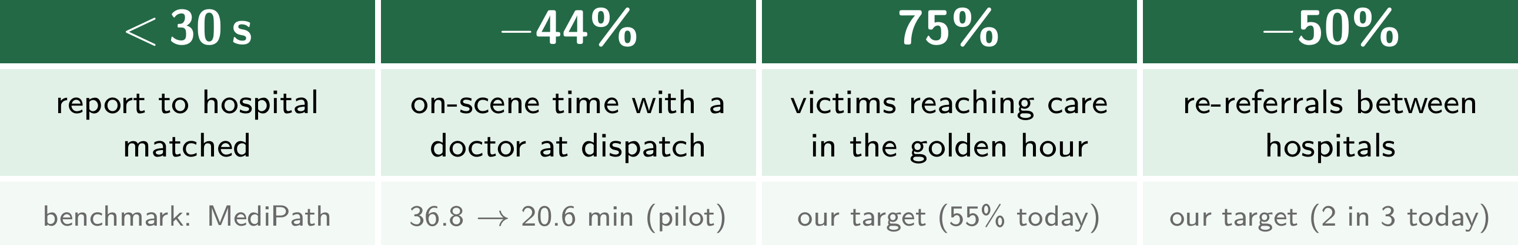
Impacts and Benefits
Victims & families
Hospitals & responders
Society & government
First aid in minutes from verified volunteers
Right hospital the first time
Family informed instantly; history shared safely
ER prepared before the patient arrives
Load shared across hospitals in surges
Fewer wasted trips and transfers
Fewer road deaths and lifelong disabilities
Crash-hotspot data for road-safety planning
One shared layer over 108/112
Measurable outcomes for our pilot

Slide 13
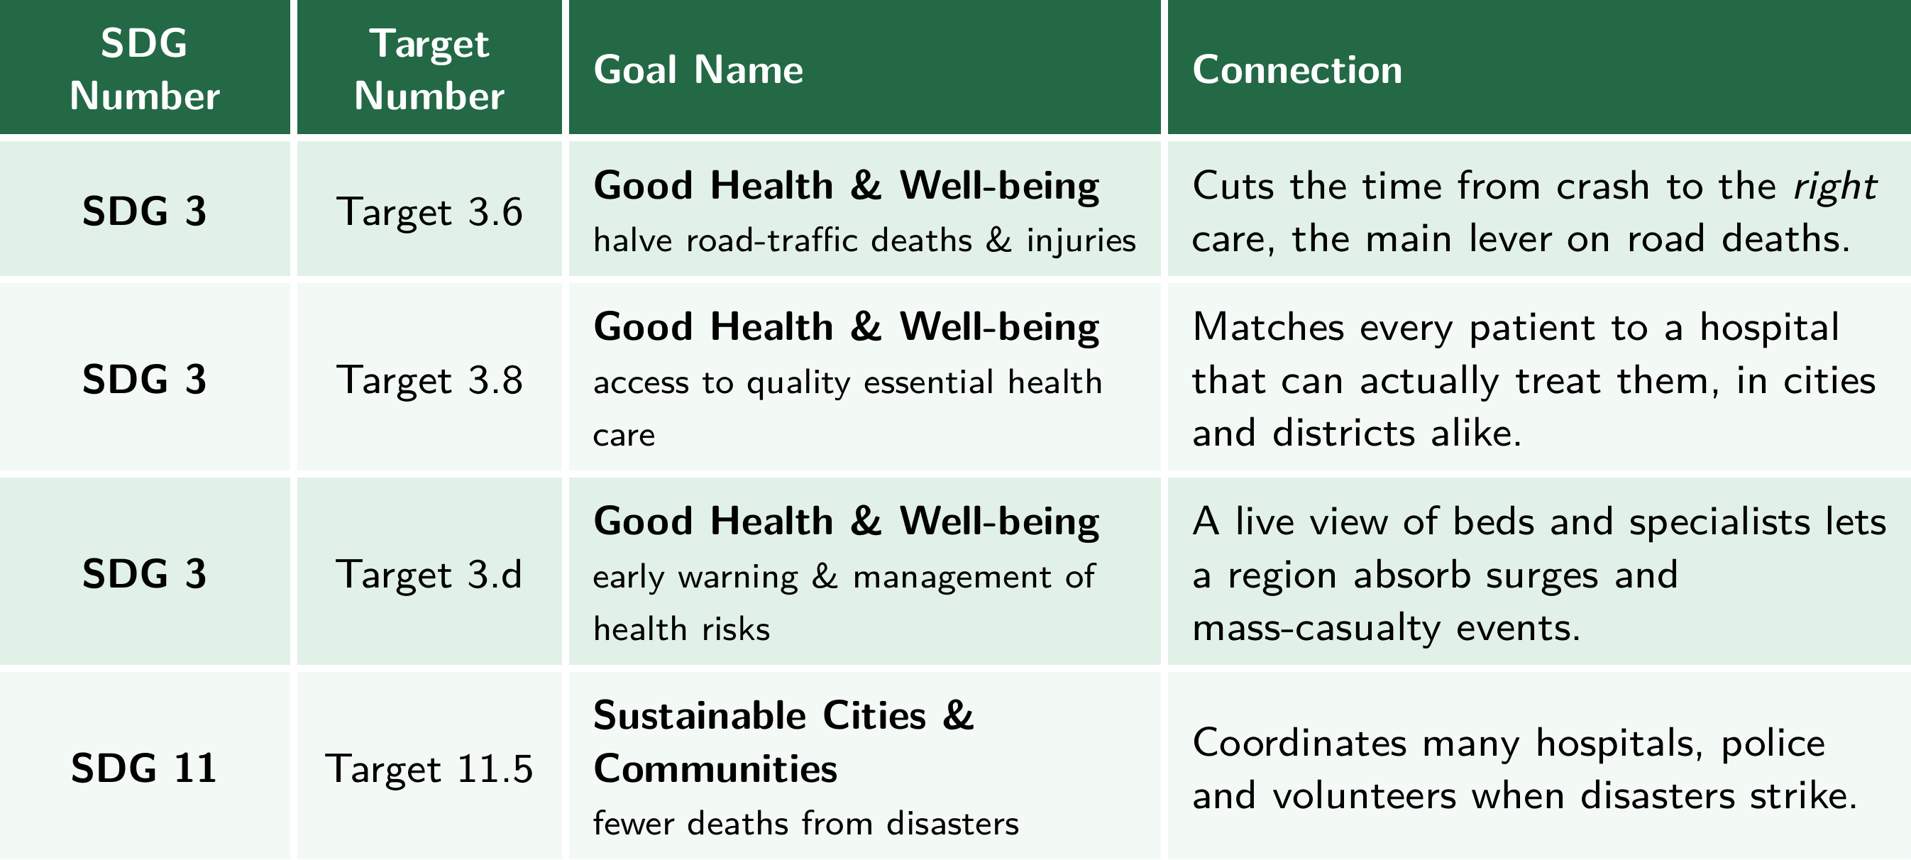
Sustainable Development Goals (SDGs)

Slide 14
Individual Member Contribution
Member | Contribution or responsibility
Shreyas | Conducted surveys, analyzed existing emergency response systems and identified the problem
Shabarish | Designed the technical architecture and planned the system workflow
Sandilya | Checked feasibility, estimated costs and analyzed impacts
Pranav | Developed the proposed solution concept and coordinated presentation content

Slide 15
Yukti ID
Yukti ID
IR20261051032
QuickER
One accident report. Every responder. Zero lost minutes.
Thank you!

