Slide 1
Scenario C
Rubric-Aware Writing Feedback MVP
A student-facing formative feedback tool that turns a draft and rubric into concrete revision priorities before instructor review.
Core measure: the learner knows what to revise next.

Slide 2
PROBLEM
Students need earlier rubric-aligned guidance
The MVP addresses the feedback gap before final instructor or TA review.
Learner pain
Course-team constraint
Product opportunity
Students often submit writing without knowing whether it matches the rubric or where revision effort should go first.
Instructors and TAs cannot always provide early, individualized draft feedback to every student.
A rubric-aware workflow can provide specific, formative guidance while preserving instructor authority.
Rubric-Aware Writing Feedback MVP | 02

Slide 3
PRODUCT
V1 keeps the student workflow focused and revision-oriented
Submit
Analyze
Align
Revise
Draft + rubric
Structure + argument
Criterion evidence
Priorities + checklist
Includes: overall summary, readiness level, strengths, top priorities, rubric cards, inline comments, coaching questions, topic map, checklist.
Excludes: grades, LMS submission, plagiarism detection, OCR, full draft-to-draft tracking.
Captures usefulness ratings and basic events so pilot quality can be measured.
Rubric-Aware Writing Feedback MVP | 03

Slide 4
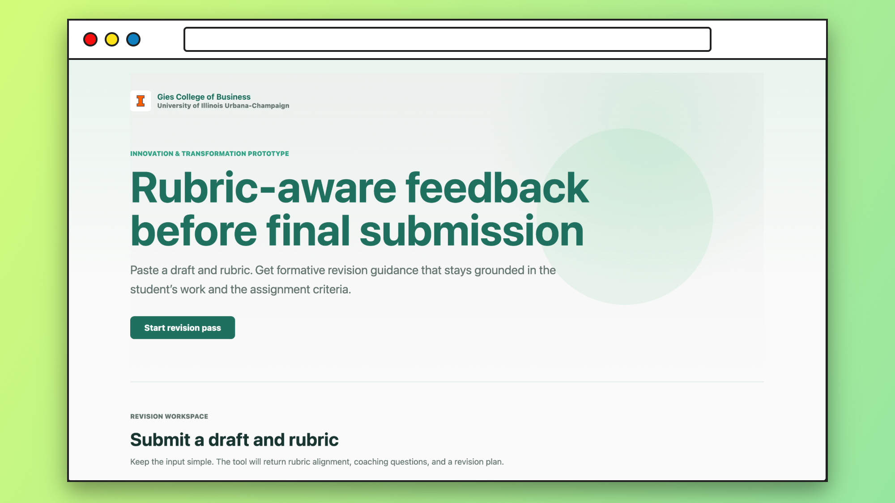

Slide 5
AI WORKFLOW
A staged agentic pipeline beats one generic chatbot response
1
2
3
4
5
6
Validate
Parse rubric
Analyze draft
Align
Synthesize
Check
Draft, rubric, length, file type
Criteria only from provided rubric
Structure, thesis, flow, reasoning
Evidence or not_enough_evidence
Student-facing revision guidance
Tone, grounding, no grades
Guardrail
Trust signal
The model must not invent criteria or assign grades.
Each rubric item cites draft evidence or marks uncertainty.
Rubric-Aware Writing Feedback MVP | 04

Slide 6
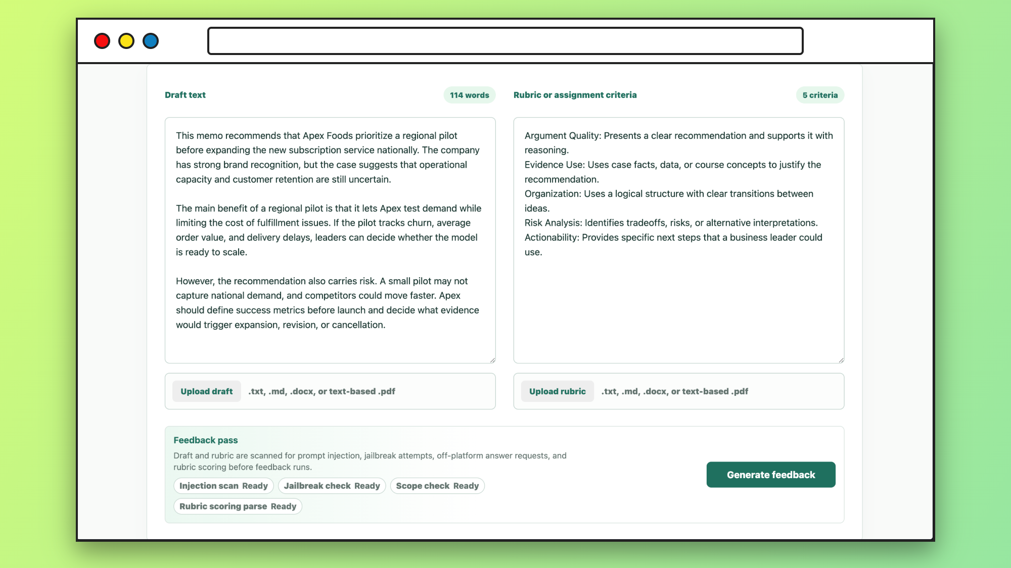

Slide 7
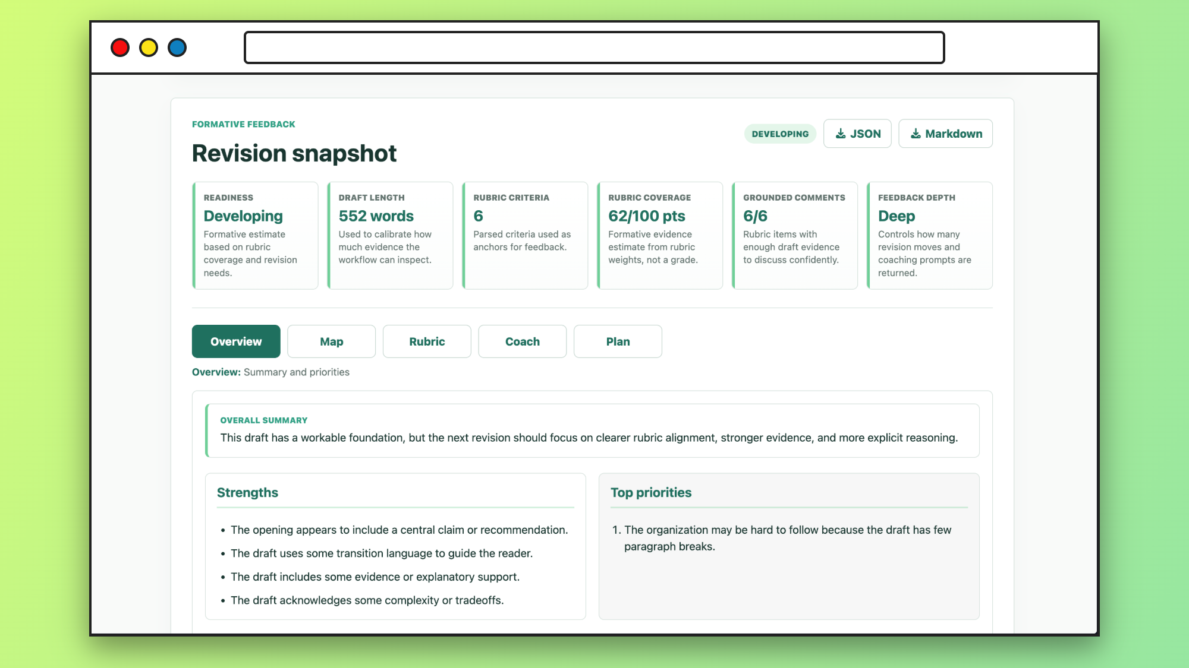

Slide 8
ARCHITECTURE
The stack is simple, typed, and ready for a two-week MVP
React UI
FastAPI
Agent Flow
Pydantic
Draft form results rating
Routes validation errors
Parse analyze align
Structured validated JSON
PostgreSQL
LLM Provider
Observability
Sessions events ratings
OpenAI or Azure-ready
Latency retries failures
Rubric-Aware Writing Feedback MVP | 05

Slide 9
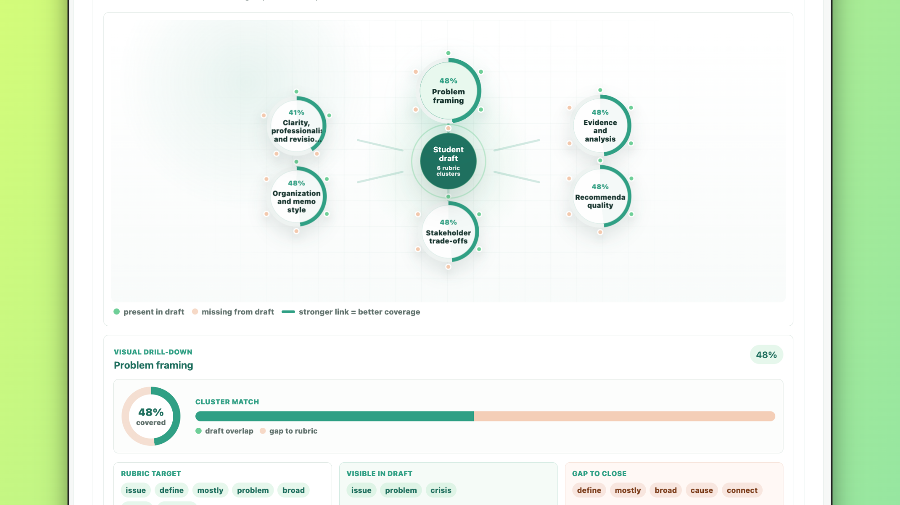

Slide 10
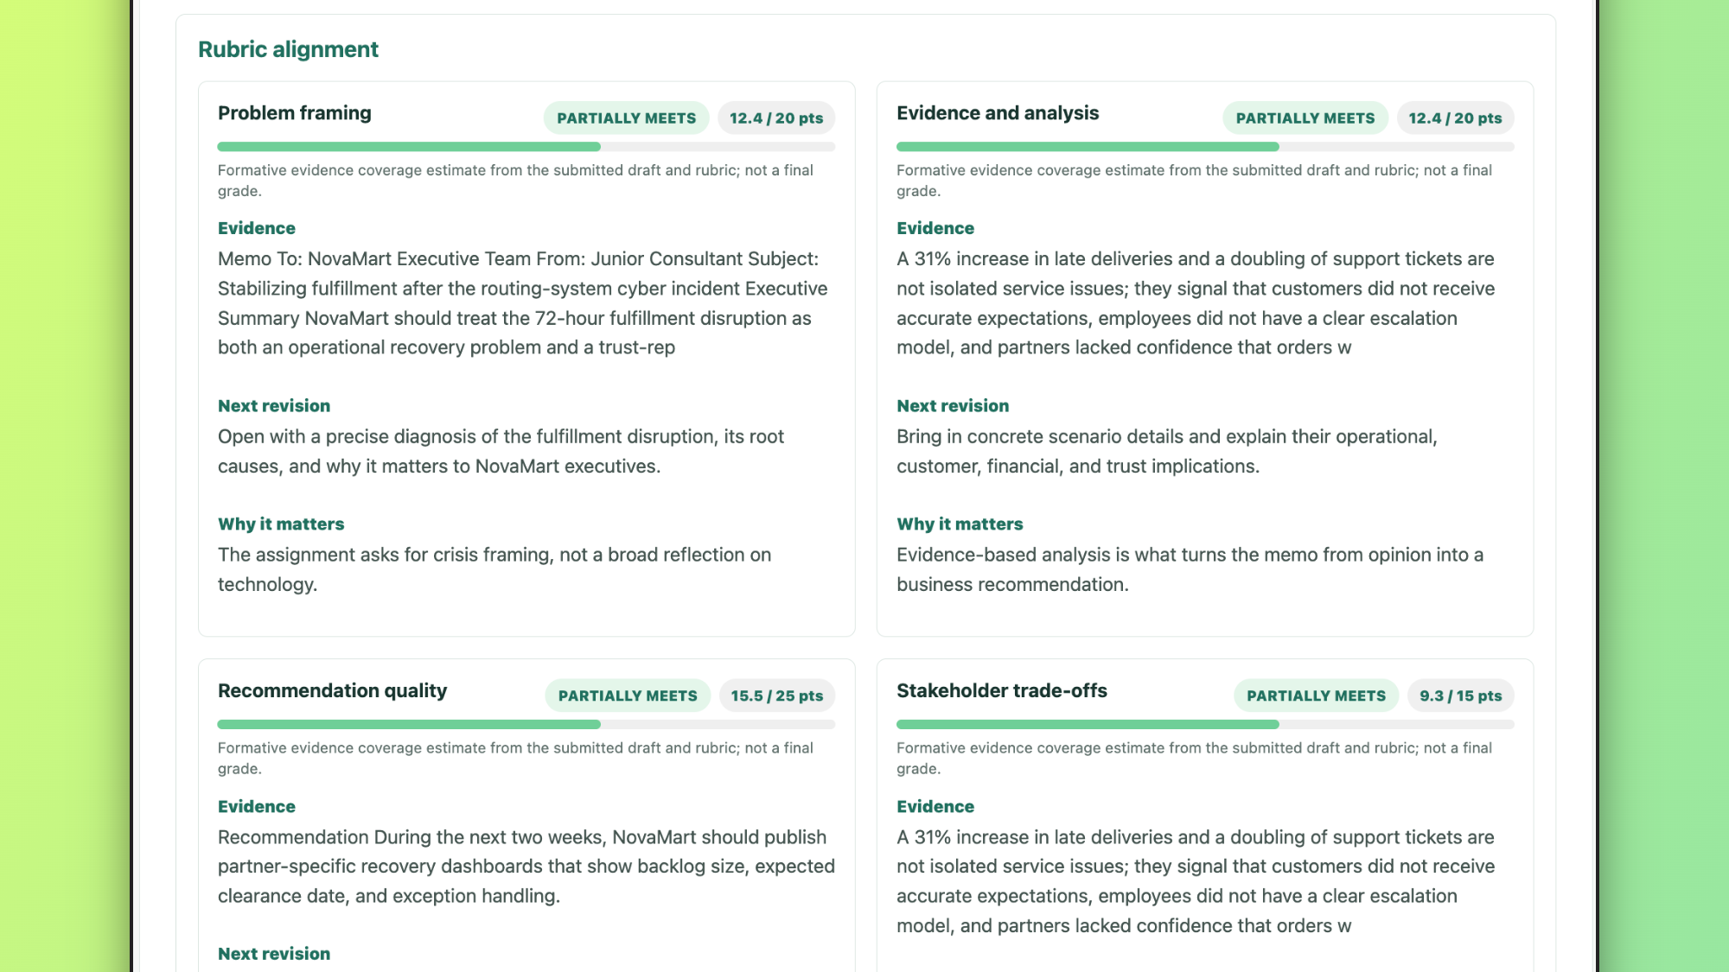

Slide 11
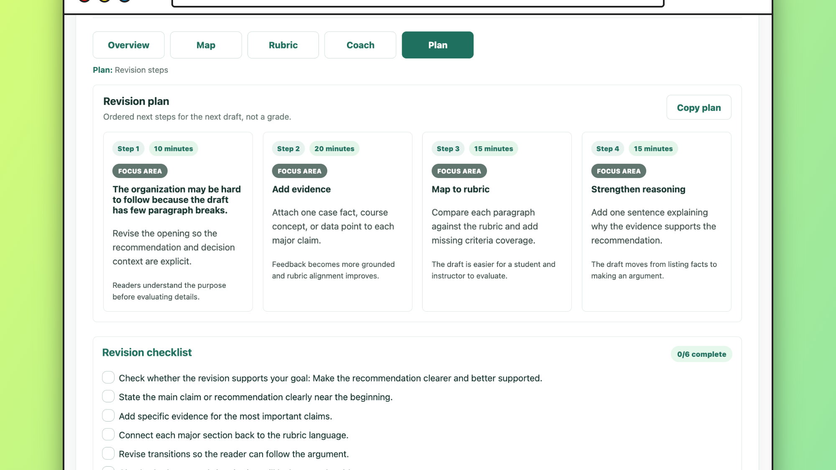

Slide 12
PILOT READINESS
Definition of done balances function, AI quality, and learning value
Functional readiness
AI output readiness
Product learning
Submit draft and rubric Receive structured feedback See priorities and checklist Submit usefulness rating
Schema validation passes No grades or authority claims Feedback grounded in evidence Uncertainty is explicit
Completion and failure rates Latency and validation failures Usefulness ratings Manual quality review samples
Rubric-Aware Writing Feedback MVP | 06

Slide 13
Primary risk
Feedback that sounds polished can still be vague, unsupported, or misaligned.
Mitigation system
Explicit rubric anchors the analysis
Rubric-first parsing prevents invented criteria
Draft evidence is required for criterion-level feedback
not_enough_evidence replaces guessing
Safety checks remove harsh or grade-like language
Scenario D later compares draft progress over time
The MVP succeeds when a student leaves with a clearer, safer revision plan.
Rubric-Aware Writing Feedback MVP | 07

