Slide 1

Problem Statement:
CRCE x UMIT
Team Name: TechBot
Team Members: Aditya Dhumal, Pramod Garhwal
Shreyash Pawar, Vishal Sargar .
Domain: Web Development

Slide 2
Idea / Approach Details
Approach to this Problem Statement is an Inventory Management Application which help Luigi(USER) to keep track of different categories of goods required.
Three Subsections to perform CRUD Operations.
Redirection between Pages according to convenience.
Details of each product provided on hovering over.
View of distribution in the storage according to the quantity provided by updates in the inventory.

Slide 3
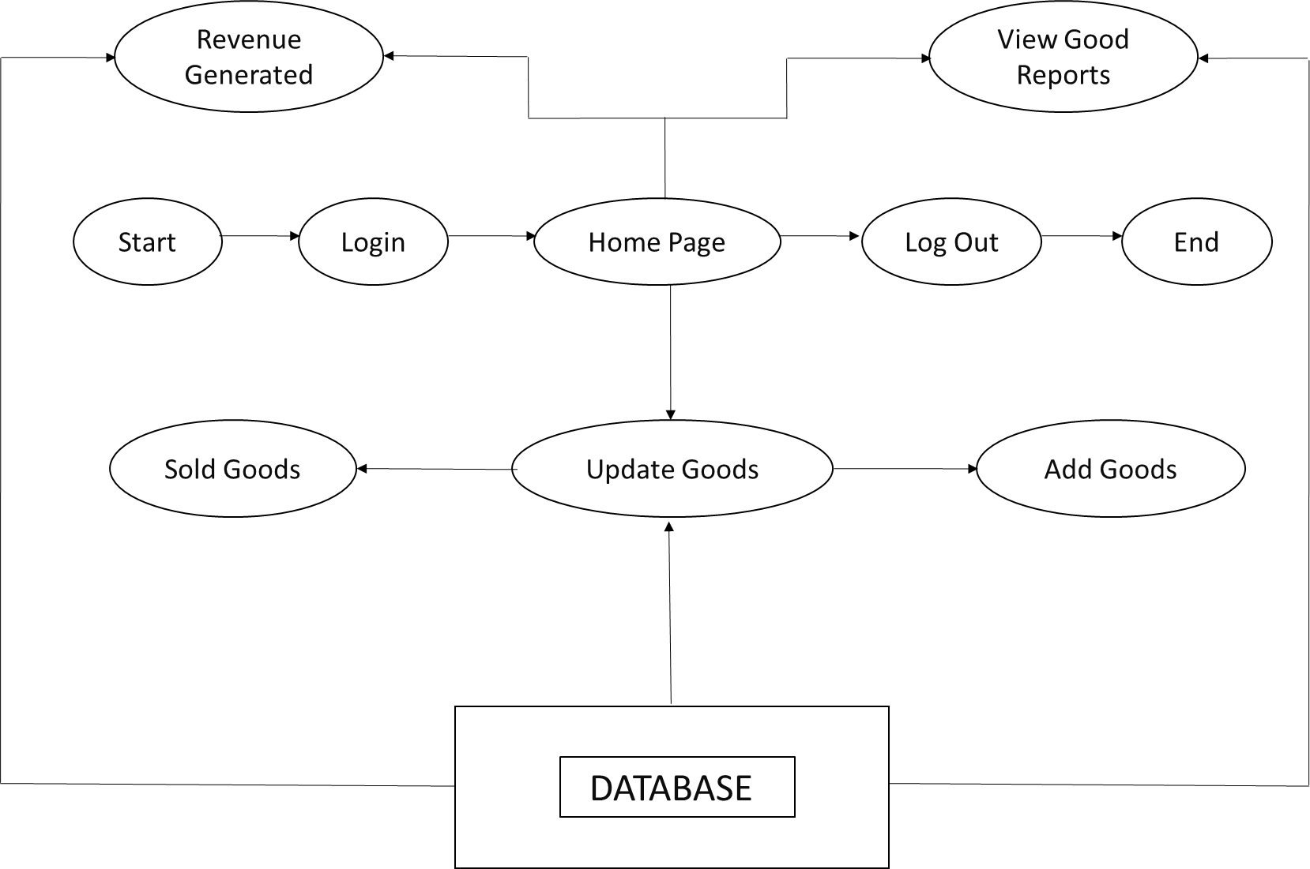
Flowchart / Architectural Diagram

Slide 4
Use Cases
Some use cases for the inventory software are:
It can be used for military equipment inventory to keep track on the military weapons usage.
It can also be used in Grocery stores to keep record of goods purchased or sold.
This can also be used in large godown.
In medical stores.

Slide 5
Technology Stack
HTML/CSS
JAVASCRIPT
PHP
SQL

Slide 6
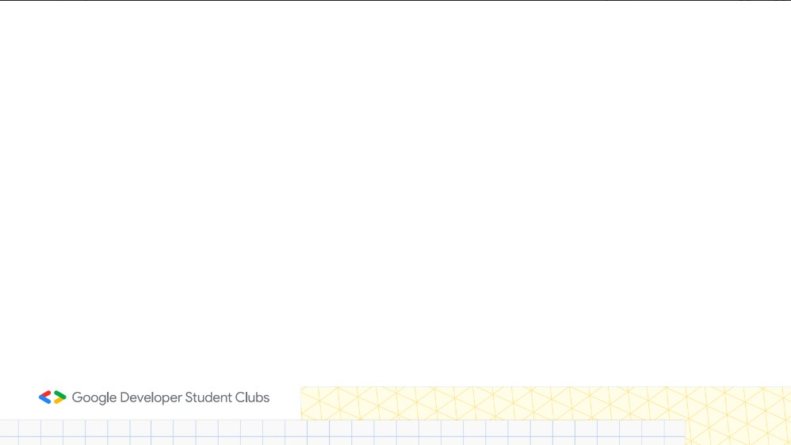

Important Points
Kindly keep the maximum slides limit to 6 pages
All the topics should be utilized for the description of your idea Try to avoid paragraphs and post your idea in points
Keep your explanation precisely and easy to understand
Idea should be unique and novel. If it has a business potential more weightage will be given.
Name the PPT as domain_teamname_projectname(if any)

