Slide 1
Network Intrusion Detection Using Autoencoder
An Unsupervised Deep Learning Approach Using the NSL-KDD Dataset
Candidate Name : [Student Name]
Roll Number : [Roll Number]
Program / Specialization : MSc Computer Science (AI & ML)
Institution : [College / University Name]
Project Supervisor : [Guide / Supervisor Name]
Academic Year : 2025 – 2026
Notes:
Good morning respected evaluators and faculty. Today I present my deep learning project: 'Network Intrusion Detection Using Autoencoder'. In this work, we address cyber threat detection as an unsupervised anomaly detection task on the NSL-KDD benchmark, training exclusively on normal traffic to detect intrusions based on reconstruction error.
Key Takeaway: A leakage-free, unsupervised deep learning framework for network intrusion detection.

Slide 2
MSC AI & ML DEEP LEARNING PROJECT
Problem Statement: The Challenge of Network Intrusion Detection
Traditional NIDS Limitations
The Anomaly Detection Alternative
• Signature-Based Vulnerability: Conventional systems rely on pre-compiled databases of known attack signatures (e.g., Snort rules).
• Zero-Day Blindspot: Novel attack variants and modified payloads bypass static pattern-matching rules effortlessly.
• Supervised ML Bottleneck: Supervised models require vast, balanced, perfectly labeled datasets containing all conceivable attack types.
• Labeling Cost & Delay: Accurate cyberattack labeling in live enterprise networks is expensive, labor-intensive, and fundamentally reactive.
• The Unsupervised Paradigm: Rather than modeling every attack, learn what legitimate, normal traffic looks like.
• Deep Autoencoder Representation: Compress normal telemetry into a low-dimensional manifold and learn to reconstruct it.
• Reconstruction Discrepancy: Anomalous traffic that deviates from normal statistical patterns cannot be reconstructed faithfully.
• Core Research Question: Can an unsupervised Dense Autoencoder achieve high detection precision on unseen attacks while keeping false alarms strictly bounded?
Notes:
Here we contrast traditional signature-based NIDS with anomaly detection. Signature-based tools and supervised classifiers struggle when facing novel attacks or unlabeled data. Our project asks: can an Autoencoder learn only normal traffic and flag anomalies via reconstruction failure?
Key Takeaway: Anomaly detection shifts the paradigm from chasing attack signatures to establishing a normal baseline.

Slide 3
MSC AI & ML DEEP LEARNING PROJECT
Project Motivation: Why Reconstruction-Based Anomaly Detection?
1. Dynamic Threat Landscape
2. Natural Abundance of Normal Telemetry
Cyberattacks constantly evolve through obfuscation, polymorphic payloads, and novel exploitation vectors, rendering static rule engines obsolete.
In production networks, over 99% of raw network packets represent benign user traffic. Normal traffic provides an abundant, reliable baseline.
3. Zero-Contamination One-Class Learning
4. Objective Metric for Alerting
Training strictly on normal traffic eliminates the risk of model bias toward specific attack families represented in training sets.
Reconstruction Mean Squared Error (MSE) provides a continuous, interpretable score measuring statistical deviation from normal behavior.
Notes:
Our motivation rests on four pillars: attacks evolve, normal data is abundant, one-class training avoids attack bias, and reconstruction error provides an objective anomaly signal. We emphasize that this approach does not guarantee detection of every stealthy intrusion, but reliably flags traffic that deviates statistically from normal baselines.
Key Takeaway: Normal network traffic offers a rich, self-supervised learning signal for anomaly detection.

Slide 4
MSC AI & ML DEEP LEARNING PROJECT
Project Objectives: Research & Engineering Goals
1. Design Leakage-Free Preprocessing Pipeline: Construct a ColumnTransformer pipeline that standardizes 38 numerical features and one-hot encodes 3 categorical features, fitted strictly on normal training data without test contamination.
2. Develop Symmetric Dense Autoencoder Architecture: Design a multi-stage fully connected autoencoder (77 -> 64 -> 32 -> 16 -> 32 -> 64 -> 77) with a 16-dimensional bottleneck to force optimal feature compression.
3. Implement Unsupervised Normal-Only Training: Train the network exclusively on benign records from KDDTrain+ using Adam and MSE loss, completely isolating attack records during model parameter fitting.
4. Derive Principled Anomaly Decision Threshold: Empirically select the decision boundary as the 95th percentile of normal validation reconstruction errors, guaranteeing a reference false-positive rate of ~5%.
5. Rigorous Evaluation on Unseen KDDTest+ Benchmark: Quantify real-world generalization across 22,544 untouched test records, evaluating Accuracy, Precision, Recall, F1, ROC-AUC, and attack-family sensitivity.
6. Deploy Operational Streamlit Application: Deliver an interactive cybersecurity dashboard supporting single-connection diagnostic inspection, batch CSV inference, and real-time feature deviation explanations.
Notes:
Here are our six core objectives spanning the entire machine learning lifecycle: leakage-free preprocessing, deep autoencoder modeling, normal-only training, validation-calibrated thresholding, comprehensive benchmark testing, and an operational web demonstration.
Key Takeaway: Clear, verifiable objectives bridging theoretical modeling and practical cybersecurity deployment.

Slide 5
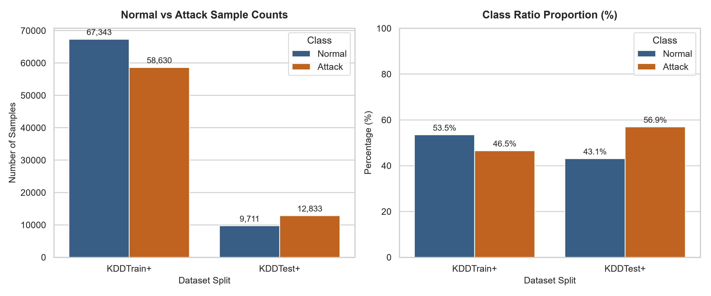
MSC AI & ML DEEP LEARNING PROJECT
Dataset: NSL-KDD Benchmark Characteristics
Dataset Structure & Splits
Traffic Label Distribution
• Benchmark Name: NSL-KDD (Refined KDD Cup 99 without duplicates)
• Training Set (KDDTrain+): 125,973 records (67,343 Normal, 58,630 Attacks)
• Unseen Test Set (KDDTest+): 22,544 records (9,711 Normal, 12,833 Attacks)
• Original Traffic Features: 41 Features (3 Categorical, 38 Numerical)
• Categorical Fields: protocol_type (3), service (70), flag (11)
• Numerical Fields: Duration, byte counts, error rates, host statistics
• Metadata Columns (Isolated): label (specific attack), difficulty_level (score)
• Attack Taxonomy: DoS, Probe, R2L, U2R (38 distinct attack types)
Notes:
Slide 5 presents the NSL-KDD dataset. KDDTrain+ contains 125,973 records, while KDDTest+ contains 22,544 records. The chart on the right shows the verified distribution between normal traffic and attack categories. Crucially, the 41 network traffic features were separated from labels and difficulty scores before any modeling.
Key Takeaway: NSL-KDD provides an established benchmark with realistic feature diversity and novel test attacks.

Slide 6
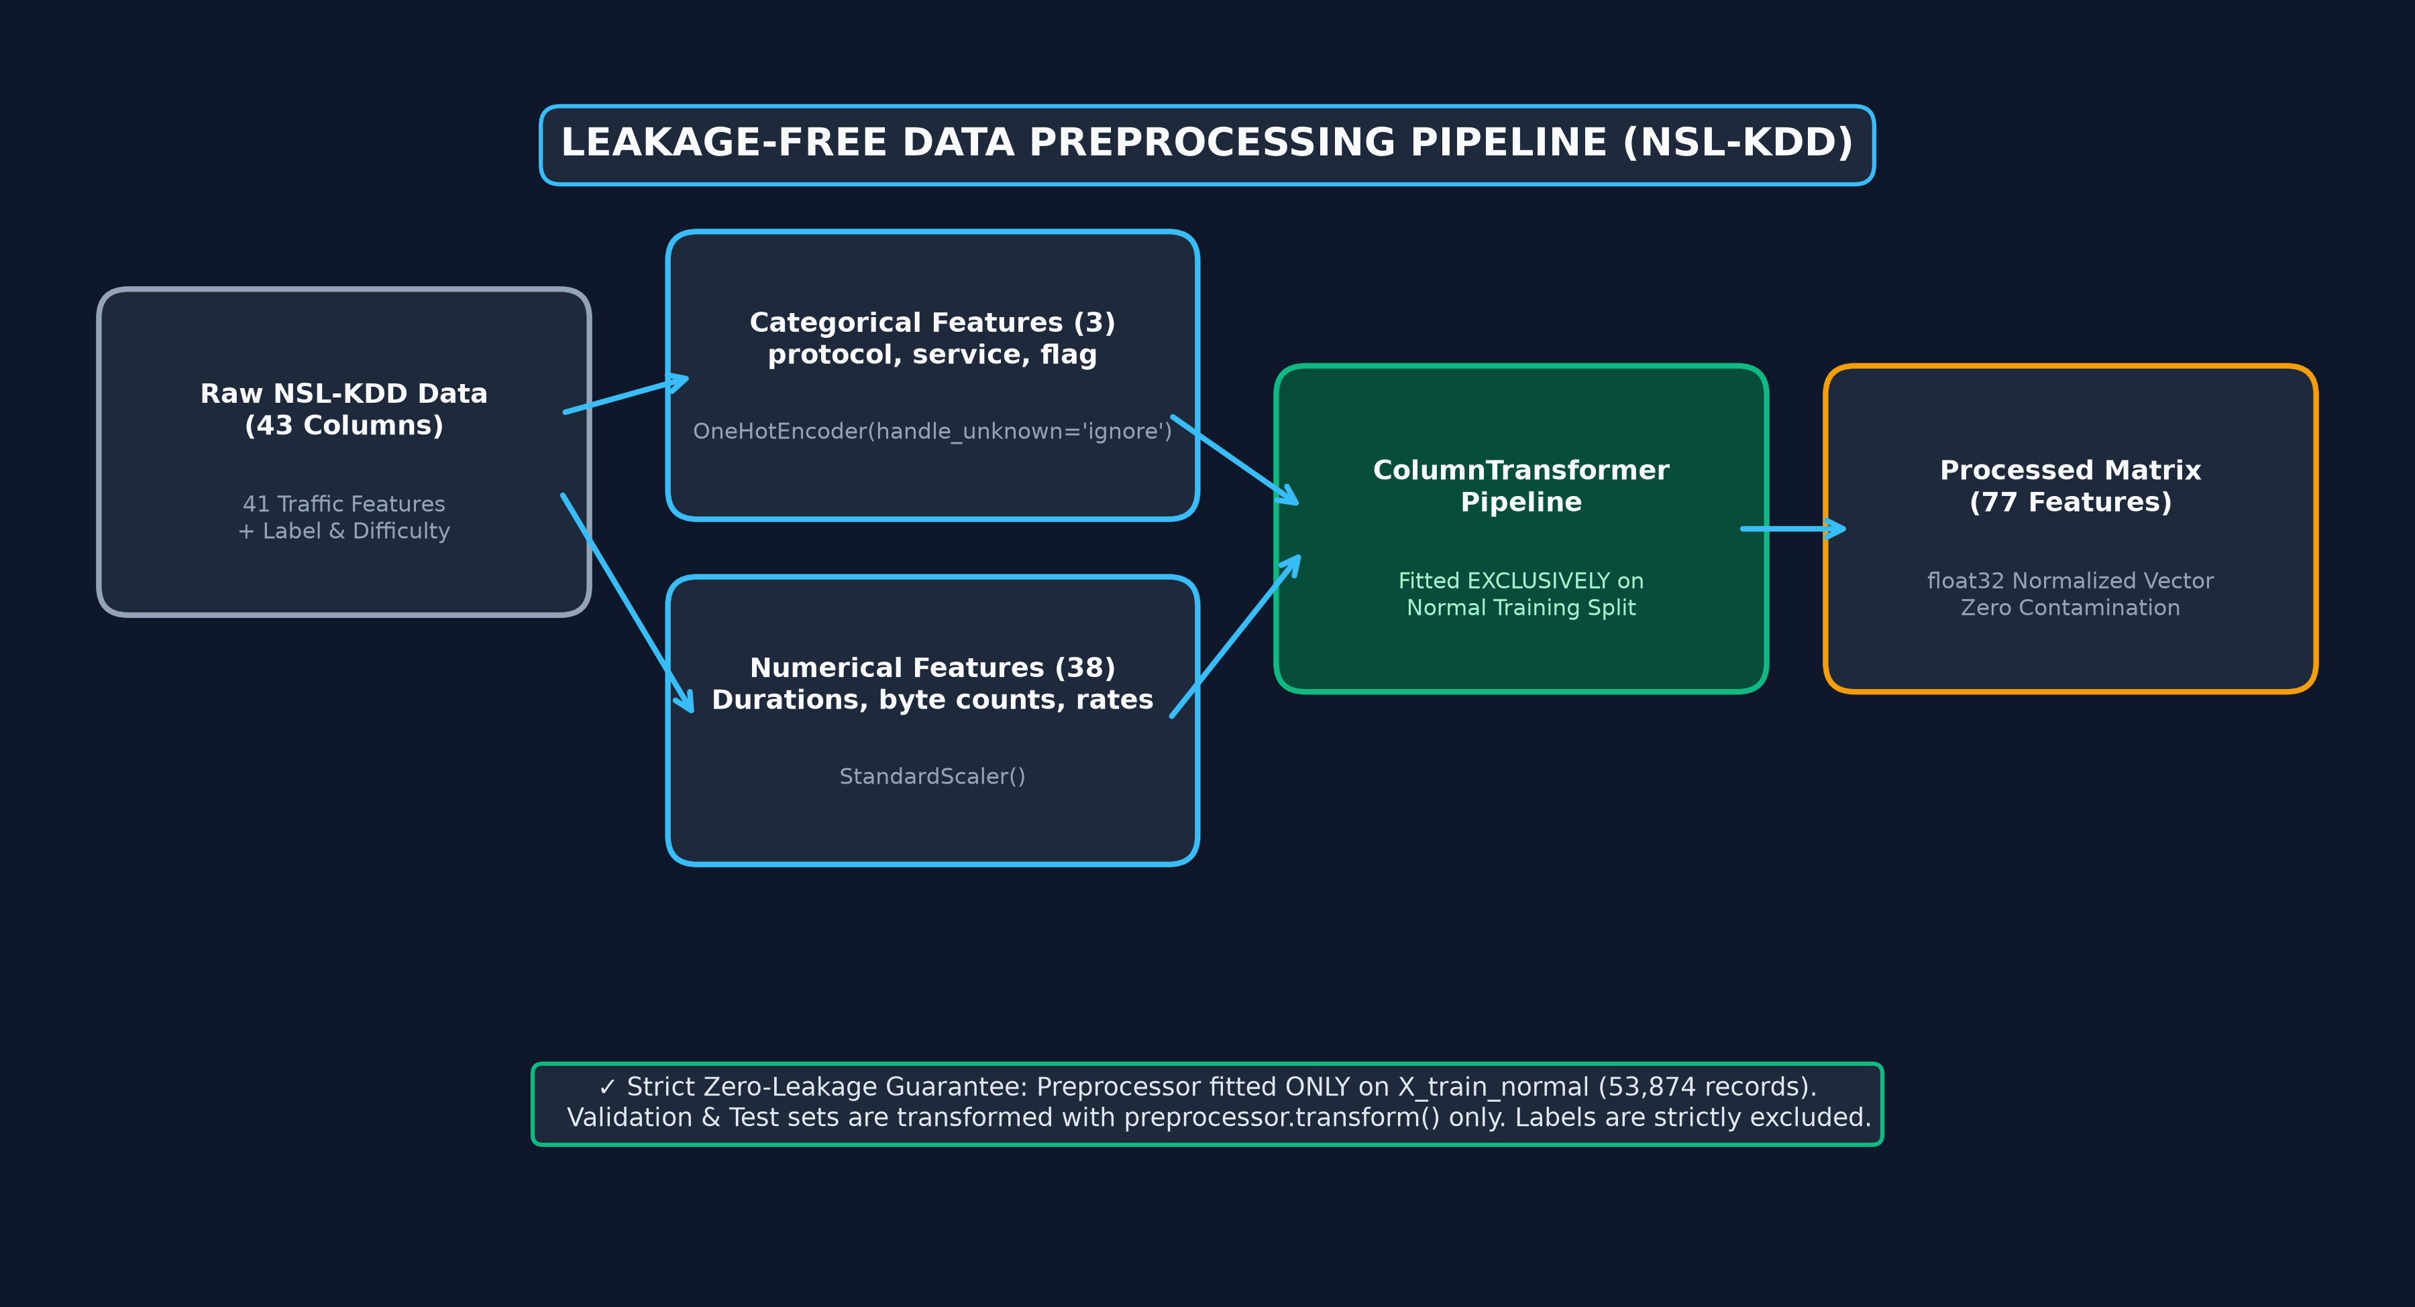
MSC AI & ML DEEP LEARNING PROJECT
Data Preprocessing: Strict Leakage-Free Pipeline
Notes:
Slide 6 illustrates our leakage-free preprocessing pipeline. OneHotEncoder processes the 3 categorical attributes, while StandardScaler scales the 38 numerical features. The ColumnTransformer was fitted strictly on normal training data (X_train_normal). Validation and test sets were transformed only, ensuring zero future information leaked into the model.
Key Takeaway: Methodological rigor prevents optimistic bias by fitting preprocessors exclusively on training data.

Slide 7
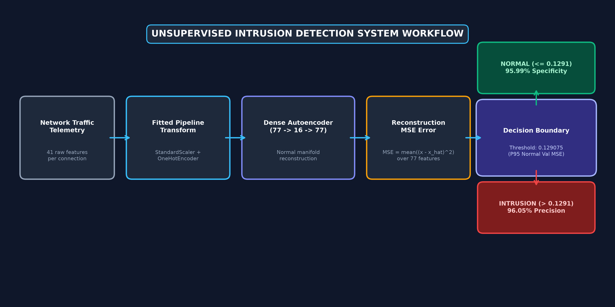
MSC AI & ML DEEP LEARNING PROJECT
Proposed Methodology: Unsupervised Anomaly Workflow
Notes:
Slide 7 walks through the end-to-end detection workflow. Raw telemetry is preprocessed into 77 dimensions, passed to the Autoencoder, and reconstructed. The per-sample Mean Squared Error measures reconstruction failure. If error exceeds the threshold of 0.1291, an intrusion alert is triggered; otherwise, it is classified as normal.
Key Takeaway: An elegant, fully automated pipeline from raw network packet telemetry to binary alert decision.

Slide 8
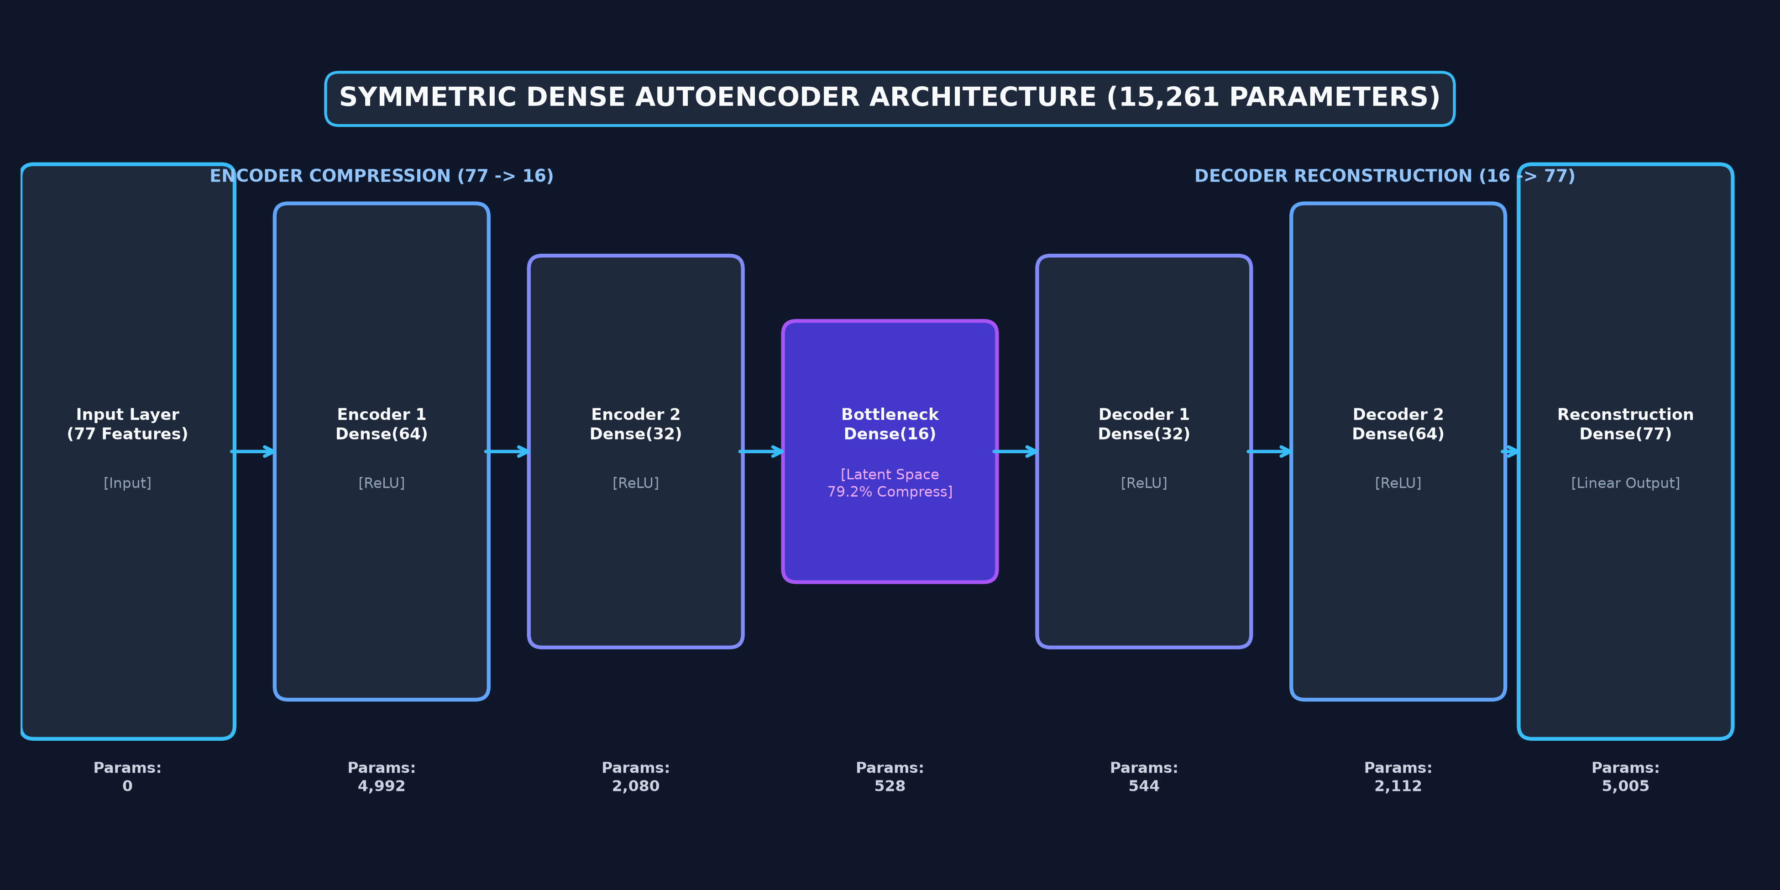
MSC AI & ML DEEP LEARNING PROJECT
Autoencoder Architecture: Deep Neural Network Design
Notes:
Slide 8 displays our confirmed Dense Autoencoder architecture. Starting with 77 inputs, the encoder compresses through 64 and 32 neurons down to a 16-dimensional bottleneck—a 79.2% compression ratio. The decoder symmetrically expands back to 77 linear output neurons. Total trainable parameters are exactly 15,261, optimized using Adam and MSE loss.
Key Takeaway: The 16-neuron latent bottleneck acts as a compression barrier, preventing anomalies from reconstructing.

Slide 9
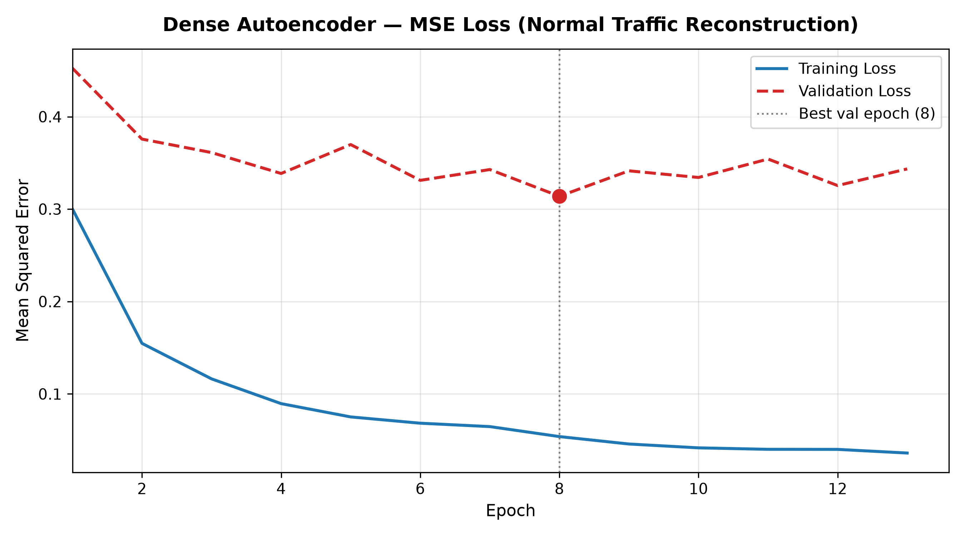
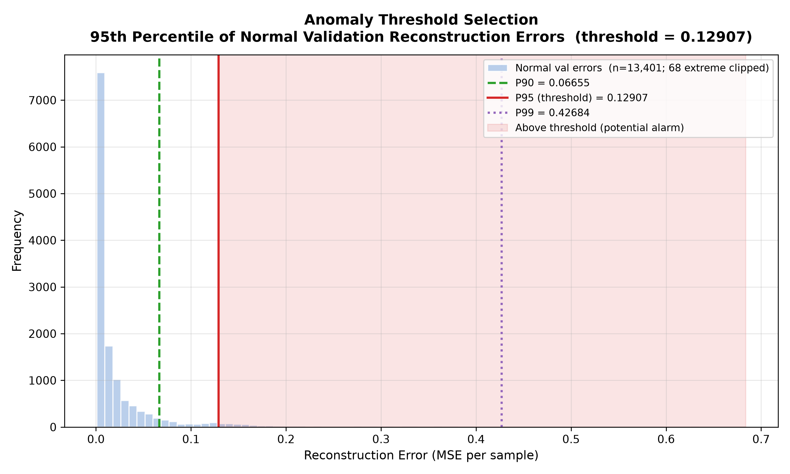
MSC AI & ML DEEP LEARNING PROJECT
Model Training & Principled Threshold Calibration
Training & Validation Loss Convergence
Threshold Calibration (Validation P95)
Notes:
Slide 9 demonstrates model training and threshold calibration. On the left, the loss curve shows smooth convergence down to a validation loss of 0.3138 at epoch 8 before early stopping. On the right, we plot the reconstruction error histogram on normal validation records. The threshold of 0.129075 was calibrated as the 95th percentile, mathematically fixing the expected false positive rate to ~5%.
Key Takeaway: The threshold is grounded in validation error percentiles rather than an arbitrary heuristic cutoff.

Slide 10
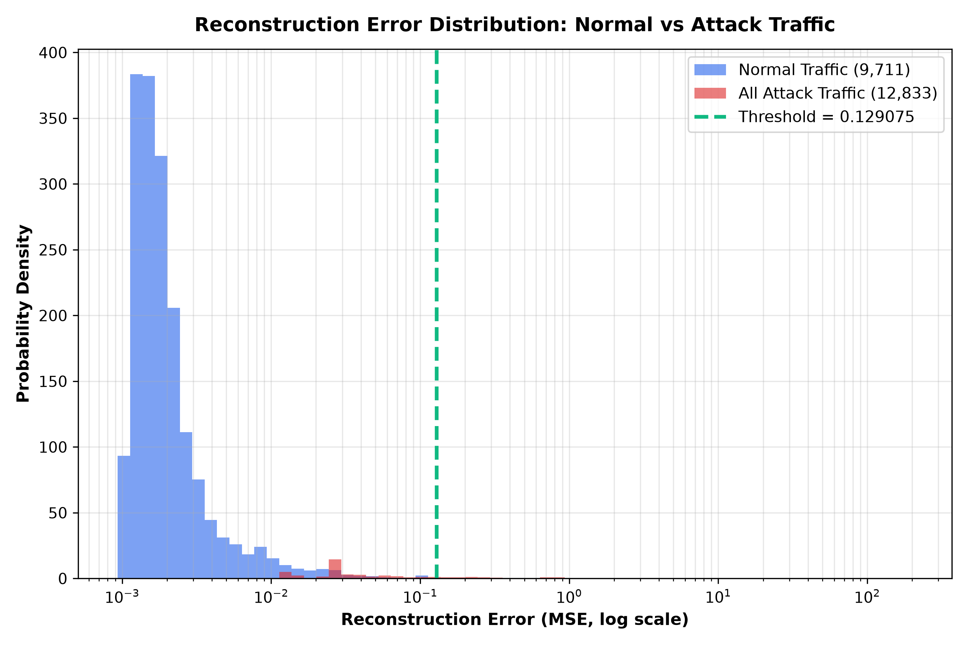
MSC AI & ML DEEP LEARNING PROJECT
Reconstruction Error Analysis: Normal vs Attack Separation
Reconstruction Error Statistics
Empirical Error Distribution
• Normal Median MSE: 0.003158
• Attack Median MSE: 0.457592
• Median Separation: 144.9x Higher for Attacks
• Normal Mean MSE: 0.038540
• Attack Mean MSE: 0.963125
• Normal P95 MSE: 0.112638 (Below 0.1291 threshold)
• Attack P95 MSE: 1.578233 (12.2x above threshold)
• Separation Principle: Attacks violate normal feature correlations, yielding high reconstruction penalties.
Notes:
Slide 10 highlights the core anomaly detection signal. The median reconstruction error for attack traffic (0.4576) is 144.9 times higher than normal traffic (0.0032). The log-scale distribution plot confirms clean separation: normal traffic concentrates heavily to the left of the green threshold line, while the attack distribution shifts decisively to the right.
Key Takeaway: The autoencoder reliably discriminates anomalies due to massive reconstruction error disparities.

Slide 11
MSC AI & ML DEEP LEARNING PROJECT
Final Model Performance: Validated KDDTest+ Benchmark
83.35%
ACCURACY
18,791 / 22,544 Correct
96.05%
PRECISION
Low False Alarms (9,469 / 9,858)
73.79%
RECALL
9,469 / 12,833 Attacks Flagged
83.46%
F1 SCORE
Harmonic Mean Balance
Comprehensive Evaluation Metrics Summary
• ROC-AUC Score : 95.70% — Evaluated continuously across all operating thresholds (Phase 10 confirmed).
• False Positive Rate (FPR) : 4.01% — 389 / 9,711 benign test records flagged; closely tracks the 5% validation calibration target.
• Specificity (TNR) : 95.99% — 9,322 / 9,711 normal connections correctly permitted without disruption.
• Benchmark Integrity : Zero Leakage — Evaluated strictly on untouched KDDTest+ without retraining, tuning, or threshold alterations.
Notes:
Slide 11 summarizes our official test metrics on KDDTest+. The model achieves 83.35% accuracy, an exceptional 96.05% precision, 73.79% recall, and 95.70% ROC-AUC. Crucially, the False Positive Rate is only 4.01%, validating that our 95th percentile validation threshold successfully constrained false alarms in unseen test traffic.
Key Takeaway: High precision (96.05%) prevents alert fatigue while maintaining strong detection capability.

Slide 12
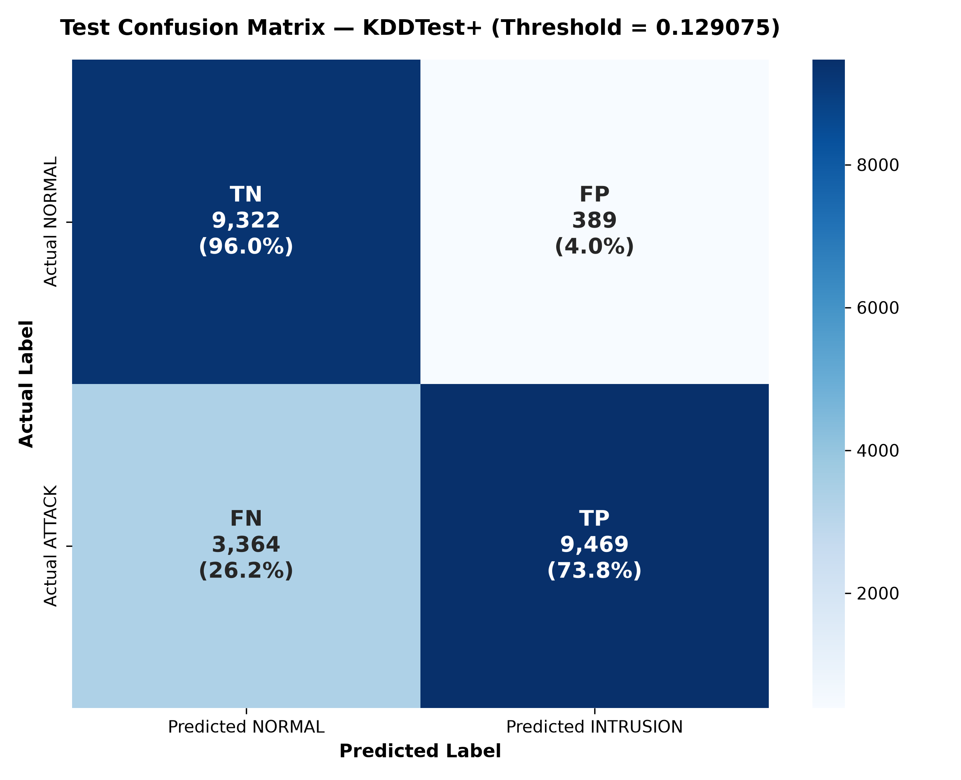
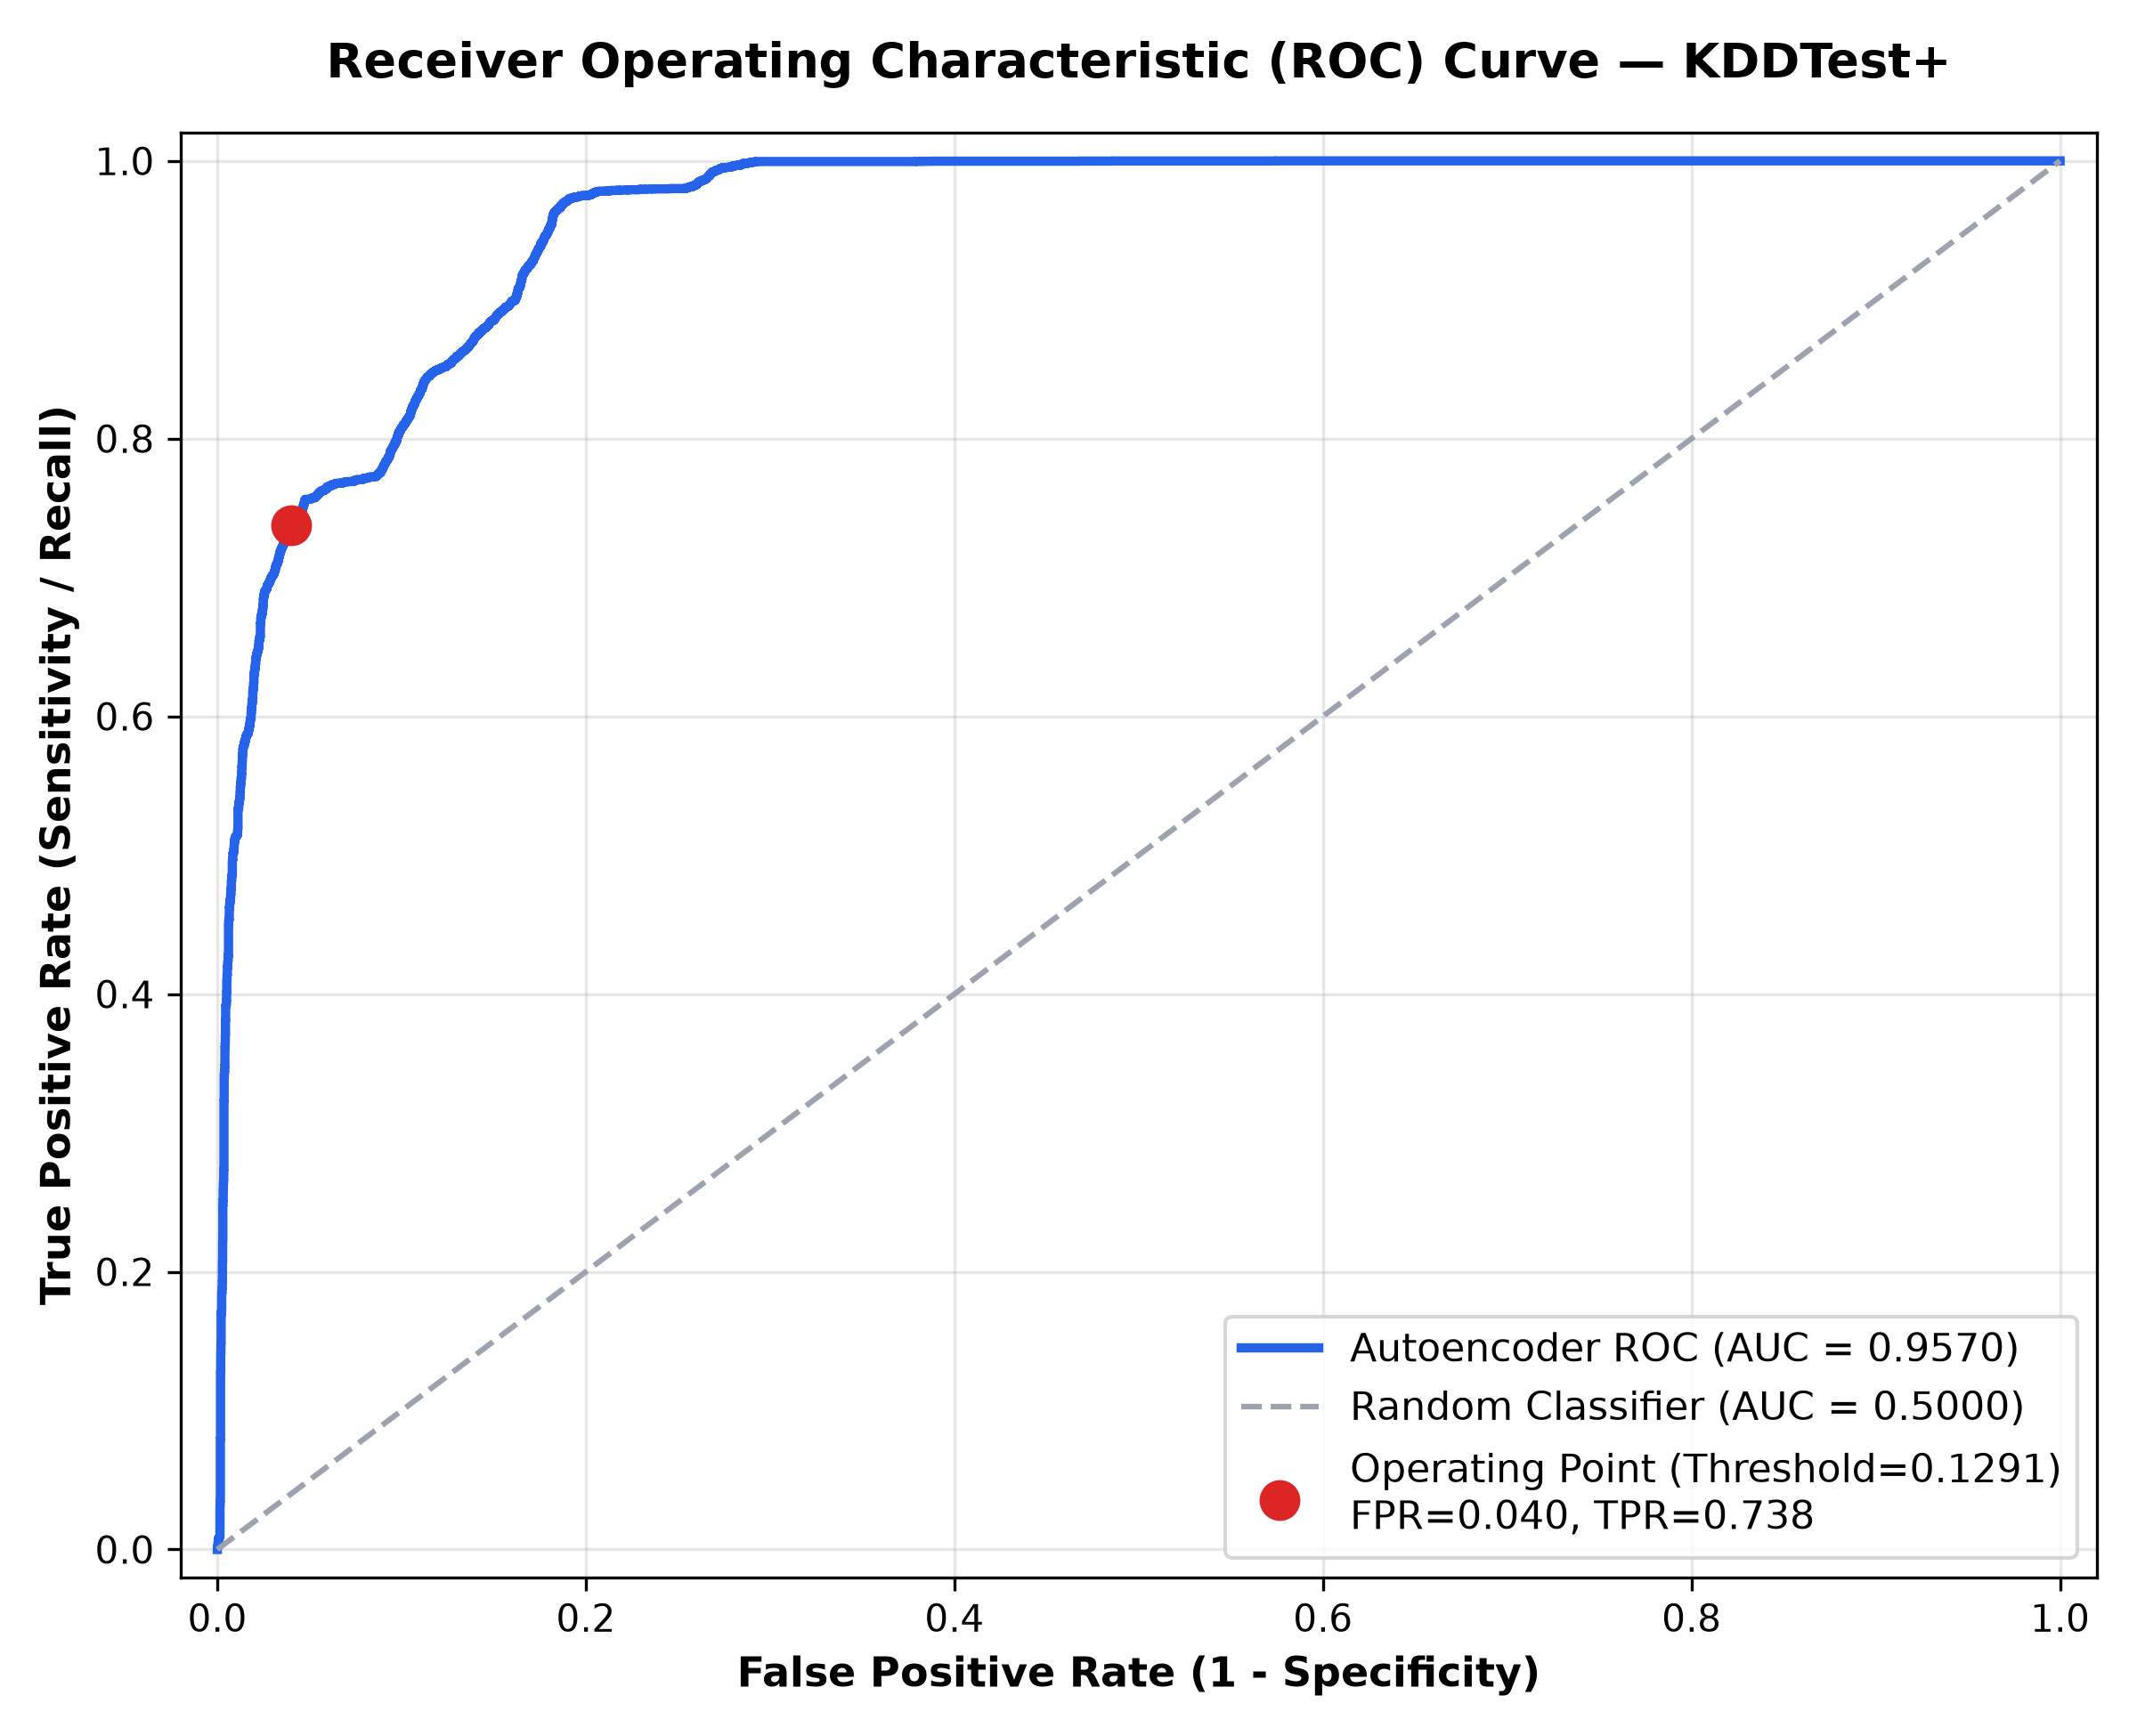
MSC AI & ML DEEP LEARNING PROJECT
Confusion Matrix & Receiver Operating Characteristic
Confusion Matrix (KDDTest+)
ROC Curve (AUC = 95.70%)
Notes:
Slide 12 presents the confusion matrix and ROC curve. On the left, out of 22,544 test connections, we correctly identify 9,322 True Negatives and 9,469 True Positives, with only 389 False Positives. On the right, the ROC curve shows an AUC of 95.70%, with the red dot marking our official operating point at FPR=4.01%, TPR=73.79%.
Key Takeaway: Strong global discriminative power reflected by an ROC-AUC of 95.70%.

Slide 13
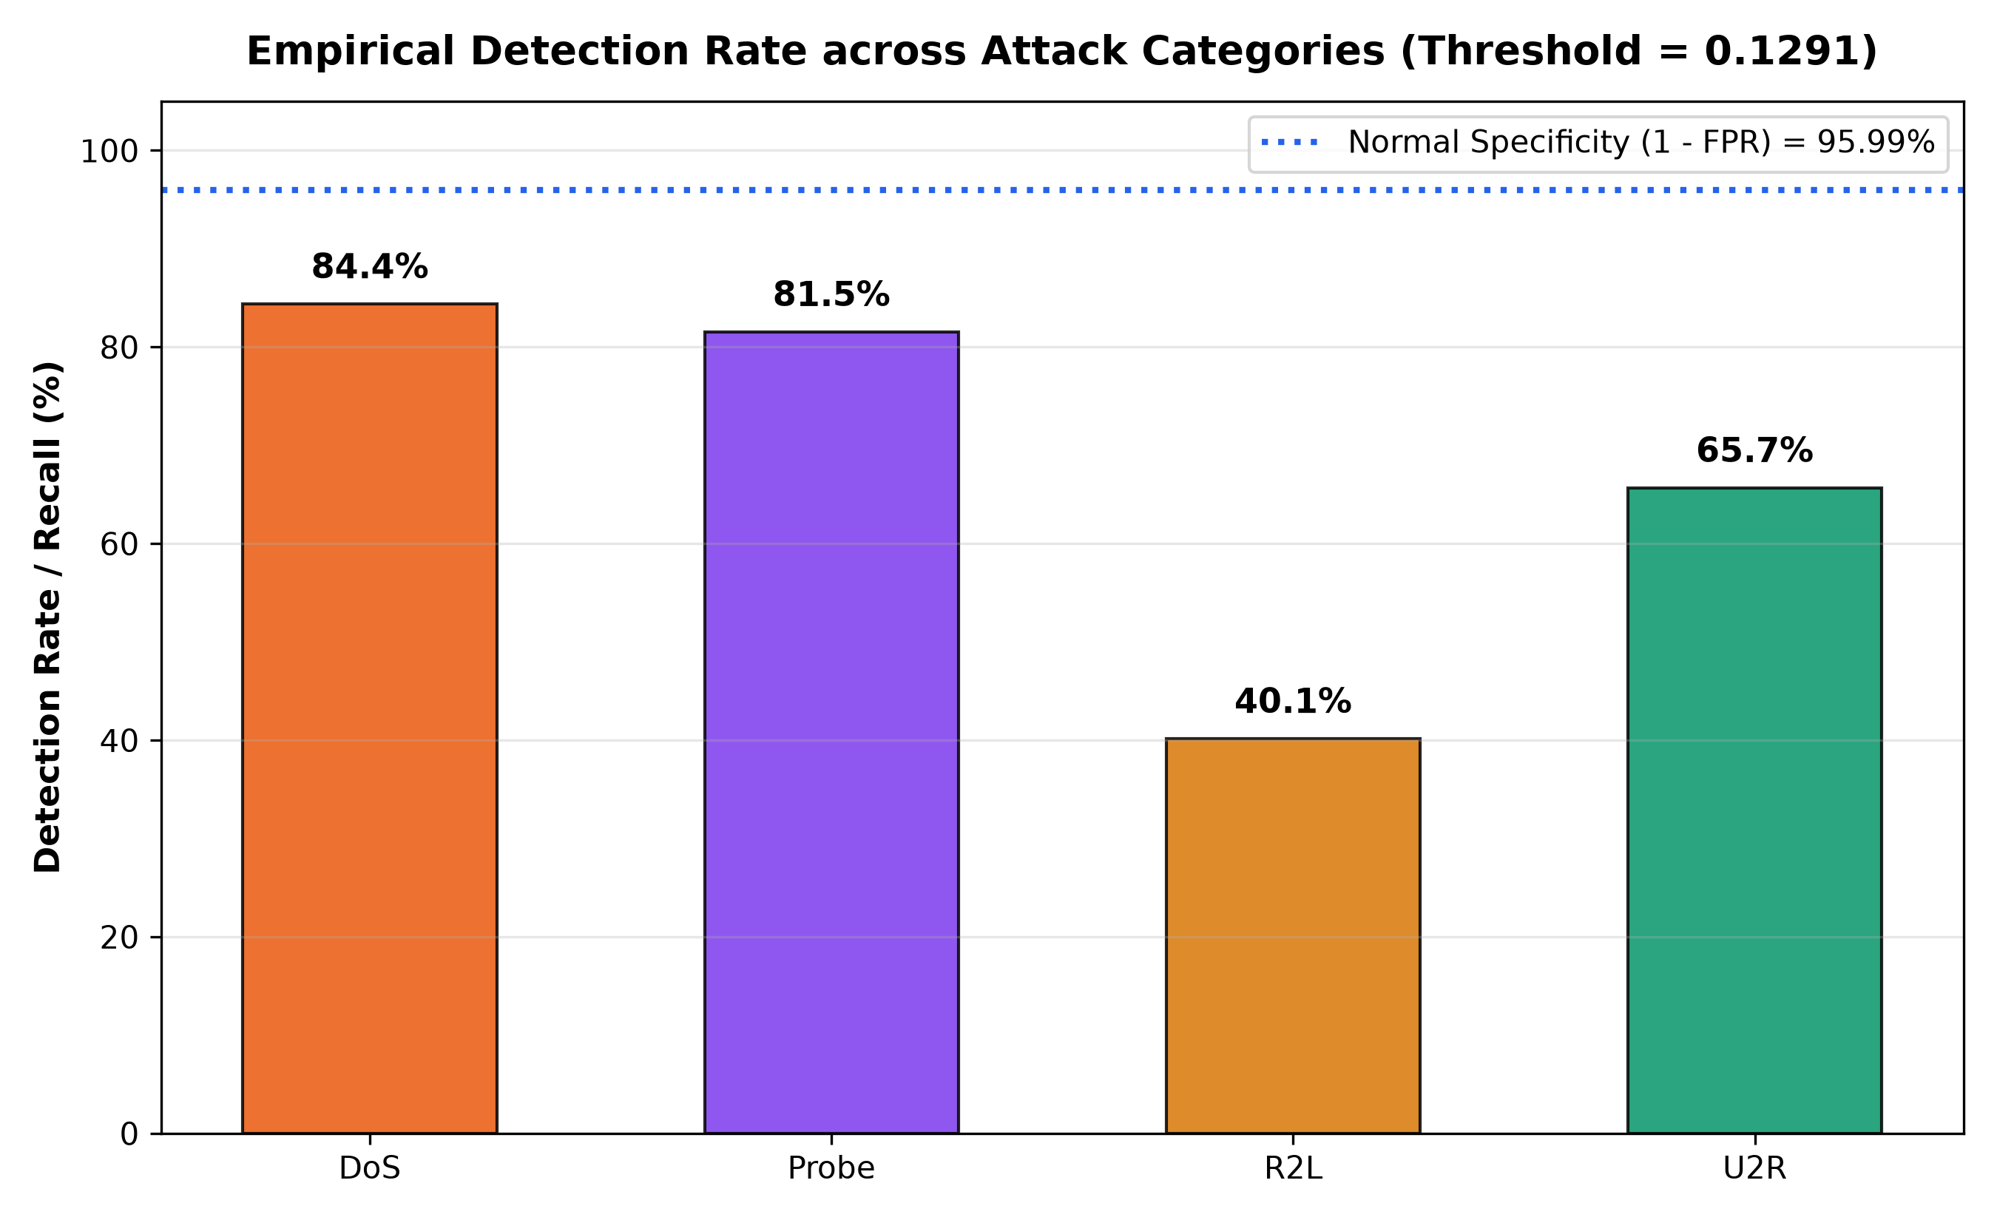
MSC AI & ML DEEP LEARNING PROJECT
Attack-Family Breakdown & Granular Error Diagnostics
Detection Rates by Attack Family
Empirical Detection Rates vs Specificity
• DoS Attacks: 84.37% Recall (6,292 / 7,458)
Volumetric floods (Neptune, Apache2) cause massive connection rate anomalies; mean MSE = 0.6511.
• Probe Attacks: 81.54% Recall (1,974 / 2,421)
Network scanning (Portsweep, Mscan) perturbs destination host distributions; mean MSE = 0.7465.
• U2R Attacks: 65.67% Recall (44 / 67)
Privilege escalation attempts incur severe structural reconstruction penalties; mean MSE = 30.2773.
• R2L Attacks: 40.15% Recall (1,159 / 2,887)
HARDEST FAMILY: Interactive password guessing (Guess_passwd) mimics valid user sessions at the header level; median MSE = 0.0435.
• Error Distribution: 3,364 Total Missed (FN)
R2L accounts for 51.4% of all missed attacks due to payload-agnostic tabular feature overlap.
Notes:
Slide 13 breaks down performance across attack families. DoS and Probe are detected reliably at 84.4% and 81.5% because flooding and scanning disrupt host connection rates. In contrast, R2L is the hardest category at 40.15% detection, representing 51.4% of all missed attacks. This occurs because password guessing over valid sessions mimics legitimate telemetry in header metadata.
Key Takeaway: Volumetric and scanning threats are detected easily, while content-based R2L intrusions reveal feature limitations.

Slide 14
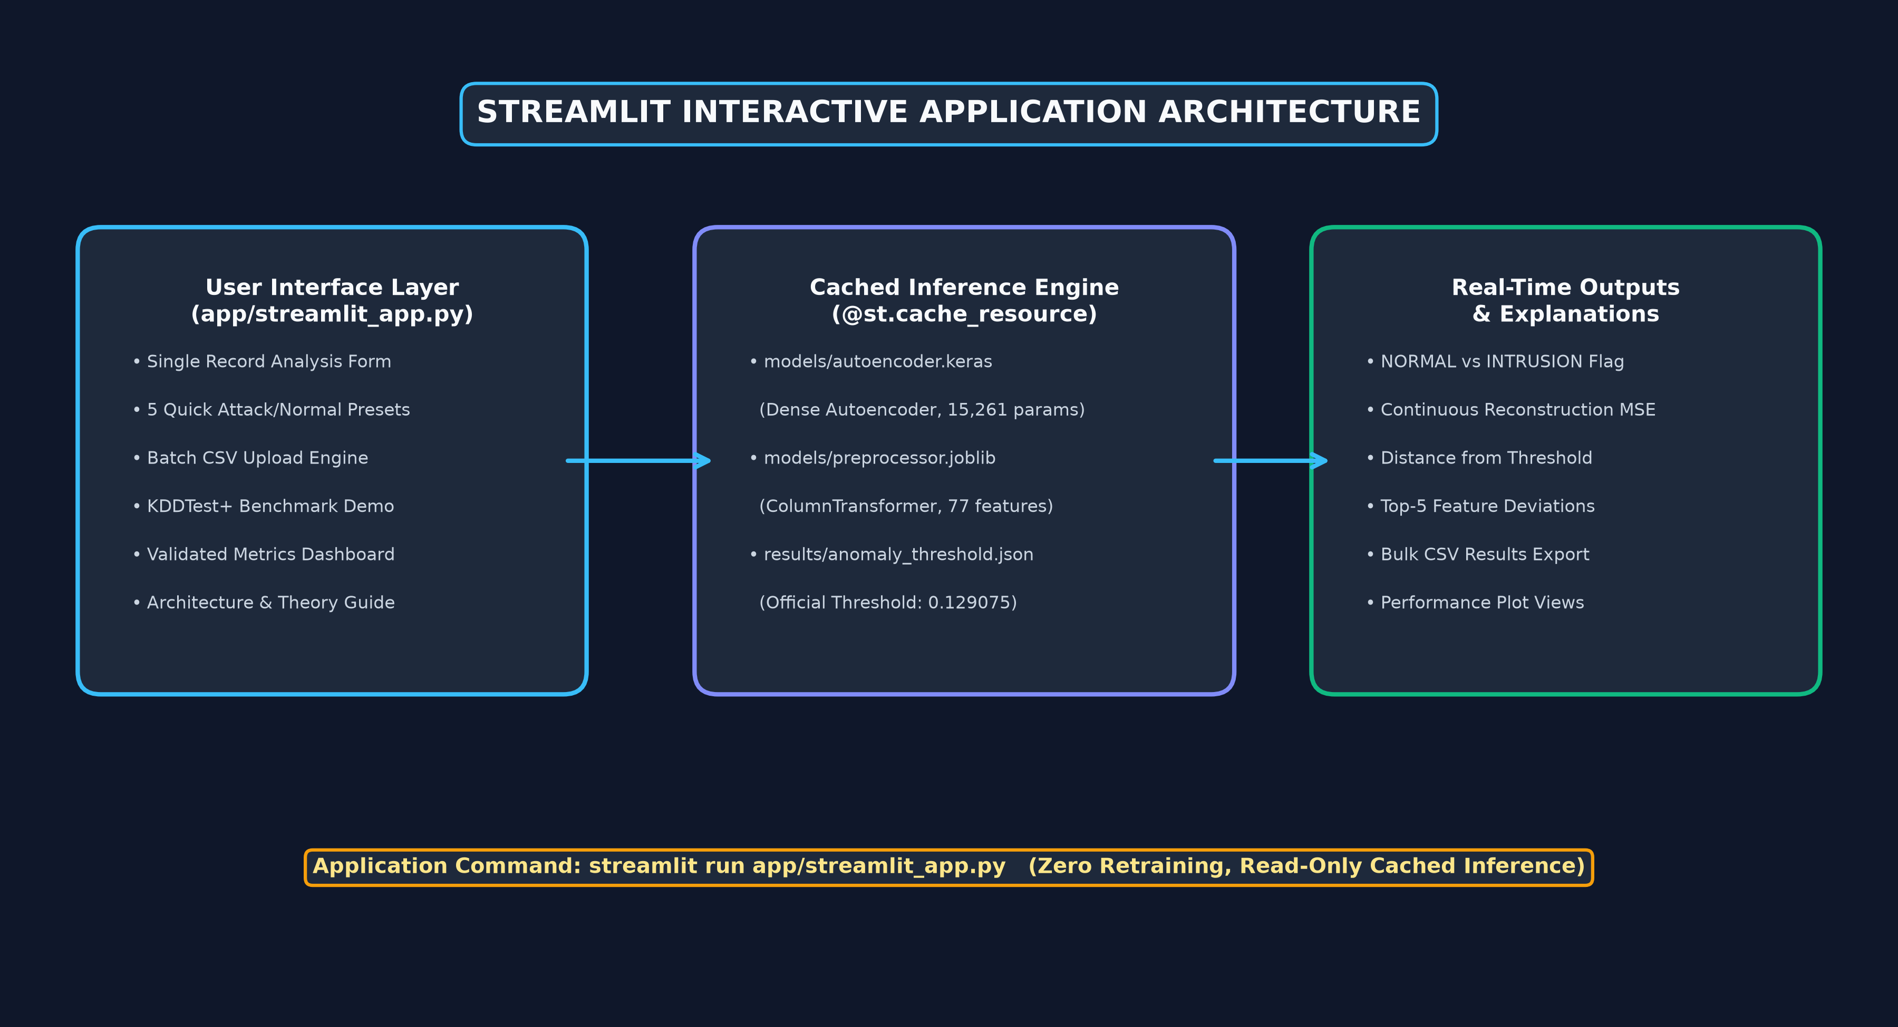
MSC AI & ML DEEP LEARNING PROJECT
Interactive Deployment: Streamlit NIDS Web Application
Notes:
Slide 14 outlines our Streamlit web application. The system offers single-record analysis with 5 pre-loaded attack presets, batch CSV processing with live throughput, and real-time explainability highlighting the top 5 reconstruction deviations. Importantly, the UI clarifies that reconstruction error is an anomaly measure, not a calibrated attack probability.
Key Takeaway: Operational prototype enabling interactive viva demonstration and batch telemetry processing.

Slide 15
MSC AI & ML DEEP LEARNING PROJECT
Conclusions & Future Research Directions
Research Conclusions
Future Scope & Improvements
• Unsupervised Viability: Dense Autoencoders successfully establish a normal behavioral baseline using benign-only training data.
• High Generalization Precision: Achieved 96.05% precision and 83.35% accuracy on 22,544 untouched test connections.
• Principled Calibration: Deriving the decision threshold from the validation 95th percentile constrained test FPR to 4.01%.
• Discriminative Power: Demonstrated 144.9x higher median reconstruction error for attacks compared to normal traffic.
• Operational Deployment: Packaged as an interactive, explainable Streamlit application for cybersecurity workflows.
• Deep Packet Inspection (DPI) Hybridization: Combine tabular header autoencoders with byte-level payload NLP/CNN models to detect stealthy R2L intrusions.
• Sequential Modeling (LSTM / Transformers): Capture multi-connection temporal sequences to detect low-and-slow probing campaigns across extended time windows.
• Adaptive Service-Specific Thresholding: Replace single global threshold with service-conditioned cutoffs (e.g., separate thresholds for HTTP, DNS, SSH).
• Contemporary Dataset Validation: Evaluate generalization on modern benchmarks like CIC-IDS2017 and CSE-CIC-IDS2018.
• Explainable AI (XAI) Attribution: Integrate SHAP / Integrated Gradients to trace feature contributions to reconstruction loss.
Notes:
In conclusion, we have demonstrated that an unsupervised Dense Autoencoder can detect network intrusions with 83.35% accuracy, 96.05% precision, and an ROC-AUC of 95.70% on unseen benchmark traffic. For future work, incorporating payload inspection and sequential modeling will address R2L payload blindspots. Thank you, and I am now ready for questions.
Key Takeaway: A successful, mathematically verified proof-of-concept for unsupervised deep learning intrusion detection.

