Slide 1



NEMO CLI · NV 1.2 — 2026
NEMO
The autonomous coding agent,
in your terminal.
One prompt. A real tool loop. It writes the code, runs it, reads the output and fixes what it broke.
RUNTIME
MODELS
LICENSE
Node + TypeScript
NVIDIA NIM
Apache-2.0
NEMO CLI · NV 1.2
01 / 10 INTRO
Notes:
NEMO is a local coding agent for the terminal. One prompt becomes a real tool loop that writes code, runs it and checks its own work.

Slide 2
CONTENTS
What's inside
01
The loop
05
Quickstart
02
Surface
06
Live demo
03
Autonomy
07
Proof
04
Principles
08
Memory
NEMO CLI · NV 1.2
02 / 10 CONTENTS
Notes:
Ten slides: the loop, the surface, autonomy, principles, quickstart, a live demo, the proof and the memory model.

Slide 3


SECTION ONE
The loop
Plan, act, verify — and know when to forget.
01
NEMO CLI · NV 1.2
03 / 10 THE LOOP
Notes:
First movement: how a single turn actually executes.

Slide 4
01 — THE LOOP
Plans. Writes. Runs.
Then checks itself.
01
02
03
04
OBSERVE
WRITE
RUN
CHECK
Repo map, diff and @-mentions land before the first token.
Exact-match edits — multi_edit applies atomically or not at all.
Shell and test output come back into context, truncated and safe.
If it failed, the loop reads the error and tries again.
verdict(mode, category) → allow · ask · deny
NEMO CLI · NV 1.2
04 / 10 THE LOOP
Notes:
Four beats per turn. The agent never assumes an edit worked.

Slide 5

02 — SURFACE
Everything, from one prompt.
18 tools, 7 context providers, resumable sessions and auto-loaded rules — one process.
TOOLS
CONTEXT
SESSIONS
RULES
18 schemas
@-mentions
JSONL
auto-loaded
shell · read · write · edit_file · multi_edit · apply_patch · grep · glob · web_fetch
@file · @folder · @glob · @codebase · @repo-map · @diff · @web
Every turn appended to ~/.nemo/sessions, resumable by id
NEMO.md · AGENTS.md · CLAUDE.md · .nemo/rules/*.md
No config required. No daemon. No account.
NEMO CLI · NV 1.2
05 / 10 SURFACE
Notes:
Tools, context, sessions, rules. That is the whole surface.

Slide 6

03 — AUTONOMY
Four modes. One verdict.
MODE
READ
WRITE / EXEC
DESTRUCTIVE
USE IT FOR
read-only inspect
ALLOW
DENY
DENY
Zero-side-effect exploration
confirm default
ALLOW
ASK
ASK
Pair-programming, every mutation approved
auto unattended
ALLOW
ALLOW
ASK
Long edits, destruction still guarded
full-access yolo
ALLOW
ALLOW
ALLOW
Throwaway checkouts only
Destructive commands always resolve to ask unless full access is explicit.
NEMO CLI · NV 1.2
06 / 10 AUTONOMY
Notes:
One function decides allow, ask or deny. Destructive always asks unless you opted into full access.

Slide 7
04 — PRINCIPLES
Inversion, not optimism.
01
02
03
Lexical, not embeddings.
One process, not a daemon.
Opt-in, not telemetry.
Rank by term overlap. Instant, transparent, reproducible — no vector store to keep in sync.
Node strips the TypeScript directly. No build step, no background service, no runtime deps.
Nothing is reported anywhere. The key lives in the environment and never touches disk.
A small agent that actually runs end to end beats a large agent that only exists in a deck.
NEMO CLI · NV 1.2
07 / 10 PRINCIPLES
Notes:
The bias is subtraction: no vector DB, no daemon, no telemetry.

Slide 8
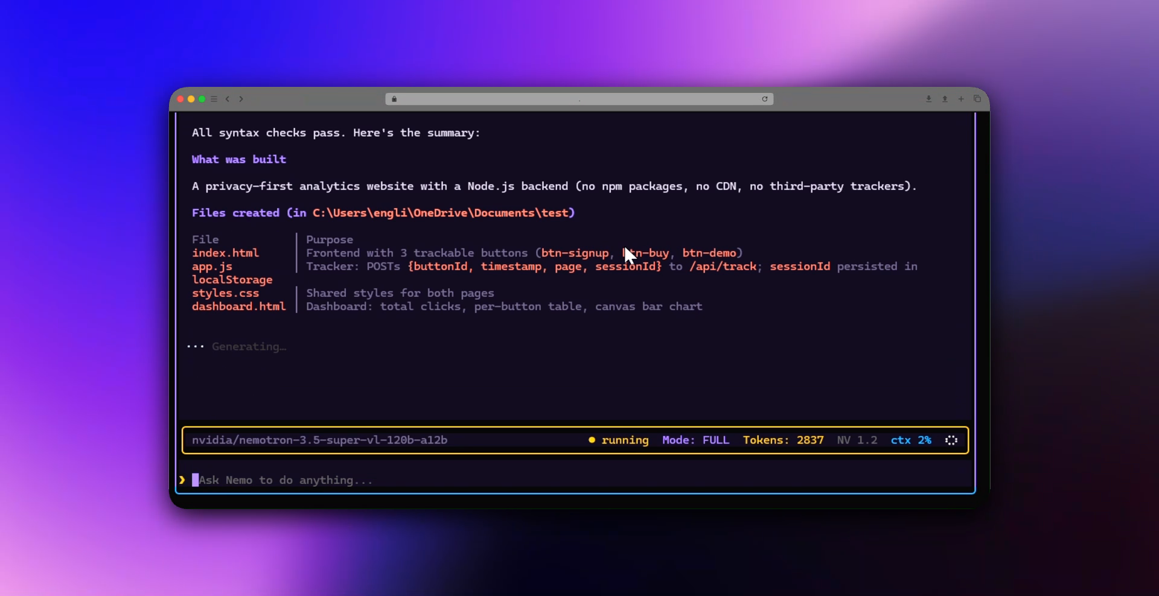
07 — PROOF
One prompt. Real files.
A privacy-first analytics site — Node backend, three files, no packages, no CDN, no third-party trackers.
3
0
files written
npm packages
LIVE SESSION · NV 1.2 · SESSION JSONL SAVED
0
41s
CDNs / trackers
wall clock
NEMO CLI · NV 1.2
08 / 10 PROOF
Notes:
Real output from the recorded session: three files, zero dependencies, zero trackers.

Slide 9

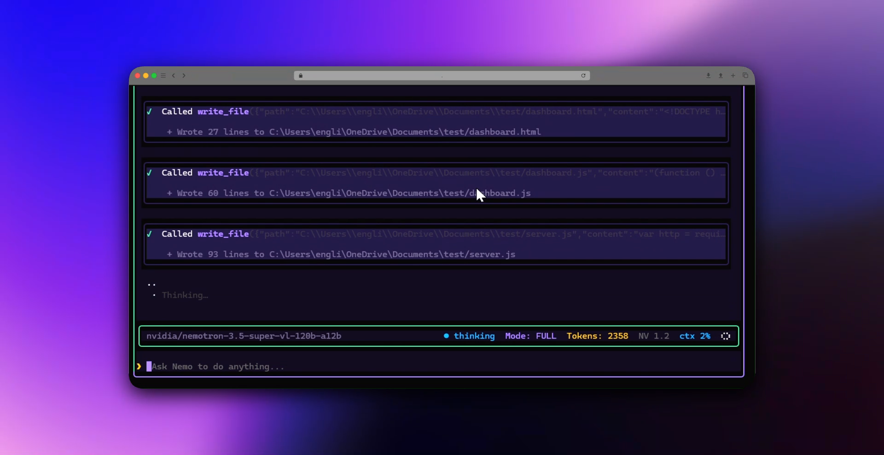
06 — LIVE DEMO
● REC
Watch it
build the app.
A real terminal session, recorded end to end. No cuts, no staged edits.
PLAYS NEXT IN THE VIDEO
TERMINAL · NV 1.2 · UNSCHEDULED DEMO
NEMO CLI · NV 1.2
09 / 10 LIVE DEMO
Notes:
This is where the recorded demo plays.

Slide 10
nemo.
The autonomous coding agent, in your terminal.
$ nemo
Node 22.6+ · NVIDIA NIM · Apache-2.0
Built for terminals. Shipped for humans.
NEMO CLI · NV 1.2
10 / 10 CLOSING
Notes:
Close on the command and the one-liner.

