Slide 1

CVR COLLEGE OF ENGINEERING
DEPARTMENT OF COMPUTER SCIENCE AND ENGINEERING
A Project seminar-I
on
AIRLINE BOOKING APPLICATION
by
S.SAI SHRITHAN-22B81A05DX
M.SAI KRISHNA-22B81A05DV
T.JAYANTH KUMAR-22B81A05CT
Under guidance of
Mr.N.S.S.Aditya
Department Of CSE
1

Slide 2
Contents
Abstract
Software requirements
Design
Data sets requirements
Plan of action to complete the project
<number>

Slide 3
Abstract:-
This software helps passengers to look up flights between two points which can be domestic or international.
Passengers can find and book tickets for flights through this software.
It is a simple application with a user-friendly interface. The users can access flight information and book tickets at their convenience.
Passengers can access the whole list of all the flights available on different routes with their timings and fares both for diverse classes.
One can compare the best deals for them and book a flight according to their interests.
The passengers enter the "Departure city" and "Arrival city" for particular departure and arrival dates.

Slide 4
The system displays all the flight's details such as flight no, name, price, duration of journey etc… After searching the system displays a list of available flights and allows the customer to choose a particular flight.
Then the system checks for the availability of seats on the flight. If the seats are available then the system allows the passenger to book a seat, otherwise, it asks the user to choose another flight.
The manual work is thus reduced and the chances of errors are reduced to a minimum.

Slide 5
Software:-
Developer:
HTML
CSS
Java Script
Python(Server –Side Language)
SQL(for data management)
User:
An Web Browser with JavaScript enabled

Slide 6
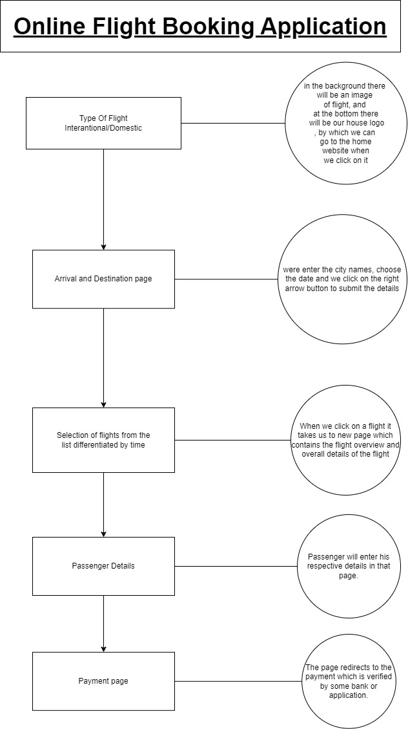
Design(Project flow diagram):-

Slide 7
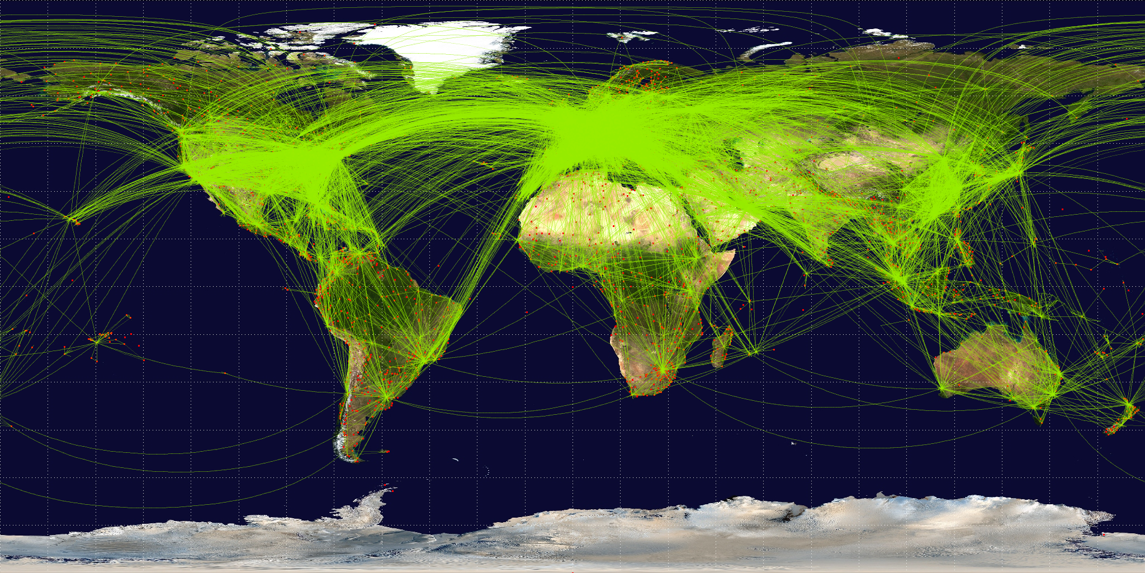
Data sets: -
Flight Data
Airport Data
Airline Data
Miscellaneous Data(time zones, currency exchange rates, etc..)

Slide 8
Plan of action to complete the project:-
Get the required icons, images/pictures.
Prepare the basic template for every entity.
Make the pages user friendly.
Make the pages responsive.
Get the required data sets.
Connect the data set.
Test the project before deployment.
Finally make necessary changes.
Deploy the mini-project.

Slide 9
Thank You

