Slide 1

GUI for a Microgrid’s Control System
Shouran Mu
supervised by Edwin Mora

Slide 2
Agenda
1
Introduction
2
Methodology
3
Implementation
4
Outlook

Slide 3
Introduction - Motivation
GUI Design
LabVIEW Implemetation
OPC Unified Architecture
Real-time Simulation

Slide 4
Introduction - Challenges
GUI designed in LabVIEW
How to present comprehensive information with GUI?
1
2
OPC Unified Architecture
How to build communication based on OPC UA?
Raspberry Pi as Bridge
How to coordinate different communication protocols?
3

Slide 5
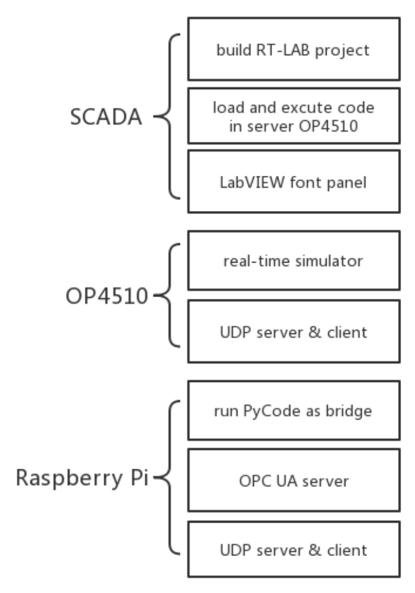
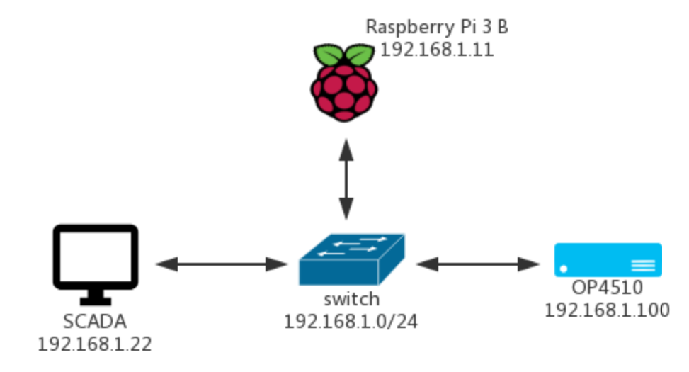
Methodology - Main Topology

Slide 6
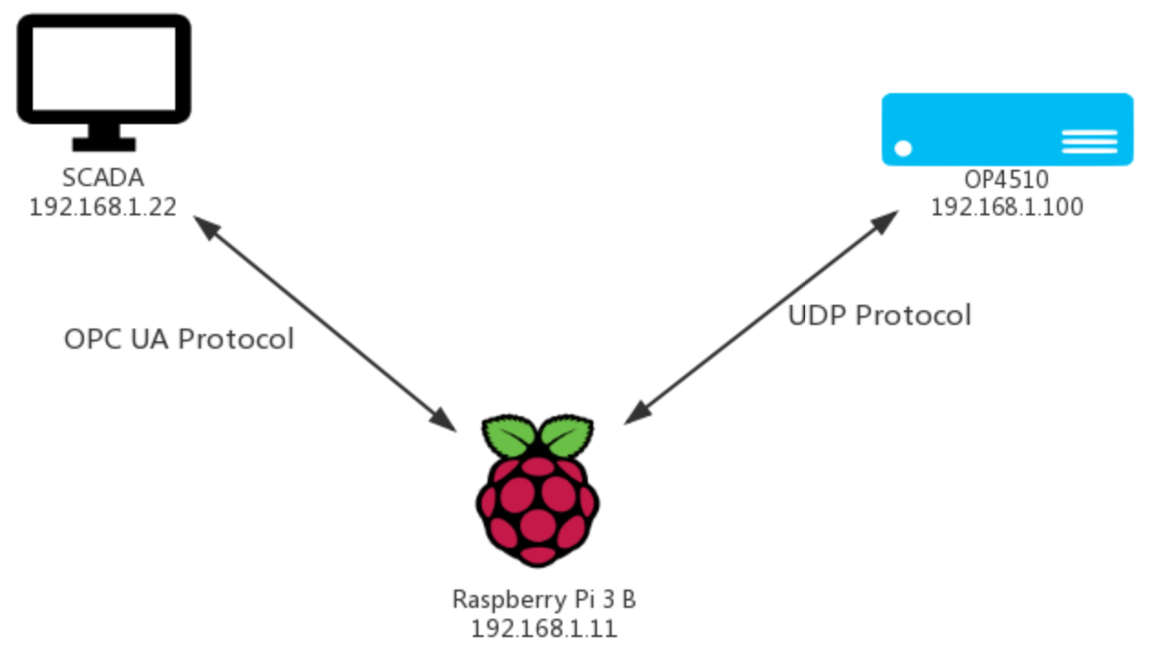
Methodology – Transmission Protocol
OPC Unified Architecture
Communication with industrial equipment and systems
Open - freely available
Cross-platform
Robust security
....
UDP Server
To listen port 8001
To receive UDP packet
UDP Client
To pack the data
To send UDP packet

Slide 7
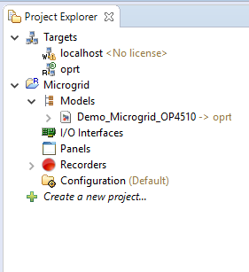
Implementation - RT-LAB Project
OPAL real-time server
IP: 192.168.1.100
Assigned to server target
Load and excute model
Simulation in real-time

Slide 8
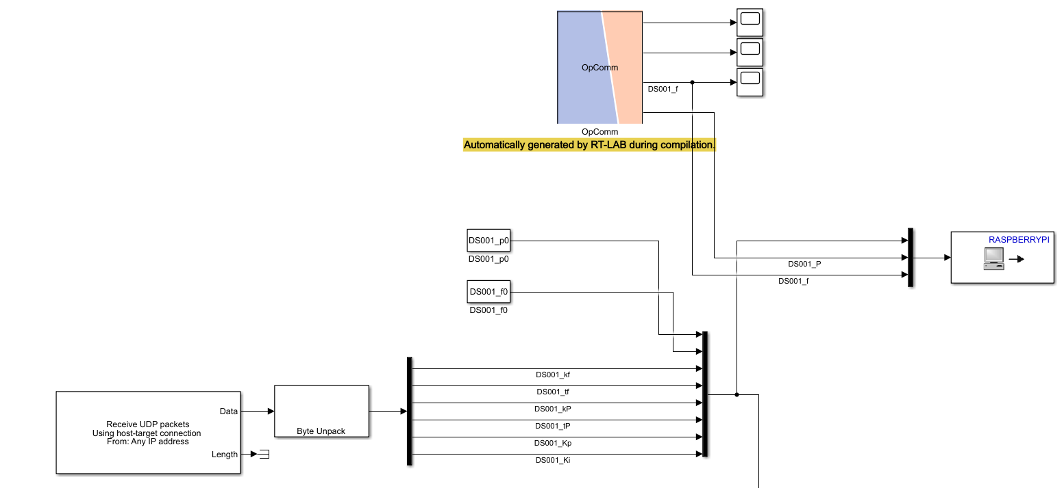
Implementation - Matlab Simulink
UDP Client
Send simulation results to Pi
UDP Server
Listen at port 8001 locally
Wait for receiving data from Pi
Parameters definded in matlab file Script_Initialization.m

Slide 9
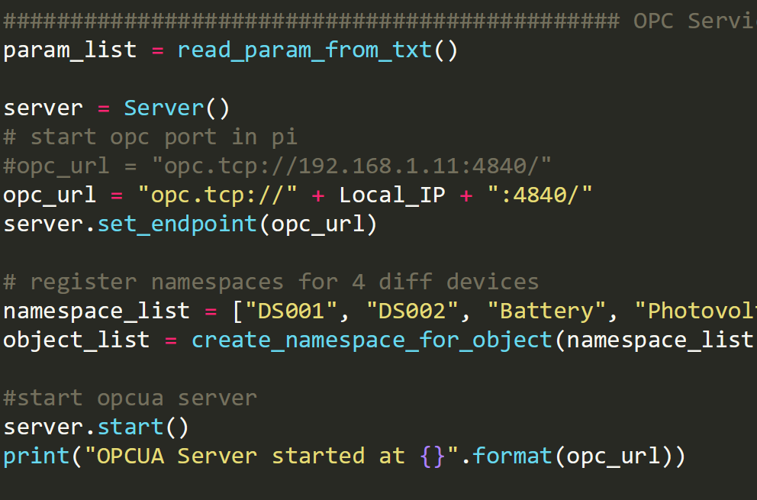
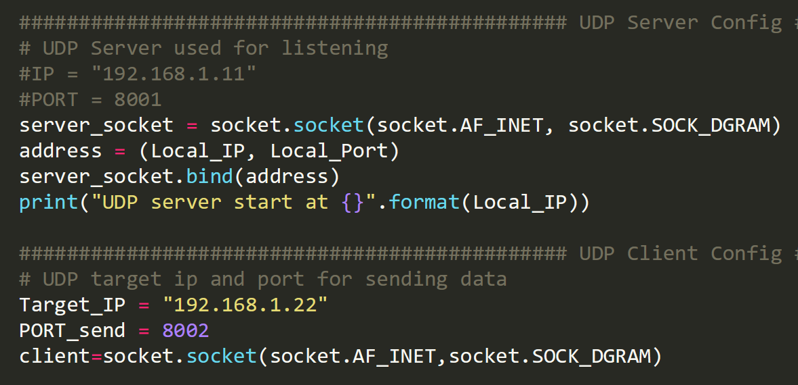
Implementation – Service Configuration
Load the parameters name from txt file
e.g. GasLevel, P, f, kf, tf, kP, tP...
Create namespace for each device
e.g. DS001, DS002, BT001, PV001
Bind UDP server with port 8001 for listening
Start OPC server at port 4840 locally
Send UDP packet to server with host IP & port 8002

Slide 10
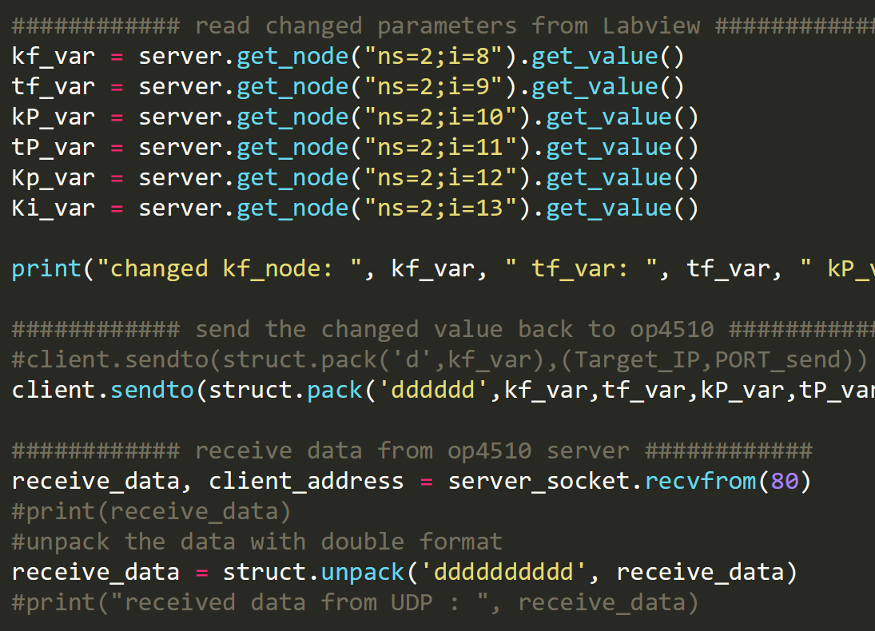
Implementation – Service
Read value by specified namespace and node id
Pack and send updated value to server OP4510 in UDP packet for simulation
Receive simulation results from server OP4510

Slide 11
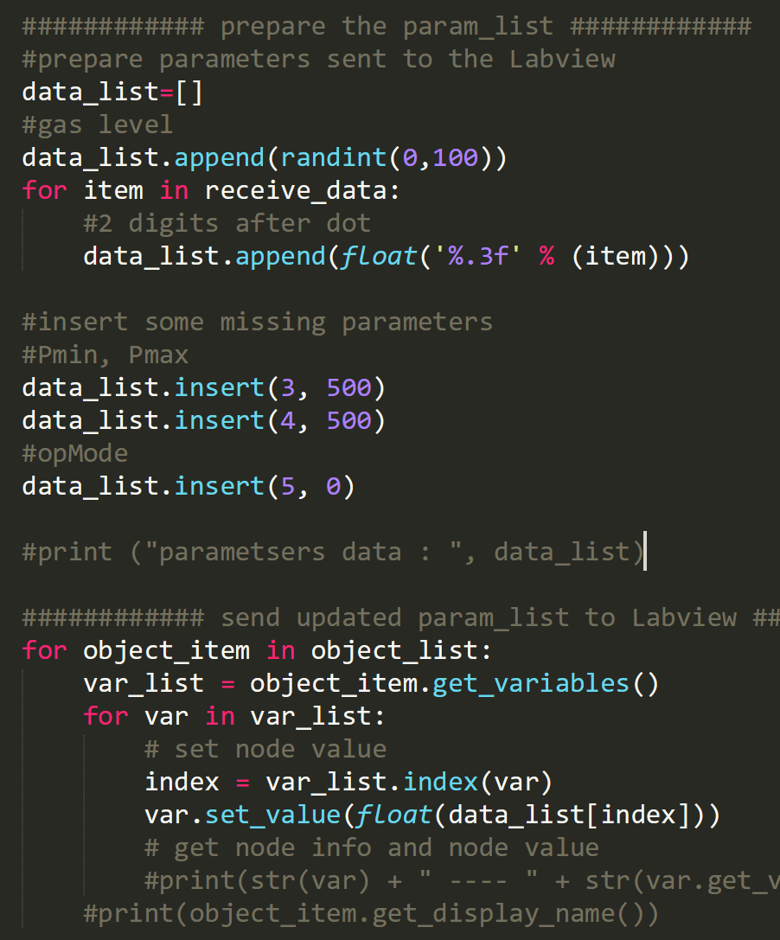
Implementation – Service
Unpack and prepare the values for building parameters
Insert some constant values (which are not provided by RT server) to build parameters list
Set complete parameters list to LabVIEW to display on each control panel

Slide 12
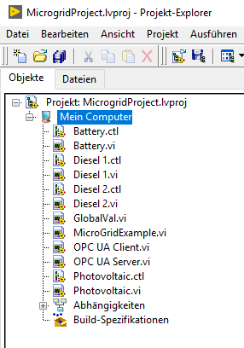
Implementation - LabView Project
Self designed control button
Sub control panel to show more detailed Info for each device
Main control panel
Used for OPC UA communication test

Slide 13
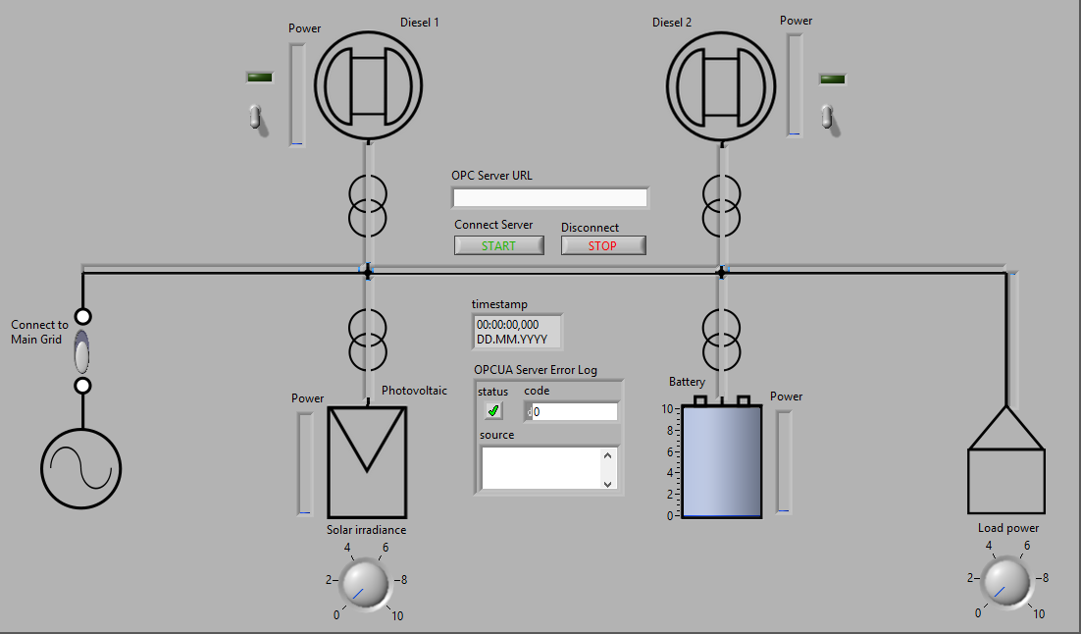
Implementation - Main Control Panel
URL used to connect to OPC server in Pi
Connect the device to microgrid by switch
Image button to open sub control panel

Slide 14
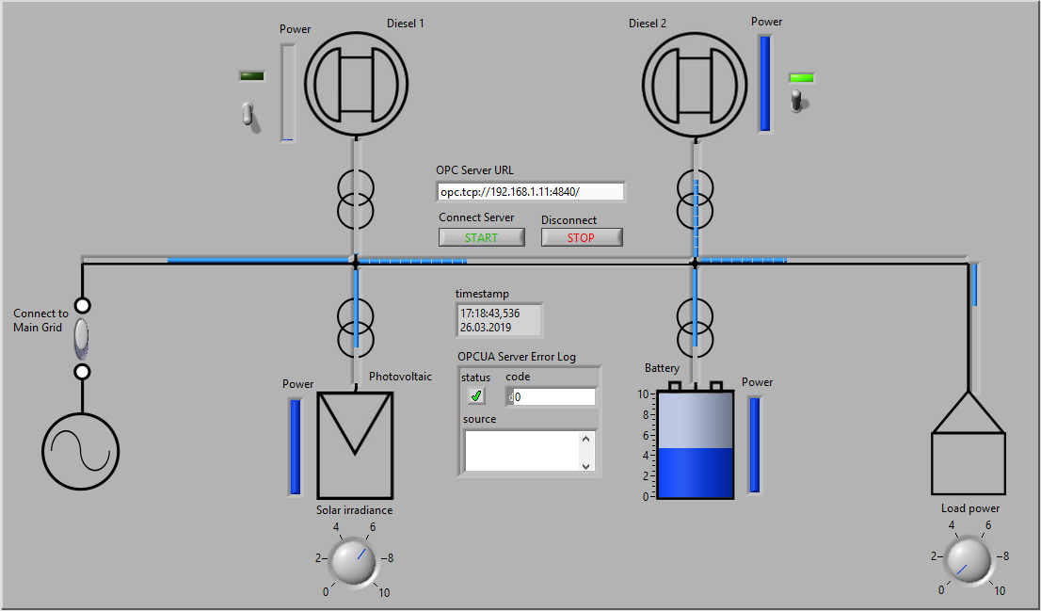
Implementation - Main Control Panel
Energy flow animation to show more information dynamiccally
Power slide shows power capacity of the PV device

Slide 15
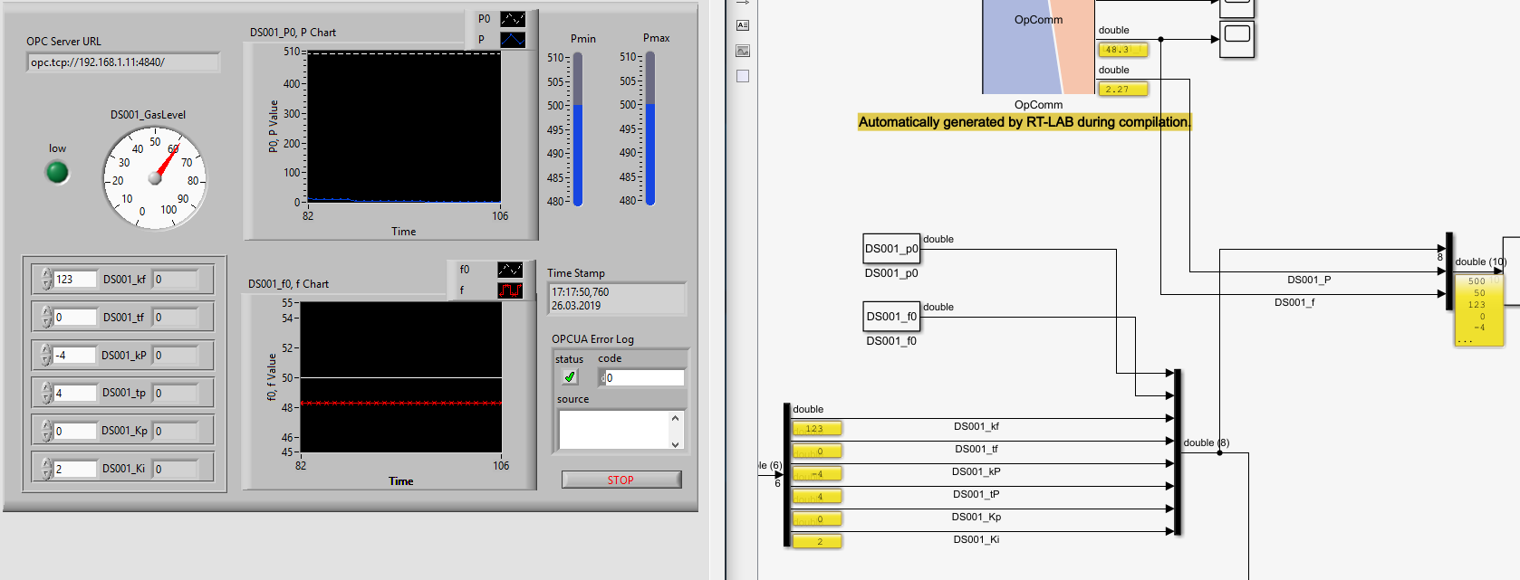
Implementation - Sub Control Panel
Parameters changed in control panel will be sent to RT server online (or in real-time)

Slide 16
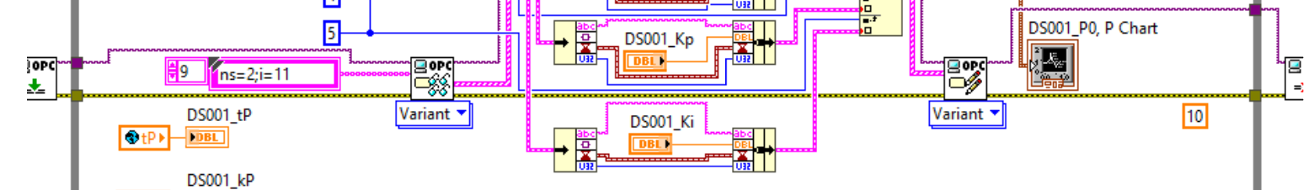
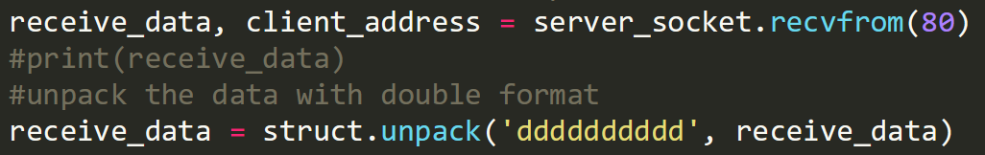
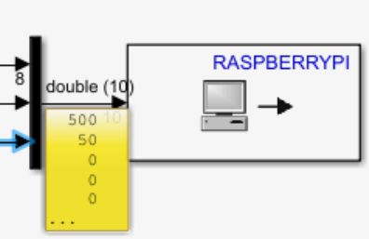
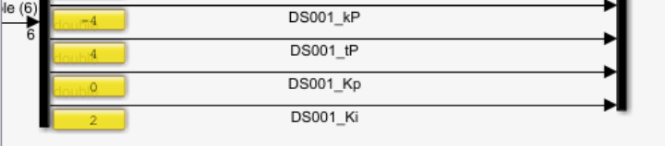
Implementation - Example
1st
Changed value will be updated by LabVIEW OPC UA Toolkit
Simulation and sent results with Simulink UDP
Transmission Element

Slide 17
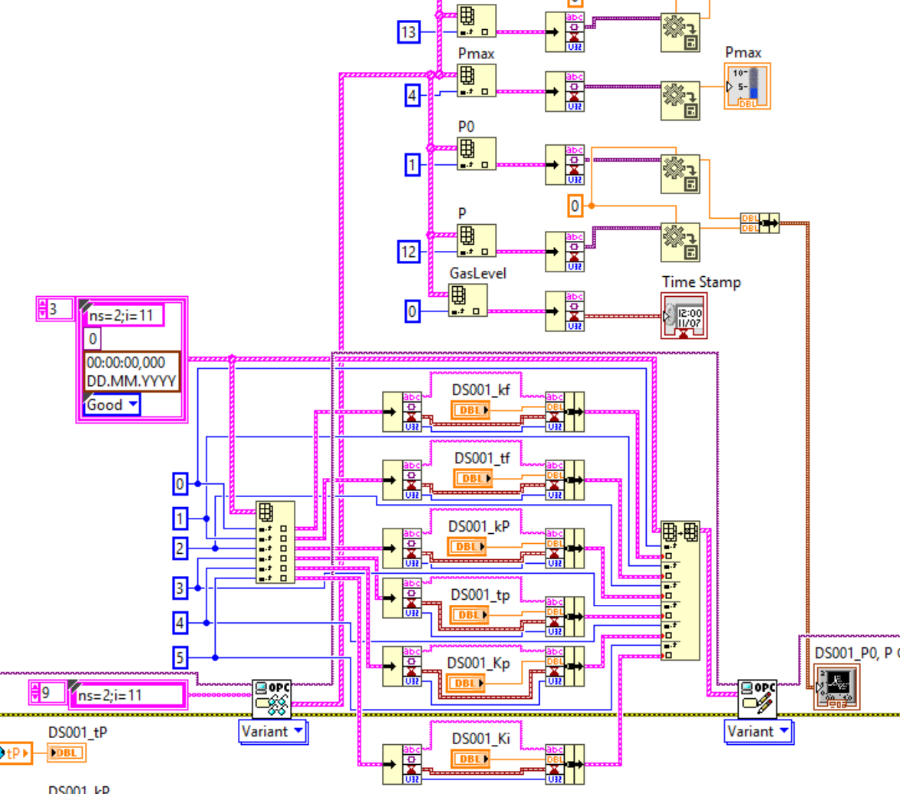

Outlook – to be better...
How to improve the data flow for a big set of parameters rather than using index?
Test this application with a real microgrid model?

Slide 18

Question about ...

