Slide 1
Contents:
Introduction
Research and gather detailed Information
Explore Real word Applications
Steps for use RunwayML AI Tool
Advantage and Disadvantages
Purpose
External references
Links to the official AI Tool website
Linkdin posts and discussion related to work
Relevant Facebook posts
Instagram posts
Youtube Videos
Webinar links

Slide 2
Introduction
RunwayML is the new game-changer in video editing.It is developed By Danielle Sastrawan. It is AI research company.
This compressive video editing platform offers a range of machine learning capabilities that streamline the video editing process, making editing videos faster, easier and much more acessible to everyone.
With everything from basic editing to sophisticated post production,Runway ML is like having your own video editing studio right in your browser.
In a just few minutes, you can upload videos and perform massive modifications, which would otherwise take hours with additional video editors.

Slide 3
Detailed Information on RunwayML AI Tool
creative for Runwayml is platform that allows you to create anything you can imagine with artificial intellgence(AI). Whether you want to generate videos,images,audio,or text, Runway has a tool for you.
you can use Runways AI Magic Tools to transform your content with just a few clicks, or train your own custom models with AI Training.
You can also use Runway's full-feature video editor to edit your videos online with professional quality.Runway was founded by artists who wanted to make AI accessible and everyone.
Runway was founded by artists who wanted to make AI accessible and creative for everyone.Runway also supports and showcases the work of storytellers who use AI to create new forms of expression.Runway is more than just a technology company, it is a community of creators who are shaping the future of storytelling with AI.

Slide 4
Real word Applications
Generate Videos.
Generate Images.
Infinitely Expand Images.
Reimagine Any Image.
Train Custom Models.
Erase Things from Videos.
Slow Mo Any Video
Move Image Tool

Slide 5
Steps for How to use RunwayML
step1: Sign up for a free account on the Runway ML website.
Step2: choose image to create your dataset.
Step3:Provide your model with a keyword.
Step4:Wait about few minutes for training results to process.
Step5: Explore your model by instantly exploring 100 free HD images.
Step6: Discover new ways to customize images with Text to image.
Step7:Use Runway AI Magic Tools for unparalleled content creation.
Step8:Collaorate in real time and keep your assest centralized.
Step9:Explore the diverse tools available on Runway AI
Step10:Runway AI: Constantly evolving to meet your need.

Slide 6
Specific use cases for RunwayML tool
1.Generating photorealistic images or image captions.
2.Creating realistic 3D models of buildings and interiors.
3.Customizing videos with subtitles, and transcripts.
4.Collborating in real time for effcient workflows.
5.Using machine learning to generate art and entertainment.
6.Chaining together models for enhanced creativity.

Slide 7
Advantages and Disadvantages
It offers 30+ AI Magic Tools that can generate and edit content with text, images, or video clips.
It has a professional online video editing software that can handle basic to advanced post-processing tasks.
It has a research division that develops multimodal AI systems to enable new types of creative tools.
The big disadvantages is that it requires credits to use a some of the AI magic tools and upscale and remove watermarks on generated videos.
It's depending upon internet speed.
The next pron is that it does not support PNG or ProRes exports for video projects.

Slide 8
Purpose & Features
RunwayML is a platform for artists to use machine learning tools in intuitive ways without any coding experience for media ranging from video, audio, to text. On RunwayML, users can create and publish pre-trained machine learning models for applications such as as generating photorealistic images or image captions.
Gen-2: Text to Video. Generate videos with text prompts.
Gen-1: Video to Video. Change the style of a video with text or images.
AI Training. Create custom portraits, animals, styles and more.
Text to Image. ...
Image to Image. ...
Expand Image. ...
Frame Interpolation. ...
Erase and Replace.

Slide 9
API Integrating the tool AI Tool with java
This document references the folder Localhost Network API. Hosted models are always available on the web and do not require you to have the runway app running. We recommand using the new hosted models feature in order to interact with models feature in order to interact with models feature in order to interact with models anytime from anywhere. This document references the older LocalHost Network API.Hosted models are
Always available on the web and do not require you to have the runway app running.
Link for API: https://help.runwayml.com/hc/en-us/articles/4402117295763-Localhost-Network-API

Slide 10
Links to the official AI tool websites
https://runwayml.com/
https://easywithai.com/ai-video-tools/runwayml/
https://www.youtube.com/watch?v=cxS4pT16_XQ
https://www.mlyearning.org/runway-ai/
https://allthingsai.com/tool/runway
https://robottools.ai/software/runway/
Linkdin:
https://www.linkedin.com/posts/aagupta_runway-the-video-ai-leader-activity-7058651231904301056-QqqS
Instagram:
https://www.instagram.com/runwayapp/?hl=en
Youtube:
https://www.youtube.com/runwayml
https://www.youtube.com/watch?v=xH15JvgcCZo
Facebook:https://www.facebook.com/runwayml/photos/want-a-quick-way-to-learn-about-runwayml-get-started-with-these-newshort-videos-/1678623662270058/

Slide 11
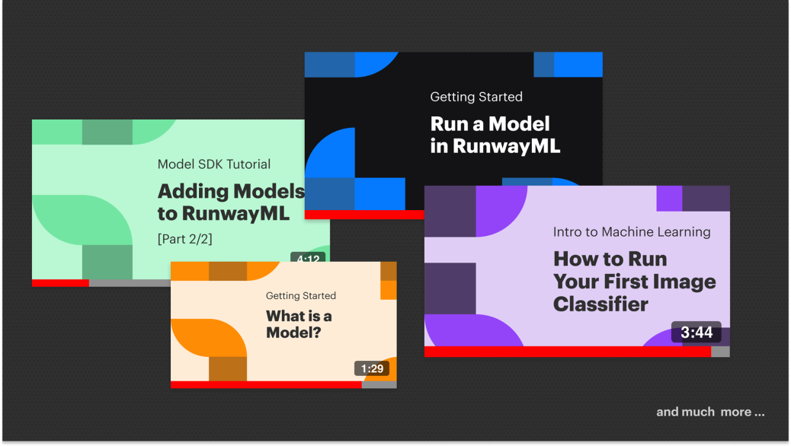
Revelant facebook posts
https://www.facebook.com/runwayml/photos/want-a-quick-way-to-learn-about-runwayml-get-started-with-these-newshort-videos-/1678623662270058/

Slide 12
RunWayML AI Magic Tools
1.Text to Video
2.Video to Video
3.AI Training
4.Text to Image
5.Expand Image
6.Frame Interpolation
7.Erase and Replace
8.Infinite Image
9.Backdrop Remix
10.Image Variation
11.3D Texture
12.Inpainting
13.Color Grade
14.Clean Audio

Slide 13
Youtube Videos and Webinar Links
https://www.youtube.com/runwayml
https://www.youtube.com/hashtag/runwayml
https://academy.runwayml.com/ai-training/using-your-model
https://academy.runwayml.com/ai-magic-tools/text-to-image
https://academy.runwayml.com/ai-magic-tools/upscale-images

