Slide 1
Third International Conference on Advances in Physical Sciences and Materials 2022 (ICAPSM 2022)
ENGINEERING GRADUATE SALARY PREDICTION USING PRINCIPAL COMPONENT ANALYSIS
Authors:
Arjun Thakur, Shubham Shah, Shruti Singh, Akash Sinha, Vishal Sirvi, Shreyansh Srivastava , Abha Marathe

Slide 2
TABLE OF CONTENTS
03
01
02
INTRODUCTION
METHODOLOGY
ALGORITHMS IMPLEMENTED
04
05
06
RESULTS & DISCUSSIONS
CONCLUSION
REFERENCES

Slide 3
INTRODUCTION
The primary goal of the regression model is to create a system that can predict the salary from a set of attribute explanatory variables.
For developing system, a dataset of Engineering graduate salary prediction has been used.
Different algorithms have been applied on it like the Linear regression algorithm, Random Forest, Decision Tree, Support Vector Machine (SVM) Regression and Xgboost.

Slide 4
DATA SET DESCRIPTION
Dataset from Kaggle consisting of 2998 records and 34 attributes out of which 19 appropriate attributes have been selected.
The dataset is saved in CSV format and its dataset's qualities are logical and competent, allowing for a precise and efficient forecast of an engineering graduate's salary.
CollegeGPA, GraduationYear ,English ,Logical ,Quant , Domain, ComputerProgramming, ElectronicsAndSemicon, ComputerScience, MechanicalEngg, ElectricalEngg, TelecomEngg, CivilEngg, conscientiousness, agreeableness, extraversion, neuroticism, openess_to_experience

Slide 5
DATA PRE-PROCESSING
Salary column outliers were removed using their index positions to enhance the r2 value.
All -1 values in the selected attributes were converted to NA values, which were then subsequently replaced by the mean values of the corresponding columns.

Slide 6
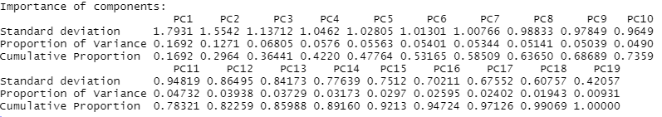
PRINCIPAL COMPONENT ANALYSIS
PCA is implemented on the 19 columns in the dataset.
15 principal components are selected, that are capable of explaining 93% of total variance.

Slide 7
METHODOLOGY

Slide 8
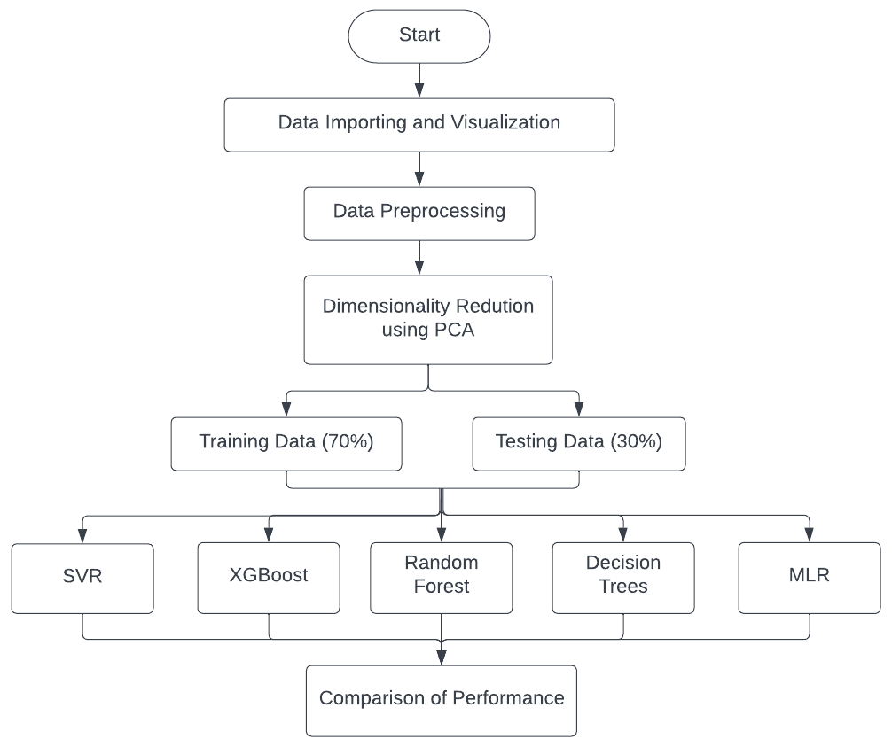

Slide 9
ALGORITHMS IMPLEMENTED

Slide 10
LINEAR REGRESSION (LR)
Regression is a statistical tool which is most commonly used in understanding and defining the relation between two variables (predictor variable and response variable).
Multiple linear regression is a way to identify the relationship among multiple variables at the same time.
its mathematical equation is given as,
y= b₀+b₁x1+b₂x2+......+b_{n}xn
where, y denotes the response variable, x1, x2, ....xn denotes the predictor variables and b0, b1, b2, …..bn are the respective coefficients.
Performance Evaluation:
RMSE: 104348.5
MAE: 18997
R-squared: 0.5875523

Slide 11
SUPPORT VECTOR REGRESSION (SVR)
Support vector machines prove to be a competent algorithm that can significantly explain the non-linearity of the data. Some of the crucial hyperparameters involved in SVR are hyperplane and kernel.
SVR kernel: Radial
its mathematical equation is given as,
K(x, x') = e^{- ɣ ||x - x'||^2}
where, ɣ denotes a scalar that signifies the influence of the training data points and ||x-x'||2 represents the square of euclidean distance between two column vectors.
Performance Evaluation:
RMSE: 29929.55
MAE: 19405.87
R-squared: 0.9350692

Slide 12
EXTREME GRADIENT BOOSTING (XGBoost)
XGBoost follows Boosting techniques in Ensemble Learning where the main aim is to correct the errors made by previously applied models in multiple iterations in which specific weights are added to the models.
Hyperparameters:
learning rate: 0.25
n-rounds: 1000
depth of tree: 6
early stopping: 3
At, 959 iteration the model gives the least RMSE value, and the early stopping occurs.
Performance Evaluation:
RMSE: 34827.99
MAE: 26151.12
R-squared: 0.9138152

Slide 13
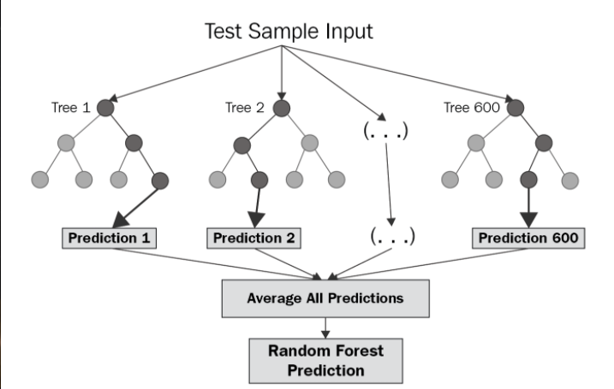
RANDOM FOREST REGRESSION (RF)
Random Forest Regression is a supervised learning algorithm that uses ensemble learning method for regression.
Ensemble learning method is a technique that combines predictions from multiple machine learning algorithms to make a more accurate prediction than a single model.
Performance Evaluation:
RMSE: 42319.56
MAE: 32130.12
R-squared: 0.8275663

Slide 14
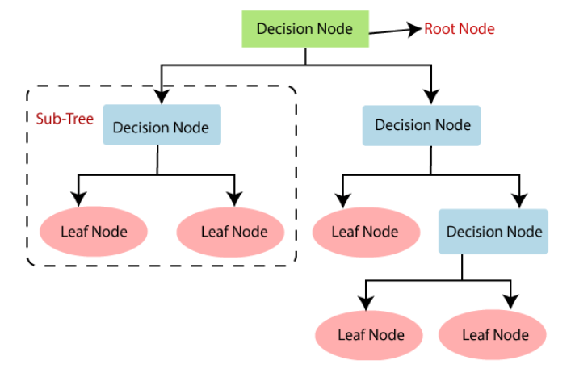
DECISION TREES (DT)
In the decision tree approach, a regression model is constructed in the shape of a tree structure. It gradually cuts a dataset into smaller sections and develops an associated decision tree. A tree containing decision nodes and leaf nodes is the end result
Performance Evaluation:
RMSE: 77397.29
MAE: 60571.13
R-squared: 0.5008397

Slide 15
RESULTS & DISCUSSIONS

Slide 16
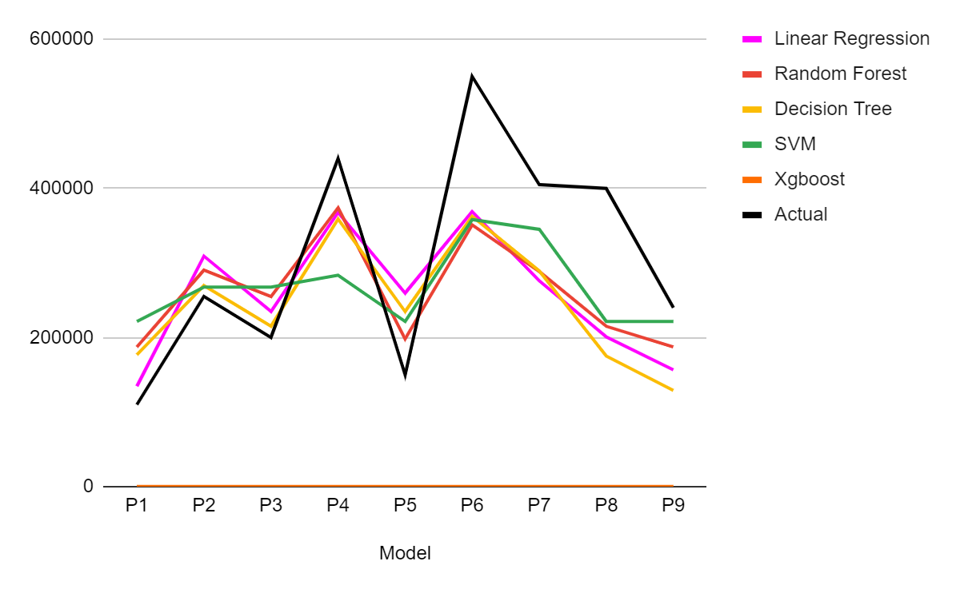
The results obtained after application of various machine learning algorithms on the columns before and after preprocessing are depicted in the form of a line chart where the black line represents the actual values.
Before PCA:
Line chart depicting actual and predicted values of all the models before PCA

Slide 17
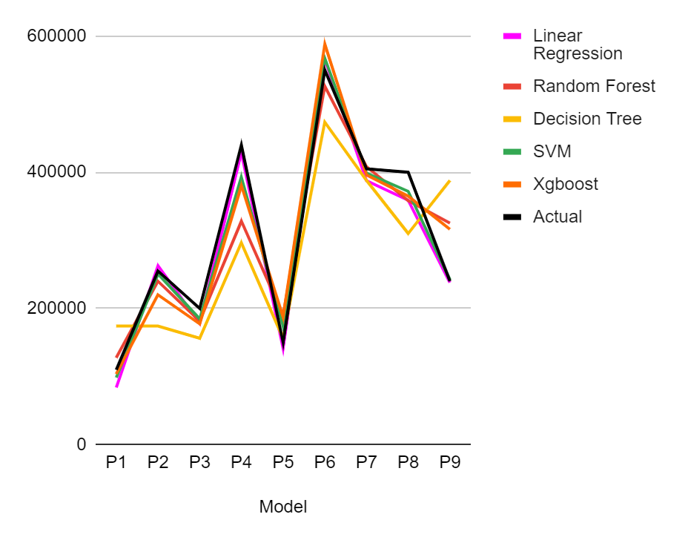
From the previous line chart it can be seen that none of the algorithms performed up to the mark and hence the PCA was applied in order to improve the results. The line chart is as follows:
After PCA:
Line chart depicting actual and predicted values of all the models after PCA
Line chart depicting actual and predicted values of all the models before PCA

Slide 18
The green line represents the SVM predictions. The green line is the closest to the black line. This indicates that SVM predictions are closer to the actual predictions when compared to other models’ predictions. Hence the accuracy of prediction was increased after applying PCA. The results of machine learning algorithms on these modified columns are:
Performance Comparison after PCA
Algorithm | MAE | RMSE | R-Square
Linear Regression | 18997 | 104348.5 | 0.5875523
SVM | 19405.87 | 29929.55 | 0.9350692
Xgboost | 26151.12 | 34827.99 | 0.9138152
Random Forest | 32130.12 | 42319.56 | 0.8275663
Decision Tree | 60571.13 | 77397.29 | 0.5008397

Slide 19
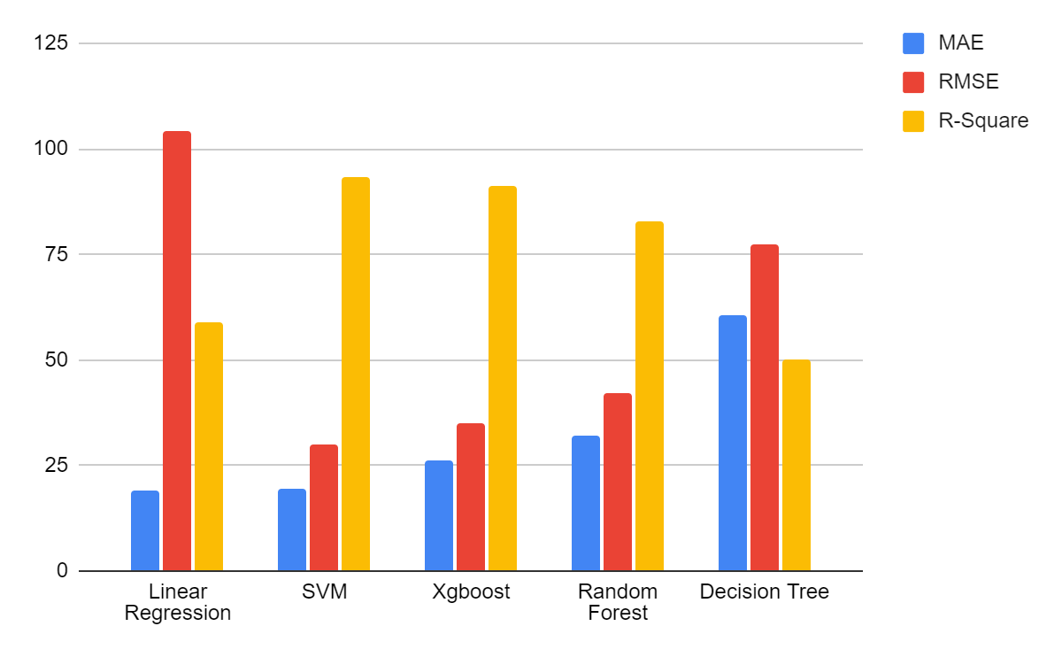
After comparing the results the best R-squared value of 0.9350692 was obtained by applying the Support Vector Machine(SVM) Regression. The following is the graph of the comparison:
In the above chart the values of respective columns have been scaled between a range from 0 to 125 for a proper view of the graph representing comparison.

Slide 20
CONCLUSION

Slide 21
Before applying PCA, the obtained results were not satisfactory, even though several preprocessing steps were performed.
This indicates the presence of multi-collinearity among the features.
Hence PCA was applied for the dimension reduction and to remove all the features that are correlated.
AFter PCA, when the same algorithms were applied on the principal components so obtained, the results improved considerably.
As per the findings the best performance was obtained for Support Vector Machine(SVM) Regression with the R-squared value of 0.9350692 followed by Xgboost, Random Forest, Linear Regression and Decision Tree in sequence.

Slide 22
REFERENCES

Slide 23
Chen, Jingyi, Shuming Mao, and Qixuan Yuan. "Salary prediction using random forest with fundamental features." In Third International Conference on Electronics and Communication; Network and Computer Technology (ECNCT 2021), vol. 12167, pp. 491-498. SPIE, 2022.
Dutta, Sananda, Airiddha Halder, and Kousik Dasgupta. "Design of a novel Prediction Engine for predicting suitable salary for a job." In 2018 Fourth International Conference on Research in Computational Intelligence and Communication Networks (ICRCICN), pp. 275-279. IEEE, 2018.
Kavitha S, Varuna S and Ramya R, "A comparative analysis on linear regression and support vector regression," 2016 Online International Conference on Green Engineering and Technologies (IC-GET), 2016, pp. 1-5, doi: 10.1109/GET.2016.7916627.
Navyashree, M., M. K. Navyashree, M. Neetu, G. R. Pooja, and Biradar Arun. "Salary prediction in IT job market." Int. Journal of Comp. Sci. and Engineering 7, no. 15 (2019).
Das, Sayan, Rupashri Barik, and Ayush Mukherjee. "Salary prediction using regression techniques." Proceedings of Industry Interactive Innovations in Science, Engineering & Technology (I3SET2K19) (2020).

Slide 24
S. Ghosh, A. Dasgupta and A. Swetapadma, "A Study on Support Vector Machine based Linear and Non-Linear Pattern Classification," 2019 International Conference on Intelligent Sustainable Systems (ICISS), 2019, pp. 24-28, doi: 10.1109/ISS1.2019.8908018.
Srivastava, Suyash, Deepanshu Sharma, and Priyanka Sharma. Comparing various Machine Learning Techniques for Predicting the Salary Status. No. 2625. EasyChair, 2020.
Kakade, Saili, Pooja Shirude, Snehal Patil, and Balwant J. Gorad. "Analyzing and Forecasting the Students Placement Package." Available at SSRN 3884634 (2021).
N. Vaswani, Y. Chi and T. Bouwmans, "Rethinking PCA for Modern Data Sets: Theory, Algorithms, and Applications [Scanning the Issue]," in Proceedings of the IEEE, vol. 106, no. 8, pp. 1274-1276, Aug. 2018, doi: 10.1109/JPROC.2018.2853498.
Saini, Bhavna, Ginika Mahajan, and Harish Sharma. "An Analytical Approach to Predict Employability Status of Students." In IOP Conference Series: Materials Science and Engineering, vol. 1099, no. 1, p. 012007. IOP Publishing, 2021.

Slide 25
Engineering Graduate Salary Prediction [Online] Available:https://www.kaggle.com/datasets/manishkc06/engineering-graduate-salary-prediction
More, Anuj, Amay Naik, and Sarita Rathod. "PREDICT-NATION Skills Based Salary Prediction for Freshers." Available at SSRN 3866758 (2021).
Manoj, Jyothi, and K. K. Suresh. "Forecast Model for Price of Gold: Multiple Linear Regression with Principal Component Analysis." Thailand Statistician 17, no. 1 (2019): 125-131.
Davino, C., R. Romano, and D. Vistocco. "Handling multicollinearity in quantile regression through the use of principal component regression." METRON (2022): 1-22.
Mor-Yosef, Liron, and Haim Avron. "Sketching for principal component regression." SIAM Journal on Matrix Analysis and Applications 40, no. 2 (2019): 454-485.
Pahwa, Ashish, and Deepali Kamthania. "Quantitative analysis of historical data for prediction of job salary in India-A case study." Journal of Statistics and Management Systems 22, no. 2 (2019): 187-198.

Slide 26
THANK
YOU

