Slide 1



Sponsored Walk, Friday, 10th July 2015

Slide 2
Sponsored Walk, Friday, 10th July 2015
16km
£25
E18 computer equipment

Slide 3
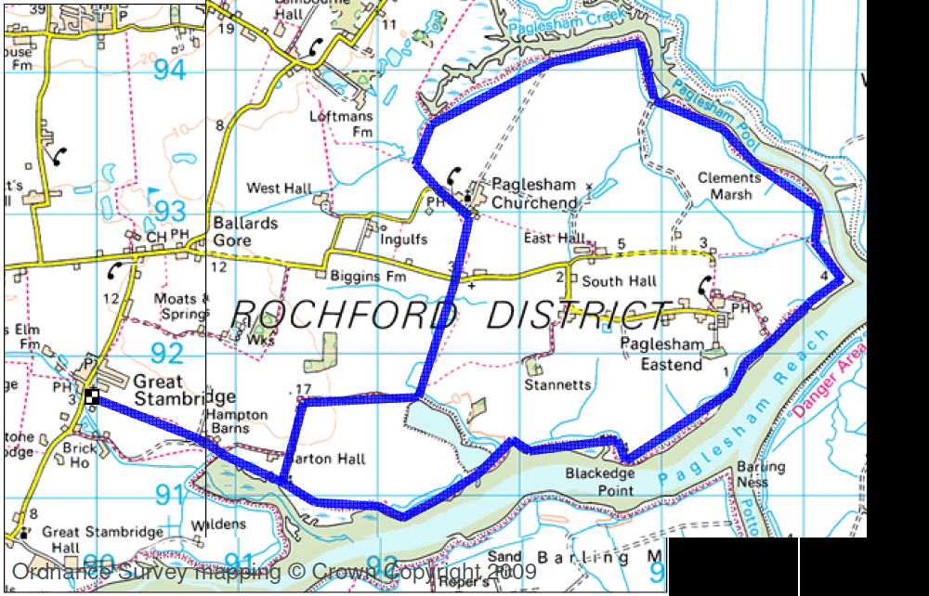
Sponsored Walk, Friday, 10th July 2015

Slide 4
Sponsored Walk, Friday, 10th July 2015
layers of clothing – e.g. T shirt, sweatshirt, pullover
trainers or walking boots
thicker woollen socks are recommended
no flip-flops, canvas plimsolls or other lightweight footwear
tracksuit bottoms or old trousers to protect the legs
no jeans or shorts
a light waterproof which can be easily carried (a cagoule or similar)
a plastic water bottle: water or squash is recommended
food – a light packed lunch and appropriate snacks
perhaps, a sun hat and sun cream would be advisable

