Slide 1
Python Tutorial - 1
Nov 14 2016

Slide 2
Have you finished your homework???
Fine, I know that there are complicated reasons for this…
Well, let’s review the basics of Python which “should” be covered in 廖雪峰.

Slide 3
Let’s take a look at the global structure first
Take this code snippet for instance.
def logged_print(content): print('LOG: Printing to console') print(content) a = 1 b = 2 logged_print(a + b)

Slide 4
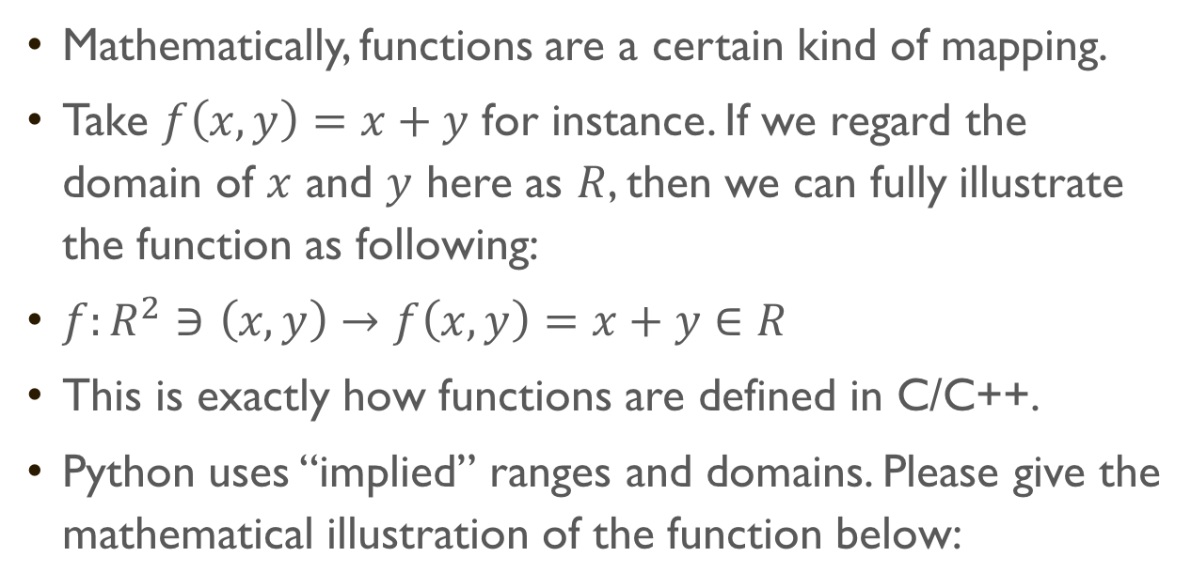
What’s a function???
Mathematically, functions are a certain kind of mapping.
Take $f\left(x, y\right)=x+y$ for instance. If we regard the domain of $x$ and $y$ here as $R$, then we can fully illustrate the function as following:
$f:R^{2}∋\left(x, y\right)→f\left(x,y\right)=x+y∈R$
This is exactly how functions are defined in C/C++.
Python uses “implied” ranges and domains. Please give the mathematical illustration of the function below:
def g(a, b, c): return a + b * c

Slide 5
Wait, some functions do not have “in/output”
Something’s omitted for simplicity.
ENV is something we’re affecting.

Slide 6
Wait, something’s wrong
Look into the code snippet…
print('I am printing something!’) print(1 + 2)
Here, something called implicit casting happened, which we’ll cover later.

Slide 7
Loops
When we try to repeat one thing with merely minor differences, we use a loop.
We’ll start from the “while” loop.
while some_statement: do_something()

Slide 8
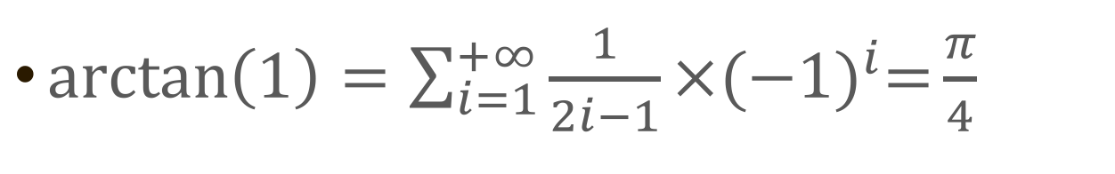
Homework Analysis
$\arctan\left(1\right)=\sum_{i=1}^{+∞}{\frac{1}{2i−1}×{(−1)}^{i}=}\frac{π}{4}$
i = 1 sum = 0 while i < 5000000: sgn = 1 if i % 2 == 1 else -1 sum += 1 / (2 * i - 1) * sgn i += 1 print(4 * sum)

Slide 9
Data types
Integer
Float (Real Number)
String
Boolean
None
List
Dictionary
Tuple & Set
Custom Object

Slide 10
Python’s feature
Python is a strongly-typed language.
Python is a dynamically-typed language.
Think back about the functions!

Slide 11
Variables
Let’s try to understand every line of code.
Think about the code snippet below.
a = 1 b = a a = 2 print(a) print(b)

Slide 12
Another example
a = {"Reading": 30, "Listening": 30, "Speaking": 30, "Writing": 30} b = a a['Speaking'] = 27 print(a) print(b)

Slide 13
Please do the homework
Again, 廖雪峰的 git 教程.
Visit https://git.turing.pro/TuringClub/pyTutorial for details (Registration needed)

