Slide 1

Employee Salary Prediction
Building a machine learning model to accurately predict salaries using workforce data.
Prepared By: Shubhamaya Majumdar
Course: B.Tech. CSE AI

Slide 2

Project Overview
Objective
To develop a machine learning model that predicts employee salaries with high accuracy by analyzing multiple workforce features including job title, years of experience, education level, age etc.
Description
This project builds a Machine Learning model to predict employee salaries using a Kaggle dataset that includes features such as job title, experience, education level, company size, industry, and location.
The data has been cleaned, preprocessed, and encoded, and multiple regression models are trained
to understand which factors influence salary.
To improve accuracy, the project implements ensemble learning techniques including:
Random Forest Regressor
Gradient Boosting Regressor
Voting Regressor (combines multiple models)
Each model is evaluated using metrics like MSE, RMSE, and R2 score, and the best-performing model is saved for future predictions.

Slide 3



Technical Approach
My approach leverages advanced ensemble learning techniques to ensure highly accurate and dynamic salary predictions across departments and domains .
Model Training
Training multiple models on the dataset to see which model performs best and gives the most accurate salary predictions and saving the model.
Gathering Dataset
Searching Kaggle for appropriate dataset.
Data Pre-processing
Cleaning the data
Creating a GUI
Creating a simple streamlit gui for taking user input and predicting salary.
Encoding Categorical Columns
Splitting into training and testing sets

Slide 4
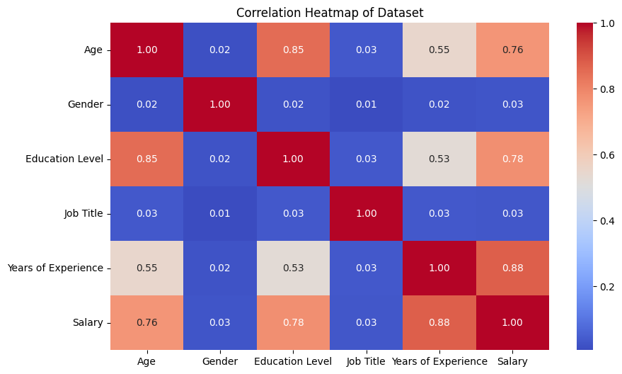



Dataset Characteristics
This Kaggle dataset comprises approximately 2500 records across the key 6 features, sourced from public compensation databases and survey data. The accompanying correlation heatmap shows the relationships between these features, helping in the identification of the most influential variables for the salary prediction.
Below are the key columns in our dataset:
Job Title
Diverse roles across departments.
Years Experience
Professional experience from entry-level to senior (0-15+ years).
Education
Educational backgrounds, from high school to PhD.
Age
Age demographics, spanning various working age groups.
Gender
Demographic information and gender distribution.
Salary
Target variable – salary amounts across different ranges.

Slide 5
The Models
My model architecture leverages multiple diverse predictive algorithms. The approach combines the strengths of individual models, improving overall accuracy, robustness, and generalization capabilities by reducing individual model biases and variances to deliver more reliable predictions.
Linear Regressor
Predicts target values based on a linear relationship between input features and output, serving as a simple baseline.
Random Forest
Uses multiple decision trees with bootstrapped samples and feature randomization to reduce overfitting and capture complex patterns.
Gradient Boosting
Iteratively trains weak models to address prior mistakes, gradually constructing a strong predictor through optimization.
Voting Classifier
Combines predictions from diverse models via weighted voting, leveraging their strengths for improved overall performance.

Slide 6
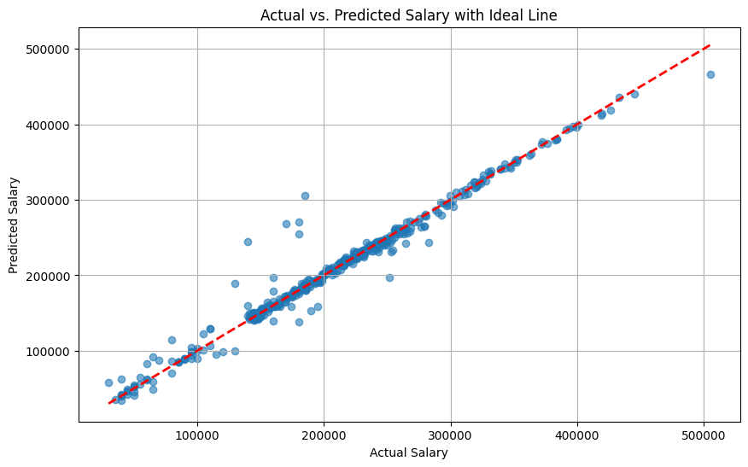
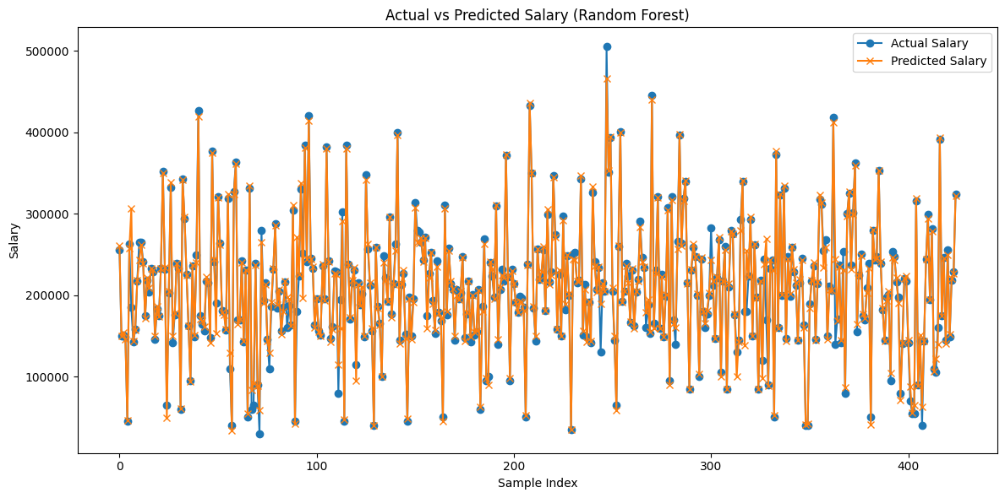
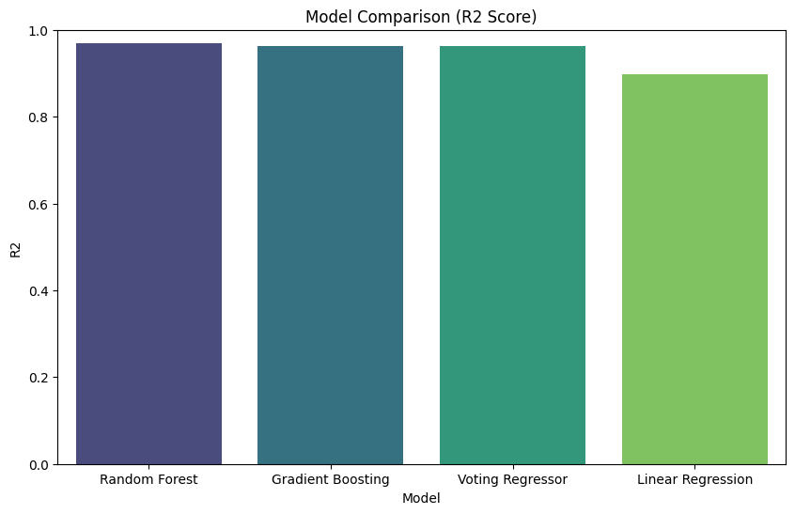
Model Performance Metrics
Key Insights
The Random Forest model demonstrates superior performance, consistently achieving the highest R2 score(0.9702) among all models. This indicates its strong ability to explain the variance in the target variable. The accompanying scatter plot and line chart visually represent the model's accuracy, showing a close alignment between actual and predicted salary values. There’s also a comparison of the r2 score of all the models used in this project.

Slide 7
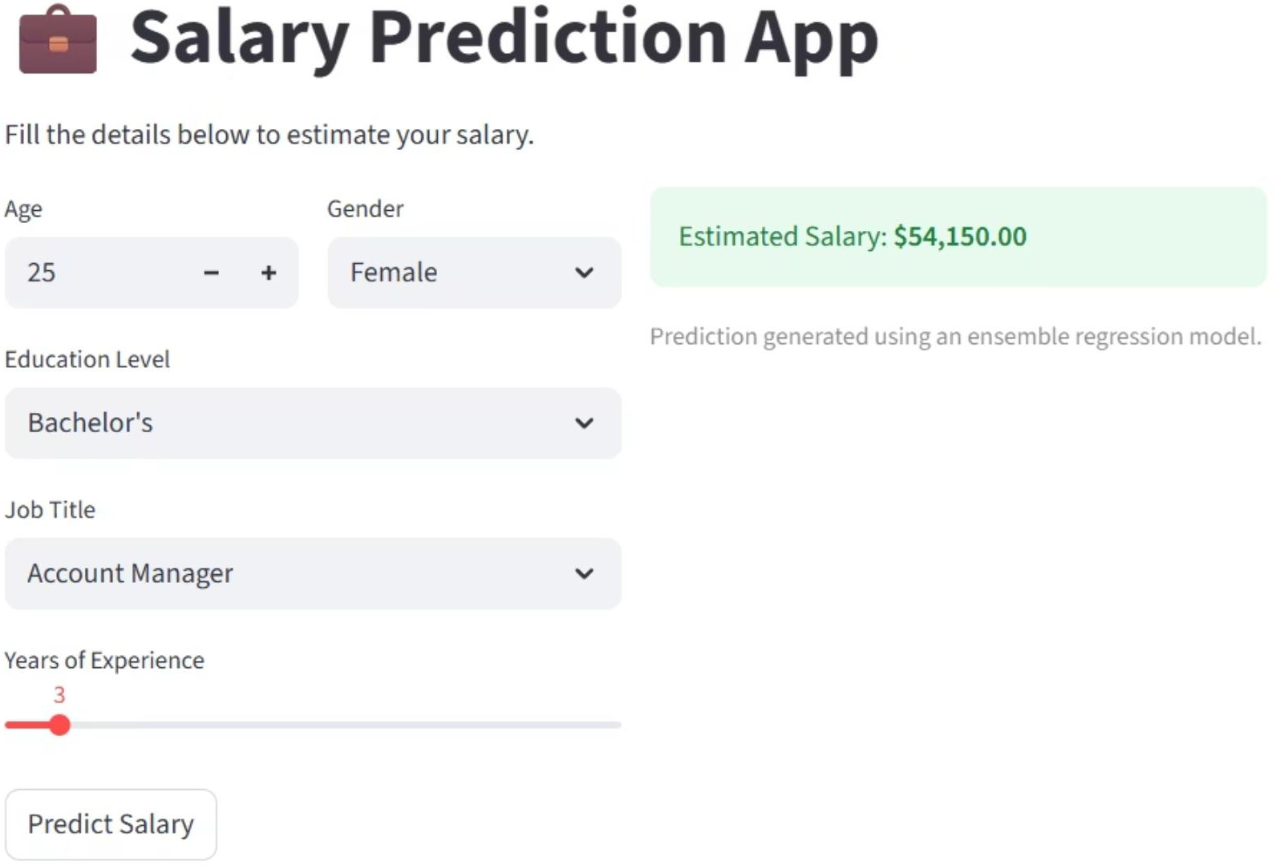
GUI Implementation
After finishing the model training, I saved the model and implemented a simple, user-friendly frontend GUI using Streamlit, enabling interactive salary predictions and data exploration.
Users can fill in their details and get a salary prediction from the model.

