Slide 1
WX UPDATE 20 SEPT 2026

Slide 2
WX UPDATE 20 SEPT 2026
Ser No | Loc | Wx App | Forecast Rain mm/% | Cloud cover % | Remarks
1 | NASHIK | Windy Accuwx | 0mm 60% | 75% 55% | LTD GO LTD GO
2 | MUMBAI | Windy Accuwx | 0.3mm 61% | 45% 31% | GO LTD GO
3 | PUNE | Windy Accuwx | 0.2mm 63% | 62% 29% | LTD GO LTD GO
4 | AHMEDNAGAR | Windy Accuwx | 0mm 55% | 51% 42% | LTD GO LTD GO
5 | AURANGABAD | Windy Accuwx | 0.0mm 55% | 54% 37% | LTD GO LTD GO
 | RAIN | CLOUD
GO | <1 MM | <50%
LTD GO | 1-5 MM | 50%-90%
NO GO | >5 MM | >90%

Slide 3
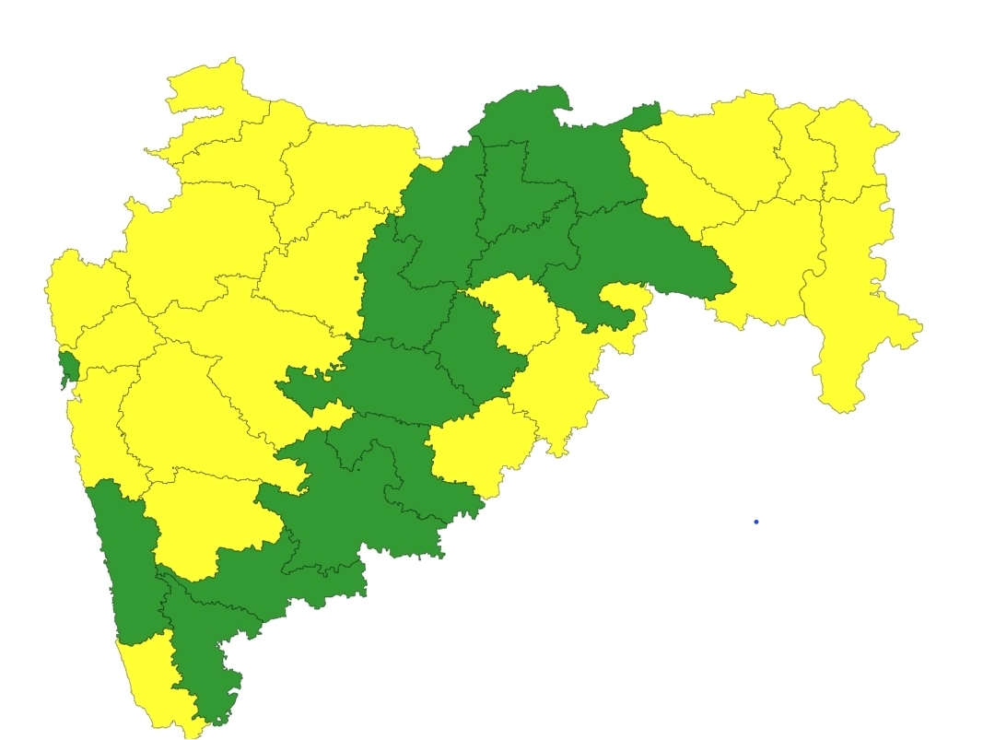
WX UPDATE 20 SEPT 2026
NASHIK
AURANGABAD
AHMEDNAGAR
MUMBAI
PUNE

