Slide 1
WX UPDATE 12 OCT 2026 - 16 OCT 2026

Slide 2
WX UPDATE 12 OCT 2026
Ser No | Loc | Wx App | Forecast Rain mm/% | Cloud cover % | Remarks
1 | NASHIK | Windy Accuwx | 0mm 0% | 50% 4% | LTD GO GO
2 | BIDAR | Windy Accuwx | 0mm 0% | 20% 0% | GO GO
3 | KADAPA | Windy Accuwx | 0.5mm 56% | 85% 52% | LTD GO LTD GO
4 | TIRUPATI | Windy Accuwx | 0.7mm 58% | 85% 42% | LTD GO LTD GO
5 | CHENNAI | Windy Accuwx | 1.4mm 40% | 85% 23% | LTD GO GO
 | RAIN | CLOUD
GO | <1 MM | <50%
LTD GO | 1-5 MM | 50%-90%
NO GO | >5 MM | >90%

Slide 3
WX UPDATE 13 OCT 2026
Ser No | Loc | Wx App | Forecast Rain mm/% | Cloud cover % | Remarks
1 | NASHIK | Windy Accuwx | 0mm 0% | 5% 0% | GO GO
2 | BIDAR | Windy Accuwx | 0mm 0% | 20% 0% | GO GO
3 | KADAPA | Windy Accuwx | 0mm 60% | 50% 20% | LTD GO GO
4 | TIRUPATI | Windy Accuwx | 3.5mm 25% | 85% 31% | LTD GO GO
5 | CHENNAI | Windy Accuwx | 0mm 55% | 20% 48% | GO GO
 | RAIN | CLOUD
GO | <1 MM | <50%
LTD GO | 1-5 MM | 50%-90%
NO GO | >5 MM | >90%

Slide 4
WX UPDATE 14 OCT 2026
Ser No | Loc | Wx App | Forecast Rain mm/% | Cloud cover % | Remarks
1 | NASHIK | Windy Accuwx | 0mm 0% | 5% 0% | GO GO
2 | BIDAR | Windy Accuwx | 0mm 0% | 20% 0% | GO GO
3 | KADAPA | Windy Accuwx | 0mm 55% | 50% 47% | LTD GO GO
4 | TIRUPATI | Windy Accuwx | 0.2mm 3% | 85% 91% | LTD GO NO GO
5 | CHENNAI | Windy Accuwx | 0mm 58% | 20% 76% | GO LTD GO
 | RAIN | CLOUD
GO | <1 MM | <50%
LTD GO | 1-5 MM | 50%-90%
NO GO | >5 MM | >90%

Slide 5
WX UPDATE 15 OCT 2026
Ser No | Loc | Wx App | Forecast Rain mm/% | Cloud cover % | Remarks
1 | NASHIK | Windy Accuwx | 0mm 0% | 5% 3% | GO GO
2 | BIDAR | Windy Accuwx | 0mm 1% | 20% 3% | GO GO
3 | KADAPA | Windy Accuwx | 0mm 25% | 50% 71% | LTD GO LTD GO
4 | TIRUPATI | Windy Accuwx | 0mm 4% | 20% 56% | GO LTD GO
5 | CHENNAI | Windy Accuwx | 0mm 5% | 20% 63% | GO LTD GO
 | RAIN | CLOUD
GO | <1 MM | <50%
LTD GO | 1-5 MM | 50%-90%
NO GO | >5 MM | >90%

Slide 6
WX UPDATE 16 OCT 2026
Ser No | Loc | Wx App | Forecast Rain mm/% | Cloud cover % | Remarks
1 | NASHIK | Windy Accuwx | 0mm 1% | 5% 3% | GO GO
2 | BIDAR | Windy Accuwx | 0mm 0% | 20% 30% | GO GO
3 | KADAPA | Windy Accuwx | 0mm 55% | 50% 30% | LTD GO LTD GO
4 | TIRUPATI | Windy Accuwx | 0mm 60% | 20% 51% | GO LTD GO
5 | CHENNAI | Windy Accuwx | 0mm 55% | 20% 19% | GO LTD GO
 | RAIN | CLOUD
GO | <1 MM | <50%
LTD GO | 1-5 MM | 50%-90%
NO GO | >5 MM | >90%

Slide 7
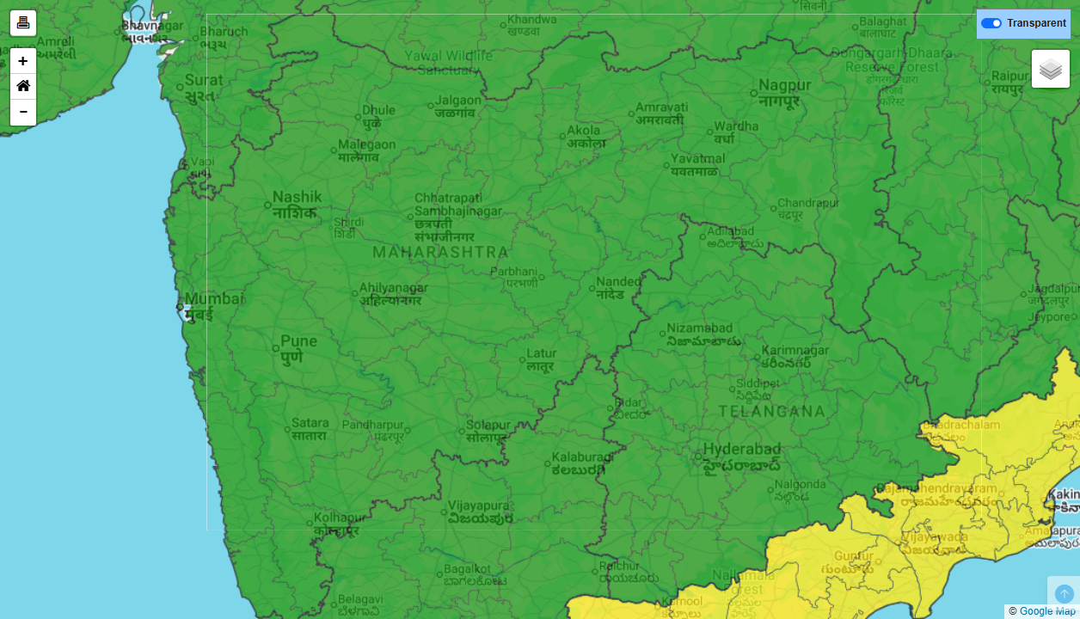
IMD DISTRICT-WISE WARNING — MAHARASHTRA (12 OCT 2026)

Slide 8
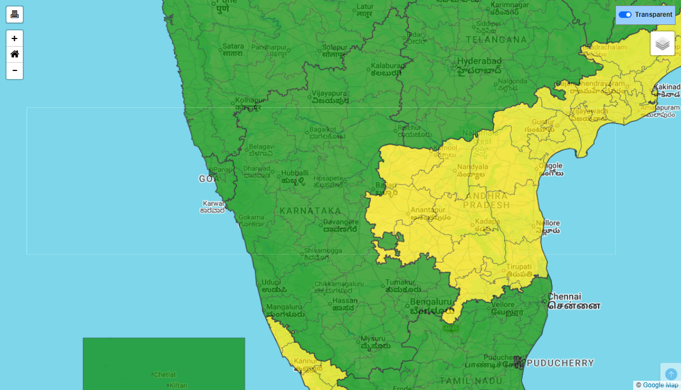
IMD DISTRICT-WISE WARNING — KARNATAKA (12 OCT 2026)

Slide 9
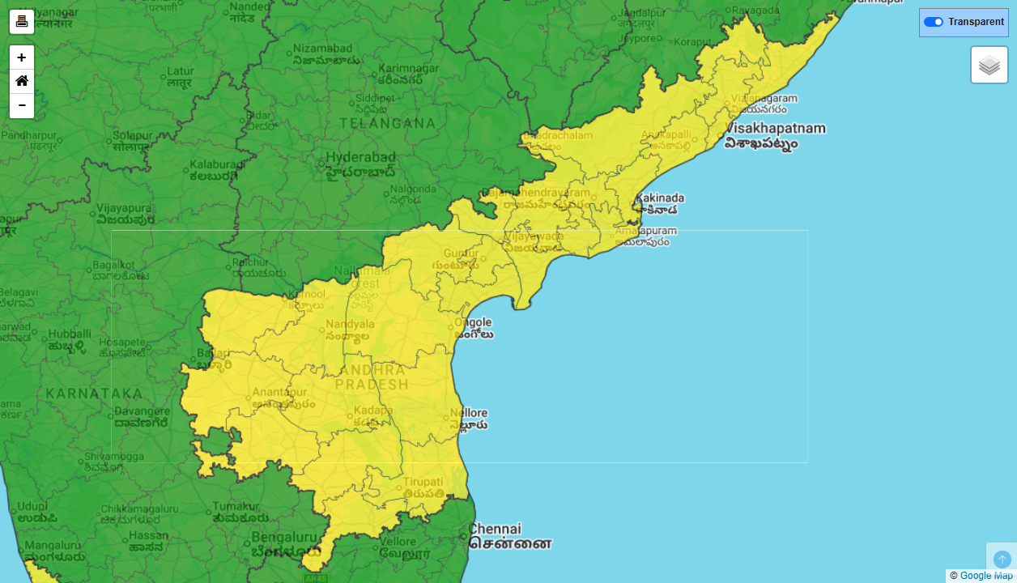
IMD DISTRICT-WISE WARNING — ANDHRA PRADESH (12 OCT 2026)

Slide 10
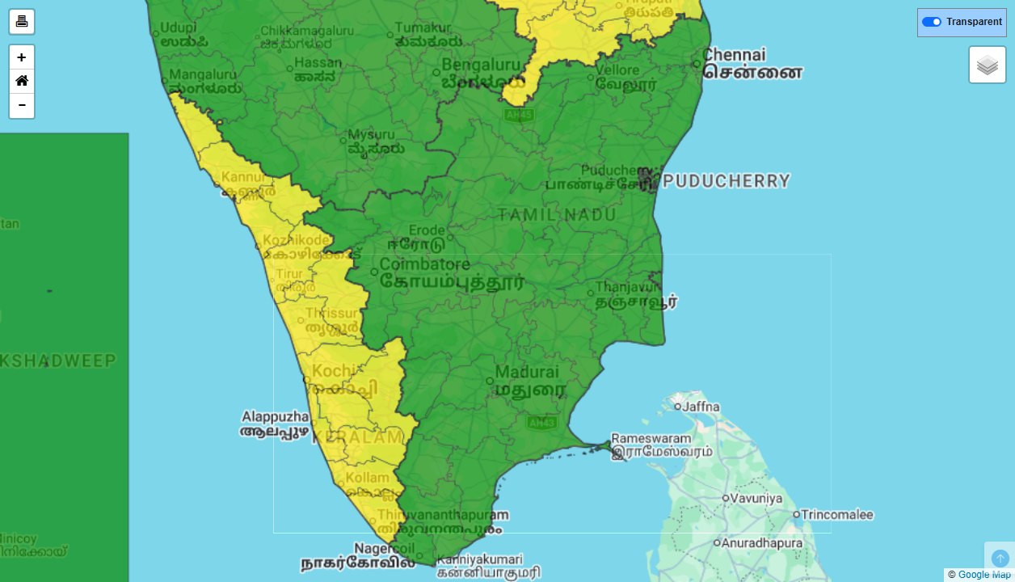
IMD DISTRICT-WISE WARNING — TAMIL NADU (12 OCT 2026)

Slide 11
IMD DISTRICT-WISE WARNING — MAHARASHTRA (13 OCT 2026)

Slide 12
IMD DISTRICT-WISE WARNING — KARNATAKA (13 OCT 2026)

Slide 13
IMD DISTRICT-WISE WARNING — ANDHRA PRADESH (13 OCT 2026)

Slide 14
IMD DISTRICT-WISE WARNING — TAMIL NADU (13 OCT 2026)

Slide 15
IMD DISTRICT-WISE WARNING — MAHARASHTRA (14 OCT 2026)

Slide 16
IMD DISTRICT-WISE WARNING — KARNATAKA (14 OCT 2026)

Slide 17
IMD DISTRICT-WISE WARNING — ANDHRA PRADESH (14 OCT 2026)

Slide 18
IMD DISTRICT-WISE WARNING — TAMIL NADU (14 OCT 2026)

Slide 19
IMD DISTRICT-WISE WARNING — MAHARASHTRA (15 OCT 2026)

Slide 20
IMD DISTRICT-WISE WARNING — KARNATAKA (15 OCT 2026)

Slide 21
IMD DISTRICT-WISE WARNING — ANDHRA PRADESH (15 OCT 2026)

Slide 22
IMD DISTRICT-WISE WARNING — TAMIL NADU (15 OCT 2026)

Slide 23
IMD DISTRICT-WISE WARNING — MAHARASHTRA (16 OCT 2026)
DATA NOT AVAILABLE ON IMD WEBSITE
(Exceeds 6-day forecast horizon)
IMD provides daily district-wise GIS warnings up to 6 days ahead.

Slide 24
IMD DISTRICT-WISE WARNING — KARNATAKA (16 OCT 2026)
DATA NOT AVAILABLE ON IMD WEBSITE
(Exceeds 6-day forecast horizon)
IMD provides daily district-wise GIS warnings up to 6 days ahead.

Slide 25
IMD DISTRICT-WISE WARNING — ANDHRA PRADESH (16 OCT 2026)
DATA NOT AVAILABLE ON IMD WEBSITE
(Exceeds 6-day forecast horizon)
IMD provides daily district-wise GIS warnings up to 6 days ahead.

Slide 26
IMD DISTRICT-WISE WARNING — TAMIL NADU (16 OCT 2026)
DATA NOT AVAILABLE ON IMD WEBSITE
(Exceeds 6-day forecast horizon)
IMD provides daily district-wise GIS warnings up to 6 days ahead.

