Slide 1

Note: The data and information in this document is reflective of a hypothetical situation and client. This document is to be used for KPMG Virtual Internship purposes only.
Sprocket Central Pty Ltd
Data analytics approach
[Division Name] - [Engagement Manager], [Senior Consultant], [Junior Consultant]

Slide 2
Note: The data and information in this document is reflective of a hypothetical situation and client. This document is to be used for KPMG Virtual Internship purposes only.
Agenda
Introduction
Data Exploration
Model Development
Interpretation

Slide 3
Note: The data and information in this document is reflective of a hypothetical situation and client. This document is to be used for KPMG Virtual Internship purposes only.
Introduction
New customers Vs Old Customers:
Factors on which the comparison will be done:
Age distributions
Past 3 years bike related purchases
Job industry category.
Wealth Segment Analysis
State-wise Analysis(Number of cars own on each states.)

Slide 4
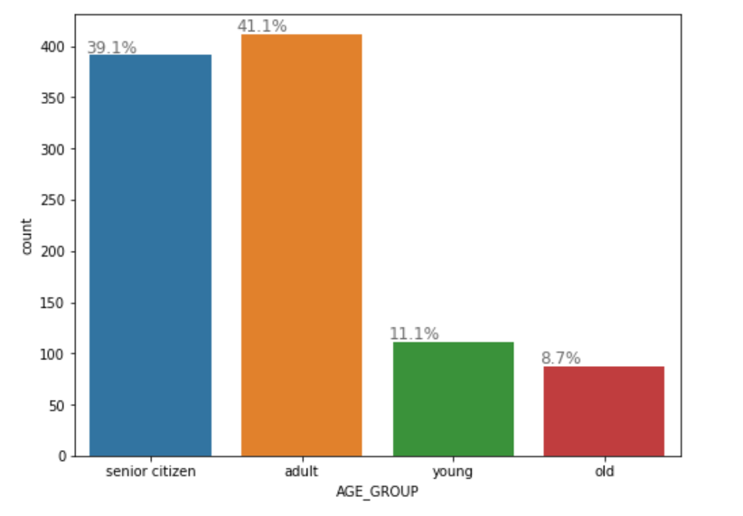
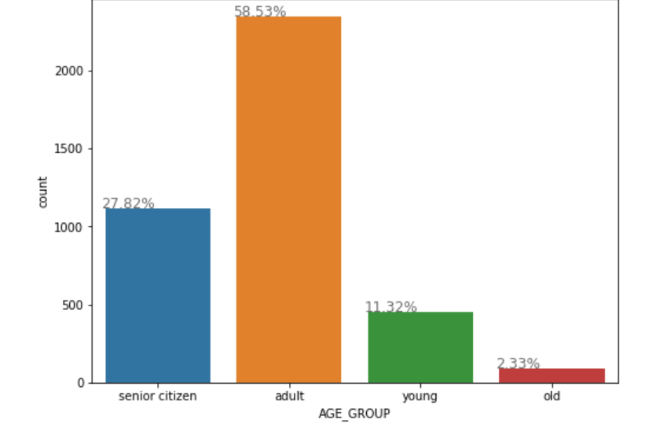
Note: The data and information in this document is reflective of a hypothetical situation and client. This document is to be used for KPMG Virtual Internship purposes only.
Data Exploration
Customers’ age distribution:
Young : Age<=25
Adult : 25<Age<=50
Senior Citizen : 50<Age<=75
Old : Age>75
New
From the given graphs, it can be easily deduced that most of the customers lie in the age group of 25 and 50.
There is a good amount (approx. 11%) of increase in number of customers who are senior-citizen and slight increase in the old ones according to new list.
Customers belonging to young age group have no significant interest in it.
So, according to this, our most important customers are those who belong to adult and senior-citizen age groups.
Old

Slide 5
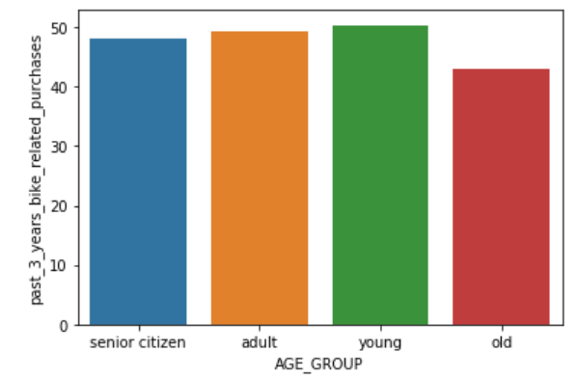
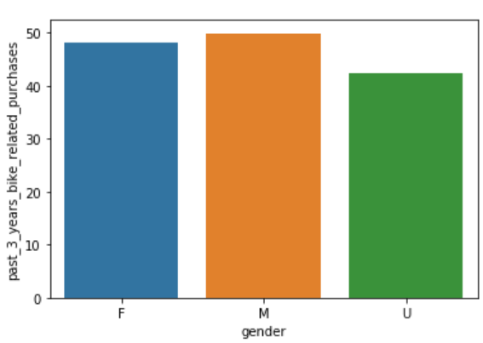
Note: The data and information in this document is reflective of a hypothetical situation and client. This document is to be used for KPMG Virtual Internship purposes only.
Data Exploration
Past 3 years bike related purchases:
As we can see, the young and adult groups are interested more in bikes other than the rest.
If we talk about gender, then male have higher average tendency to buy bikes than female.

Slide 6
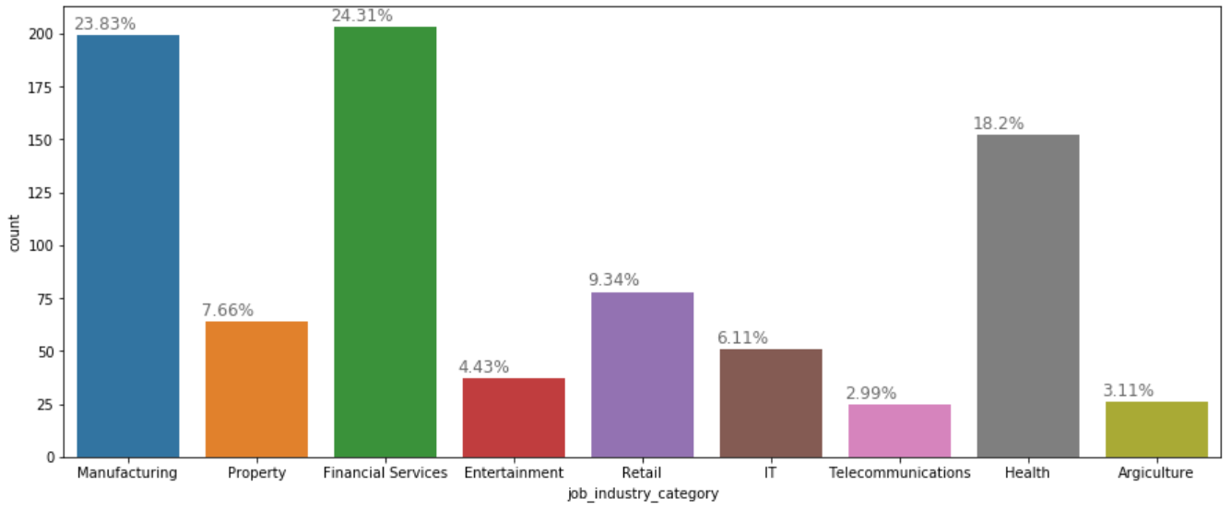
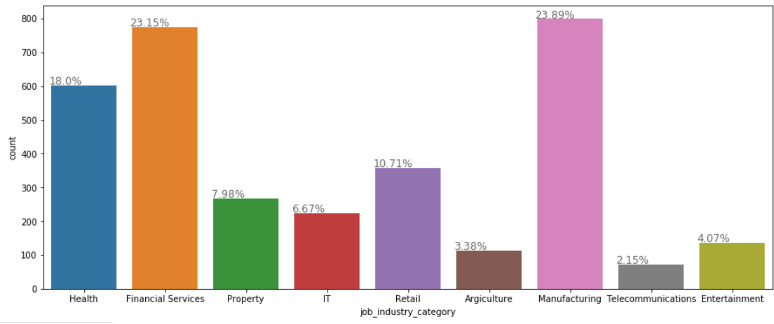
Note: The data and information in this document is reflective of a hypothetical situation and client. This document is to be used for KPMG Virtual Internship purposes only.
Data Exploration
Job industry category:
New
The customer mostly belongs to the Finance Manufacturing, and Health sectors.
There is a slight drop in the percentage of customers who belong to Retail sector; rest sectors are still same .
Old

Slide 7
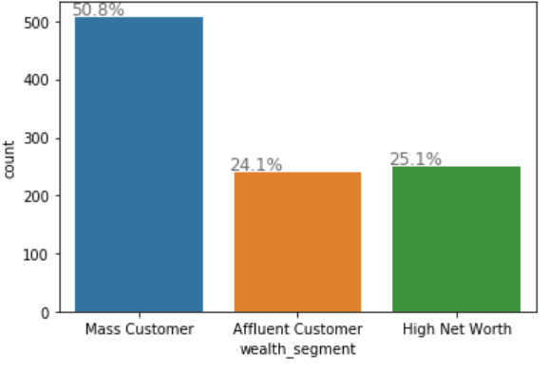
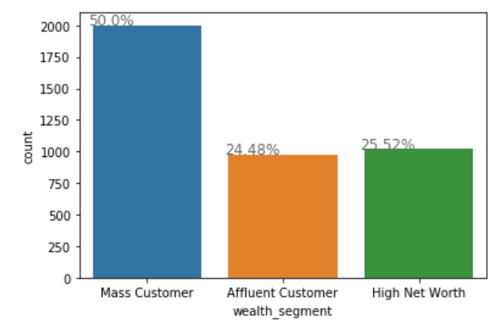
Note: The data and information in this document is reflective of a hypothetical situation and client. This document is to be used for KPMG Virtual Internship purposes only.
Data Exploration
Wealth Segment Analysis:
New
Among all the segments, the number of Mass Customers is the highest so according to the both the statistics available, the mass customer segment should be focused more.
Rest of the two have less contribution and almost same sales.
Old

Slide 8
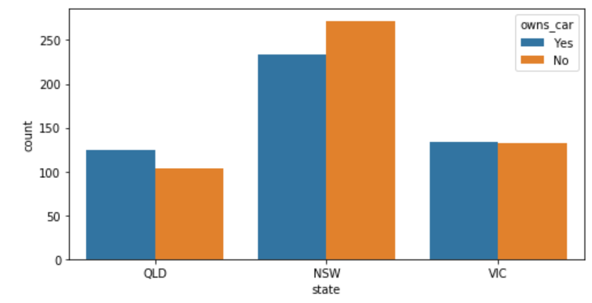
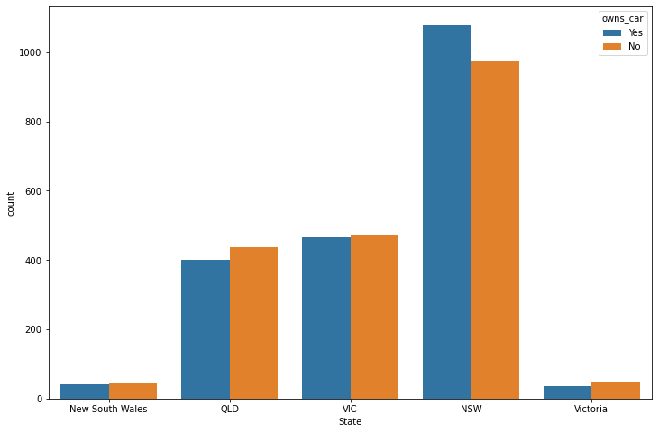
Note: The data and information in this document is reflective of a hypothetical situation and client. This document is to be used for KPMG Virtual Internship purposes only.
Data Exploration
NEW
State-wise Analysis(Number of cars own in each states.)
NSW and VIC are two most important states.
In old data, No. of customers in NSW who owns car are more likely to buy bike related items or bikes but the scenario changes in the new customer data.
In Victoria state, both type of customers that is car owner or not are almost same in number
OLD

Slide 9
Note: The data and information in this document is reflective of a hypothetical situation and client. This document is to be used for KPMG Virtual Internship purposes only.
Model Development:
The model for selecting top 1000 customers has been prepared on the basis of some important features extracted after data exploration.
Customers are selected on the basis of their state, age group, past 3 year purchases, wealth segment and job industry category.
First of all the whole data set is divided into 2 categories of customers, one who belongs to NSW and other who belongs to VIC as these were the most prominent states.
After this we divided customers of each of the state according to their age groups and only filtering the one who belongs to adult and senior citizen’s category.
Then we classified our obtained subcategories according to job industry category and taking only manufacturing, financial services and health sector into considerations.
At last we filter the remaining customers according to wealth segments and picking only those who belongs to mass customer category.
After filter our dataset through this prominent features we are left with 930 top customers.

Slide 10
Note: The data and information in this document is reflective of a hypothetical situation and client. This document is to be used for KPMG Virtual Internship purposes only.
Interpretation
Nowadays, Those who do not owns car are more likely to purchase bikes and bike related purchases.
The most attention should be given to NSW state as it has maximum sales as compared to others.
In other states also some business strategies should be applied in order to boost sales.
The needs of financial services and manufacturing related customers should be taken into consideration

