Slide 1
LEARN PHP A Scripting language
By
AMITAVA HALDER
Assistant Professor, CSE DEPT.
Supreme Knowledge Foundation Group of Institutions

Slide 2
What is PHP
PHP stands for Hypertext Preprocessor.
PHP is an interpreted language, i.e., there is no need for compilation.
PHP is a server-side scripting language.
PHP is faster than other scripting languages, for example, ASP and JSP.

Slide 3
Benefits of PHP
PHP is an open source software.
PHP costs nothing, it is free to download and use.
PHP is a server-side scripting language and is used for websites and the web applications.
PHP scripts are executed on the server.
PHP supports a wide range of databases.
PHP runs on various platforms like Linux, Windows, Unix etc.
PHP supports most web servers (for example Apache, IIS).

Slide 4
File: hello.php
<!DOCTYPE>
<html>
<body>
<?php
echo "<h2>Hello by PHP</h2>";
?>
</body>
</html>
Output:
Hello by PHP

Slide 5
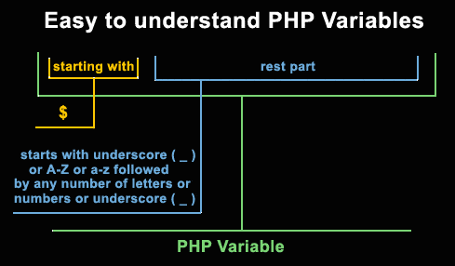
PHP variables

Slide 6
Example : Valid and invalid PHP variables
<? php
$abc = 'Welcome'; //valid
$Abc = ‘Hi'; //valid
$9xyz = 'Hello world'; //invalid; starts with a number
$_xyz = 'Hello world'; //valid; starts with an underscore
$_9xyz = 'Hello world'; //valid
$aäa = 'Hello world'; //valid; 'ä' is (Extended) ASCII 228.
?>

Slide 7
PHP Variable: Declaring string, integer and float
<?php
$str="hello string";
$x=200;
$y=44.6;
echo "string is: $str <br/>";
echo "integer is: $x <br/>";
echo "float is: $y <br/>";
?>
Output:
string is: hello string
integer is: 200
float is: 44.6

Slide 8
<?php
$x = 56;
$y = "xyz";
if (is_int($x))
{
echo "$x is Integer \n" ;
}
else
{
echo "$x is not an Integer \n" ;
}
if (is_int($y))
{
echo "$y is Integer \n" ;
}
else
{
echo "$y is not Integer \n" ;
}
?>

Slide 9
Selection Structure
PHP if else statement is used to test condition. There are various ways to use if statement in PHP.
if
if-else
if-else-if
nested if

Slide 10
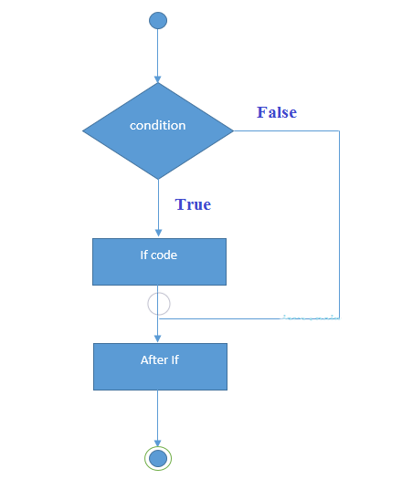
PHP If Statement
Syntax:
if(condition){
//code to be executed
}

Slide 11
<?php
$num=12;
if($num<100){
echo "$num is less than 100";
}
?>
Output:
12 is less than 100

Slide 12
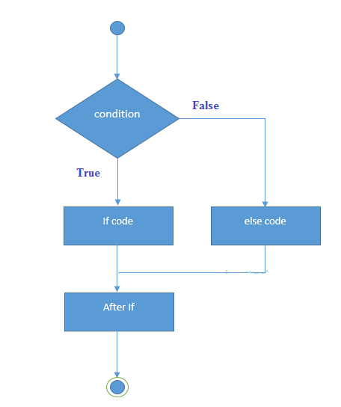
PHP If-else Statement
Syntax:
if(condition){
//code to be executed if true
}
else{
//code to be executed if false
}

Slide 13
<?php
$num=12;
if($num%2==0){
echo "$num is even number";
}
else{
echo "$num is odd number";
}
?>
Output:
12 is even number

Slide 14
PHP Switch
Syntax
switch(expression){
case value1:
//code to be executed
break;
case value2:
//code to be executed
break;
......
default:
code to be executed if all cases are not matched;
}

Slide 15
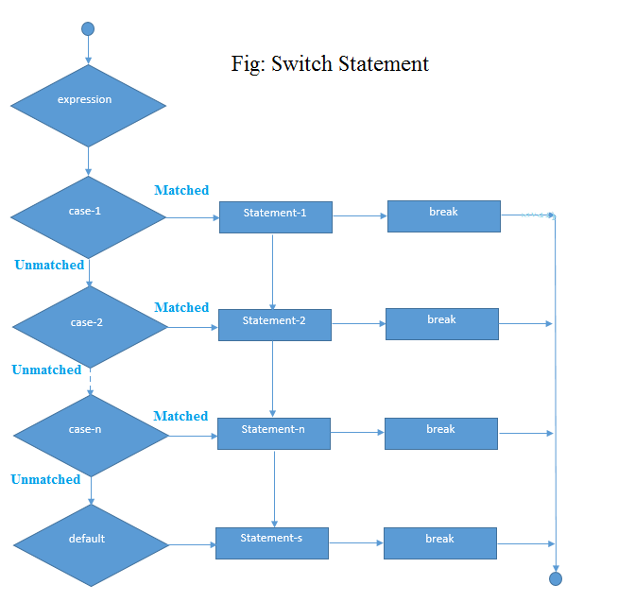

Slide 16
<?php
$num=20;
switch($num){
case 10:
echo("number is equals to 10");
break;
case 20:
echo("number is equal to 20");
break;
case 30:
echo("number is equal to 30");
break;
default:
echo("number is not equal to 10, 20 or 30");
}
?>
Output:
number is equal to 20

Slide 17
PHP For Loop
Syntax:
for(initialization; condition; increment/decrement){
//code to be executed
}

Slide 18
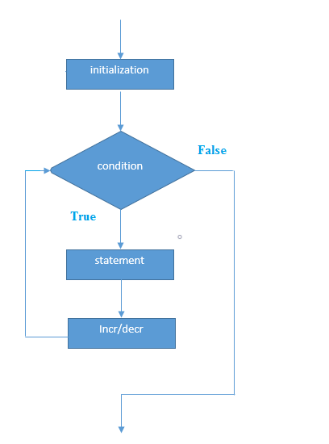

Slide 19
<?php
for($n=1;$n<=10;$n++){
echo "$n<br/>";
}
?>
Output:
1 2 3 4 5 6 7 8 9 10

Slide 20
PHP Nested For Loop
<?php
for($i=1;$i<=3;$i++){
for($j=1;$j<=3;$j++){
echo "$i $j<br/>";
}
}
?>

Slide 21
Output:
1 1
1 2
1 3
2 1
2 2
2 3
3 1
3 2
3 3

Slide 22
PHP For Each Loop
Syntax
foreach( $array as $var ){
//code to be executed
}

Slide 23
<?php
$season=array("summer","winter","spring","autumn");
foreach( $season as $arr ){
echo "Season is: $arr<br />";
}
?>
Output:
Season is: summer
Season is: winter
Season is: spring
Season is: autumn

Slide 24
PHP While Loop
Syntax:
while(condition){
//code to be executed
}
<?php
$n=1;
while($n<=10){
echo "$n<br/>";
$n++;
}
?>

Slide 25
PHP do while loop
<?php
$n=1;
do{
echo "$n<br/>";
$n++;
}while($n<=10);
?>
Syntax:
do{
//code to be executed
}while(condition);

Slide 26
PHP Functions
PHP function is a piece of code that can be reused many times. It can take input as argument list and return value. There are thousands of built-in functions in PHP.
In PHP, we can define Conditional function, Function within Function and Recursive function also.

Slide 27
Advantage of PHP Functions
Code Reusability: PHP functions are defined only once and can be invoked many times, like in other programming languages.
Less Code: It saves a lot of code because you don't need to write the logic many times. By the use of function, you can write the logic only once and reuse it.
Easy to understand: PHP functions separate the programming logic. So it is easier to understand the flow of the application because every logic is divided in the form of functions.

Slide 28
PHP User-defined Functions
Syntax:
function functionname(){
//code to be executed
}

Slide 29
<?php
function sayHello(){
echo "Hello PHP Function";
}
sayHello();//calling function
?>
Output:
Hello PHP Function

Slide 30
PHP Function Arguments
<?php
function sayHello($name){
echo "Hello $name<br/>";
}
sayHello(“Manab Sir");
sayHello(“Amitava Sir");
sayHello(“Aritra Sir");
?>
Output:
Hello Manab Sir
Hello Amitava Sir
Hello Aritra Sir

Slide 31
<?php
function sayHello($name,$age){
echo "Hello $name, you are $age years old<br/>";
}
sayHello("Sonoo",27);
sayHello("Vimal",29);
sayHello("John",23);
?>
Output:
Hello Sonoo, you are 27 years old
Hello Vimal, you are 29 years old
Hello John, you are 23 years old

Slide 32
PHP Call By Reference
<?php
function adder(&$str2)
{
$str2 .= 'Call By Reference';
}
$str = 'Hello ';
adder($str);
echo $str;
?>
Output:
Hello Call By Reference

Slide 33
PHP Function: Default Argument Value
<?php
function sayHello($name="Sonoo"){
echo "Hello $name<br/>";
}
sayHello("Rajesh");
sayHello(); //passing no value
sayHello("John");
?>
Output:
Hello Rajesh
Hello Sonoo
Hello John

Slide 34
PHP Function: Returning Value
<?php
function cube($n){
return $n*$n*$n;
}
echo "Cube of 3 is: ".cube(3);
?>
Output:
Cube of 3 is: 27

Slide 35
PHP Parameterized Example 1
<!DOCTYPE html>
<html>
head>
<title>Parameter Addition and Subtraction Example</title>
</head>
<body>
<?php
//Adding two numbers
function add($x, $y) {
$sum = $x + $y;
echo "Sum of two numbers is = $sum <br><br>";
}
add(467, 943);
//Subtracting two numbers
function sub($x, $y) {
$diff = $x - $y;
echo "Difference between two numbers is = $diff";
}
sub(943, 467);
?>
</body>
</html>

Slide 36
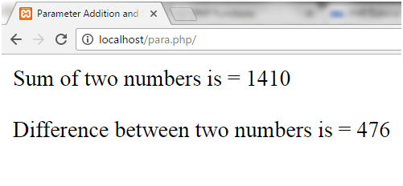

Slide 37
<?php
//add() function with two parameter
function add($x, $y) {
$sum=$x+$y;
echo "Sum = $sum <br><br>";
}
//sub() function with two parameter
function sub($x, $y) {
$sub=$x-$y;
echo "Diff = $sub <br><br>";
}
//call function, get two argument through input box and click on add or sub button
if(isset($_POST['add'])) {
//call add() function
add($_POST['first'],$_POST['second']);
}
if(isset($_POST['sub'])) {
//call add() function
sub($_POST['first'],$_POST['second']);
}
?>
<form method="post">
Enter first number: <input type=“text" name="first"/><br><br>
Enter second number: <input type=“text" name="second"/><br><br>
<input type="submit" name="add" value="ADDITION"/>
<input type="submit" name="sub" value="SUBTRACTION"/>
</form>

Slide 38
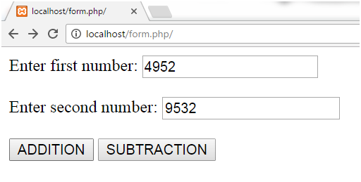
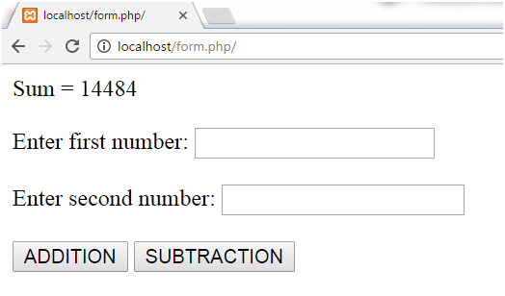
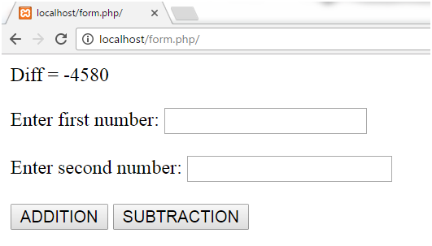

Slide 39
Call By ‘value’ Vs call by ‘reference’
<?php
function increment($i) {
$i++;
}
$i = 10;
increment($i);
echo $i;
?>
Output:
10
<?php
function increment(&$i) {
$i++;
}
$i = 10;
increment($i);
echo $i;
?>
Output:
11

Slide 40
PHP Recursive Function
<?php
function display($number) {
if($number<=5){
echo "$number <br/>";
display($number+1);
}
}
display(1);
?>
Output:
1
2
3
4
5

Slide 41
Factorial Number
<?php
function factorial($n) {
if ($n < 0)
return -1; /*Wrong value*/
if ($n == 0)
return 1; /*Terminating condition*/
return ($n * factorial ($n -1));
}
echo factorial(5);
?>
Output:
120

Slide 42
PHP Arrays
Advantage of PHP Array
Less Code: We don't need to define multiple variables.
Easy to traverse: By the help of single loop, we can traverse all the elements of an array.
Sorting: We can sort the elements of array.

Slide 43
PHP Array Types
There are 3 types of array in PHP.
Indexed Array
Associative Array
Multidimensional Array

Slide 44
PHP Indexed Array
PHP index is represented by number which starts from 0. We can store number, string and object in the PHP array. All PHP array elements are assigned to an index number by default.

Slide 45
There are two ways to define indexed array:
1st way:
$season=array("summer","winter","spring","autumn");
2nd way:
$season[0]="summer";
$season[1]="winter";
$season[2]="spring";
$season[3]="autumn";

Slide 46
PHP Associative Array
We can associate name with each array elements in PHP using => symbol.
There are two ways to define associative array:
1st way:
$salary=array("Sonoo"=>"350000","John"=>"450000","Kartik"=>"200000");

Slide 47
2nd way:
$salary["Sonoo"]="350000";
$salary["John"]="450000";
$salary["Kartik"]="200000";

Slide 48
<?php
$salary=array("Sonoo"=>"350000","John"=>"450000","Kartik"=>"200000");
echo "Sonoo salary: ".$salary["Sonoo"]."<br/>";
echo "John salary: ".$salary["John"]."<br/>";
echo "Kartik salary: ".$salary["Kartik"]."<br/>";
?>
Output:
Sonoo salary: 350000
John salary: 450000
Kartik salary: 200000

Slide 49
PHP Multidimensional Array
<?php
$emp = array
(
array(1,"sonoo",400000),
array(2,"john",500000),
array(3,"rahul",300000)
);
for ($row = 0; $row < 3; $row++) {
for ($col = 0; $col < 3; $col++) {
echo $emp[$row][$col]." ";
}
echo "<br/>";
}
?>
Output:
1 sonoo 400000
2 john 500000
3 rahul 300000

Slide 50
Traversing PHP Indexed Array
<?php
$size=array("Big","Medium","Short");
foreach( $size as $s )
{
echo "Size is: $s<br />";
}
?>
Output:
Size is: Big
Size is: Medium
Size is: Short

Slide 51
PHP Array Functions
PHP count() function
PHP count() function counts all elements in an array.
<?php
$season=array("summer","winter","spring","autumn");
echo count($season);
?>
Output:
4

Slide 52
PHP sort() function
PHP sort() function sorts all the elements in an array.
<?php
$season=array("summer","winter","spring","autumn");
sort($season);
foreach( $season as $s )
{
echo "$s<br />";
}
?>
Output:
autumn
spring
summer
winter

Slide 53
PHP array_reverse() function
PHP array_reverse() function returns an array containing elements in reversed order.
<?php
$season=array("summer","winter","spring","autumn");
$reverseseason=array_reverse($season);
foreach( $reverseseason as $s )
{
echo "$s<br />";
}
?>
Output:
autumn
spring
winter
summer

Slide 54
PHP String
chop() Function
The chop() function is used to remove whitespace or other predefined character from the right end of a string.

Slide 55
<?php
$str = "Hello World!";
echo "Your string is :".$str."<br>";
echo "By using 'chop()' Functions is your string is: “
.chop($str,"World!");
?>
Output:
Your string is :Hello World!
By using 'chop()' Functions is your string is: Hello

Slide 56
trim() function
PHP string trim() function is in-built function. It is used to strip whitespace from the beginning and end of a string or both side of a string.

Slide 57
<?php
$str = " Hello PHP! ";
echo "Without trim() function: ".$str;
echo "<br>";
echo "With trim() function: ".trim($str);
?>
Output:
Without trim() function: Hello PHP!
With trim() function: Hello PHP!

Slide 58
ltrim() function
PHP string ltrim() function is predefined function. It is often used to remove whitespace from both sides of a string or other character from the left side of a string.

Slide 59
<?php
$str = " Hello PHP!";
echo "Without ltrim() Function: " . $str;
echo "<br>";
echo "With ltrim() function : " . ltrim($str);
?>
Output:
Without ltrim() Function: Hello PHP!
With ltrim() function : Hello PHP!

Slide 60
strtolower() function
The strtolower() function returns string in lowercase letter.

Slide 61
<?php
$str="My name is KHAN";
$str=strtolower($str);
echo $str;
?>
Output:
my name is khan

Slide 62
strrev() function
The strrev() function returns reversed string.
<?php
$str="my name is Sonoo jaiswal";
$str=strrev($str);
echo $str;
?>
Output:
lawsiaj oonoS si eman ym

Slide 63
strlen() function
The strlen() function returns length of the string.
<?php
$str="my name is Sonoo jaiswal";
$str=strlen($str);
echo $str;
?>
Output:
24

Slide 64
EXERCISE..........
1. Write a function to calculate the factorial of a number (a non-negative integer). The function accepts the number as an argument.
2. Write a function to check a number is prime or not.
Note: A prime number (or a prime) is a natural number greater than 1 that has no positive divisors other than 1 and itself.

Slide 65
3. Write a program in PHP to print Fibonacci series . 0, 1, 1, 2, 3, 5, 8, 13, 21, 34
4. Write a program to find whether a number is Armstrong or not
/*If the sum of cubes of individual digits of a number is equal to the number itslef then it is called Armstrong Number.*/

Slide 66
5. Write a program to print Reverse of any number
6. Program to find the sum of elements in an array.
7. Program to merge two arrays into a new array.
8. Program to remove the duplicate values from an array.
9. Write a Program for finding the smallest number in an array
10. Write a function to sort an array.
11. Program to join the array elements into a string.
12. Write a function to reverse a string.
13. Write a PHP function that checks whether a passed string is a palindrome or not?

Slide 67
THANK YOU
HAVE A NICE DAY

