Slide 1


BMW GROUP - CUSTOMER JOURNEY ANALYTICS
AI-Powered
Customer
Service Chatbot
Presented by: Shubham
Chitaguppe
RAG-based prototype using LangChain, LangGraph,
ChromaDB, Ollama & LangSmith
LangChain
LangGraph
ChromaDB
Ollama
Streamlit
LangSmith
Intern AI Engineer Case Study | BMW Group | 2026
Notes:
1

Slide 2
AGENDA
What We'll Cover Today
01
02
Solution & Architecture
Business Problem
Why BMW needs an AI chatbot
RAG pipeline design and decisions
03
04
Technical Deep Dive
Benchmarking Results
LangChain, LangGraph, ChromaDB
LangSmith data-driven decisions
05
06
Roadmap & Q&A
Demo
Live prototype walkthrough
Production path and next steps
Page 2
Notes:
2

Slide 3
BUSINESS PROBLEM
The Challenge BMW Faces
100s
∞
24/7
Daily Inquiries
Knowledge Exists
Expected Support
Vehicles, warranty, service, ordering
But not easily accessible to customers
Customers expect instant answers
Solution: AI Chatbot with RAG
Answer customer questions instantly • Reduce support workload • Available 24/7 • Grounded in verified knowledge base
Page 3
Notes:
3

Slide 4
SOLUTION
Why RAG? Comparing Approaches
Fine-tuning
Prompt Engineering
RAG
Strengths:
Strengths:
Strengths:
Domain specific
Simple
Retrieves exact knowledge, no
hallucinations, easy to update
Limitations:
Limitations:
Limitations:
Expensive, slow, needs retraining for updates
Limited context, hallucinations, no knowledge base
Slightly more complex setup
RECOMMENDED
Page 4
Notes:
4

Slide 5
ARCHITECTURE
RAG Pipeline Overview
User Query
LangGraph
Retrieve Node
ChromaDB
MMR Search
LangChain
LCEL Chain
Streaming
Response
▶
▶
▶
▶
Streamlit UI
Stateful graph
Vector store
Prompt + LLM
Token by token
INGESTION PIPELINE (one-time setup)
6 Knowledge Base
.txt Documents
DirectoryLoader
+ TextSplitter
nomic-embed-text
Embeddings
ChromaDB
Persistent Store
→
→
→
LangSmith Observability - traces every step: retrieval latency, LLM latency, token usage, inputs/outputs
Page 5
Notes:
5

Slide 6
TECHNICAL DECISIONS
Why I Chose What I Chose
llama3.2:3b
nomic-embed-text
Best answer quality vs latency tradeoff. Benchmarked vs tinyllama and llama3.2:1b — 3b gave noticeably better answers with acceptable local CPU latency.
Best quality/speed tradeoff for local embedding. Runs via Ollama — no API key required, no external infrastructure needed.
MMR Retrieval
chunk_size=600, overlap=50
Reduces redundant chunks. Plain similarity returned duplicate content from small docs. MMR balances relevance + diversity.
Larger chunks preserve more context per unit. Overlap ensures sentences at boundaries are captured. Tuned from 200 → 600 for better coherence.
LangGraph
ChromaDB
Modular graph node for retrieval. Easy to extend with query rewriting, guardrails, or routing nodes later. Each node independently traceable.
Runs locally, persistent storage, native LangChain integration. No external infrastructure needed for prototype.
Page 6
Notes:
6

Slide 7
BENCHMARKING
Data-Driven Decisions via LangSmith
01
Baseline
tinyllama + similarity + chunk=500
High latency, duplicate chunks
02
Model
tinyllama → llama3.2:1b
Better quality answers
03
Retriever
similarity → MMR
Eliminated duplicate chunks
04
Chunk Size
500 → 200 tokens
Precise retrieval, no redundancy
05
Output Tokens
unlimited → num_predict=200
Faster generation
06
Top-K
5 → 3 chunks
Optimal context, fastest latency
07
Model Upgrade
llama3.2:1b → llama3.2:3b
Noticeably better answer quality
08
Final Chunks
chunk=200 → 600, overlap=20 → 50
Better context coherence, improved answers
Page 7
Notes:
7

Slide 8
ENGINEERING CHALLENGES
Problems Faced & How I Solved Them
⚠ LangSmith 401/403 errors
✓ os.environ must be set before LangChain imports — load_dotenv() alone not sufficient
⚠ LangGraph + Streaming conflict
✓ Used LangGraph for retrieval node only, streamed generation separately in Streamlit
⚠ Duplicate chunks in retrieval
✓ Switched similarity → MMR + reduced chunk_size 500 → 200, then tuned to 600 for better coherence
⚠ ChromaDB rebuilding every run
✓ Added os.path.exists() check - load if exists, build only on first run
⚠ High LLM latency on CPU
✓ Set num_predict=200, reduced top_k=3, chose llama3.2:3b for best quality/latency balance
Page 8
Notes:
8

Slide 9
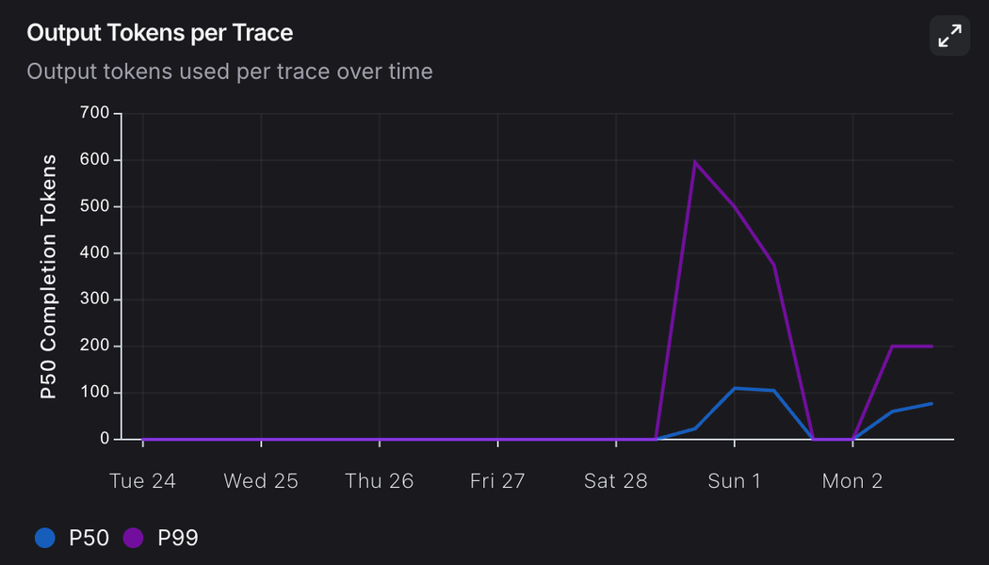
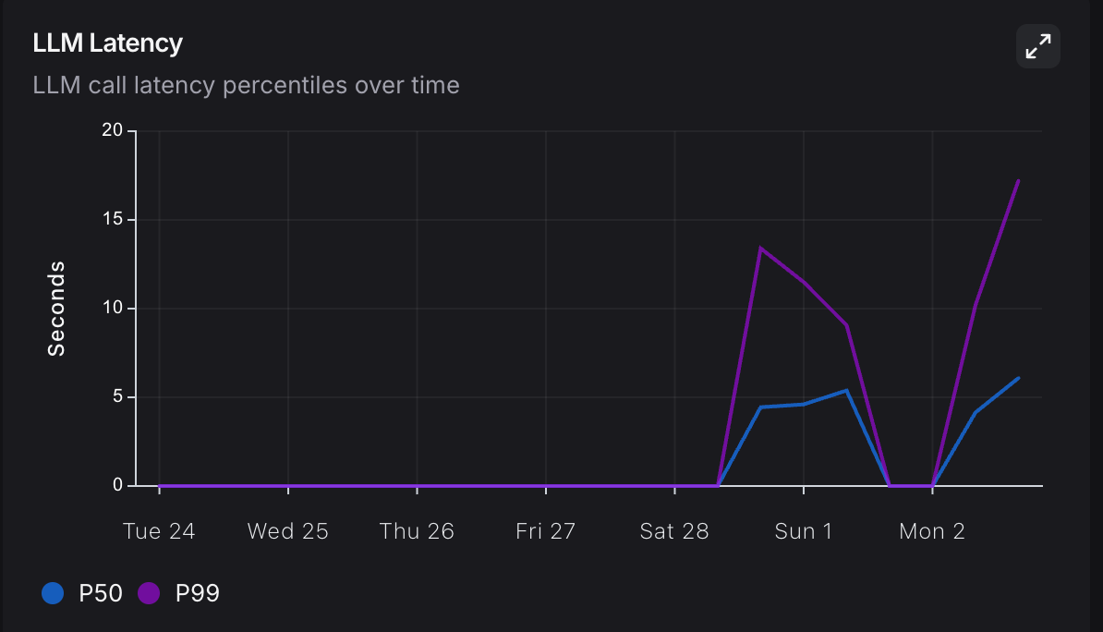
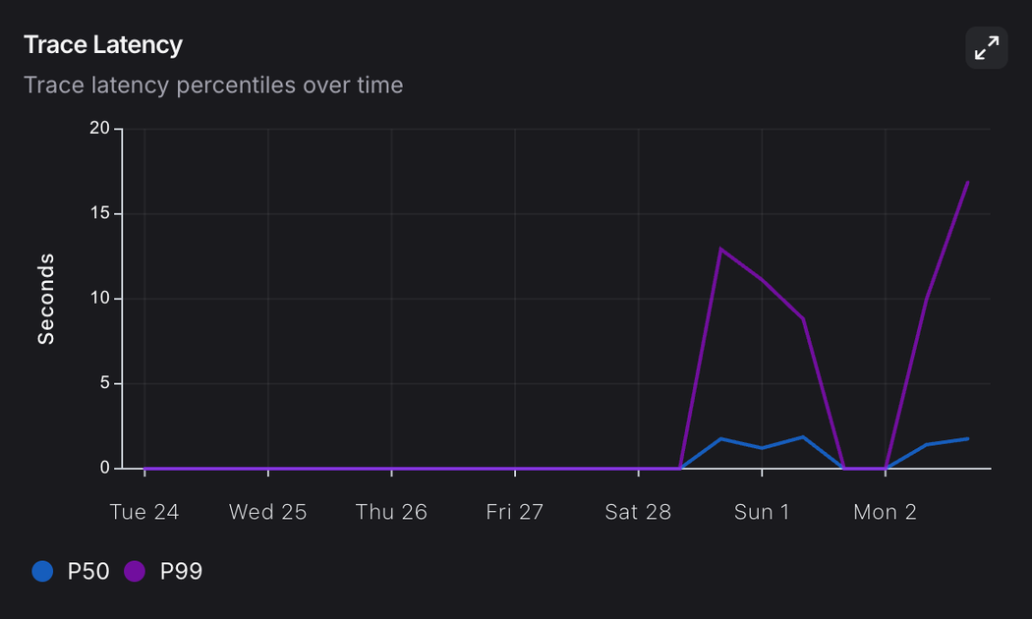
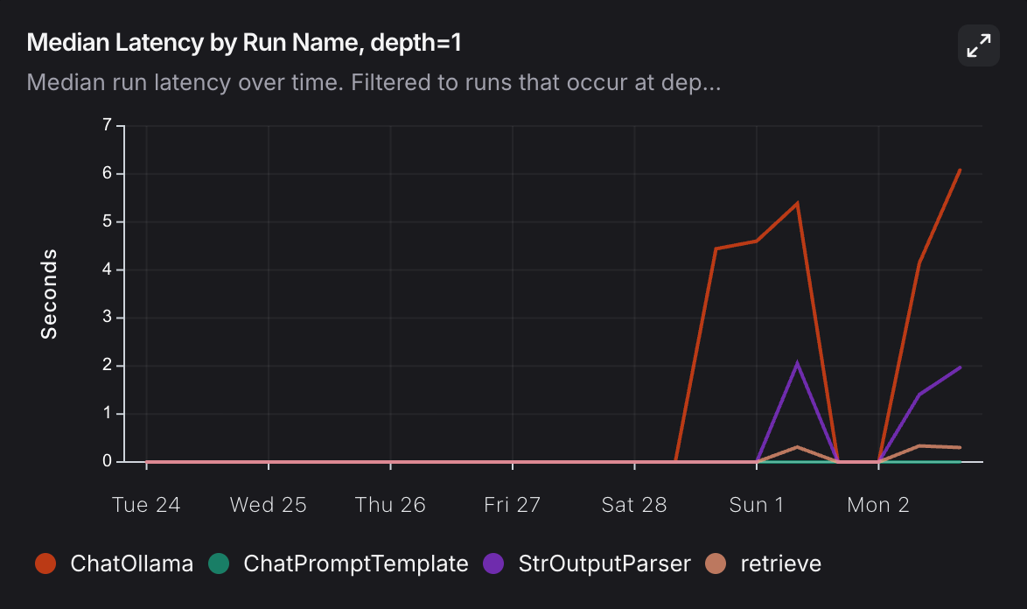
Page 9
Notes:
9

Slide 10
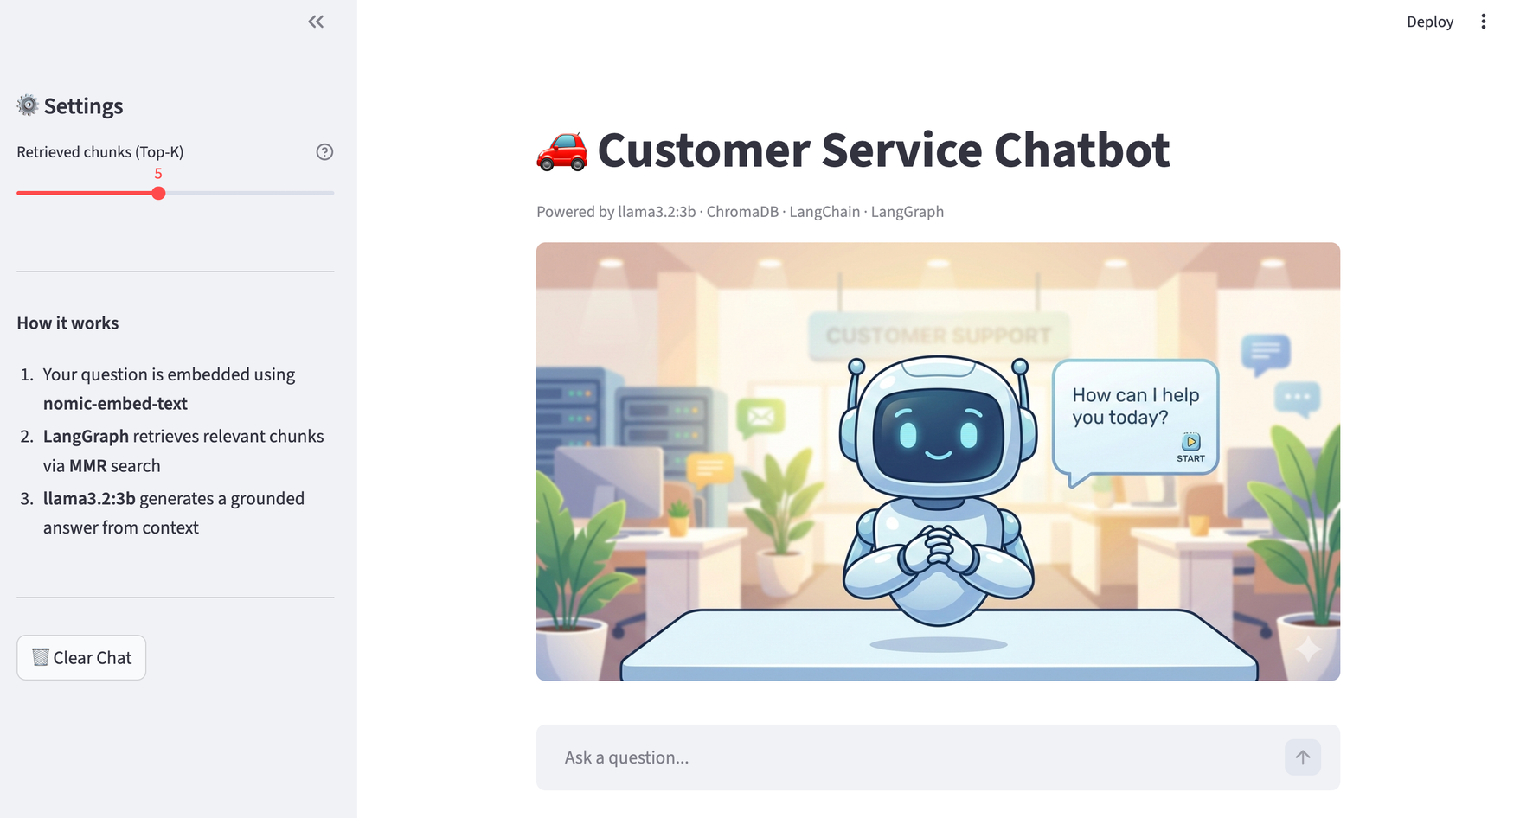
DEMO
Live Prototype Walkthrough
Streamlit chat interface
Source document citations
Token-by-token streaming
Configurable Top-K slider
Clear chat history
LangSmith tracing
Page 10
Notes:
10

Slide 11
ROADMAP
From Prototype to Production
Now - Prototype
Short Term
Production
Local Ollama LLM (llama3.2:3b)
Query rewriting node
GPT-4o / Claude API
ChromaDB local
Guardrails node
Pinecone / Weaviate
Basic Streamlit UI
Multi-language support
AWS / GCP deployment
LangSmith monitoring
Better UI/UX
Self-hosted LangSmith
Page 11
Notes:
11

Slide 12
SUMMARY
What We Built & What's Next
End-to-end local RAG chatbot - LangChain + LangGraph + ChromaDB + Ollama
Data-driven decisions - every choice backed by LangSmith benchmarking data
MMR retrieval + chunk_size=600, overlap=50 - best context coherence on small documents
Streaming responses - token-by-token output for better user experience
Production-ready architecture - modular, extensible, observable
Questions & Answers
Page 12
Notes:
12

Slide 13
Thank
you!
Notes:
13

