Slide 1

FACEBOOK- EXPLORATORY DATA ANALYSIS
SUBMITTED BY:
SHUBHAM GROVER
RTR.SHUBHAMGROVER@GMAIL.COM

Slide 2
INTRODUCTION TO TOPIC
Facebook (stylized as Facebook) is an American online social media and social networking service based in Menlo Park, California, and a flagship service of the namesake company Facebook, Inc. It was founded by Mark Zuckerberg, along with fellow Harvard College students and roommates Eduardo Savarin, Andrew McCollum, Dustin Muscovite, and Chris Hughes.
Therefore the Facebook was first launched in September ,2006 from then only the demand for Facebook among youngsters is to be seen.
Whether young ,old all are on Facebook and mostly it is used to get connected with your sol old friend be it in school and be it in colleges
We can send the request ,accept the request,also likes some photos or get likes on our photos.

Slide 3
PROJECT INTRODUCTION
We have been provided the facebook data for which we have to analyzed and get some insight from that data related to columns it has
The link for Dataset is as under:-https://github.com/insaid2018/Term-1/raw/master/Data/Projects/facebook_data.csv
There fore objective Is to study the data deeply and find some correlation between columns given in the data
Also how it one column related to other and how one column changes with another column of decrease or increase will be studied as this project
There would be data with m*n rows where rows and columns would contain data that can be in form of string,integer,float,Boolean and some values can be missing
We will be find the analysis between the Data Set as project
Also will be using python as language to study the relationship and libraries like matplotlib,pandas ,numpy and seaborn to get graphical representation of the columns
Another thing we would require is IDE where we would do anyalsis so here we will be taking colab as IDE .

Slide 4
Problem Statement
Facebook has become quite popular in the recent few years with people all over the world using it as a medium to share their status,thoughts and pictures with their friends. With the mobile app , it has become even more popular and easier to access. People from all age groups are connected to facebook, however there are certain differences in their way of using it such as with respect to initiating friendships and sending likes . We are trying to study the dataset provided to identify certain patterns with respect to how the users are making use of this most popular social networking app depending on their age group,gender etc.
Dataset link : https://github.com/insaid2018/Term-raw/master/Data/Projects/facebook_data.csv

Slide 5
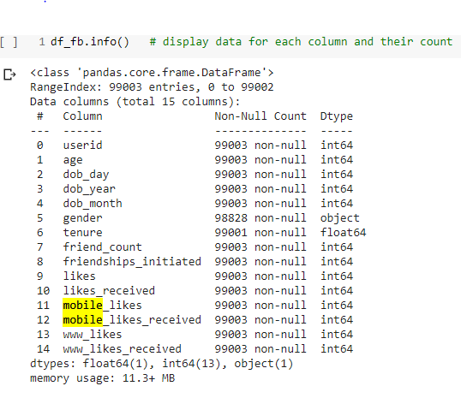
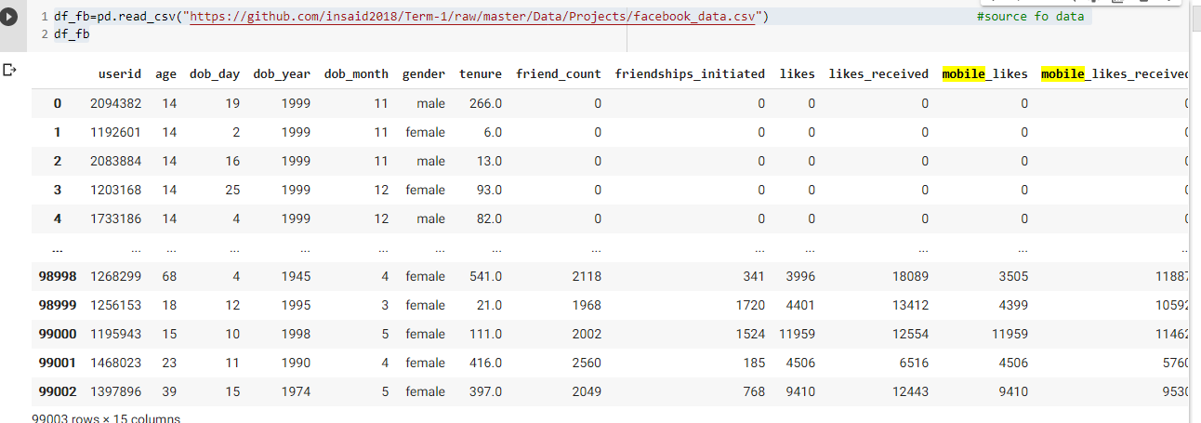
Objective 1:To Load Data from source and study the columns how many columns are there and what are there data types
Details of column

Slide 6
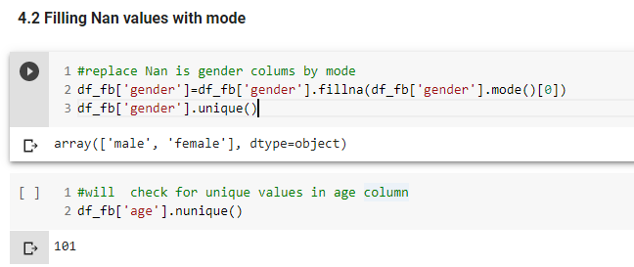
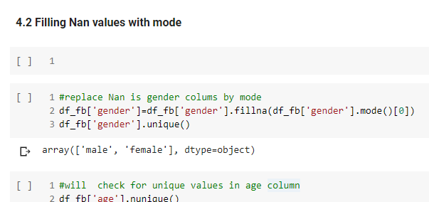
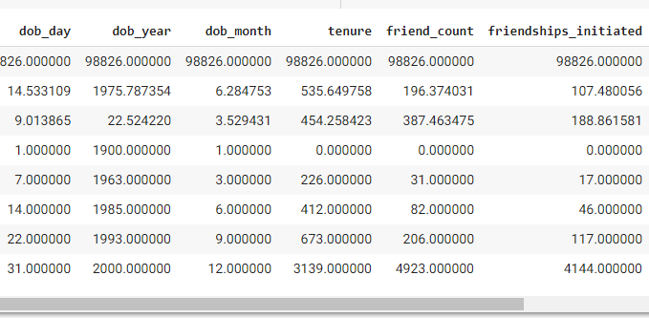
Objective 2:to study the columns behavior ,what are data types ,is there any missing values ,how many are there unique values and what is minimum ,maximum value of the integer also find the mean median too ,we can use functions like describe, info and sample to get more insight of columns. We can also do pandas profiling which will give more insight .
columns

Slide 7
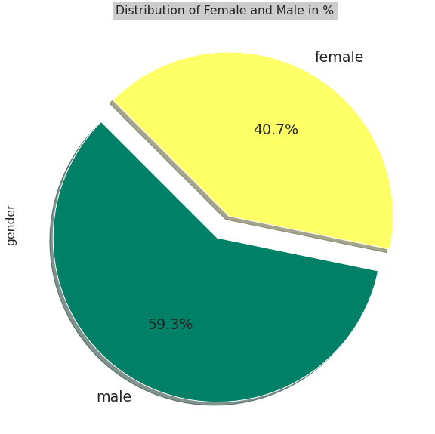
Therefore will analyze some columns and see how they are related with each other below is the gender columns having 59.3% of male and 40.7% of female .we will analyze how gender ,age is related to each other

Slide 8
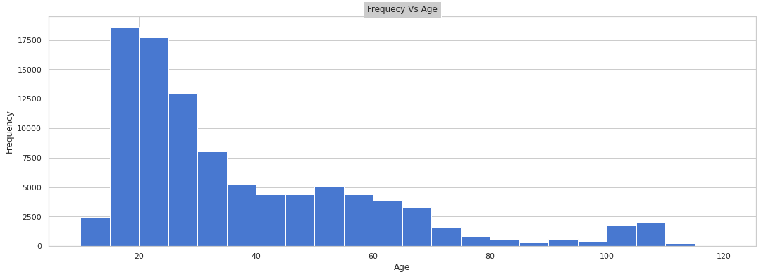
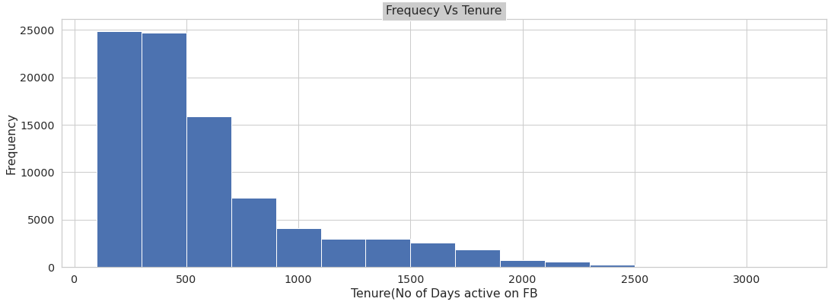
Question: We will analyze two graphs here Frequency Vs Age and Frequency Vs Tenure. Findings/Visualizations: Most of users are between age group of 20 to 25 years and most of them have tenure from 0 to 750 days.

Slide 9
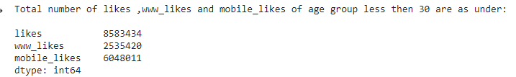
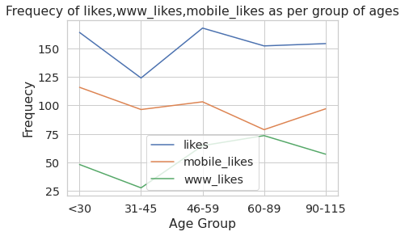
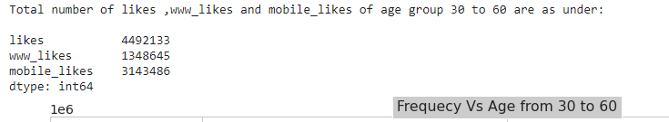
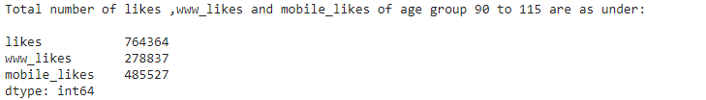
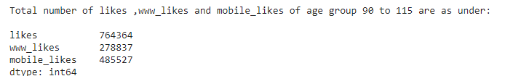
Question:After that we will see the comparision of likes, www_likes and mobile_likes with respect to age Findings/Visualizations:-From below graph we can conclude that the number of likes are greater then www_likes and mobile_likes in every age group that is being compared
graph

Slide 10
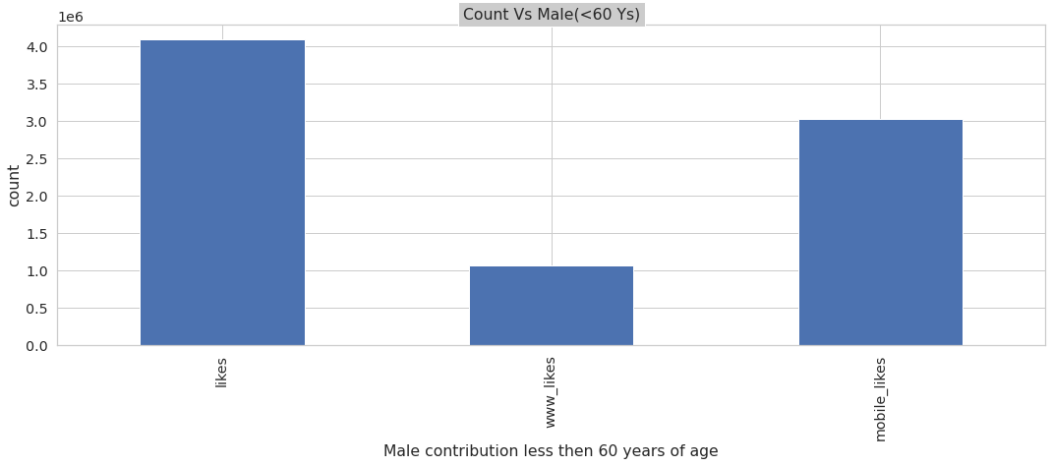
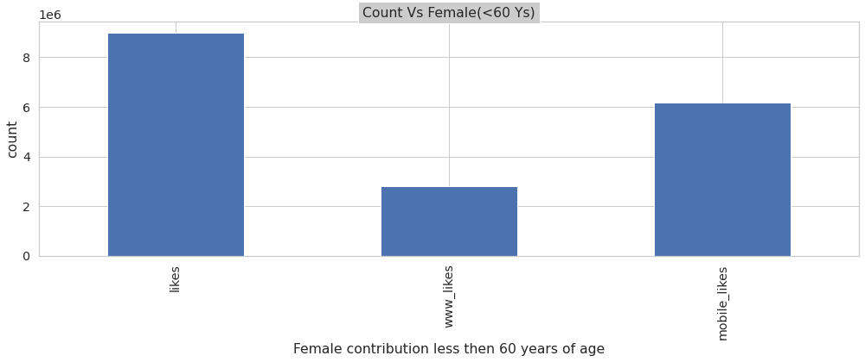
Question:We will compare two columns male and female with number of likes,mobile_likes and www_likes,the age group here is less then 60 years of age. Findings/Visualizations: mobile_likes have more frequency as compared to www_likes.
Male contribution in likes,www_likes and mobile_likes
Femalecontribution in likes,www_likes and mobile_likes

Slide 11
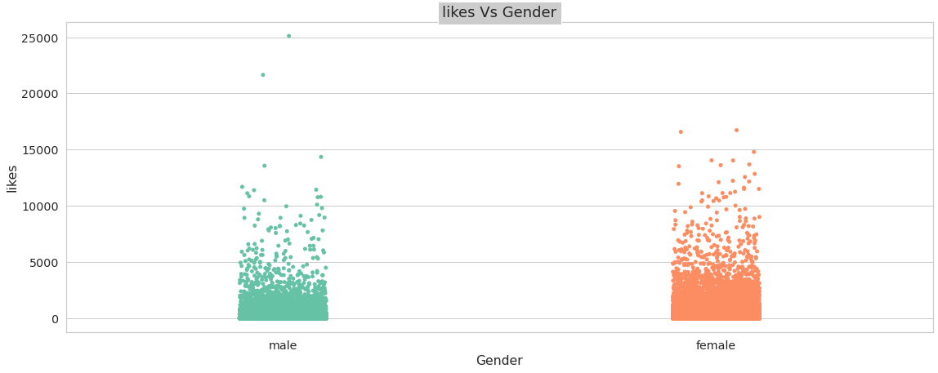
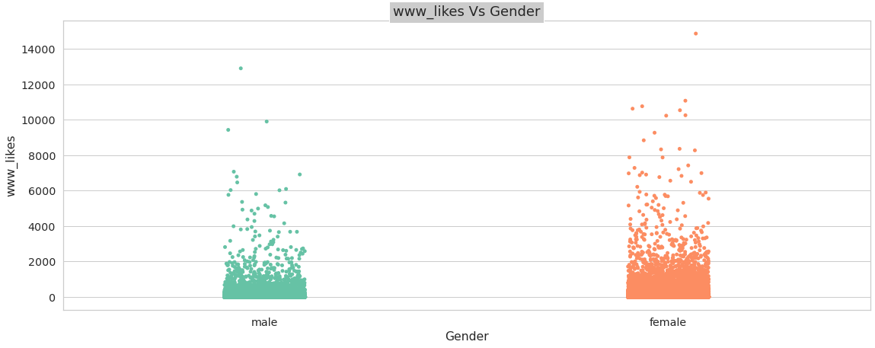
Question: We will compare two columns www_likes and likes vs gender. Findings/Visualizations:-here we can see that female has more count as compared to male in likes,www_likes
Likes Vs Gender
www_likes Vs Gender

Slide 12
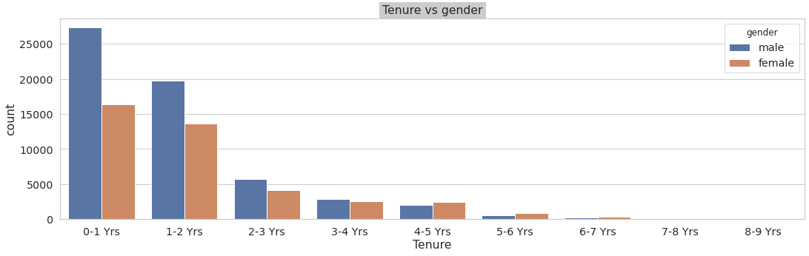
Question:We will compare Tenure Vs gender which gender has more years with FB. Findings/Visualizations:-We conclude that male has more years with FB as compared to female in all age groups.

Slide 13
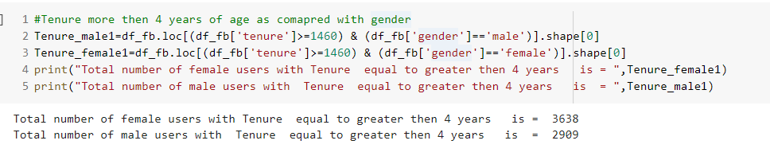
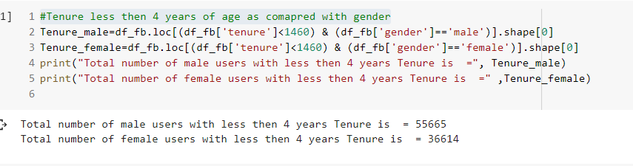
Question: Will compare male and female who has tenure less then 4 years or more . Findings/Visualization: found that female users with age more then 4 years are more as compared to male where as male users are more with tenure less then 4 years of time frame.

Slide 14
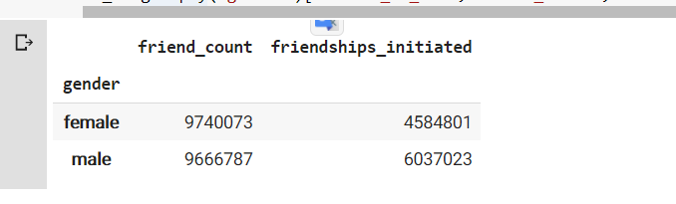
Question: Will see the friend_count and friendship_intiated in male and female. Findings/Visualization: Therefore the count for friend -count and friendship_initated is more in female and friendship_initated is more in male as compared to female.

Slide 15
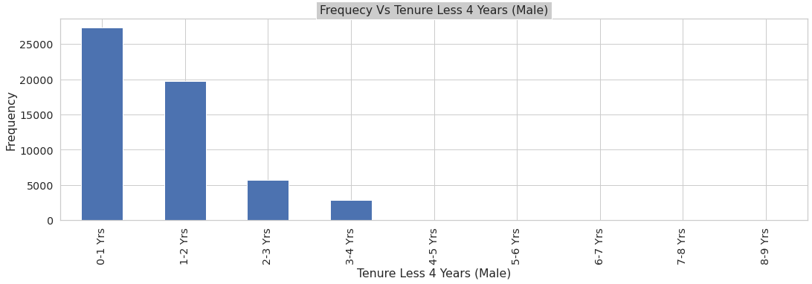
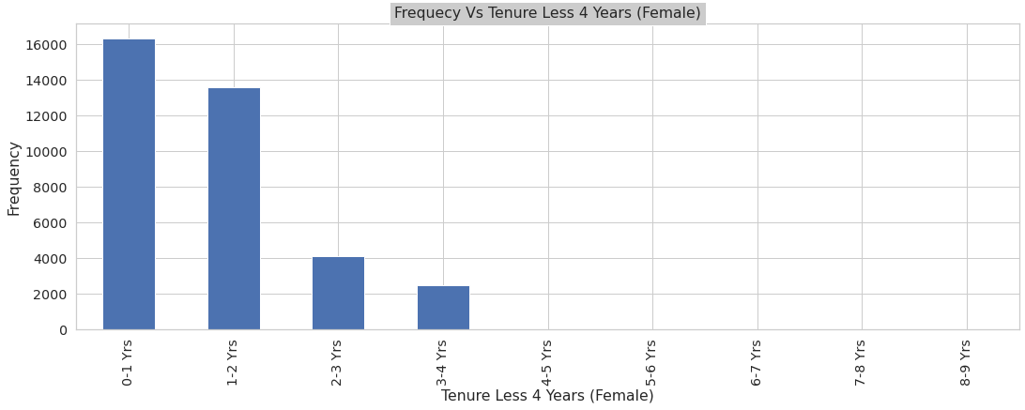
Question:-Will compare frequency Vs tenure(less then 4 years) Findings/Visualizations:-here we can see that the male are more with tenure less then 4 years in age group 0-1 years
Frequency Vs Tenure(male)
Frequency Vs Tenure(Female)

Slide 16
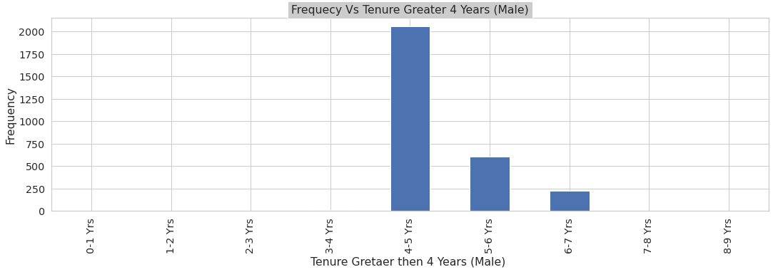
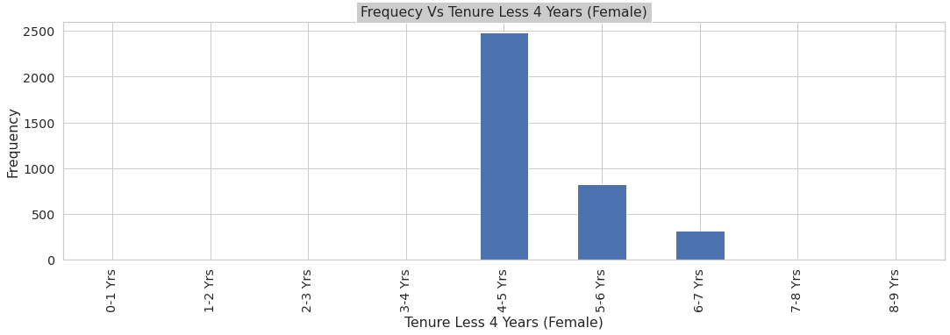
Question:Will compare frequency Vs (more then 4 years) here we can see that the Female are more with tenure less then 4 years in age group 3-4 years
Frequency Vs Tenure(male)
Frequency Vs Tenure(Female)

Slide 17
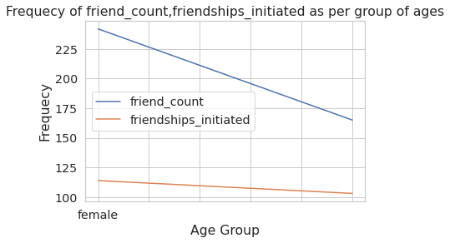
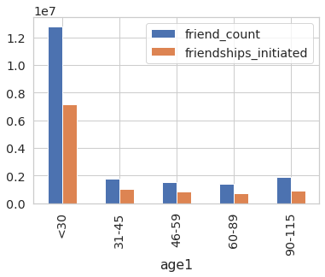
Question: Will compare the friend_count,friendship_initated with the gender along with age group. Findings/Visulaization: We get that the frequency is more in female for friend_count and with less then 30 years of age
Frequency of friend_count,friendship_initated Vs Gender
Frequency of friend_count,friendship_initated Vs age group

Slide 18
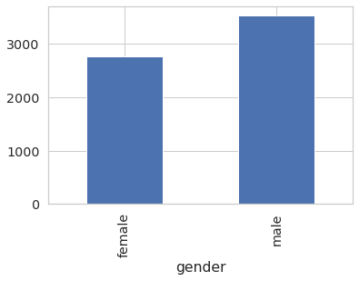
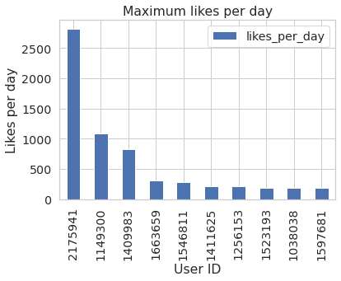
Question:-will compare maximum likes and will compare that with gender. Findings/Visualization:-male has maximum likes per day along with other graph showing frequency of userid too.
likes Vs Gender
Maximum Likes per day

Slide 19
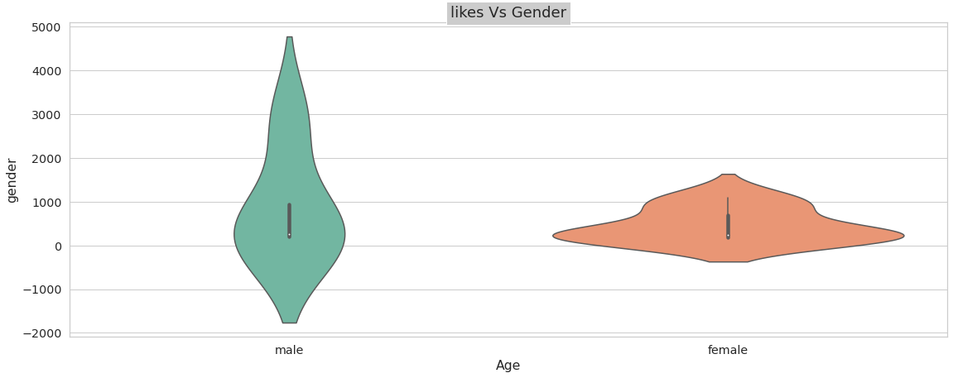
Question:-likes received on basis of female and male. Findings/Visualizations:- male has more number of friend request initiated as compared with female per day.

Slide 20
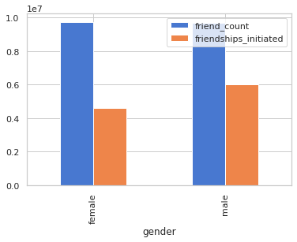
Question: total number of friend_count ,friendship_initiated compared to gender. Findings/Visualization: As per below graph we can find that the number of friendship_initiated is more in case of female

Slide 21
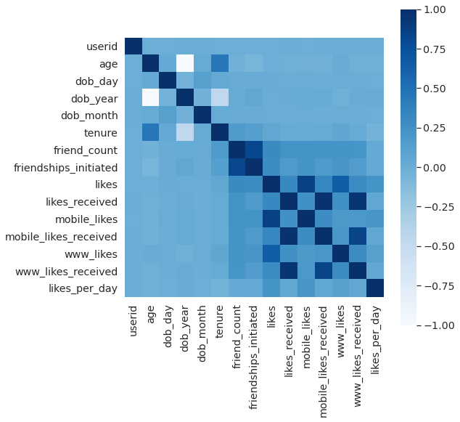
Question: correlation between different columns Findings/Visualization: age,like_per_day,mobile_likes are highly correlated with each other

Slide 22
Conclusion
1.The people having Age between 15 to 25 have more frequency or more data as compared to other age groups ,also there are user with data in terms of likes,www_likes and mobile_likes whose age is more then 80 years of age as shown in Section 5.3(Grouping of age group >80 years)
2.Out of 99001 of records the 5721 is having age greater then 80 years which is around(5.8%)
3.We conclude that the age group between 0 to 30 has more likes,www_likes and mobile_likes ad comapred to other groups also we conclude that the mobile likes are more as compared to www_likes within all age groups
4.User like to surfed FB more from mobile rather then www in all age groups this pattern is noted.
5.Female with less then 60 years of age get more likes,www_likes and mobile_likes with more then 60 years of age.
6.Therefore on analysing the likes between 30 -60 age group and between 60-90 age group we can see drop of (2.83%)therefore on analysing the likes between 30 -60 age group and between 60-90 age group we can see drop of (2.83%).
7.Therefore on analysing the www_likes between 30 -60 age group and between 60-90 age group we can see drop of (1.74%).
8.Therefore on analysing the mobile_likes between 30 -60 age group and between 60-90 age group we can see drop of (3.87%).
9.The above stats shows that the female are more then male when the tenure is compared which is more then 4 years if compared less then 4 years then male are more as compared to female
10.This shows that users with age group less then 30 has more friend_count,friendships_initiated and female has more firend_count and friendships_initated
11.this shows that male has more number of friendship initiated per day
12.This shows that the age group less then 30 years of age initiate more likes per day
13. therefore there is more friend initiated by male as compared to female

Slide 23
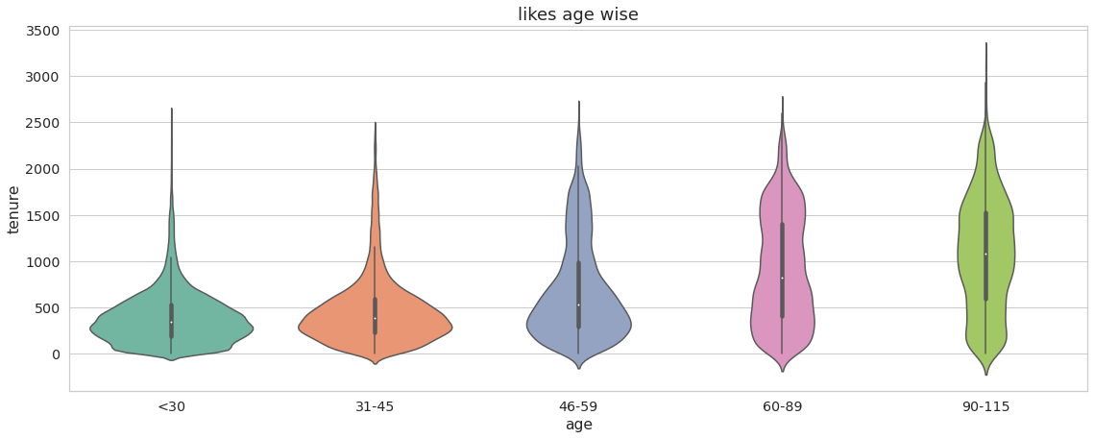
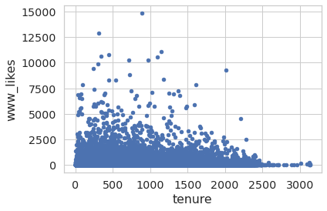
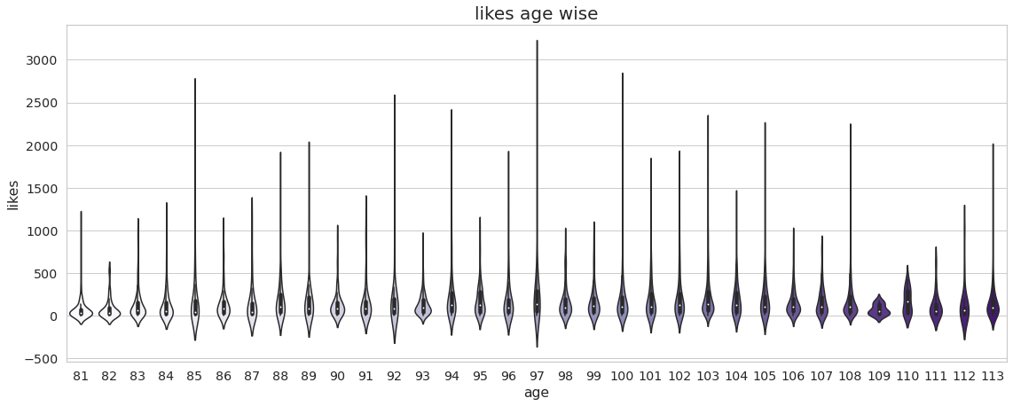
1

